Slide 1

24.5 CNN Classification
Peter H. Chen

Slide 2
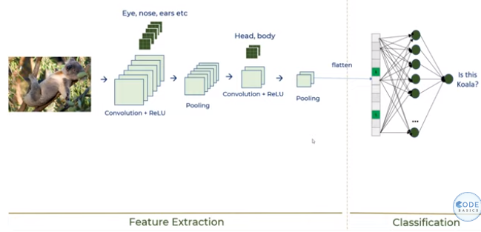
24.5 CNN Classification
https://www.youtube.com/watch?v=7HPwo4wnJeA&list=PLeo1K3hjS3uu7CxAacxVndI4bE_o3BDtO&index=24
CNN Coding (12:31-13:49/28:11)
In the last discussion, we have CNN in several layers.
In ANN, we do not have Feature Extraction. In CNN, we have Feature extraction:
1. Convolutional layers (for Eye, Nose, ears, hands, legs, etc), ReLU activation, and Pooling
2. Convolution (for Head and Body), ReLU activation, and Pooling.
Then we flatten the convolution result and feed into Dense neural network.
So, we need to add the several layers for feature extraction before we input to neural network for classification.

Slide 3
24.6 Reduce Neuron

Slide 4
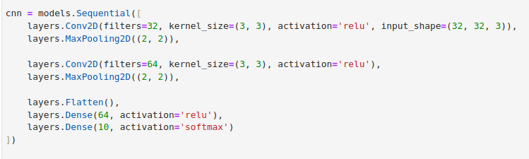
24.6 Reduce Neuron
https://www.youtube.com/watch?v=7HPwo4wnJeA&list=PLeo1K3hjS3uu7CxAacxVndI4bE_o3BDtO&index=24
Reduce Neurons (14:01-14:30/28:11)
Copy copy ANN Network, we will add CNN code.
In CNN, Dense layer, we do not need 1000 neurons, we just need about 64.
We will add the convolution layer.

Slide 5
24.7 Add Extraction Layer

Slide 6
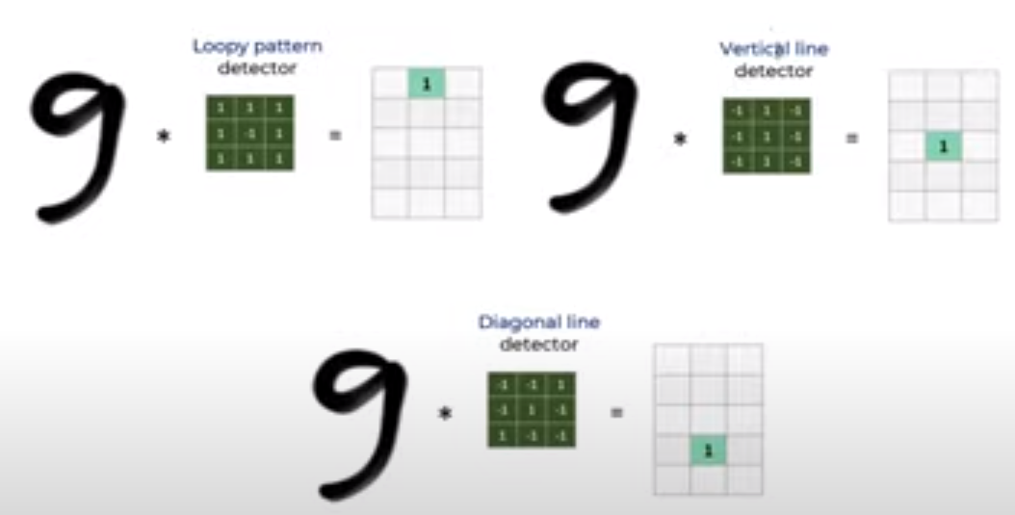
24.7 Add Extraction Layer
https://www.youtube.com/watch?v=7HPwo4wnJeA&list=PLeo1K3hjS3uu7CxAacxVndI4bE_o3BDtO&index=24
Add Extraction Layer (14:31-18:45/28:11)
We add the convolution layer (Conv2D), kernel filter 3 x 3, activation function ReLU, input image shape 32 x 32 x 3, and Max Pooling 2D layers (2, 2).
Below is the digit “9” with loopy pattern detector, vertical line detector, and Diagonal line detector.
In Tensorflow, we just need to specify how many filters we want. Tool will figure out the pattern for you.

Slide 7
24.7 Add Extraction Layer
https://www.youtube.com/watch?v=7HPwo4wnJeA&list=PLeo1K3hjS3uu7CxAacxVndI4bE_o3BDtO&index=24
CNN Coding (14:31-18:30/28:11)
How many Conv2D you need?
Answer:
We use try and error.
Here, we just use 2 Convolutional layers (2 Conv2D)

Slide 8
24.8 CNN Accuracy

Slide 9

24.8 CNN Accuracy
https://www.youtube.com/watch?v=7HPwo4wnJeA&list=PLeo1K3hjS3uu7CxAacxVndI4bE_o3BDtO&index=24
CNN Accuracy (18:31-19:30/28:11)
The rests are straight forward, we specify
1. optimizer: adam
2. loss function: sparse categorical cross entropy.
3. measurement metrics: accuracy for the error measurement.

Slide 10
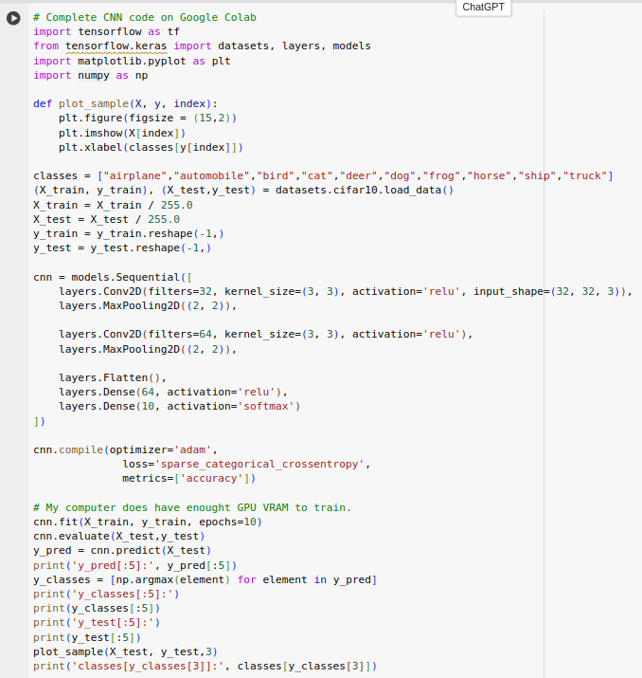
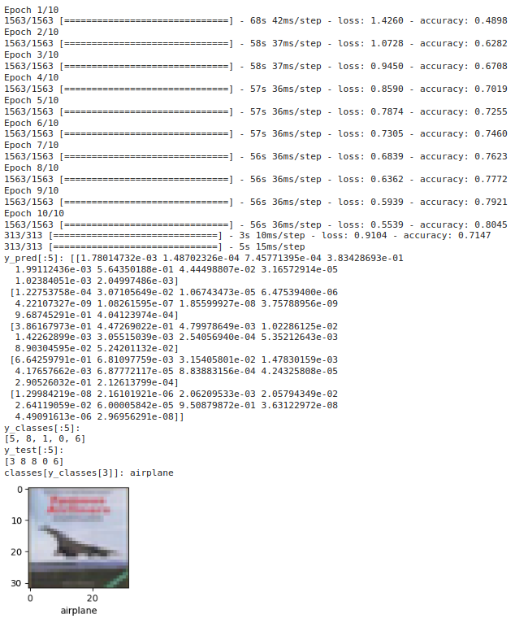
24.8 CNN Accuracy
https://www.youtube.com/watch?v=7HPwo4wnJeA&list=PLeo1K3hjS3uu7CxAacxVndI4bE_o3BDtO&index=24
CNN Accuracy (19:31-20:10/28:11)
Now, we run CNN.
Below code run on Google Colab.

Slide 11
24.8 CNN Accuracy
https://www.youtube.com/watch?v=7HPwo4wnJeA&list=PLeo1K3hjS3uu7CxAacxVndI4bE_o3BDtO&index=24
CNN Accuracy (20:11-20:30/28:11)
In ANN, after 5 epochs, we have 49%.
In CNN, after 5 epochs, we have 72.5%. We run more epochs, we have 80%.

Slide 12
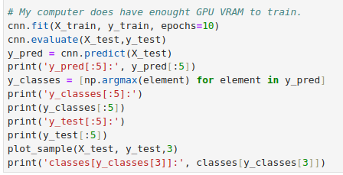
24.8 CNN Accuracy
https://www.youtube.com/watch?v=7HPwo4wnJeA&list=PLeo1K3hjS3uu7CxAacxVndI4bE_o3BDtO&index=24
CNN Accuracy (20:31-21:30/28:11)
We evaluate the accuracy: 71%
We can run more epochs to get higher accuracy.
Since the neurons is reduced. The run time is cut and overfit is reduced. The accuracy is improved.

Slide 13
24.8 CNN Accuracy
https://www.youtube.com/watch?v=7HPwo4wnJeA&list=PLeo1K3hjS3uu7CxAacxVndI4bE_o3BDtO&index=24
CNN Accuracy (20:31-21:30/28:11)
We make some prediction
> cnn.predit()

Slide 14
24.8 CNN Accuracy
https://www.youtube.com/watch?v=7HPwo4wnJeA&list=PLeo1K3hjS3uu7CxAacxVndI4bE_o3BDtO&index=24
CNN Accuracy (21:31-22:30/28:11)
We input the test data and find the max: arg_max()

Slide 15
24.8 CNN Accuracy
https://www.youtube.com/watch?v=7HPwo4wnJeA&list=PLeo1K3hjS3uu7CxAacxVndI4bE_o3BDtO&index=24
CNN Accuracy (22:31-24:30/28:11)
We plot some sample data, “airplane”.
https://www.cs.toronto.edu/~kriz/cifar.html

Slide 16
End

