Slide 1

24.9 Exercise: Handwritten Digit from ANN to CNN
Peter H. Chen

Slide 2
24.9 Exercise: Handwritten Digit from ANN to CNN
https://www.youtube.com/watch?v=7HPwo4wnJeA&list=PLeo1K3hjS3uu7CxAacxVndI4bE_o3BDtO&index=24
Exercise: Hand-Written Digit from ANN to CNN (24:31-24:50/28:11)
Use CNN instead of ANN to do handwritten digits classification using MNIST dataset.
ANN Code is below:
https://github.com/peterhchen/AIU_CS512_DL/tree/main/000_Lecture_Project/week12/02_Code
Above we used ANN for digits classification.
You need to modify this code to use CNN instead.
Check how accuracy improves fast with CNN and figure out how CNN can be a better choice for doing image classification compared to ANN.
Once you have worked on this problem on your own, you can check my solution by clicking on this link:

Slide 3
24.10 Handwriting Digit with ANN

Slide 4
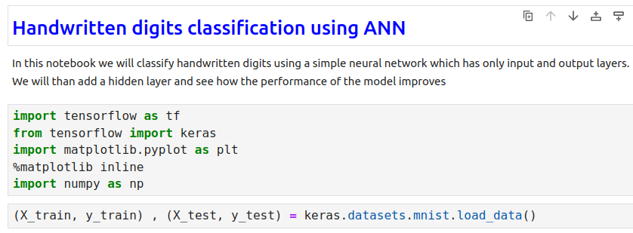
24.10 Handwriting Digit with ANN
https://www.youtube.com/watch?v=7HPwo4wnJeA&list=PLeo1K3hjS3uu7CxAacxVndI4bE_o3BDtO&index=24
Handwriting Digit with ANN (24:51-25:00/28:11)

Slide 5
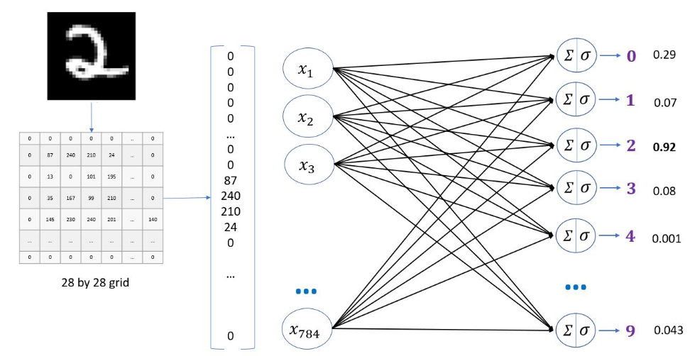
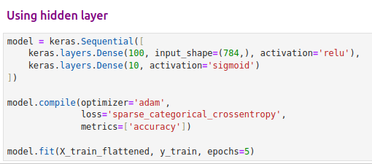

24.10 Handwriting Digit with ANN
https://www.youtube.com/watch?v=7HPwo4wnJeA&list=PLeo1K3hjS3uu7CxAacxVndI4bE_o3BDtO&index=24
Handwriting Digit with ANN (25:01-25:10/28:11)
We have accuracy 97%.
Now, we want to remove some neurons and add extraction layers.

Slide 6
24.11 Handwriting Digit with CNN

Slide 7
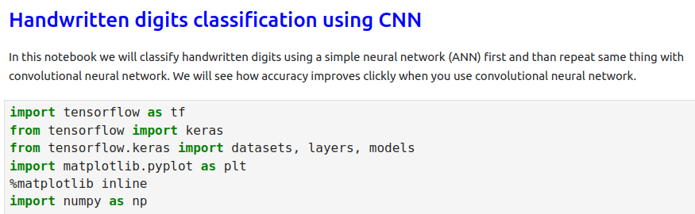
24.11 Handwriting with CNN
https://www.youtube.com/watch?v=7HPwo4wnJeA&list=PLeo1K3hjS3uu7CxAacxVndI4bE_o3BDtO&index=24
Handwriting Digit with CNN (25:11-25:20/28:11)
Import Libraries

Slide 8
24.12 Previous ANN Code

Slide 9
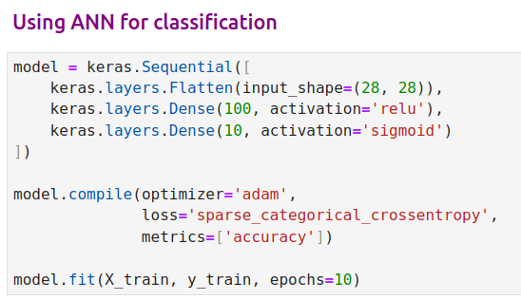
24.12 Previous ANN Code
https://www.youtube.com/watch?v=7HPwo4wnJeA&list=PLeo1K3hjS3uu7CxAacxVndI4bE_o3BDtO&index=24
Previous ANN Code (25:21-25:30/28:11)

Slide 10
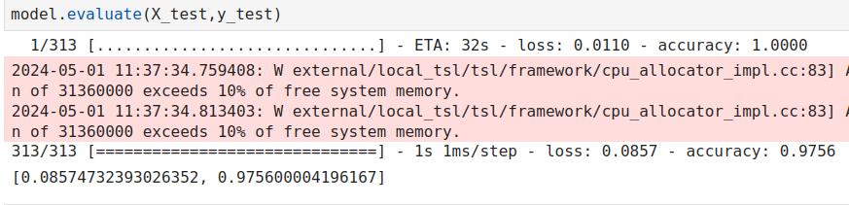
24.12 Previous ANN Code
https://www.youtube.com/watch?v=7HPwo4wnJeA&list=PLeo1K3hjS3uu7CxAacxVndI4bE_o3BDtO&index=24
Previous ANN Code (25:31-26:00/28:11)

Slide 11
24.13 Exercise: Handwriting Digit CNN Code

Slide 12
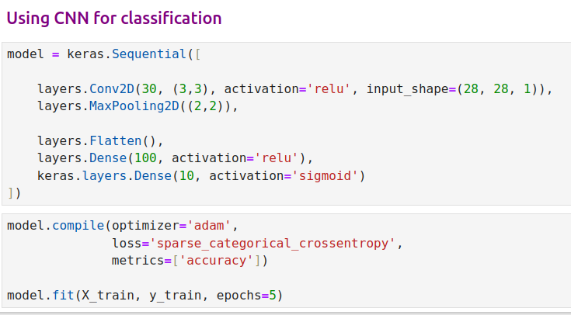
24.13 Exercise: Handwriting Digit CNN Code
https://www.youtube.com/watch?v=7HPwo4wnJeA&list=PLeo1K3hjS3uu7CxAacxVndI4bE_o3BDtO&index=24
Exercise: Handwriting Digit CNN (26:01-27:00/28:11)
Here, we reduce the input shape from 28 x 28 into 3 x 3.
We still keep the neuron 100. We can reduce the Dense neurons to any number by trial and error.

Slide 13
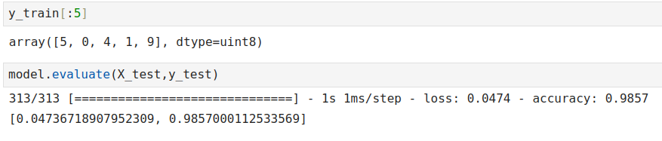
24.13 Exercise: Handwriting Digit CNN Code
https://www.youtube.com/watch?v=7HPwo4wnJeA&list=PLeo1K3hjS3uu7CxAacxVndI4bE_o3BDtO&index=24
Exercise: Handwriting Digit CNN (27:01-28:11/28:11)
We reduce input layer neurons to improve the overfitting and speed.
The accuracy still better.
ANN: 97%
CNN: 98%.

Slide 14
End

