Slide 1

20 Dropout Regularization
Peter H. Chen

Slide 2
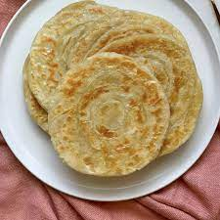

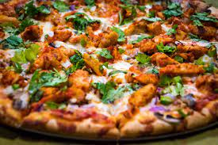
20 Dropout Regularization
https://www.youtube.com/watch?v=lcI8ukTUEbo&list=PLeo1K3hjS3uu7CxAacxVndI4bE_o3BDtO&index=20
Dropout Regularization (0:00-0:40/19:01)
When we go out to buy clothe, we will try to buy the right size to your body.
If clothe size is too small (overfit, fit too tight), when we eat Pizza, Parathan, or Biryani, we do not have space to fit.
If clothe size is too large (underfit, fit too loose), it will look like a clothe hanging on the skeleton.
The clothe is similar to model of neural network. The overfitting and underfitting of model in the machine learning is too large or too small in clothe.
Pizza
Biryani (Mixed Rice Dish)
Paratha (flat bread)

Slide 3
20 Dropout Regularization
https://www.youtube.com/watch?v=lcI8ukTUEbo&list=PLeo1K3hjS3uu7CxAacxVndI4bE_o3BDtO&index=20
Dropout Regularization (0:44-1:00/19:01)
How do we solve the overfitting and underfitting problem in neural network? There are techniques to overcome the overfitting and underfitting problem. These techniques are called regularization techniques.
When we use the training data to train the model, we may set up too many layers or too many neurons in the model. It might cause the overfitting. When we use overfitting model to test with extra data, it may not perform well.
Dropout Regularization is the technique to tackle the overfitting/underfitting problem.

Slide 4
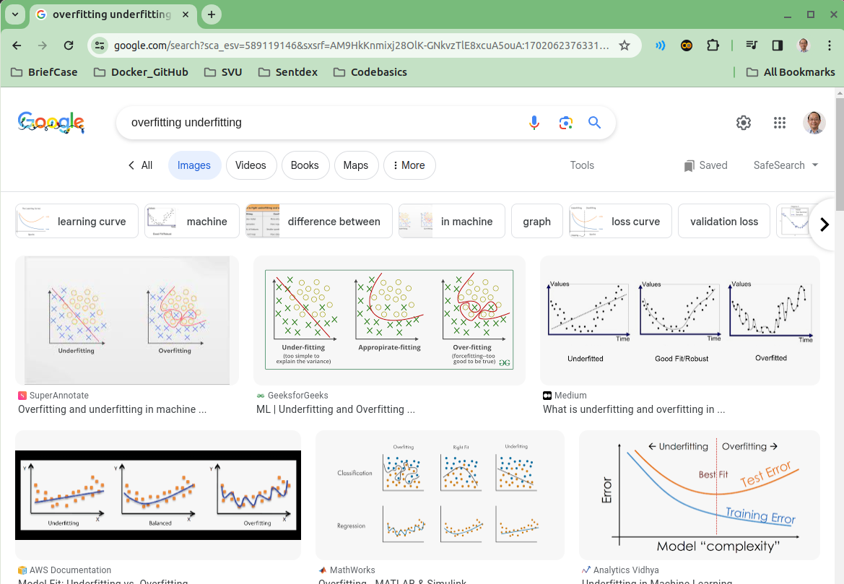
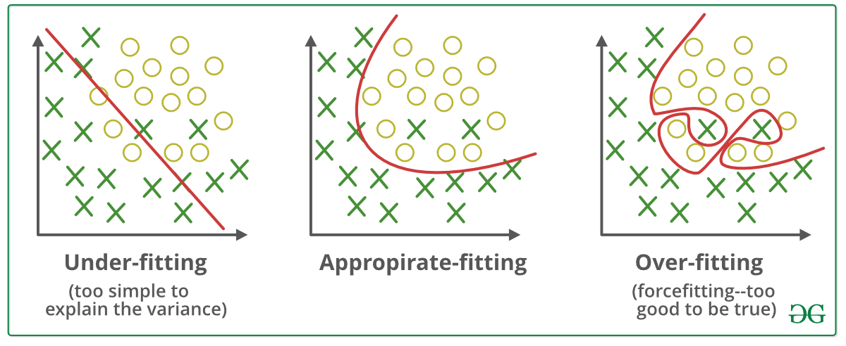
20 Dropout Regularization
https://www.youtube.com/watch?v=lcI8ukTUEbo&list=PLeo1K3hjS3uu7CxAacxVndI4bE_o3BDtO&index=20
Dropout Regularization (1:01-2:35/19:01)
Google search “Overfitting underfitting”.
We have dataset for classification problem:
If we are in underfit (too loose), we are generalized too much. Here, we draw a linear line. It is too loose to fit all training data.
If we are in overfit (too tight), we squeeze the boundary to fit. It has the best performance for training dataset, but we do the general test data, this model is too tight and will not perform well.
The Dropout Regularization find the balance between the overfit and underfit.

Slide 5
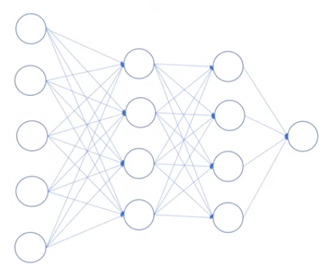
20 Dropout Regularization
https://www.youtube.com/watch?v=lcI8ukTUEbo&list=PLeo1K3hjS3uu7CxAacxVndI4bE_o3BDtO&index=20
Dropout Regularization (2:36-3:30/19:01)
Here is the example of shallow deep learning.

Slide 6
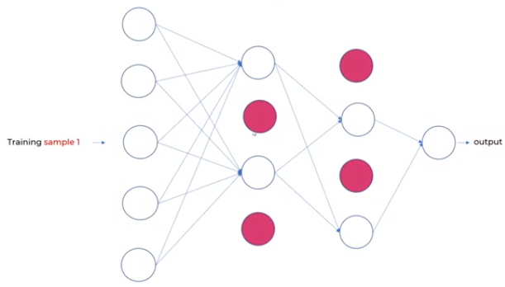
20 Dropout Regularization
https://www.youtube.com/watch?v=lcI8ukTUEbo&list=PLeo1K3hjS3uu7CxAacxVndI4bE_o3BDtO&index=20
Dropout Regularization (3:34-4:00/19:01)
We randomly drop the red neurons.
Here, we have first sample, we drop at 0.5 (50%). We drop 2 neurons out of four neurons.

Slide 7
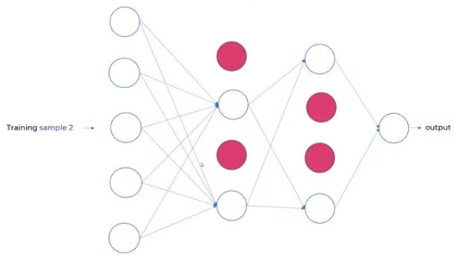
20 Dropout Regularization
https://www.youtube.com/watch?v=lcI8ukTUEbo&list=PLeo1K3hjS3uu7CxAacxVndI4bE_o3BDtO&index=20
Dropout Regularization (4:11-4:30/19:01)
In the second sample, we drop at 50%, 50% at both layers.
We can drop 50% in the first layers and 25% in the second layers.
The dropping rate are based on try and errors.

Slide 8
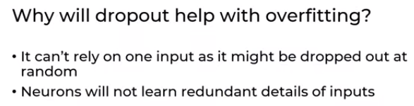
20 Dropout Regularization
https://www.youtube.com/watch?v=lcI8ukTUEbo&list=PLeo1K3hjS3uu7CxAacxVndI4bE_o3BDtO&index=20
Dropout Regularization (4:33-5:20/19:01)
Will dropout help the overfitting?
When we drop the neurons, the neurons cannot see the connected input layers.
Then, it cannot create the associated bias for inputs as well.
When we drop some neuron, the bias will not affect by the inputs. The inputs will not impact as much as before.

Slide 9
20.1 Without Dropout: Coding

Slide 10
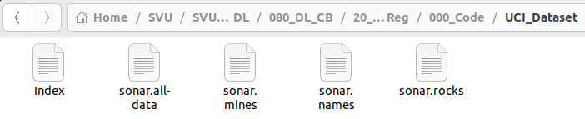
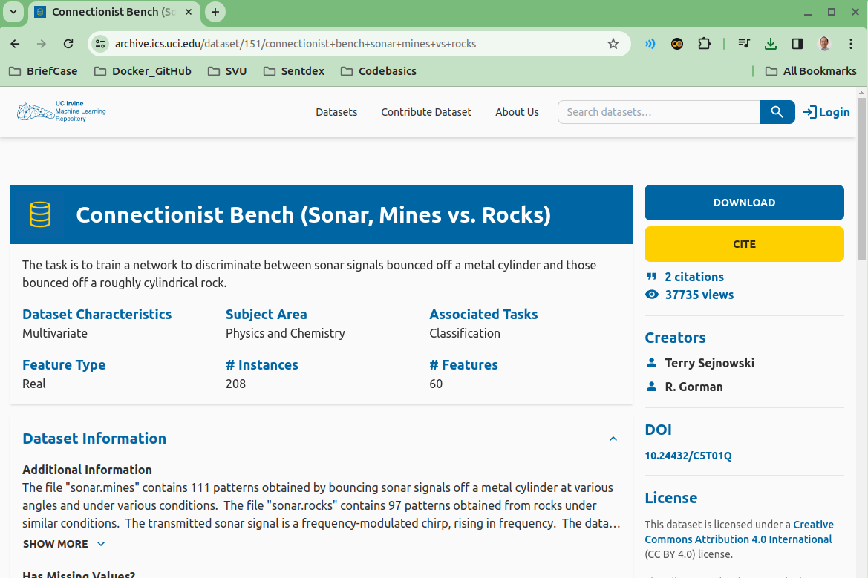
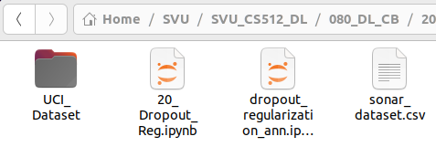
20.1 Without Dropout: Coding
https://www.youtube.com/watch?v=lcI8ukTUEbo&list=PLeo1K3hjS3uu7CxAacxVndI4bE_o3BDtO&index=20
Python Coding (5:28-6:30/19:01)
Now, we look at python code for Dropout Regularization and see how it help the overfit/underfit problem.
We are going to use dataset from UCI machine Learning.
We download and unzip. Find “sonar.all-data” into “sonar_dataset.csv” put in the working directory.

Slide 11
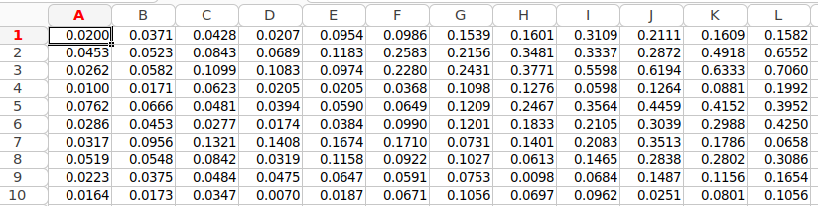
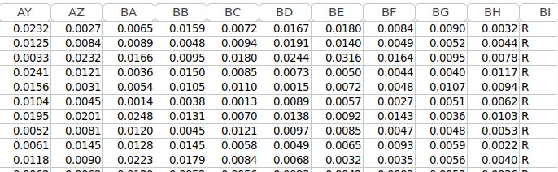
20.1 Without Dropout: Coding
https://www.youtube.com/watch?v=lcI8ukTUEbo&list=PLeo1K3hjS3uu7CxAacxVndI4bE_o3BDtO&index=20
Python Coding (6:31-7:30/19:01)
This dataset describes the sonar chirp (noise) returns bouncing off different services.
The 60 input variables are the strength of the return at different angles.
Sonar: Sound Navigation and Ranging
In Column 60, R (Rock): means Rocks are detected, M (Mines) means Mines are detected.

Slide 12
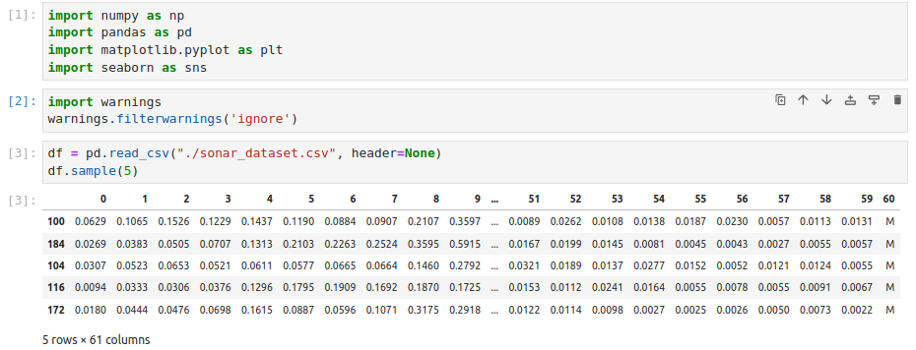
20.1 Without Dropout: Coding
https://www.youtube.com/watch?v=lcI8ukTUEbo&list=PLeo1K3hjS3uu7CxAacxVndI4bE_o3BDtO&index=20
Python Coding (6:31-6:35/19:01)
Read in dataset “sonar_dataset.csv”.
When we load the data, we have header = None. We don’t have columns name.
Print first 5 lines samples.

Slide 13
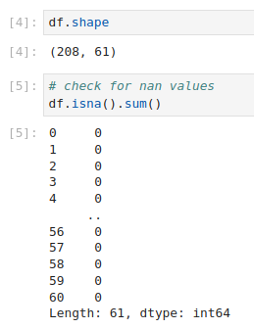
20.1 Without Dropout: Coding
https://www.youtube.com/watch?v=lcI8ukTUEbo&list=PLeo1K3hjS3uu7CxAacxVndI4bE_o3BDtO&index=20
Python Coding (6:31-6:35/19:01)
1. Check shape 208 rows x 61 columns
2. Check for columns that contains the NaN (Not a number). There are all 0. None of the columns has the NaN.

Slide 14
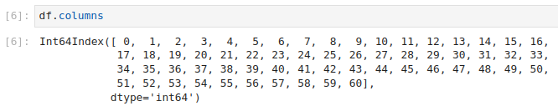
20.1 Without Dropout: Coding
https://www.youtube.com/watch?v=lcI8ukTUEbo&list=PLeo1K3hjS3uu7CxAacxVndI4bE_o3BDtO&index=20
Python Coding (7:01-7:15/19:01)
1. Check the column names (0, 1, 2, …, 60).
Columns 0 to 59 is the features. Column 60 is the target variables.

Slide 15

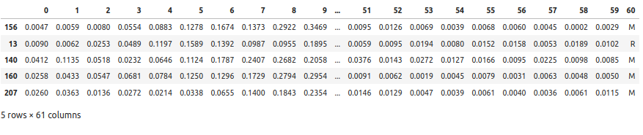
20.1 Without Dropout: Coding
https://www.youtube.com/watch?v=lcI8ukTUEbo&list=PLeo1K3hjS3uu7CxAacxVndI4bE_o3BDtO&index=20
Python Coding (7:16-7:43/19:01)
We check how many M and R in columns 60.
We totally have 208 rows.
111 + 97 = 208
We have 111 is M and 97 is R.

Slide 16
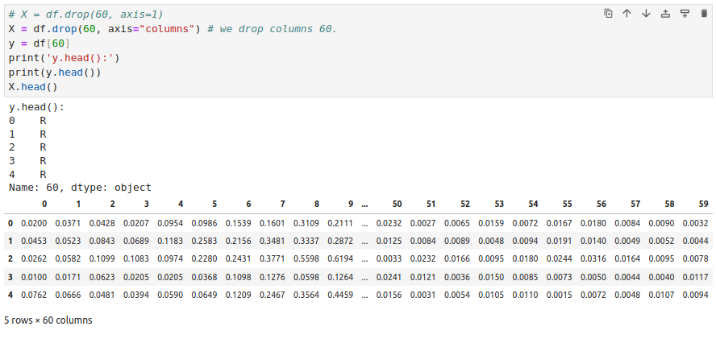
20.1 Without Dropout: Coding
https://www.youtube.com/watch?v=lcI8ukTUEbo&list=PLeo1K3hjS3uu7CxAacxVndI4bE_o3BDtO&index=20
Python Coding (7:51-8:15/19:01)
Now, we prepare the data y and X.

Slide 17
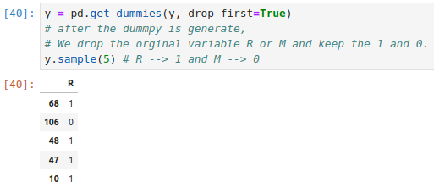
20.1 Without Dropout: Coding
https://www.youtube.com/watch?v=lcI8ukTUEbo&list=PLeo1K3hjS3uu7CxAacxVndI4bE_o3BDtO&index=20
Python Coding (8:17-9:10/19:01)
Now, we do the one-hot encoding by get_dummies().
After the one-hot encoding is generated, the original R (Rocks) and M (Mines) are drop.
Only 1 or 0 are kept.
Below are y (target) 1 (Rocks) or 0 (Mines).

Slide 18
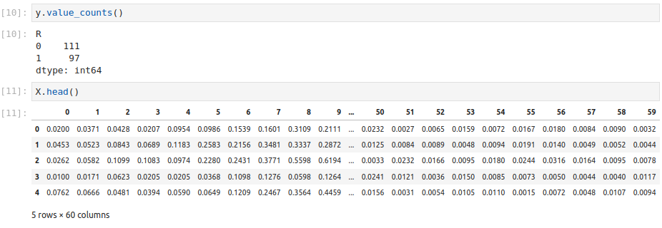
20.1 Without Dropout: Coding
https://www.youtube.com/watch?v=lcI8ukTUEbo&list=PLeo1K3hjS3uu7CxAacxVndI4bE_o3BDtO&index=20
Python Coding (9:10-9:16/19:01)
1. We have y value counts: We have M (Mines) is converted into 0 and R (Rocks) converted into 1.
2. Check the X data.

Slide 19
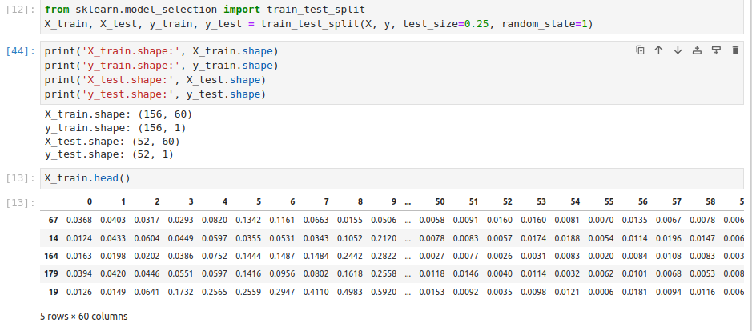
20.1 Without Dropout: Coding
https://www.youtube.com/watch?v=lcI8ukTUEbo&list=PLeo1K3hjS3uu7CxAacxVndI4bE_o3BDtO&index=20
Python Coding (9:31-10:30/19:01)
We split data into train and test.
We have X_train, y_train, X_test. y_test.

Slide 20
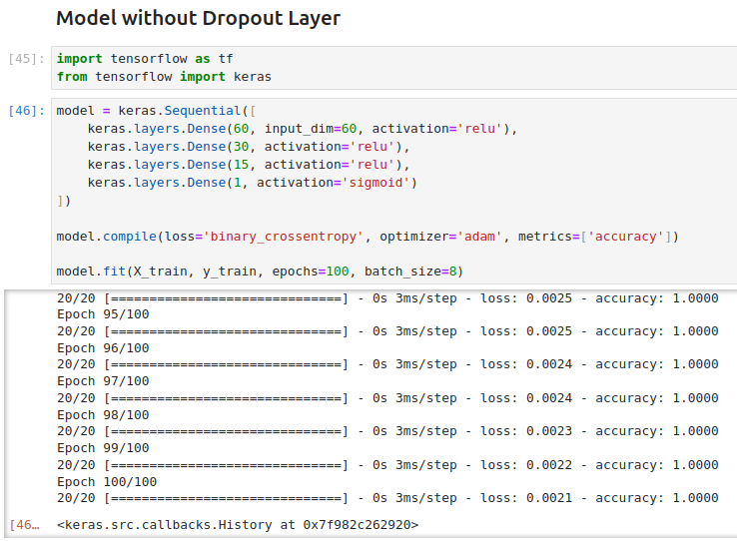
20.1 Without Dropout: Coding
https://www.youtube.com/watch?v=lcI8ukTUEbo&list=PLeo1K3hjS3uu7CxAacxVndI4bE_o3BDtO&index=20
Python Coding (10:31-12:50/19:01)
We model without dropout.
1. We have 60 columns. We have input dimension = 60 and neuron=60.
2. We have two hidden layers and try and error for number of neuron 30 and 15. We have ReLU for activation function.
3. We have output activation function sigmoid for probability distribution.
1. We have loss function binary cross entropy.
2. Optimizer adam
3. We use accuracy for measurement.
1. We train for 100 epochs for feed samples forward and back-propagation.
2. We use mini-batch size = 8 samples in each epoch.
We have accuracy 100%. This is too good.

Slide 21
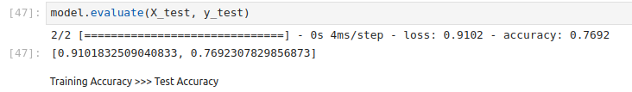
20.1 Without Dropout: Coding
https://www.youtube.com/watch?v=lcI8ukTUEbo&list=PLeo1K3hjS3uu7CxAacxVndI4bE_o3BDtO&index=20
Python Coding (12:51-13:00/19:01)
We evaluate and accuracy is 76%.
We have 100% in accuracy but only 76% in test.
We have very good accuracy in training dataset but very poor in test dataset.
This means that we are overfitting in our model.

Slide 22
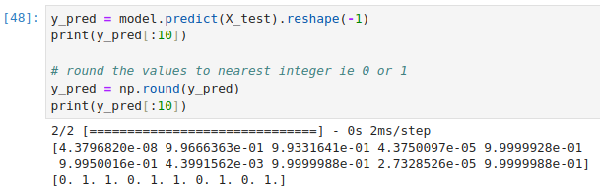
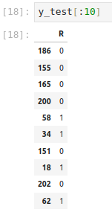
20.1 Without Dropout: Coding
https://www.youtube.com/watch?v=lcI8ukTUEbo&list=PLeo1K3hjS3uu7CxAacxVndI4bE_o3BDtO&index=20
Python Coding (13:01-13:26/19:01)
We make some prediction:
1. initial prediction and
2. round to 0 and 1.
We view the result.

Slide 23
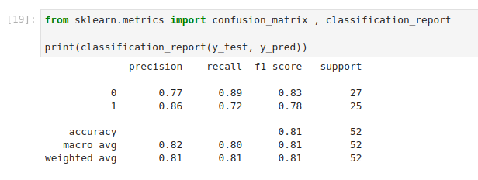
20.1 Without Dropout: Coding
https://www.youtube.com/watch?v=lcI8ukTUEbo&list=PLeo1K3hjS3uu7CxAacxVndI4bE_o3BDtO&index=20
Python Coding (14:01-14:10/19:01)
We view the confusion matrix: precision, recall, f1-score, and support (how many points we measured).

Slide 24
20.2 With Dropout: Coding

Slide 25
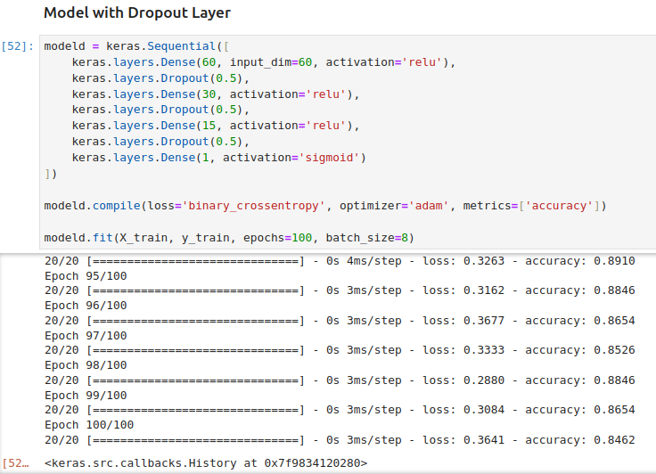
20.2 With Dropout: Coding
https://www.youtube.com/watch?v=lcI8ukTUEbo&list=PLeo1K3hjS3uu7CxAacxVndI4bE_o3BDtO&index=20
With Dropout: Coding (14:01-15:30/19:01)
Now, we want to add the Dropout layer. We have 50% dropout.
We can put 0.25 for 25% dropout. We can try and error for the best percentage.
Here, we have 91% accuracy.

Slide 26
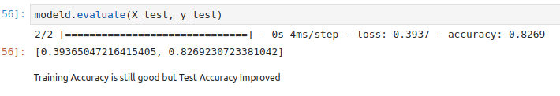
20.2 With Dropout: Coding
https://www.youtube.com/watch?v=lcI8ukTUEbo&list=PLeo1K3hjS3uu7CxAacxVndI4bE_o3BDtO&index=20
With Dropout: Coding (15:31-16:30/19:01)
Previously, without dropout, we have 76.9% accuracy in test dataset.
With dropout, we improve to 82.6% accuracy in test dataset.

Slide 27
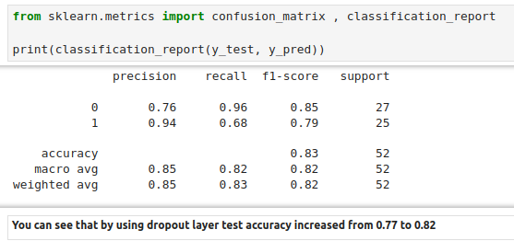
20.2 With Dropout: Coding
https://www.youtube.com/watch?v=lcI8ukTUEbo&list=PLeo1K3hjS3uu7CxAacxVndI4bE_o3BDtO&index=20
With Dropout: Coding (16:31-18:01/19:01)
Use dropout, we improve the test accuracy from 77% to 82%.

Slide 28
20.2 With Dropout: Coding
https://www.youtube.com/watch?v=lcI8ukTUEbo&list=PLeo1K3hjS3uu7CxAacxVndI4bE_o3BDtO&index=20
With Dropout: Coding (18:01-19:01/19:01)
Previously, without dropout, we have 76.9% accuracy in test dataset.
With dropout, we improve to 82.6% accuracy in test dataset.

Slide 29
End

