Slide 1

15 Chain Rule
Peter H. Chen

Slide 2
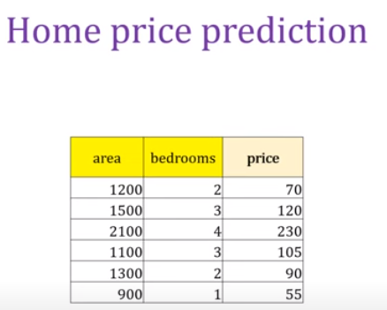
15 Chain Rule
https://www.youtube.com/watch?v=5ogmEkujoqE&list=PLeo1K3hjS3uu7CxAacxVndI4bE_o3BDtO&index=15
Chain Rule (0:00-0:42/14:05)
We discuss the chain rule of derivatives.
We use Home Price Prediction as a simple example.

Slide 3
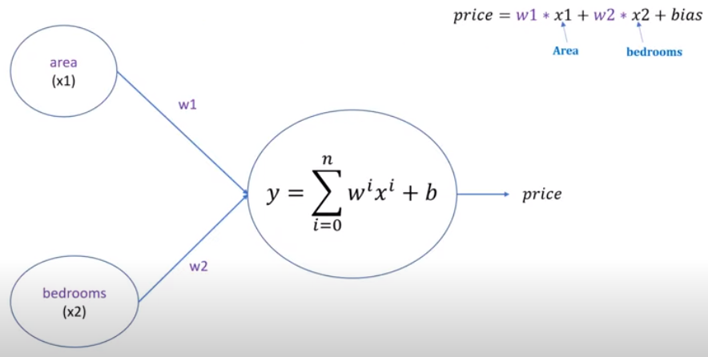
15 Chain Rule
https://www.youtube.com/watch?v=5ogmEkujoqE&list=PLeo1K3hjS3uu7CxAacxVndI4bE_o3BDtO&index=15
Chain Rule (0:43-0:51/14:05)
We have deep learning model with w1 * area + w2 * bedroom + bias.

Slide 4
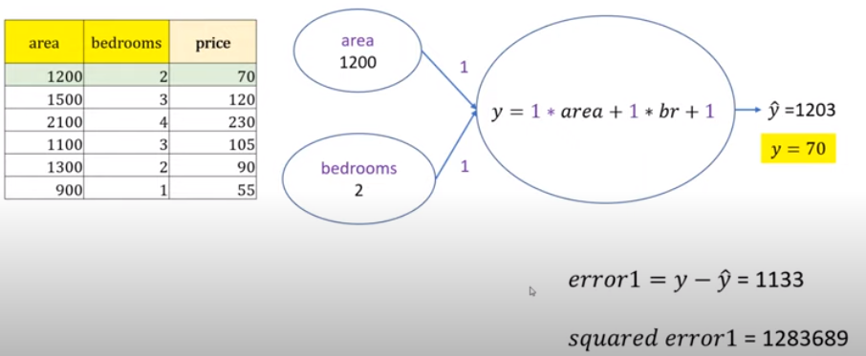
15 Chain Rule
https://www.youtube.com/watch?v=5ogmEkujoqE&list=PLeo1K3hjS3uu7CxAacxVndI4bE_o3BDtO&index=15
Chain Rule (0:52-1:21/14:05)
1. We initialize the weight and bias with some random values.
2. Pickup the first sample and train the neural network.
3. Calculate the error and squared error.

Slide 5
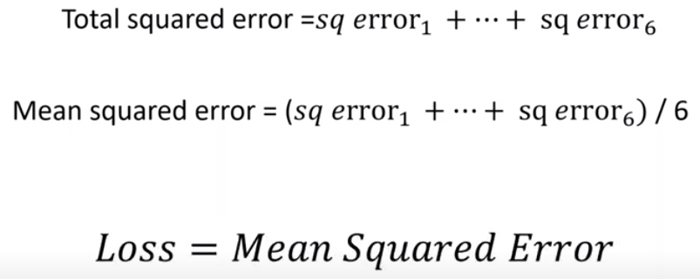
15 Chain Rule
https://www.youtube.com/watch?v=5ogmEkujoqE&list=PLeo1K3hjS3uu7CxAacxVndI4bE_o3BDtO&index=15
Chain Rule (1:19-2:19/14:05)
1. We sum of the squared error.
2. Take the MSE (Average of Squared Error). Once you have MSE, you can do the back propagation. This is the forward pass.
There is a forward pass and there is a backward pass. The the forward pass, we have the loss.

Slide 6
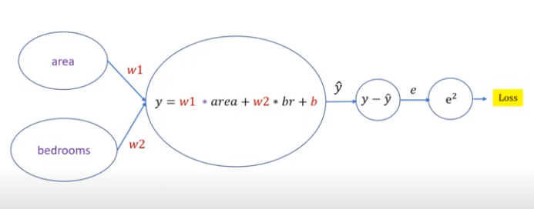
15 Chain Rule
https://www.youtube.com/watch?v=5ogmEkujoqE&list=PLeo1K3hjS3uu7CxAacxVndI4bE_o3BDtO&index=15
Chain Rule (2:49-3:10/14:05)
In the forward pass, we calculate the loss.

Slide 7
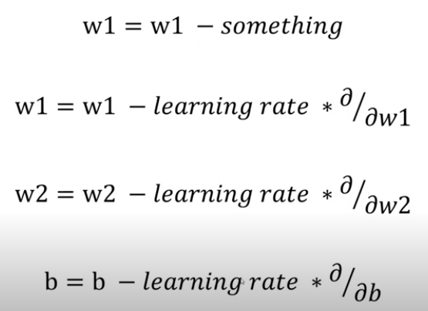
15 Chain Rule
https://www.youtube.com/watch?v=5ogmEkujoqE&list=PLeo1K3hjS3uu7CxAacxVndI4bE_o3BDtO&index=15
Chain Rule (3:1-3:30/14:05)
Once you have loss, we want to calculate the new weights and new bias.

Slide 8
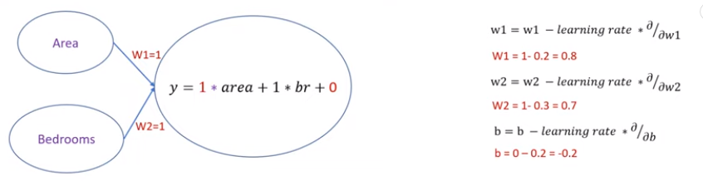
15 Chain Rule
https://www.youtube.com/watch?v=5ogmEkujoqE&list=PLeo1K3hjS3uu7CxAacxVndI4bE_o3BDtO&index=15
Chain Rule (3:50-4:10/14:05)
And then, after one epoch which is going through all the training samples and get the new weights 0.8 and 0.7 and new bias -0.2.

Slide 9
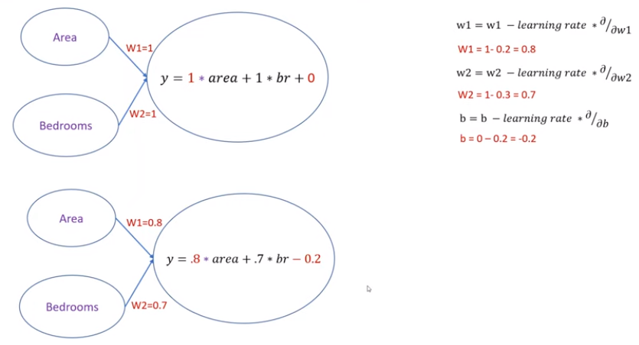
15 Chain Rule
https://www.youtube.com/watch?v=5ogmEkujoqE&list=PLeo1K3hjS3uu7CxAacxVndI4bE_o3BDtO&index=15
Chain Rule (4:11-4:20/14:05)
Then, we do another epoch with new weights and new bias.

Slide 10
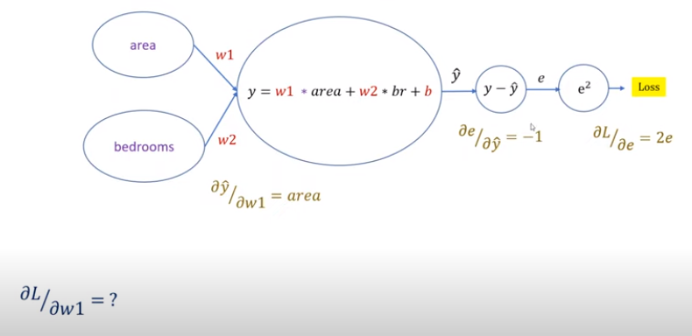
15 Chain Rule
https://www.youtube.com/watch?v=5ogmEkujoqE&list=PLeo1K3hjS3uu7CxAacxVndI4bE_o3BDtO&index=15
Chain Rule (4:31-5:50/14:05)
Go back to the generic architecture.
We take the loss and take a partial derivative of loss with respect to e. We have 2e.
The partial derivative of error with respect to y-hat (ŷ) is -1.
The partial derivative of y-hat (ŷ) respect to w1 is = area.
So, what is the partial derivative of Loss respect to w1?

Slide 11
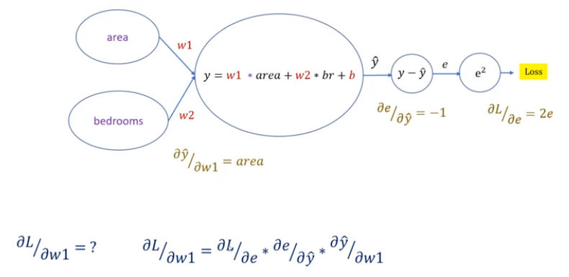
15 Chain Rule
https://www.youtube.com/watch?v=5ogmEkujoqE&list=PLeo1K3hjS3uu7CxAacxVndI4bE_o3BDtO&index=15
Chain Rule (5:55-7:40/14:05)
How do we want the partial derivative of Loss respect to w1?
We use chain rule to multiply each individual derivatives.

Slide 12
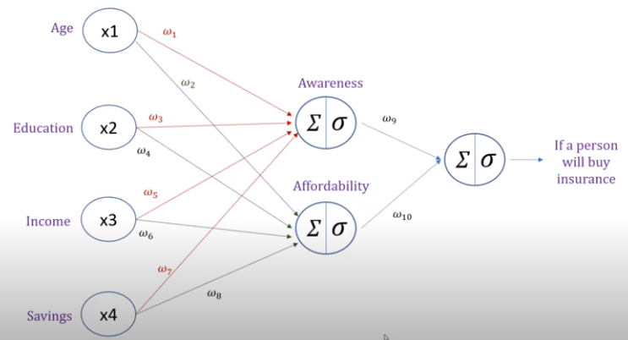
15 Chain Rule
https://www.youtube.com/watch?v=5ogmEkujoqE&list=PLeo1K3hjS3uu7CxAacxVndI4bE_o3BDtO&index=15
Chain Rule (7:47-8:50/14:05)
We might have more features (Age, Education, Income, Saving) as below.
We have two hidden neural networks, Awareness and Affordability. Some of weights maybe zero because there is no relationship between them.
Awareness may have no relation with Age and Education.

Slide 13
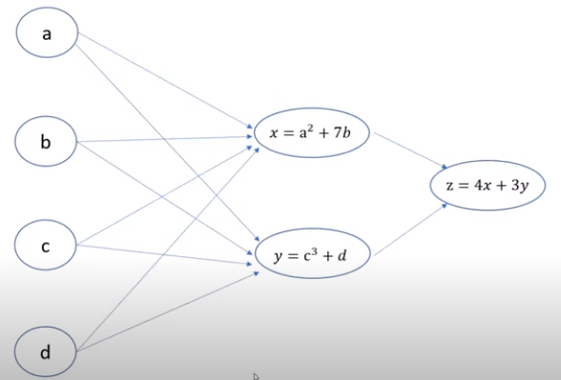
15 Chain Rule
https://www.youtube.com/watch?v=5ogmEkujoqE&list=PLeo1K3hjS3uu7CxAacxVndI4bE_o3BDtO&index=15
Chain Rule (8:52-9:40/14:05)
We can present the neural network into the mathematics.
To simplify the explanation, we simplify the neurons (with linear function and activation) into mathematical equation as below.
Below diagram is called a computation graph.
The chain rule can be explained easily by the computation graph with mathematical equation.
Below, we have input a, b, c, d.
The neuron x has relationship with a and b but have no relationship with c and d.
The neuron y has relationship with c and d but have no relationship with a and b.

Slide 14
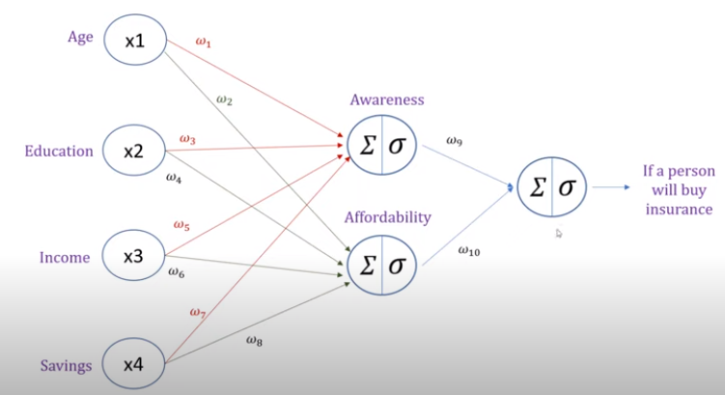
15 Chain Rule
https://www.youtube.com/watch?v=5ogmEkujoqE&list=PLeo1K3hjS3uu7CxAacxVndI4bE_o3BDtO&index=15
Chain Rule (10:03-10:40/14:05)
We put the parameters in dataset into the computation graph.
We buy insurance based on Awareness and Affordability.
If we change features X, how much change in the neuron?

Slide 15
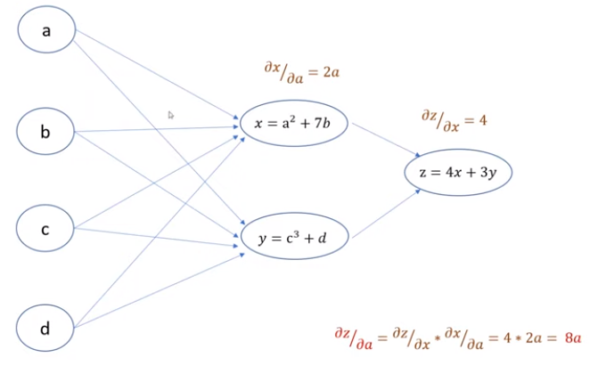
15 Chain Rule
https://www.youtube.com/watch?v=5ogmEkujoqE&list=PLeo1K3hjS3uu7CxAacxVndI4bE_o3BDtO&index=15
Chain Rule (11:02-11:40/14:05)
If I have a change in x, how much change in z?
The partial derivative of z with respect to x is 4.
The derivative of x with respect to a is 2a.
If we have change in a, how much change in z? We have 8*a.

Slide 16
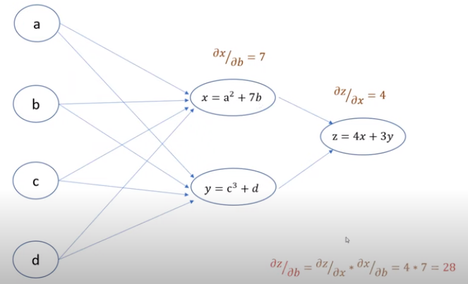
15 Chain Rule
https://www.youtube.com/watch?v=5ogmEkujoqE&list=PLeo1K3hjS3uu7CxAacxVndI4bE_o3BDtO&index=15
Chain Rule (12:39-14:05/14:05)
If I have a change in b, how much change in z?
The derivative of z with respect to z is 4.
The derivative of x with respect to b is 7.
If we have change in b, how much change in z? We have 4 * 7 = 28.

Slide 17
End

