Slide 1

20 Dropout Regularization
Peter H. Chen

Slide 2
20 Dropout Regularization
https://www.youtube.com/watch?v=lcI8ukTUEbo&list=PLeo1K3hjS3uu7CxAacxVndI4bE_o3BDtO&index=20
Dropout Regularization (0:00-0:10/19:01)
What is difference from statistical/regressional Machine Learning and Neural Network.
1. Statistical/Regressional machine learning models are trained using algorithms to learn patterns from data. Statistical Machine learning is the Polynomial/Equation based modeling. The sci-learn is the library for statistical machine learning.
2. Neural networks use multiple layers of neurons to model and train with backpropagation, adjusting the weights and biases. Google Tensorflow framework and Meta Pytorch library are used for Neural Network programming.
Three layers of neural network model is called shallow neural network. Shallow neural network is equivalent to statistical machine learning.
More than four layers neural network is deep neural network for learning. Totally different from statistical Machine Learning.

Slide 3
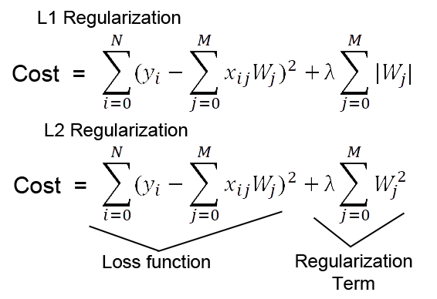
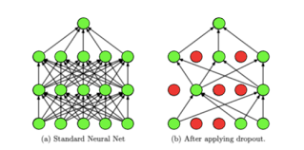
20 Dropout Regularization
https://www.youtube.com/watch?v=lcI8ukTUEbo&list=PLeo1K3hjS3uu7CxAacxVndI4bE_o3BDtO&index=20
Dropout Regularization (0:11-0:20/19:01)
What is difference from Regularization in Machine Learning and Dropout in Neural Network?
1. Regularization is used in statistical/regressional machine learning to reduced the overfit problem. Below is the exmaple of regularization (L1 regularization). There is regularization terms with hyperparameter lambda (λ) added to Loss function to avoid the overfit. The small coefficients (i.e., slopes) will be removed.
2. Neural Network does not have mathematical formula. The regularization concept is converted into the dropout regularization (or dropout in short) for the overfit. The small weights (by trial and errors) of neuron will be removed from the neural networks.

Slide 4
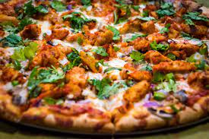

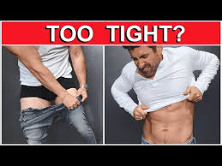
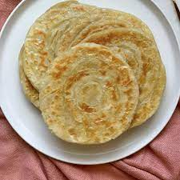
20 Dropout Regularization
https://www.youtube.com/watch?v=lcI8ukTUEbo&list=PLeo1K3hjS3uu7CxAacxVndI4bE_o3BDtO&index=20
Dropout Regularization (0:21-0:30/19:01)
When we go out to buy clothe, we will try to buy the right size to your body.
If clothe size is too small (overfit, fit too tight), then we do not have space to fit when we eat some food, such as, we eat Pizza, Parathan, or Biryani.
The clothe become too tight.
Pizza
Cannot eat any food
Clothe too tight
Biryani (Mixed Rice Dish)
Paratha (flat bread)

Slide 5
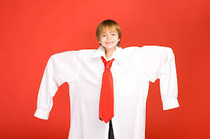
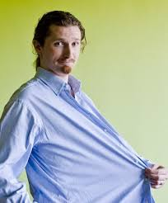
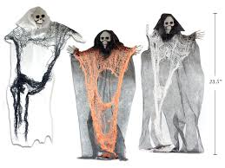
20 Dropout Regularization
https://www.youtube.com/watch?v=lcI8ukTUEbo&list=PLeo1K3hjS3uu7CxAacxVndI4bE_o3BDtO&index=20
Dropout Regularization (0:31-0:40/19:01)
If clothe size is too large (underfit, fit too loose), it will look like a clothe hanging on the skeleton.
The clothe is similar to model of neural network.
We try to buy the right size of clothe when we buy the clothe.

Slide 6
20.01 Dropout Overfitting

Slide 7
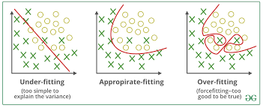
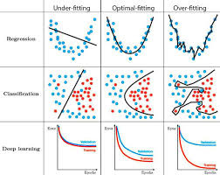
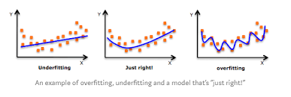
20.01 Dropout Overfitting
https://www.youtube.com/watch?v=lcI8ukTUEbo&list=PLeo1K3hjS3uu7CxAacxVndI4bE_o3BDtO&index=20
Dropout Overfitting (0:41-0:50/19:01)
The overfitting and underfitting of model in the machine learning is similar to wear the clothe too large or too small.
Below are examples of overfitting, underfitting, and optimal-fitting in machine learning, deep learning, and classification.

Slide 8
20.01 Dropout Overfitting
https://www.youtube.com/watch?v=lcI8ukTUEbo&list=PLeo1K3hjS3uu7CxAacxVndI4bE_o3BDtO&index=20
Dropout Overfitting (0:51-1:00/19:01)
How do we solve the overfitting and underfitting problem in neural network?
There are techniques to overcome the overfitting and underfitting problem.
These techniques are called regularization techniques.
When we use the training data to train the model, we may set up too many layers or too many neurons in the model.
It might cause the overfitting.
When we use overfitting model to test with extra data, it may not perform well.
Dropout Regularization is the technique to tackle the overfitting/underfitting problem.

Slide 9
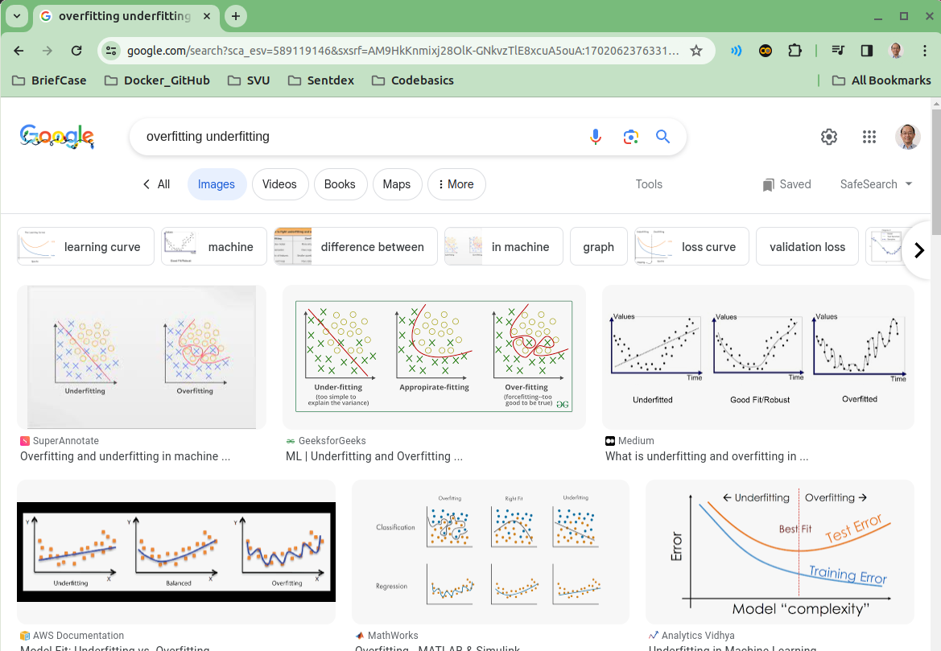
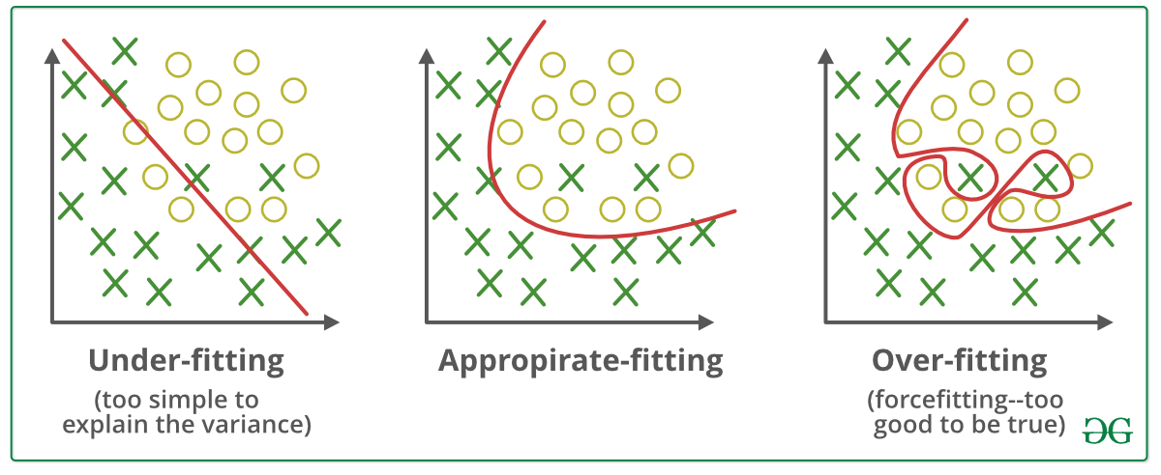
20.01 Dropout Overfitting
https://www.youtube.com/watch?v=lcI8ukTUEbo&list=PLeo1K3hjS3uu7CxAacxVndI4bE_o3BDtO&index=20
Dropout Overfitting (1:01-2:35/19:01)
Google search “Overfitting underfitting”.
We have dataset for classification problem:
If we are in underfit (too loose), we are generalized too much.
Here, we draw a linear line. It is too loose to fit all training data.
If we are in overfit (too tight), we squeeze the boundary to fit.
It has the best performance (very low degree of freedom, low dimension space, and very fast) for training dataset, but we do the general test data, this model is too tight and will not perform well.
The Dropout Regularization find the balance between the overfit and underfit.

Slide 10
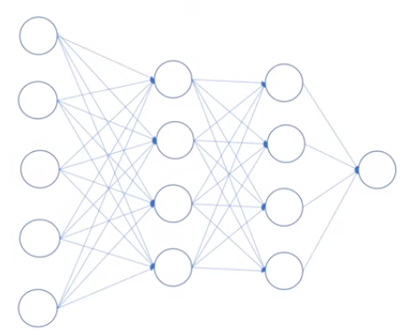
20.01 Dropout Overfitting
https://www.youtube.com/watch?v=lcI8ukTUEbo&list=PLeo1K3hjS3uu7CxAacxVndI4bE_o3BDtO&index=20
Dropout Overfitting (2:36-3:30/19:01)
Here is the example of Deep Neural Network (i.e., 4 layers of neural network).
Note:
1. Shallow Neural Network: 3 layers
2. Deep Neural Network: more than 4 layers.
1-input layer
2-hidden layers
1-output layer

Slide 11
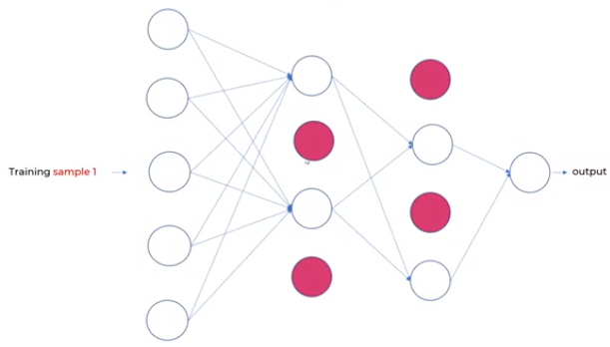
20.01 Dropout Overfitting
https://www.youtube.com/watch?v=lcI8ukTUEbo&list=PLeo1K3hjS3uu7CxAacxVndI4bE_o3BDtO&index=20
Dropout Overfitting (3:34-4:00/19:01)
We randomly drop the red neurons.
Here, we have first sample, we drop at 0.5 (50%).
We drop 2 neurons out of four neurons.
Note:
1. When we drop out the neurons, the weights (i.e., weights = 0) are removed between the neurons.
2. When the neurons is dropped out, the memory size of neural network is automatically reduced.
3. This is similar to that we buy very tight clothe

Slide 12
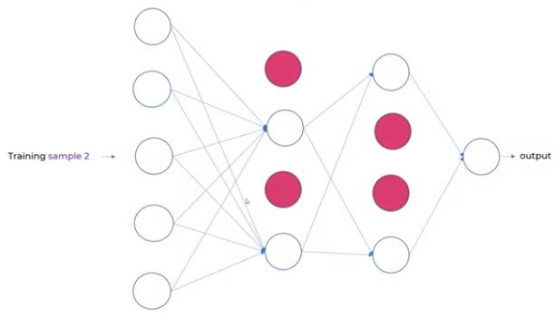
20.01 Dropout Overfitting
https://www.youtube.com/watch?v=lcI8ukTUEbo&list=PLeo1K3hjS3uu7CxAacxVndI4bE_o3BDtO&index=20
Dropout Overfitting (4:11-4:30/19:01)
In the second sample, we drop at 50%, 50% at both layers.
We also can drop 50% in the first layers and 25% in the second layers.
The dropping rate are really based on try and errors.

Slide 13
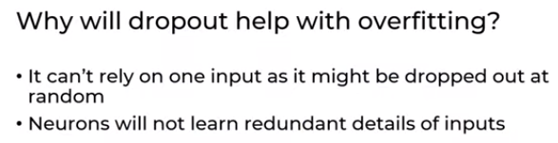
20.01 Dropout Overfitting
https://www.youtube.com/watch?v=lcI8ukTUEbo&list=PLeo1K3hjS3uu7CxAacxVndI4bE_o3BDtO&index=20
Dropout Overfitting (4:33-5:20/19:01)
Will dropout help the overfitting?
When we drop the neurons, the neurons cannot see the connected input layers.
Then, it cannot create the associated bias for inputs as well.
When we drop some neuron, the bias will not affect by the inputs.
The inputs will not impact as much as before.
Question:
When we drop some neurons, some of input parameters are not used at all. What is that mean in the thinking with statistical/regressional machine learning?
Answer:
1. The unused parameters is no longer used, i.e., no weights and bias associated with that parameters.
2. In statistical machine learning of thinking, the degree of polynomial or degree of freedom (in statistical machine learning) is reduced.

Slide 14
End

