Slide 1

008 Activation Function
Peter H. Chen

Slide 2
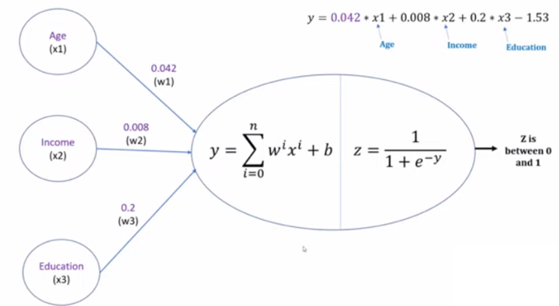
008 Activation Function
https://www.youtube.com/watch?v=icZItWxw7AI&list=PLeo1K3hjS3uu7CxAacxVndI4bE_o3BDtO&index=8
Activation Function (0:00-1:00/16:28)
We look the activation function with a single neuron and implement activation function with PyTorch.
We have some negative infinity and positive infinity at the end of neuron.
We use sigmoid function to convert the output between 0 (not buy insurance) and 1 (buy insurance).

Slide 3
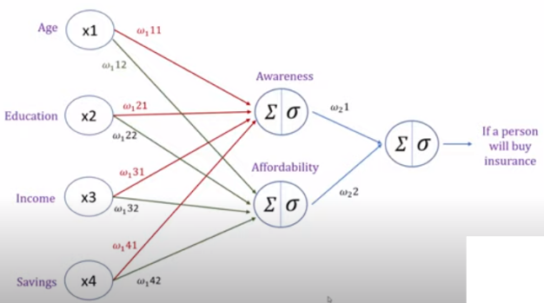
008 Activation Function
https://www.youtube.com/watch?v=icZItWxw7AI&list=PLeo1K3hjS3uu7CxAacxVndI4bE_o3BDtO&index=8
Activation Function (1:33-1:50/16:28)
For multi-layers of neurons with the hidden layer.

Slide 4
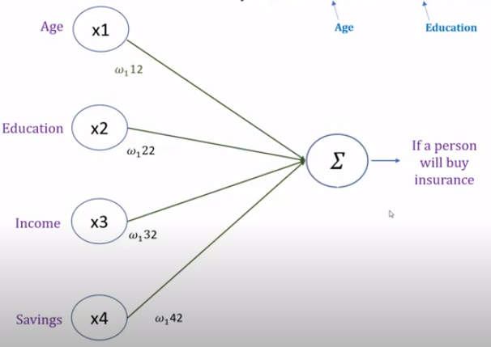

008 Activation Function
https://www.youtube.com/watch?v=icZItWxw7AI&list=PLeo1K3hjS3uu7CxAacxVndI4bE_o3BDtO&index=8
Activation Function (1:33-1:50/16:28)
We look at math and we realize that is the output of linear regression for the input features.
In real life, the linear regression cannot solve the problem. We need the non-linear equation for prediction( Buy or bot buy insurance).
The single neuron is with linear weight combination is not good enough to solve the problem.
We need the hidden layer to solve the problem.

Slide 5
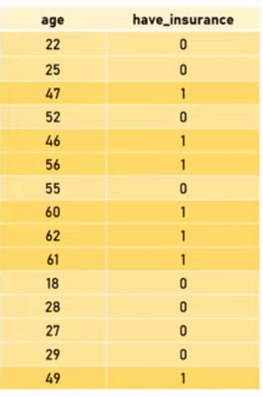

008 Activation Function
https://www.youtube.com/watch?v=icZItWxw7AI&list=PLeo1K3hjS3uu7CxAacxVndI4bE_o3BDtO&index=8
Activation Function (2:00-3:00/16:28)
We look at the binary classification problem again.
Given an age of a person.
We want to find a Function that can predict whether this person will buy insurance or not.

Slide 6
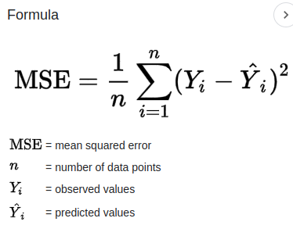
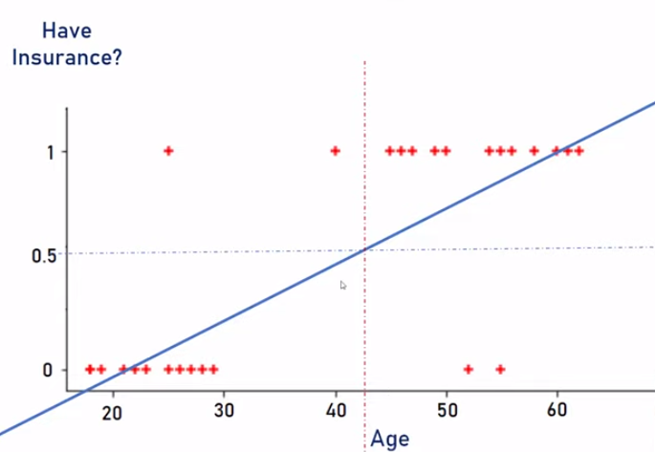
008 Activation Function
https://www.youtube.com/watch?v=icZItWxw7AI&list=PLeo1K3hjS3uu7CxAacxVndI4bE_o3BDtO&index=8
Activation Function (3:01-4:20/16:28)
We can draw a line with linear regression.
The linear regression is the minimization of the mean square error.
With the linear regression, we can find the age that have the probability of 50% buy insurance (or not to buy insurance).

Slide 7
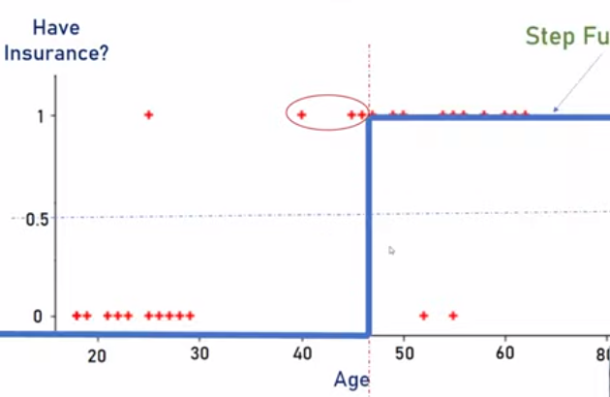
008 Activation Function
https://www.youtube.com/watch?v=icZItWxw7AI&list=PLeo1K3hjS3uu7CxAacxVndI4bE_o3BDtO&index=8
Activation Function (4:29-4:50/16:28)
Below, instead of linear regression, we use another way, Step Function, to classify the Buy Insurance or Not Buy Insurance.
Step function is another activation function. Step Function is not very popular.
Step Function

Slide 8
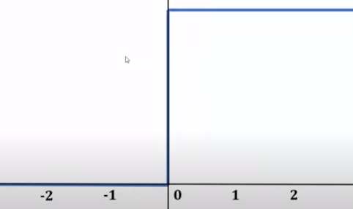
008 Activation Function
https://www.youtube.com/watch?v=icZItWxw7AI&list=PLeo1K3hjS3uu7CxAacxVndI4bE_o3BDtO&index=8
Activation Function (5:01-5:02/16:28)
Below is a simple presentation of Step Function.
Step Function

Slide 9
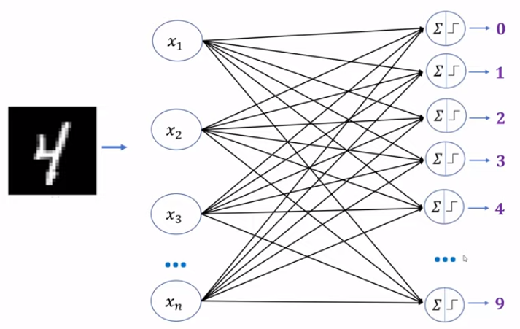
008 Activation Function
https://www.youtube.com/watch?v=icZItWxw7AI&list=PLeo1K3hjS3uu7CxAacxVndI4bE_o3BDtO&index=8
Activation Function (5:09-5:20/16:28)
Neural network for categorical classification.
The prediction for each digit is either 0 or 1.
Prediction
0
0
1
0
1
0

Slide 10
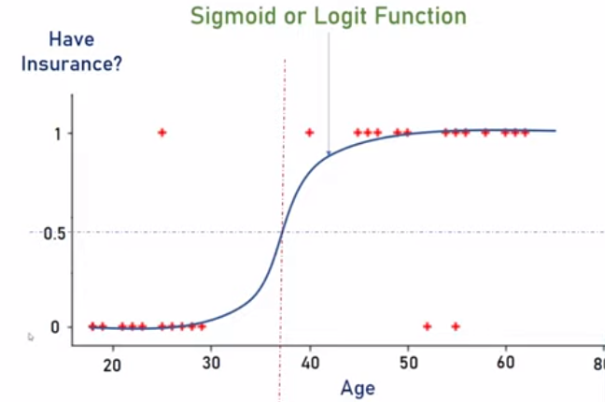
008 Activation Function
https://www.youtube.com/watch?v=icZItWxw7AI&list=PLeo1K3hjS3uu7CxAacxVndI4bE_o3BDtO&index=8
Activation Function (5:41-5:50/16:28)
Sigmoid or logit function foe binary classificatory.
The Step function cannot take derivative in transition point.
Therefore, we use Sigmoid function instead of step function.

Slide 11
008 Activation Function
https://www.youtube.com/watch?v=icZItWxw7AI&list=PLeo1K3hjS3uu7CxAacxVndI4bE_o3BDtO&index=8
Activation Function (5:31-6:20/16:28)
Use probability between 0 to 1 (for example 0.82), instead of 0 or 1, for Multi-class Classification, i.e., Categorical Decision.
The probability os a float number, not integer 0 or 1.
Multi-Class Classification
0.02
0.31
0.7
0.08
0.82
0.05

Slide 12
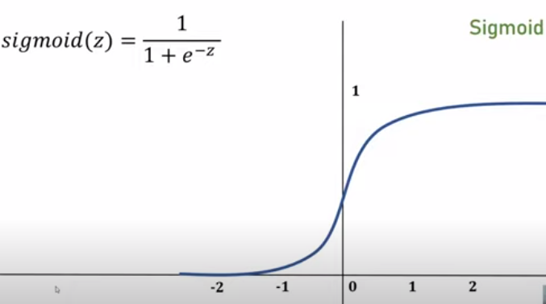
008 Activation Function
https://www.youtube.com/watch?v=icZItWxw7AI&list=PLeo1K3hjS3uu7CxAacxVndI4bE_o3BDtO&index=8
Activation Function (6:29-6:50/16:28)
Sigmoid is used for prediction with float (between 0 to 1) instead of integer (0 or 1).

Slide 13
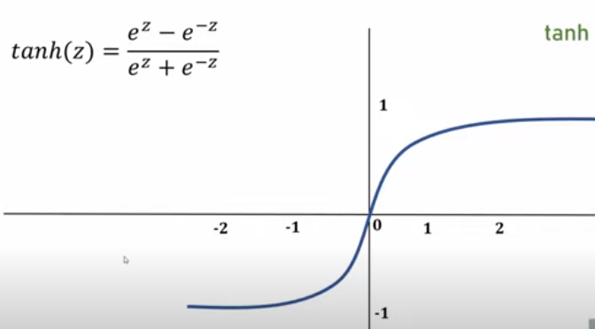
008 Activation Function
https://www.youtube.com/watch?v=icZItWxw7AI&list=PLeo1K3hjS3uu7CxAacxVndI4bE_o3BDtO&index=8
Activation Function (6:51-7:00/16:28)
There also have Tanh function for decision for float conversion.

Slide 14
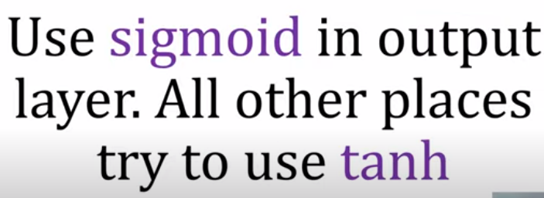
008 Activation Function
https://www.youtube.com/watch?v=icZItWxw7AI&list=PLeo1K3hjS3uu7CxAacxVndI4bE_o3BDtO&index=8
Activation Function (7:01-7:07/16:28)
At the final output layer, we use Sigmoid (or Softmax) for probability distribution and argmax to find the index of element with max probability.
For all other (hidden) layers, we use ReLU function (instead of tanh or sigmoid).
Why? We will next.
ReLU, we will see next.

Slide 15
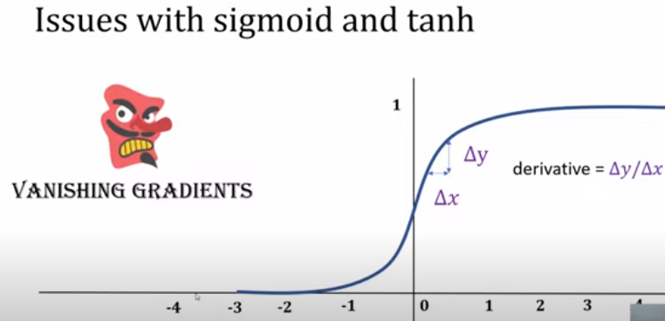
008 Activation Function
https://www.youtube.com/watch?v=icZItWxw7AI&list=PLeo1K3hjS3uu7CxAacxVndI4bE_o3BDtO&index=8
Activation Function (7:30-9:50/16:28)
Take derivative vanish problem in Sigmoid and tanh.
We have Vanish Gradient problem in Sigmoid and tanh.
We need easier way to handle Vanish Gradient.
What is “Vanish Gradient”?
1. Gradient: multiplication of sequences of partial derivative.
2. Vanish Gradient: Just one of the partial derivative is zero causes result of multiplication become zero.

Slide 16
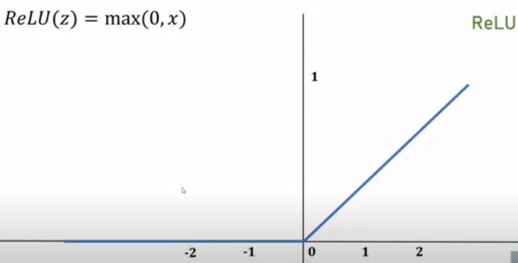
008 Activation Function
https://www.youtube.com/watch?v=icZItWxw7AI&list=PLeo1K3hjS3uu7CxAacxVndI4bE_o3BDtO&index=8
Activation Function (9:50-10:20/16:28)
ReLU is very popular and easy.
Question:
How ReLU handle to handle “Vanish Gradient”?

Slide 17
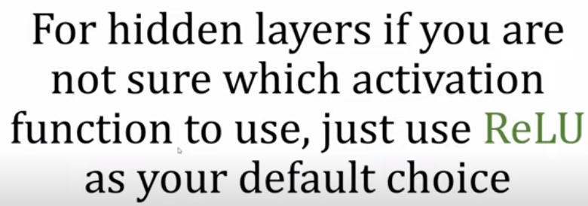
008 Activation Function
https://www.youtube.com/watch?v=icZItWxw7AI&list=PLeo1K3hjS3uu7CxAacxVndI4bE_o3BDtO&index=8
Activation Function (10:23-11:08/16:28)
For hidden layer, we use ReLU instead of Tanh.
We will see how ReLU handle “Vanish Gradient” problem.

Slide 18
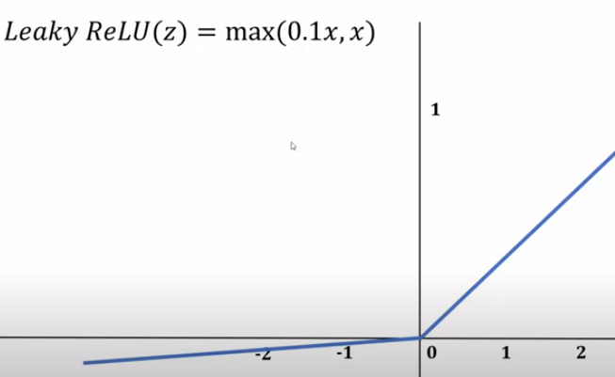
008 Activation Function
https://www.youtube.com/watch?v=icZItWxw7AI&list=PLeo1K3hjS3uu7CxAacxVndI4bE_o3BDtO&index=8
Activation Function (11:10-11:20/16:28)
When x close to 0, it is called Leaky ReLU.
There is a Leaky ReLU, instead of max (0, x), we use max (0.1*x, x)
Leaky ReLU

Slide 19
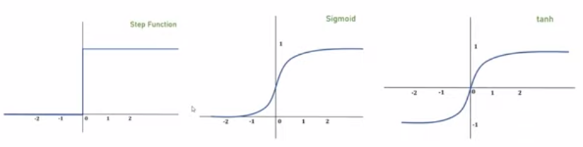
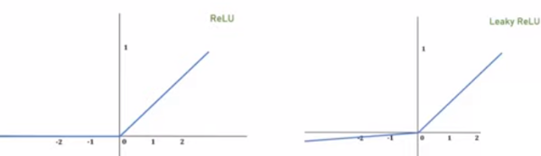
008 Activation Function
https://www.youtube.com/watch?v=icZItWxw7AI&list=PLeo1K3hjS3uu7CxAacxVndI4bE_o3BDtO&index=8
Activation Function (11:30-12:00/16:28)
Below are all the activation function. They are good to use.

Slide 20
008.1 Activation Function Coding

Slide 21
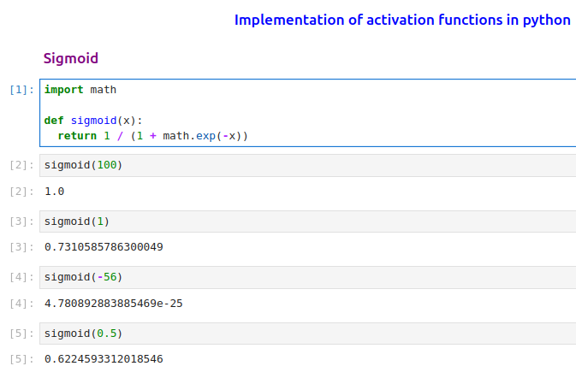
008.1 Activation Function Coding
https://www.youtube.com/watch?v=icZItWxw7AI&list=PLeo1K3hjS3uu7CxAacxVndI4bE_o3BDtO&index=8
Activation Function Coding (12:11-12:30/16:28)
sigmoid

Slide 22
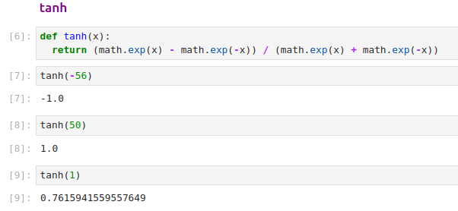
008.1 Activation Function Coding
https://www.youtube.com/watch?v=icZItWxw7AI&list=PLeo1K3hjS3uu7CxAacxVndI4bE_o3BDtO&index=8
Activation Function Coding (13:00-13:30/16:28)
tanh

Slide 23
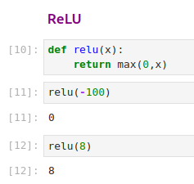
008.1 Activation Function Coding
https://www.youtube.com/watch?v=icZItWxw7AI&list=PLeo1K3hjS3uu7CxAacxVndI4bE_o3BDtO&index=8
Activation Function Coding (14:00-14:30/16:28)
ReLU

Slide 24
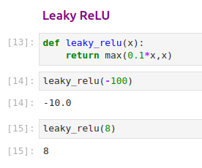
008.1 Activation Function Coding
https://www.youtube.com/watch?v=icZItWxw7AI&list=PLeo1K3hjS3uu7CxAacxVndI4bE_o3BDtO&index=8
Activation Function Coding (15:00-16:28/16:28)
Leaky ReLU

Slide 25
End

