Slide 1

20.00 W09: Review
Peter H. Chen

Slide 2

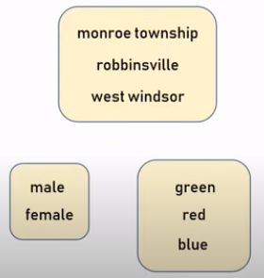
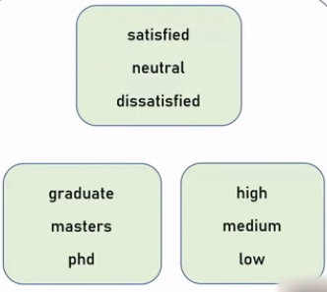
20.00 Categorical
https://www.youtube.com/watch?v=9yl6-HEY7_s&list=PLeo1K3hjS3uvCeTYTeyfe0-rN5r8zn9rw&index=6
Categorical (1:39-1:41/21:34)
These text variables below are called the “Categorical Variables”.
The township name are called “Nominal” [名义上; 名目上(めいもくじょう)] variable.
The categorical variables have two types:
1. Nominal: They don’t have any numeric order in between or any order relationship between each other: For example, township name, gender (male/female), colors names.
2. Ordinal (序数/じょすう): These can be order numerically.
The township names are nominal categorical variables, the simple integer encoding will not work. We need “One-hot-encoding” for nominal categorical variables.
Nominal
Ordinal

Slide 3
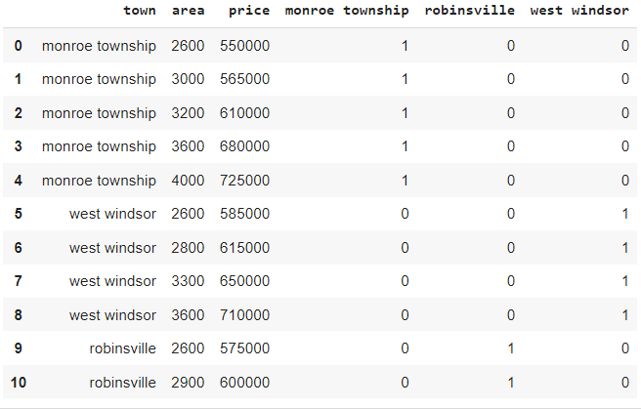
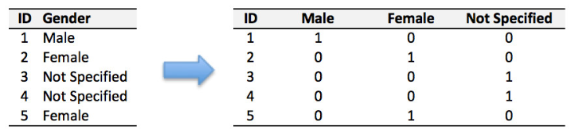
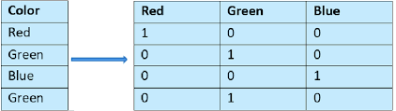
20.00 Categorical
https://www.youtube.com/watch?v=9yl6-HEY7_s&list=PLeo1K3hjS3uvCeTYTeyfe0-rN5r8zn9rw&index=6
Categorical (1:51-3:00/21:34)
Below are the one-hot-encoding examples:
1. township
2. gender
3. colors
1
Question:
When should we need the One Hot Encoding?
1. One-Hot encoding technique is used when the features are nominal (Text data which do not have any order or relationship between the data).
2. In one hot encoding, for every categorical feature, a new variable is created.
3. Categorical features are mapped with a binary variable containing either 0 or 1.
2
3

Slide 4
20.01 Confusion Matrix

Slide 5
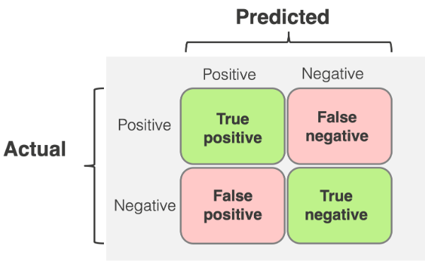
19 Introduction to Confusion Matrix
https://www.youtube.com/watch?v=-dsoGHvk7II
Introduction to Confusion Matrix (0:11-0:30/25:12)
What is Confusion Matrix?
Confusion matrix is 2×2 for binary classification with Actual (Fact) values (1/0) on vertical axis and Predicted (Model Prediction) with values (positive/negative) on horizontal axis.
(Model Prediction)
(1)
(0)
(1)
(Fact)
(0)

Slide 6
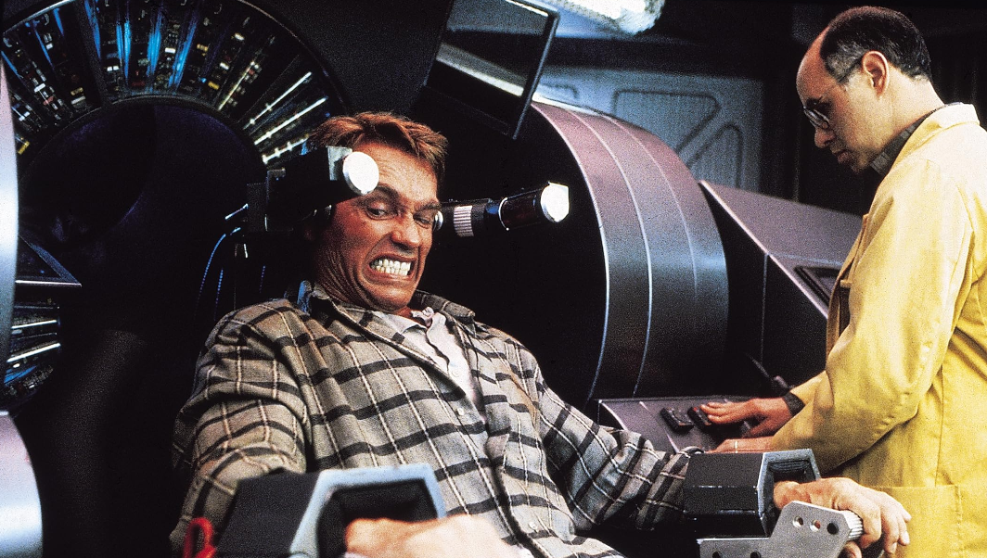


19 Introduction to Confusion Matrix
https://www.youtube.com/watch?v=-dsoGHvk7II
Introduction to Confusion Matrix (0:31-1:00/24:11)
What is difference of Recall (Facts: True or False) and Precision (Prediction: Positive or Negative)?
1. Recall (Actual Fact: True/False): True or False are the Actual Facts labeled by human being. True or False are the facts in recall (memory). There are two famous recall (memory) movies: US Hollywood movie “Total Recall (1990)” by Arnold Schwarzenegger and the India Bollywood movie “Ghajini (2008)” by Aamir Khan. Both movies try to find the facts (True or False) in their “recall (memory)”.
2. Precision (Prediction: Positive/Negative): Precision means how good of predictions by the model. The Hollywood movie “Minority Report (2002)” by Tom Cruise. The computer model predict crime people and kill them. The positive/negative prediction may be incorrect.
Recall (Fact):
Total Recall
Recall (Fact):
Ghajini
Precision (Model Prediction):
Minority Report

Slide 7
19.01 Convert Table into Confusion Matrix
https://www.youtube.com/watch?v=-dsoGHvk7II
Convert Table into Confusion Matrix (1:01-01:30/24:11)
We will be discussing Confusion Matrix, TPR (True Positive Rate), FPR (False Positive Rate), TNR (True Negative Rate), and FNR (False Negative Rate).
First, if we want to see the accuracy of Model, we need the concept of Confusion Matrix.
Suppose:
1. True output (Target Label) is y and
2. Model Prediction output is ŷ.
3. We have the y and ŷ results as below table.
How to find the accuracy of Model?
y (fact, human being target label) | ŷ (Precision, Model prediction, positive (1), negative (0)) | Result
1 | 1 | True Positive
1 | 1 | True Positive
0 | 1 | False Positive
1 | 0 | False negative
1 | 1 | True Positive
0 | 0 | True negative

Slide 8
19.01 Convert Table into Confusion Matrix
https://www.youtube.com/watch?v=-dsoGHvk7II
Convert Table into Confusion Matrix (1:46-04:00/24:11)
From the left table, we create the right confusion Matrix:
Question a: From the left table, how many Actual Value (y) = 1 and model Prediction (ŷ ) = 1?
Answer: 3
Question b: From the left table, how many Actual Value (y) = 1 and model prediction (ŷ ) = 0?
Answer: 1
Question c: From the left table, how many Actual Value (y) = 0 and model prediction (ŷ ) = 1?
Answer: 1
Question d: From the left table, how many Actual Value (y) = 0 and model Prediction (ŷ ) = 0
Answer: 1
Target Label (Actual Value) Output, y | Model Prediction Output, ŷ
1 | 1
1 | 1
0 | 1
1 | 0
1 | 1
Confusion Matrix for two class labels
y |  | Model Prediction ( ŷ)
 |  | 1 | 0
Actual Value (y) | 1 | 3 | 1
 | 0 | 1 | 0

Slide 9
19.02 Confusion Matrix in Notation
https://www.youtube.com/watch?v=-dsoGHvk7II
Confusion Matrix in Notation (4:01-07:00/24:11)
We use Notation (TP, FP, FN, and TN) to represent the numbers in the Confusion Matrix.
How to convert the number based Confusion Matrix into Notation based Confusion Matrix?
1. For prediction notation, we use
1.1 Prediction value 1 → P
1.2 Prediction value 0 → N.
2. For the actual notation, we need to match Actual value (0 or 1) with Model Prediction (0 or 1):
2.1 1 ↔ 1 → T (True)
2.2 1 ↔ 0 → F (False)
2.3 0 ↔ 0 → T (True)
2.4 0 ↔ 1 → F (False)
3. Then, we complete the number to notation conversion.
Confusion Matrix with Notation (FP, FN, FP, TN)
Confusion Matrix for two class labels
 |  | Model Prediction ( ŷ)
 |  | 1 | 0
Actual Value (y) | 1 | 3 | 1
 | 0 | 1 | 0
 |  | Model Prediction ( ŷ)
 |  | 1 | 0
Actual Value (y) | 1 | TP | FN
 | 0 | FP | TN

Slide 10
End

