Slide 1

10 Matrix
Peter H. Chen

Slide 2
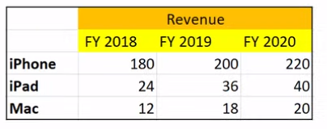
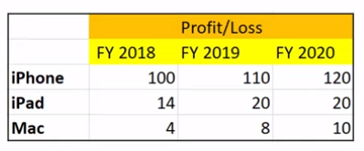
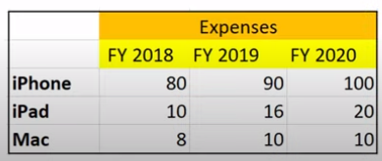
10 Matrix
https://www.youtube.com/watch?v=Wibxjrxf5ko&list=PLeo1K3hjS3uu7CxAacxVndI4bE_o3BDtO&index=10
Matrix (0:00-2:00/11:41)
Neural network training uses matrix inner dot product, matrix multiplication, etc.
Below, we have three tables: Revenue, Expenses, and Profit/Loss of Apple Company.
Given Revenue from Expense, how to get Profit/Loss table?
They are very simple mathematical calculations.

Slide 3
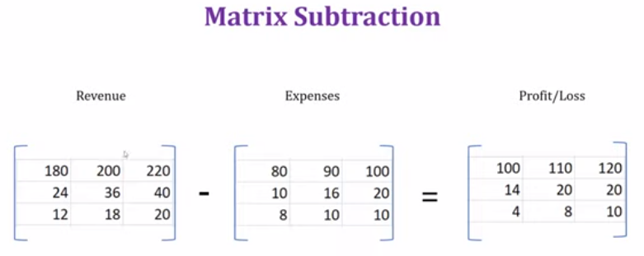
10 Matrix
https://www.youtube.com/watch?v=Wibxjrxf5ko&list=PLeo1K3hjS3uu7CxAacxVndI4bE_o3BDtO&index=10
Matrix (2:21-2:30/11:41)
We subtract Revenue from Expense, we have Profit/Loss table.
This is called Matrix subtraction.

Slide 4
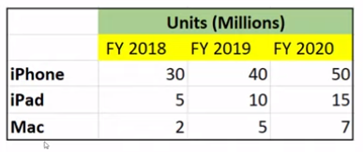

10 Matrix
https://www.youtube.com/watch?v=Wibxjrxf5ko&list=PLeo1K3hjS3uu7CxAacxVndI4bE_o3BDtO&index=10
Matrix (2:51-3:30/11:41)
Another example:
Now, we want to find out how much of “Total sale of iPhone”.

Slide 5
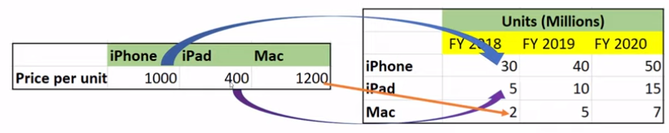
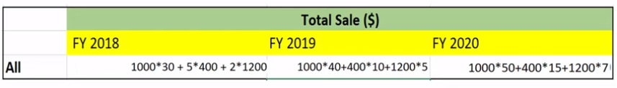
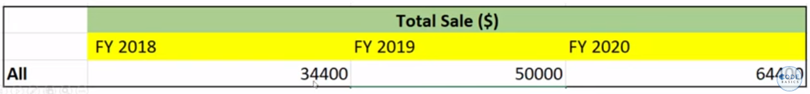
10 Matrix
https://www.youtube.com/watch?v=Wibxjrxf5ko&list=PLeo1K3hjS3uu7CxAacxVndI4bE_o3BDtO&index=10
Matrix (3:31-4:00/11:41)
Another example:
Multiply the unit price to total number and sum together.
64400

Slide 6
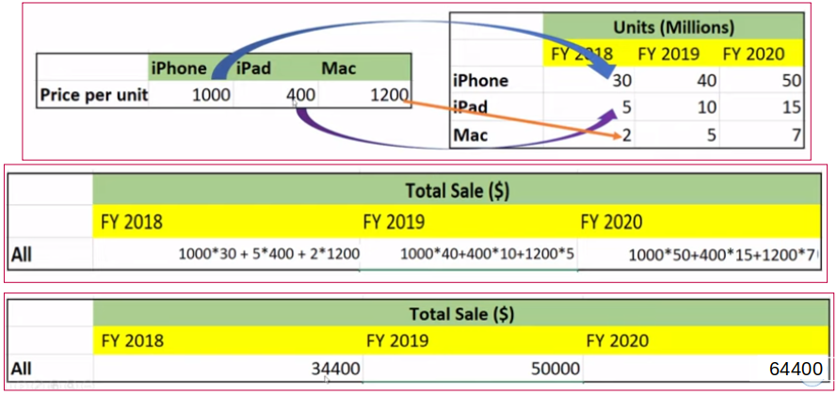
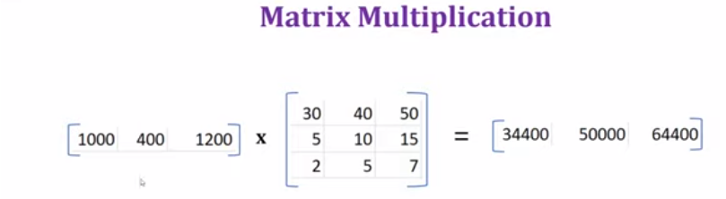
10 Matrix
https://www.youtube.com/watch?v=Wibxjrxf5ko&list=PLeo1K3hjS3uu7CxAacxVndI4bE_o3BDtO&index=10
Matrix (4:15-4:20/11:41)
Matrix Multiplication

Slide 7
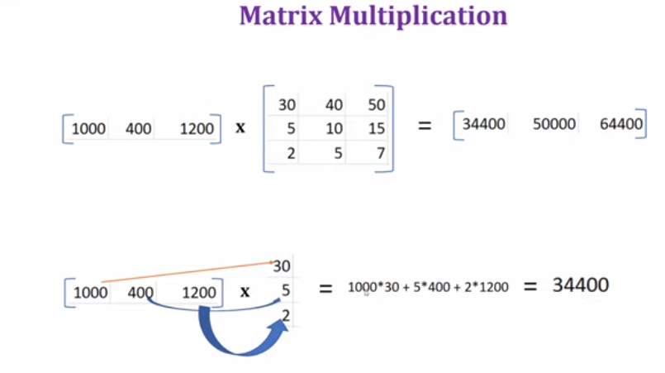
10 Matrix
https://www.youtube.com/watch?v=Wibxjrxf5ko&list=PLeo1K3hjS3uu7CxAacxVndI4bE_o3BDtO&index=10
Matrix (4:51-5:36/11:41)
We call this operation, dot product.

Slide 8
010.1 Matrix Coding

Slide 9
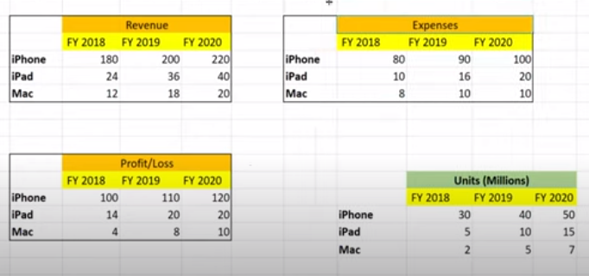
10 Matrix Coding
https://www.youtube.com/watch?v=Wibxjrxf5ko&list=PLeo1K3hjS3uu7CxAacxVndI4bE_o3BDtO&index=10
Matrix Coding (5:51-5:56/11:41)
Now, we do the matrix coding by numpy in Jupyter notebook.

Slide 10
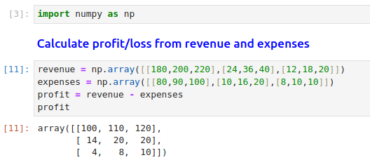
10 Matrix Coding
https://www.youtube.com/watch?v=Wibxjrxf5ko&list=PLeo1K3hjS3uu7CxAacxVndI4bE_o3BDtO&index=10
Matrix Coding (6:01-8:00/11:41)
Now, we do the matrix coding by numpy in Jupyter notebook.
[
[180, 200, 220],
[ 24, 36, 40],
[ 12, 18, 20]
]
[
[ 80, 90, 100],
[ 10, 16, 20],
[ 8, 10, 10]
]
[
[ 100, 110, 120],
[ 14, 20, 20],
[ 4, 8, 10]
]
-
=

Slide 11
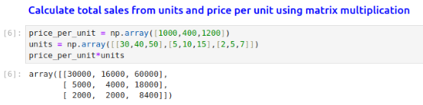
10 Matrix Coding
https://www.youtube.com/watch?v=Wibxjrxf5ko&list=PLeo1K3hjS3uu7CxAacxVndI4bE_o3BDtO&index=10
Matrix Coding (8:01-8:30/11:41)
Matrix Multiplication:
.
[
[30, 40, 50],
[ 5, 10, 15],
[ 2, 5, 7]
]
[1000, 400, 1200]
[1000 x 30, 400 x 40, 1200 x 50,
1000 x 5, 400 x 10, 1200 x 15,
1000 x 2, 400 x 5, 1200 x 7]
=
=
[30,000, 16,000, 60,000,
5,000, 4,000, 18,000,
2,000, 2,000, 8,400]

Slide 12

10 Matrix Coding
https://www.youtube.com/watch?v=Wibxjrxf5ko&list=PLeo1K3hjS3uu7CxAacxVndI4bE_o3BDtO&index=10
Matrix Coding (8:01-8:30/11:41)
Matrix dot product:
.
[
[30, 40, 50],
[ 5, 10, 15],
[ 2, 5, 7]
]
[1000, 400, 1200]
[1000 x 30 + 400 x 5 + 1200 x 2,
1000 x 40 + 400 x 10 + 1200 x 5,
1000 x 50 + 400 x 15 + 1200 x 7]
=
[30,000 + 2,000 + 2,400,
40,000 + 4,000 + 6,000
50,000 + 6,000 + 8,400
]
=
=
[34,400, 50,000, 64,400]

Slide 13
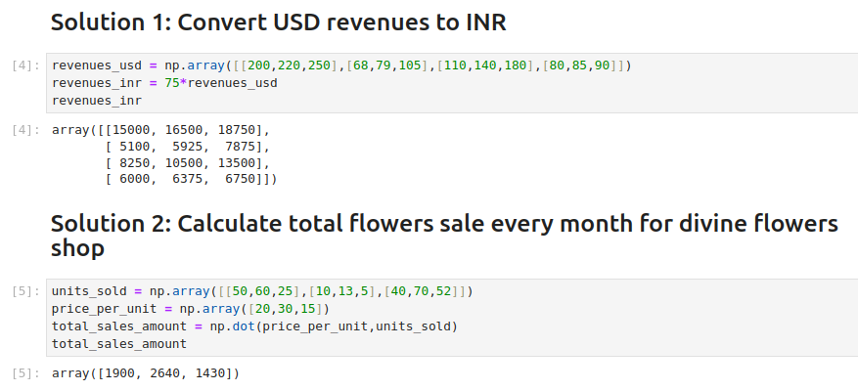
10 Matrix Coding
https://www.youtube.com/watch?v=Wibxjrxf5ko&list=PLeo1K3hjS3uu7CxAacxVndI4bE_o3BDtO&index=10
Matrix Coding (8:01-11:41/11:41)
Exercise:

Slide 14
End

