Slide 1
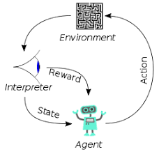
002 Why Deep Learning?
Peter H. Chen

Slide 2

002 Why Deep Learning?
https://www.youtube.com/watch?v=yfsTZbwgMSE&list=PLeo1K3hjS3uu7CxAacxVndI4bE_o3BDtO&index=2
Why Deep Learning is so Popular? (0:00-2:00/5:24)
What the deep learning become so popular now?
1. Data Grow: Because the Social Media (Facebook, Twitter, etc), Content rating (Reddit Blog, Amazon, etc), Encyclopedia Summarization (Chat GPT, Chat Bot, etc) in medical, law, etc. become so popular, the sentiment analysis for deep learning work better if the volume of data is higher.
That is the general principle behind the neural network for statistical application. We need the high volume of statistical data.

Slide 3
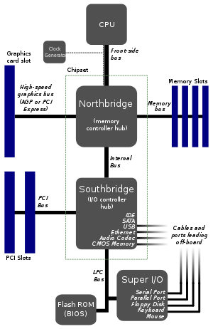
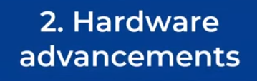
002 Why Deep Learning?
https://www.youtube.com/watch?v=yfsTZbwgMSE&list=PLeo1K3hjS3uu7CxAacxVndI4bE_o3BDtO&index=2
Why Deep Learning is so Popular? (2:01-2:30/5:24)
2. Hardware Advancement:
2.1 The computer (North Bridge system) with system speed and memory capacity improvement (e.g, from 500MB to 100-GB).
North Bridge and South Bridge Speed up

Slide 4
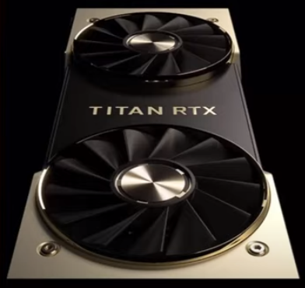
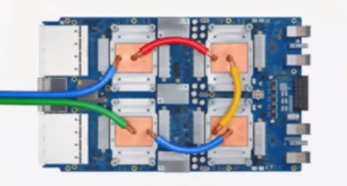
002 Why Deep Learning?
https://www.youtube.com/watch?v=yfsTZbwgMSE&list=PLeo1K3hjS3uu7CxAacxVndI4bE_o3BDtO&index=2
Why Deep Learning is so Popular? (2:31-3:00/5:24)
2. Hardware Advancement:
2.1 The computer (North Bridge system) with system speed and memory capacity improvement (e.g, from 500MB to 100-GB).
2.2 NVIDIA (South Bridge ASICs) 8-GPUs with 100GB VRAM.
2.3 Google TPU (Tensor/Tensorflow Processing Unit): ASICs based GPU. We can run jobs on local computer or in Cloud.
NVIDIA South Bridge GPU
Google ASICs TPU

Slide 5

002 Why Deep Learning?
https://www.youtube.com/watch?v=yfsTZbwgMSE&list=PLeo1K3hjS3uu7CxAacxVndI4bE_o3BDtO&index=2
Why Deep Learning is so Popular? (2:31-3:00/5:24)
3. Python and Open-source Ecosystem:
This is the most important reason.
Previously, I used C++ for neural network. It is hard to implement.
You need very strong foundation in computer science.
But Python is very easy to learn cross all the disciplines and all grades of elementary school.
Python is very easy for mathematical and statistics background, they can learn and write deep learning in a week. C++ is too hard to learn.
Meta PyTorch libraries and Google Tensorflow are framework: framework are collections of libraries (folder), packages (files), classes (object-based), methods (functions inside the class). These are all free.
We can cloud to save hardware cost.
If you are not in AI, ML, DL, DRL, LLM, Full Stack, etc, you are far behind the market.

Slide 6
End

