Slide 1

19.7 Python Confusion Matrix
Peter H. Chen

Slide 2
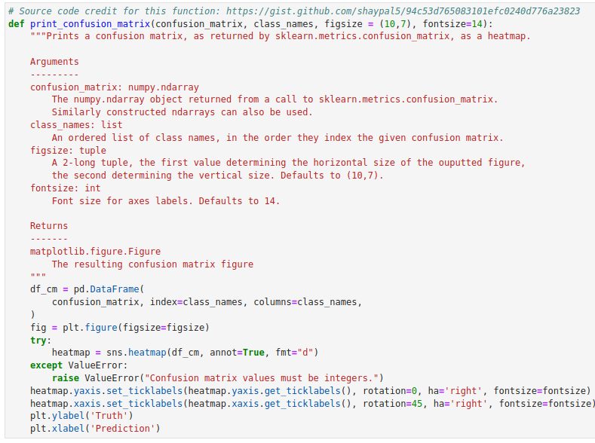
19.7 Python Confusion Matrix
https://www.youtube.com/watch?v=2osIZ-dSPGE&list=PLeo1K3hjS3uu7CxAacxVndI4bE_o3BDtO&index=19
Python Confusion Matrix (7:59-8:20/11:45)
We define print_confusion_matrix ():
Import libraries
Inputs:
1. confusion_matrix:
2. class_names: index given to confusion matrix:
3. fig-size:
4. font-size:

Slide 3
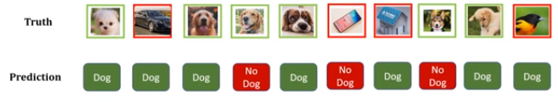
19.7 Python Confusion Matrix
https://www.youtube.com/watch?v=2osIZ-dSPGE&list=PLeo1K3hjS3uu7CxAacxVndI4bE_o3BDtO&index=19
Python Confusion Matrix (8:35-8:20/11:45)
What is confusion matrix?
We have
Truth array: [“Dog”, “Not a dog”, “Dog”, “Dog”, “Dog”, “No a dog”. “Not a dog”, ... ]
Prediction array = [“Dog”, “Dog”, “Dog”, “Not a dog”, “Dog”, ...]

Slide 4
19.7 Python Confusion Matrix
https://www.youtube.com/watch?v=2osIZ-dSPGE&list=PLeo1K3hjS3uu7CxAacxVndI4bE_o3BDtO&index=19
Python Confusion Matrix (8:35-8:50/11:45)
When we construct the confusion matrix, we need “truth” array and “prediction” array.
> cm = confusion_matrix (truth, prediction)

Slide 5
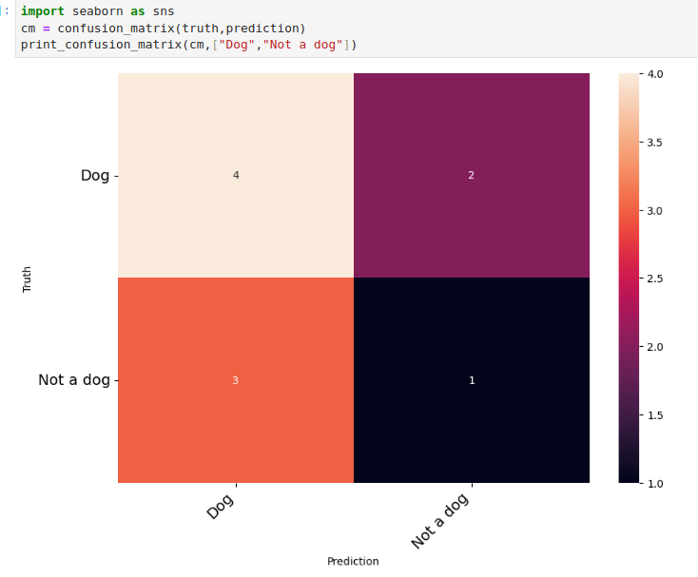
19.7 Python Confusion Matrix
https://www.youtube.com/watch?v=2osIZ-dSPGE&list=PLeo1K3hjS3uu7CxAacxVndI4bE_o3BDtO&index=19
Python Confusion Matrix (8:35-10:00/11:45)
> print_confusion_matrix (cm, {“Dog”, “Not a dog”].
4: True Positive: Truth os Dog = 4, Prediction is positive (Dog) is 4.
2: True Negative: Truth is Dog = 2, but prediction is negative = 2
3: False Negative: Truth is not a Dog, but prediction is a Dog.
1: False Negative: Truth is not a dog, prediction is not a Dog.
Diagonal are all correct prediction.
Off-diagonal are not the correct prediction.

Slide 6
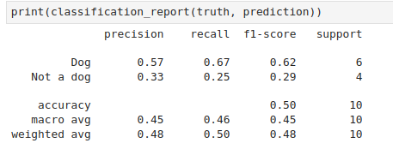
19.7 Python Confusion Matrix
https://www.youtube.com/watch?v=2osIZ-dSPGE&list=PLeo1K3hjS3uu7CxAacxVndI4bE_o3BDtO&index=19
Python Confusion Matrix (10:01-11:00/11:45)
> print_confusion_matrix (cm, {“Dog”, “Not a dog”].
Check the results of 19.01_Confusion_Matrix.ppt”.

Slide 7
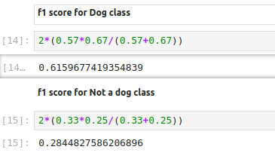
19.7 Python Confusion Matrix
https://www.youtube.com/watch?v=2osIZ-dSPGE&list=PLeo1K3hjS3uu7CxAacxVndI4bE_o3BDtO&index=19
Python Confusion Matrix (11:01-11:45/11:45)
> print_confusion_matrix (cm, {“Dog”, “Not a dog”].

Slide 8
End

