Slide 1

21.00 Review W10: Regularization
Peter H. Chen

Slide 2
21.00 Review W10: Regularization
https://www.youtube.com/watch?v=VqKq78PVO9g&list=PLeo1K3hjS3uvCeTYTeyfe0-rN5r8zn9rw&index=18
Regularization (0:00-0:10/19:20)
Overfitting in
1. Statistical/math equation based Machine Learning and
2. Neural Network very common.
We review the L1 and L2 Regularization to solve the overfit problem in Statistical Machine Learning.

Slide 3
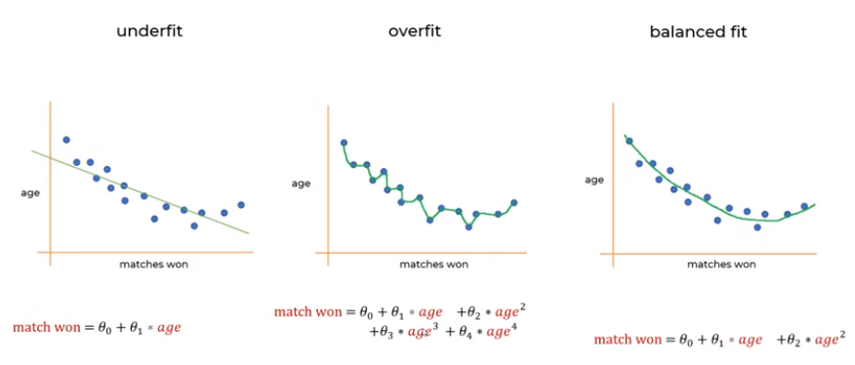
21.00 Review W10: Regularization
https://www.youtube.com/watch?v=VqKq78PVO9g&list=PLeo1K3hjS3uvCeTYTeyfe0-rN5r8zn9rw&index=18
Regularization (0:51-1:30/19:20)
We have statistical (Math Equation based) machine learning model
1. Underfit
2. Overfit: The polynomial degrees of age are too much.
3. Balanced fit (Optimal fit).

Slide 4
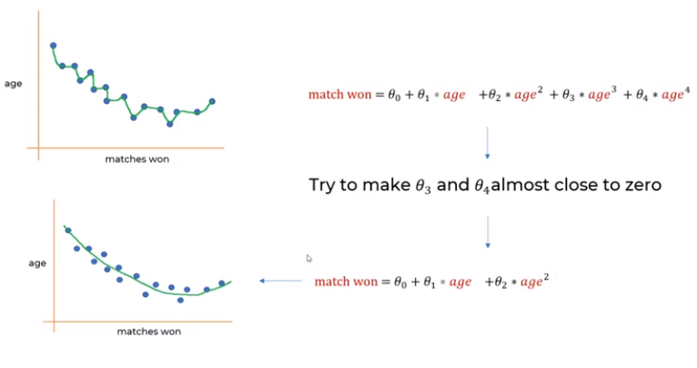
21.00 Review W10: Regularizatio
https://www.youtube.com/watch?v=VqKq78PVO9g&list=PLeo1K3hjS3uvCeTYTeyfe0-rN5r8zn9rw&index=18
Regularization (1:31-4:30/19:20)
How do we get the optimal fit from overfit?
How to make coefficients of higher order of degree (3 and 4) to zero?

Slide 5
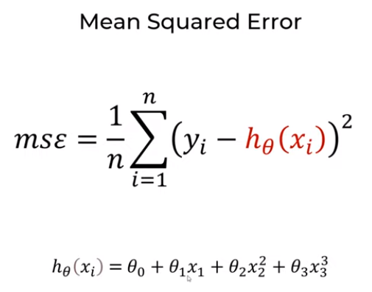
21.00 Review W10: Regularization
https://www.youtube.com/watch?v=VqKq78PVO9g&list=PLeo1K3hjS3uvCeTYTeyfe0-rN5r8zn9rw&index=18
Regularization (4:31-5:30/19:20)
We want to minimize the error.

Slide 6
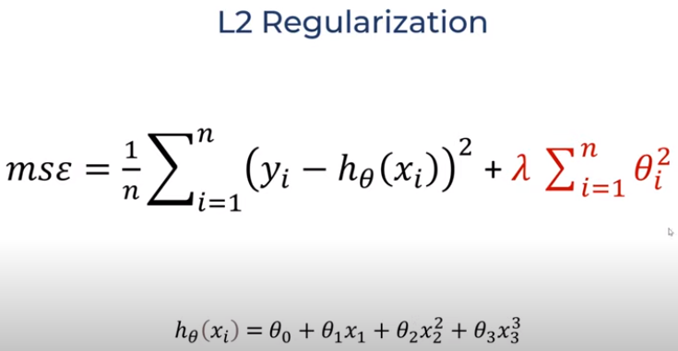
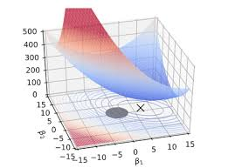
21.00 Review W10: Regularization
https://www.youtube.com/watch?v=VqKq78PVO9g&list=PLeo1K3hjS3uvCeTYTeyfe0-rN5r8zn9rw&index=18
Regularization (5:31-6:30/19:20)
L2 (Least Square)/Ridge Regularization: We add weight terms to minimize the values.
The author (Hoerl and Kennard om 1970) plots of quadratic functions often look like ridges.
If the coefficients are small, add extra term has no impact to MSE values. We can remove that coefficients from the Regressional Model equation
L1 (Absolute Value) Regularization: LASSO (Least Absolute Shrinkage and Selection Operator) Regularization.
(Ridge Regularization)

Slide 7
21.01 Read Data

Slide 8
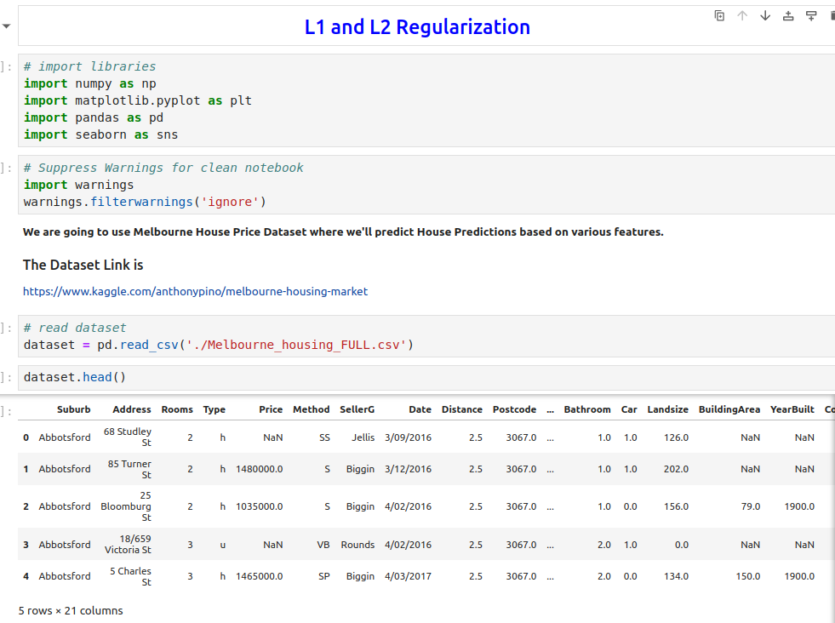

21.01 Read Data
https://www.youtube.com/watch?v=VqKq78PVO9g&list=PLeo1K3hjS3uvCeTYTeyfe0-rN5r8zn9rw&index=18
Read Data (6:31-8:30/19:20)
Read the Melbourne house information.

Slide 9
21.02 Cleanup Data

Slide 10
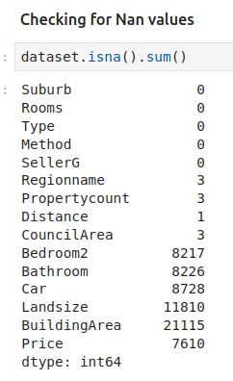
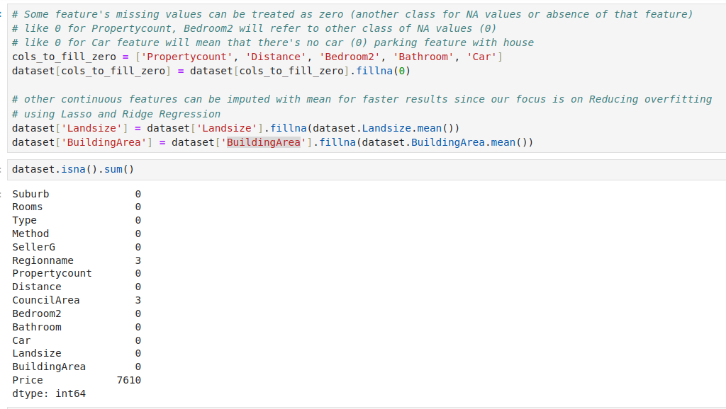
21.02 Cleanup Data
https://www.youtube.com/watch?v=VqKq78PVO9g&list=PLeo1K3hjS3uvCeTYTeyfe0-rN5r8zn9rw&index=18
Cleanup Data (8:31-10:30/19:20)
1. Set NaN to zero:
1.1 Propertycount and Bedroom2 = 0 means NA (Not-Available) class
1.2 Car = 0 means no Car parking.
2. Landsize and BuildingArea: take average
3. Remove rows (Council Area and Price) with NaN

Slide 11
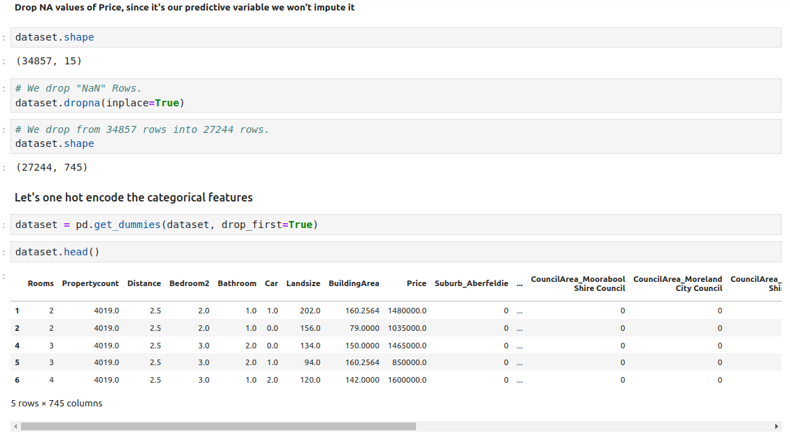
21.02 Cleanup Data
https://www.youtube.com/watch?v=VqKq78PVO9g&list=PLeo1K3hjS3uvCeTYTeyfe0-rN5r8zn9rw&index=18
Cleanup Data (10:31-11:30/19:20)

Slide 12
21.03 Dataset into Train and Test

Slide 13
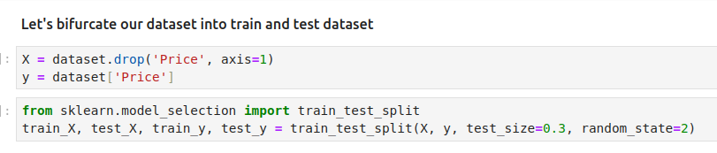
21.03 Dataset into Train and Test
https://www.youtube.com/watch?v=VqKq78PVO9g&list=PLeo1K3hjS3uvCeTYTeyfe0-rN5r8zn9rw&index=18
Dataset into Train and Test (11:31-12:30/19:20)
Split dataset into Training and Test dataset.

Slide 14
21.04 Underfit: Linear Regression

Slide 15
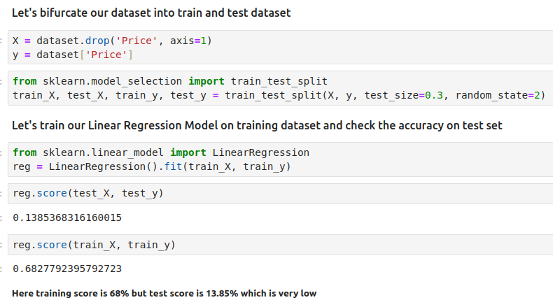
21.04 Underfit: Linear Regression
https://www.youtube.com/watch?v=VqKq78PVO9g&list=PLeo1K3hjS3uvCeTYTeyfe0-rN5r8zn9rw&index=18
Underfit: Linear Regression (12:31-13:30/19:20)
Train Linear Regression Model.
Train is 68%
But test is 13.85%
Both are very low (underfit).

Slide 16
21.05 L2 (LASSO) Regularization

Slide 17
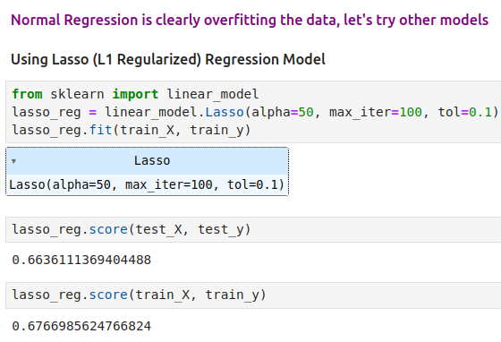
21.05 L2 (LASSO) Regularization
https://www.youtube.com/watch?v=VqKq78PVO9g&list=PLeo1K3hjS3uvCeTYTeyfe0-rN5r8zn9rw&index=18
L2 (LASSO) Regularization (13:31-15:30/19:20)
Train L2 (LASSO) Regularization Model.
Train is 66%
test improve to 67.6%.

Slide 18
21.06 L1 (Ridge) Regularization

Slide 19
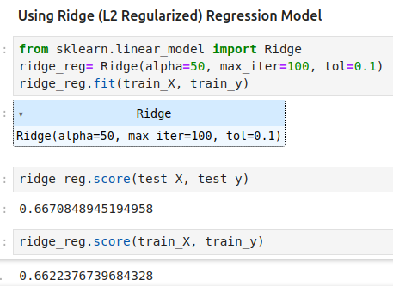
21.06 L1 (Ridge) Regularization
https://www.youtube.com/watch?v=VqKq78PVO9g&list=PLeo1K3hjS3uvCeTYTeyfe0-rN5r8zn9rw&index=18
L1 (Ridge) Regularization (15:31-19:20/19:20)
Train L1 (Ridge)Regression Model.
Train is 66%
test is 66.2%.

Slide 20
21.07 Summary

Slide 21
21.07 Summary
https://www.youtube.com/watch?v=VqKq78PVO9g&list=PLeo1K3hjS3uvCeTYTeyfe0-rN5r8zn9rw&index=18
Summary (15:31-19:20/19:20)
We see L2 (LASSO) and L1 (Ridge) Regularization improve the test accuracy.

Slide 22
End

