Slide 1

15 Chain Rule
Peter H. Chen

Slide 2
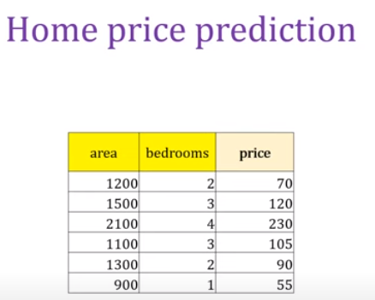
15 Chain Rule
https://www.youtube.com/watch?v=5ogmEkujoqE&list=PLeo1K3hjS3uu7CxAacxVndI4bE_o3BDtO&index=15
Chain Rule (0:00-0:30/14:05)
We discuss the chain rule of derivatives.
Chain rule is very important for machine learning, neural network, and deep learning.
We use Home Price Prediction as a simple example.
This is the simplest example for chain rule applied to deep learning and neural network problem.

Slide 3
15 Chain Rule
https://www.youtube.com/watch?v=5ogmEkujoqE&list=PLeo1K3hjS3uu7CxAacxVndI4bE_o3BDtO&index=15
Chain Rule (0:31-0:42/14:05)
What cause vanishing and exploding gradients in chain rule?
The chain rule has the multiplication of each individual derivatives.
1. If one of the derivatives is zero, the result of chain rule will be vanishing,
2. If one of the derivatives is overflow, the result of chain rule will exploding.
3. In reinforcement learning, We need to set the small number epsilon (e.g., 10E-5) to prevent vanishing and set the maximum number (e.g., 10E+5) to prevent exploding..

Slide 4
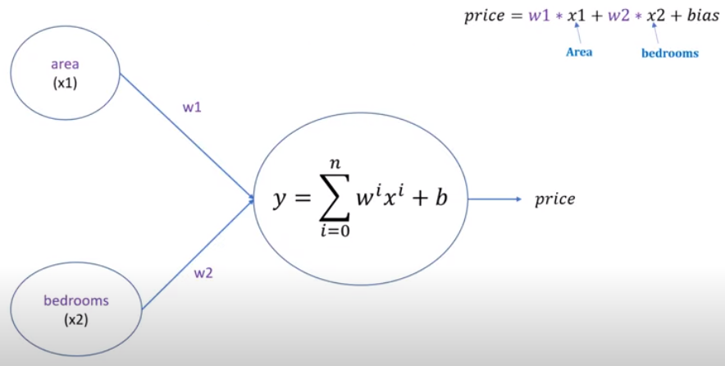
15 Chain Rule
https://www.youtube.com/watch?v=5ogmEkujoqE&list=PLeo1K3hjS3uu7CxAacxVndI4bE_o3BDtO&index=15
Chain Rule (0:43-0:51/14:05)
We have deep learning model with w1 * area + w2 * bedroom + bias.
Here, we have the model of area, bedrooms, and bias.
We want to predict the house price.

Slide 5
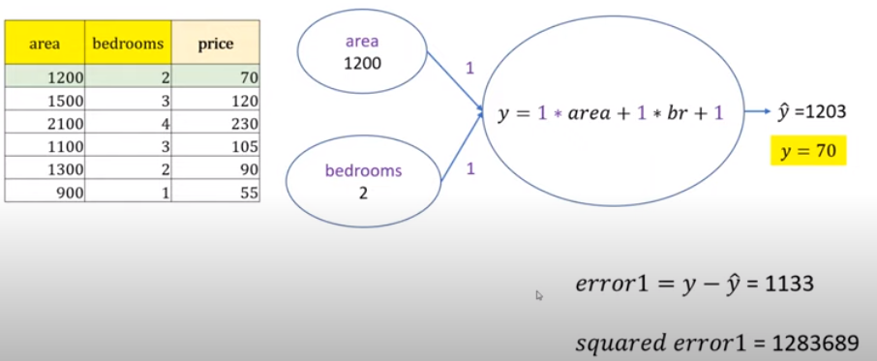
15 Chain Rule
https://www.youtube.com/watch?v=5ogmEkujoqE&list=PLeo1K3hjS3uu7CxAacxVndI4bE_o3BDtO&index=15
Chain Rule (0:52-2:15/14:05)
When we train the neural network, we use the table for database.
1. We initialize the weight and bias with some random values. Here, we initialize w1, w2, and bias into 1.
2. Pickup the first sample and train the neural network.
3. Calculate the error and squared error.

Slide 6
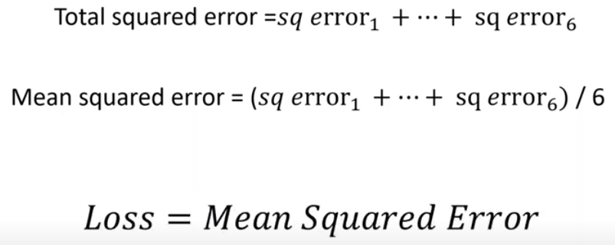
15 Chain Rule
https://www.youtube.com/watch?v=5ogmEkujoqE&list=PLeo1K3hjS3uu7CxAacxVndI4bE_o3BDtO&index=15
Chain Rule (2:17-2:40/14:05)
1. We sum of the squared error.
2. Take the MSE (Average of Squared Error). We call MSE is the Loss. This is the forward pass.
3. There is a forward pass and there is a backward pass.
4. In the forward pass, we get the value of loss.
5. Once you have MSE, you can do the back propagate and adjust your weights.

Slide 7
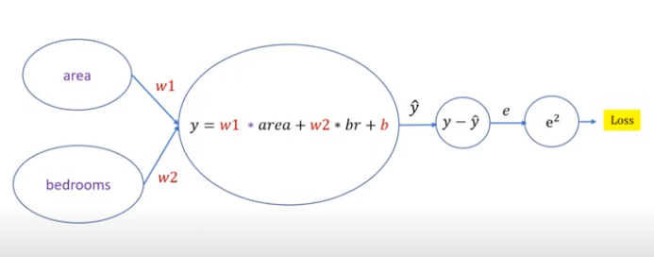
15 Chain Rule
https://www.youtube.com/watch?v=5ogmEkujoqE&list=PLeo1K3hjS3uu7CxAacxVndI4bE_o3BDtO&index=15
Chain Rule (2:49-3:05/14:05)
In the forward pass, we calculate the loss.
1. In the simplified architecture, we get the prediction ŷ.
2. W take difference error (e) between target y and prediction ŷ.
3. We square the error (e) and we get the loss.

Slide 8
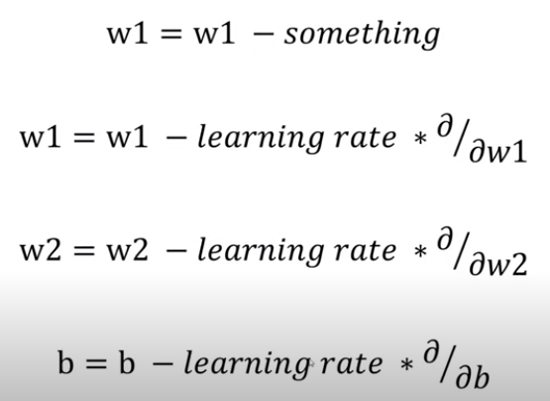
15 Chain Rule
https://www.youtube.com/watch?v=5ogmEkujoqE&list=PLeo1K3hjS3uu7CxAacxVndI4bE_o3BDtO&index=15
Chain Rule (3:06-3:40/14:05)
Once you have loss, we want to adjust the weight.
We want to subtract something from w1. We want to get the right weights for neural network.
We want to calculate the new weights and new bias.

Slide 9
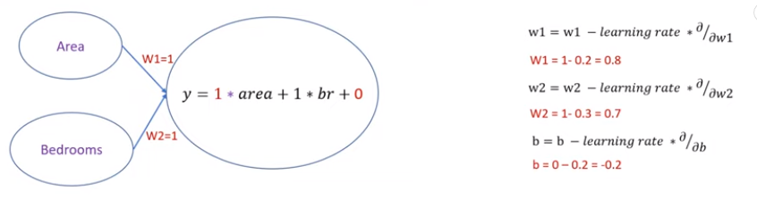
15 Chain Rule
https://www.youtube.com/watch?v=5ogmEkujoqE&list=PLeo1K3hjS3uu7CxAacxVndI4bE_o3BDtO&index=15
Chain Rule (3:50-4:10/14:05)
After we go through one epoch which is going through all the training samples, we get the new weights 0.8 and 0.7 and new bias -0.2.

Slide 10
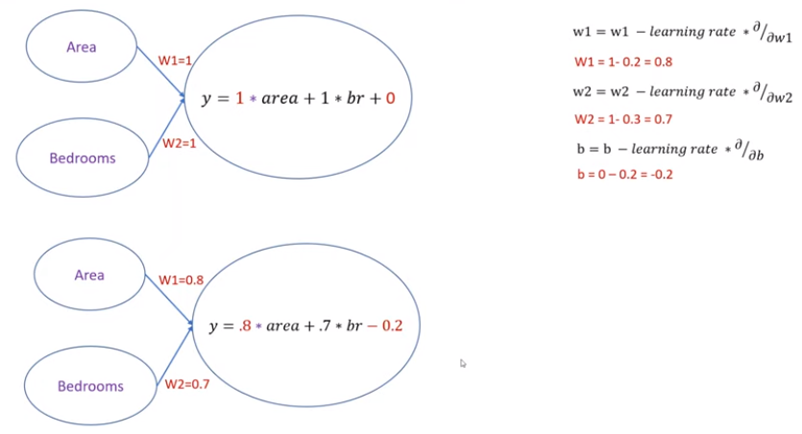
15 Chain Rule
https://www.youtube.com/watch?v=5ogmEkujoqE&list=PLeo1K3hjS3uu7CxAacxVndI4bE_o3BDtO&index=15
Chain Rule (4:11-4:20/14:05)
Then, we do another epoch with new weights and new bias.
We keep on doing this until we get the optimal weights.

Slide 11
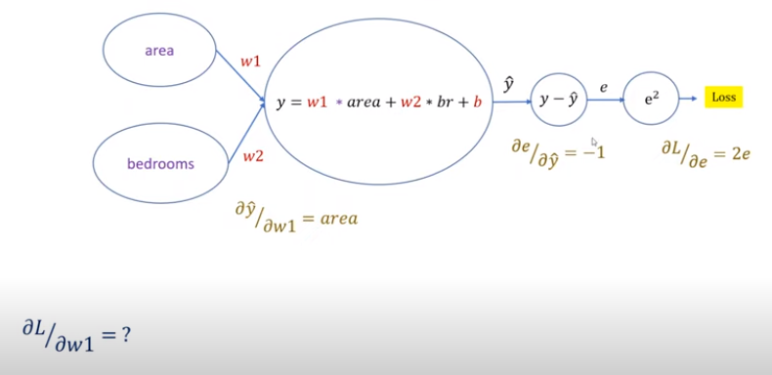
15 Chain Rule
https://www.youtube.com/watch?v=5ogmEkujoqE&list=PLeo1K3hjS3uu7CxAacxVndI4bE_o3BDtO&index=15
Chain Rule (4:31-5:50/14:05)
Go back to the generic architecture.
We take the loss and take a partial derivative of loss with respect to e. We have 2e.
The partial derivative of error with respect to y-hat (ŷ) is -1.
The partial derivative of y-hat (ŷ) respect to w1 is = area.
So, what is the partial derivative of Loss respect to w1?

Slide 12
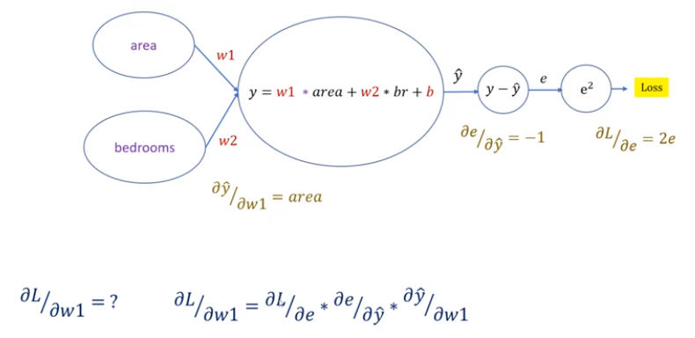
15 Chain Rule
https://www.youtube.com/watch?v=5ogmEkujoqE&list=PLeo1K3hjS3uu7CxAacxVndI4bE_o3BDtO&index=15
Chain Rule (5:55-7:40/14:05)
How do we want the partial derivative of Loss respect to w1?
We use chain rule to multiply each individual derivatives.

Slide 13
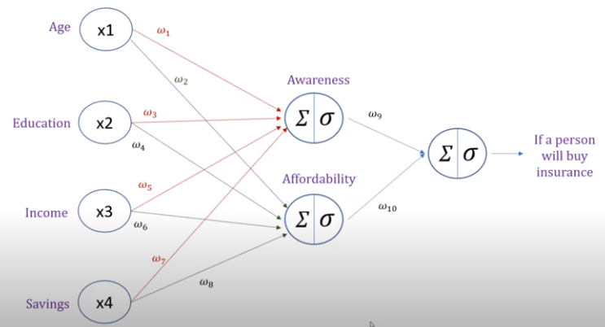
15 Chain Rule
https://www.youtube.com/watch?v=5ogmEkujoqE&list=PLeo1K3hjS3uu7CxAacxVndI4bE_o3BDtO&index=15
Chain Rule (7:47-8:50/14:05)
We might have more features (Age, Education, Income, Saving) as below.
We have two hidden neural networks, Awareness and Affordability. Some of weights maybe zero because there is no relationship between them.
Awareness may have no relation (weight is zero) with Age and Education.

Slide 14
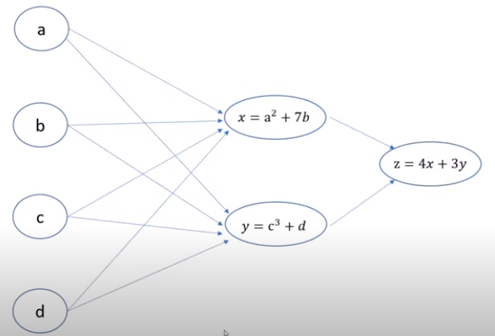
15 Chain Rule
https://www.youtube.com/watch?v=5ogmEkujoqE&list=PLeo1K3hjS3uu7CxAacxVndI4bE_o3BDtO&index=15
Chain Rule (8:52-10:00/14:05)
We can present the neural network into the general mathematics.
To simplify the explanation, we simplify the neurons (with linear function and activation) into mathematical equation as below.
Below diagram is called a computation graph.
The chain rule can be explained easily by the computation graph with mathematical equation.
Below, we have input a, b, c, d.
The neuron x has relationship with a and b but have no relationship with c and d.
The neuron y has relationship with c and d but have no relationship with a and b.

Slide 15
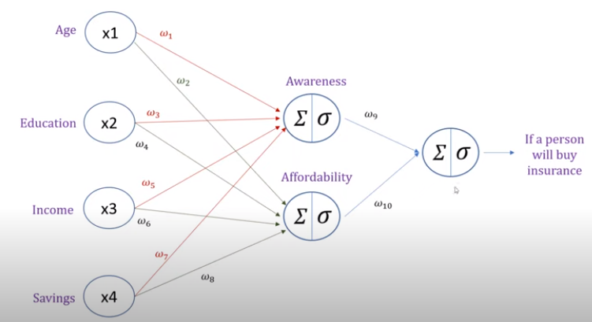
15 Chain Rule
https://www.youtube.com/watch?v=5ogmEkujoqE&list=PLeo1K3hjS3uu7CxAacxVndI4bE_o3BDtO&index=15
Chain Rule (10:03-10:40/14:05)
We put the parameters in dataset into the computation graph.
We buy insurance based on Awareness and Affordability.
If we change features X, how much change in the output neuron?

Slide 16
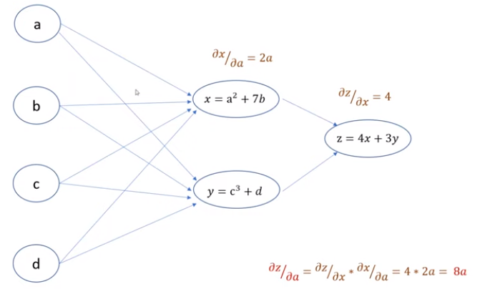
15 Chain Rule
https://www.youtube.com/watch?v=5ogmEkujoqE&list=PLeo1K3hjS3uu7CxAacxVndI4bE_o3BDtO&index=15
Chain Rule (11:02-11:40/14:05)
If I have a change in x, how much change in z?
The partial derivative of z with respect to x is 4.
The derivative of x with respect to a is 2a.
If we have change in a, how much change in z? We have 8*a.

Slide 17
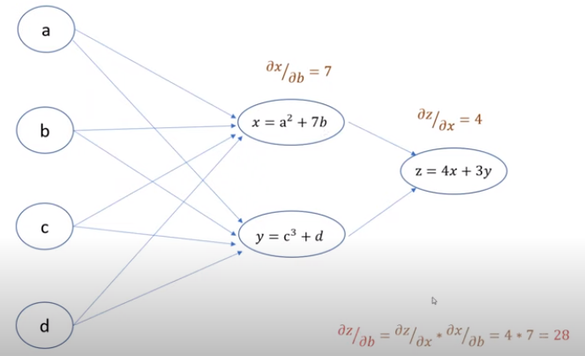
15 Chain Rule
https://www.youtube.com/watch?v=5ogmEkujoqE&list=PLeo1K3hjS3uu7CxAacxVndI4bE_o3BDtO&index=15
Chain Rule (12:39-14:05/14:05)
Same thing if I have a change in b, how much change in z?
The derivative of z with respect to z is 4.
The derivative of x with respect to b is 7.
If we have change in b, how much change in z? We have 4 * 7 = 28.

Slide 18
End

