Slide 1

17.16 BM Exercise/Solution
Peter H. Chen

Slide 2
17.16 Import TF/Version

Slide 3
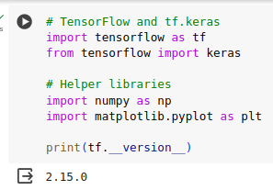
17.16 Import TF/Version
https://www.youtube.com/watch?v=YmDaqXMIoeY&list=PLeo1K3hjS3uu7CxAacxVndI4bE_o3BDtO&index=17
Import TF/Version (22:01-22:10/23:57)

Slide 4
17.17 Check CPU/GPU Device

Slide 5
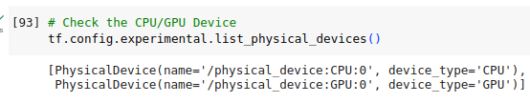
17.17 Check CPU/GPU Device
https://www.youtube.com/watch?v=YmDaqXMIoeY&list=PLeo1K3hjS3uu7CxAacxVndI4bE_o3BDtO&index=17
Check CPU/GPU Devices (22:01-22:10/23:57)

Slide 6
17.18 Load MNIST Fashion Dataset

Slide 7
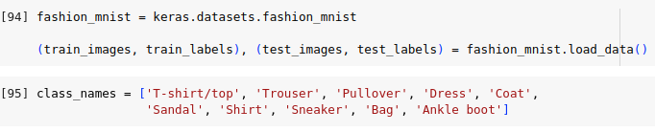
17.18 Load MNIST Fashion Dataset
https://www.youtube.com/watch?v=YmDaqXMIoeY&list=PLeo1K3hjS3uu7CxAacxVndI4bE_o3BDtO&index=17
Load MNIST Fashion Dataset (22:01-22:10/23:57)

Slide 8
17.19 Check Fashion Dataset

Slide 9
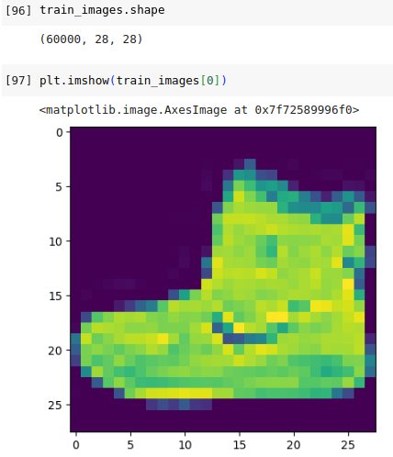
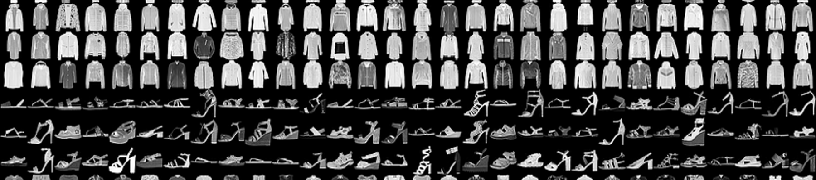
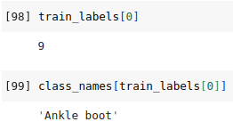
17.19 Check Fashion Dataset
https://www.youtube.com/watch?v=YmDaqXMIoeY&list=PLeo1K3hjS3uu7CxAacxVndI4bE_o3BDtO&index=17
Check Fashion Dataset (22:11-22:20/23:57)
Question: The original MNIST dataset is black and white (right side below). Why the display is color?
Answer: Because matplotlib imshow (…, cmap = “viridis”), here, “cmap” means “color map”, cmap uses default “viridis” to display. The Latin word “viridis” means “green”. You can set imshow (…, cmpa = “gray”) to display image in black and white.

Slide 10
17.20 Plot 5 Fashion Dataset

Slide 11

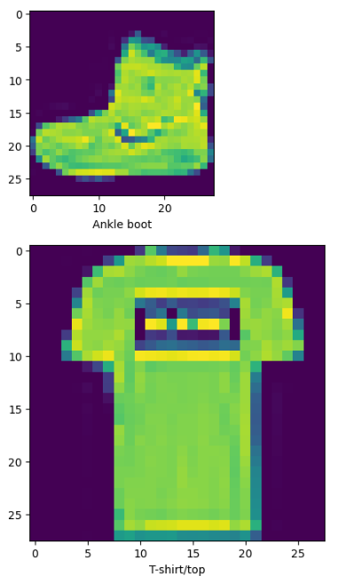
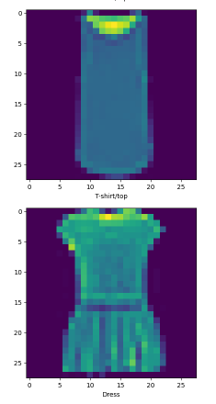
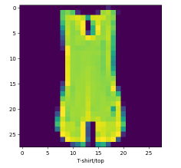
17.20 Plot Fashion Dataset
https://www.youtube.com/watch?v=YmDaqXMIoeY&list=PLeo1K3hjS3uu7CxAacxVndI4bE_o3BDtO&index=17
Plot 5 Fashion Dataset (22:21-22:30/23:57)

Slide 12

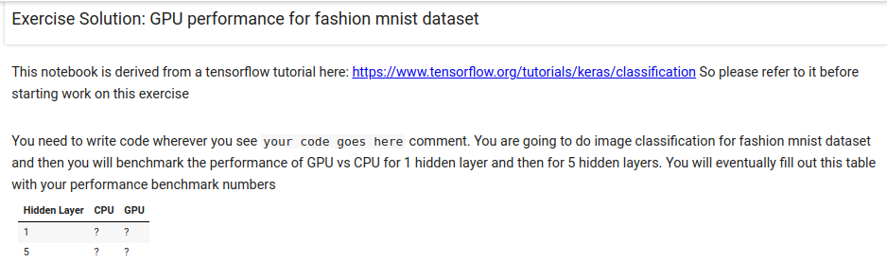
17.15 Exercise Solution
https://www.youtube.com/watch?v=YmDaqXMIoeY&list=PLeo1K3hjS3uu7CxAacxVndI4bE_o3BDtO&index=17
Exercise (21:37-22:00/23:57)
Below, we have exercise in the Benchmark code for colab for 5 epochs.
1. In stead of CIFAR-10, we use MNIST fashion.
2. Create 1 Hidden Layer
3. Create 5 Hidden Layers.

Slide 13
17.21 Scale Images

Slide 14
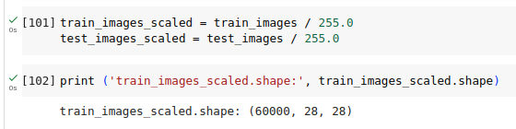
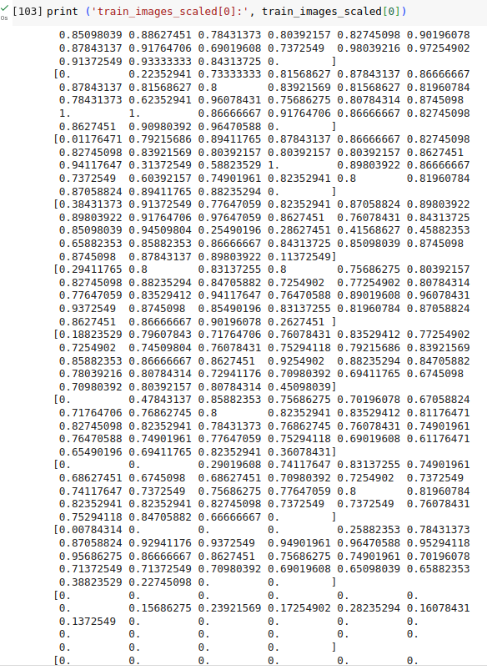
17.21 Scale Images
https://www.youtube.com/watch?v=YmDaqXMIoeY&list=PLeo1K3hjS3uu7CxAacxVndI4bE_o3BDtO&index=17
Scale Images (22:31-22:40/23:57)

Slide 15
17.22 Define Model

Slide 16
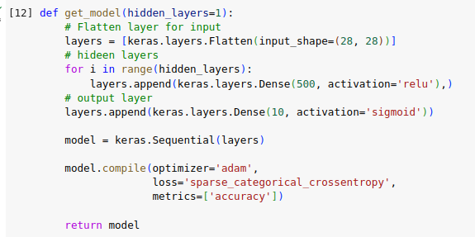
17.22 Define Model
https://www.youtube.com/watch?v=YmDaqXMIoeY&list=PLeo1K3hjS3uu7CxAacxVndI4bE_o3BDtO&index=17
Define Model (22:41-22:50/23:57)
We define layer 1 to 5 for the ANN (Artificial Neural Network).

Slide 17
17.23 Train Model: 1 Hidden Layer with 1 Epoch

Slide 18
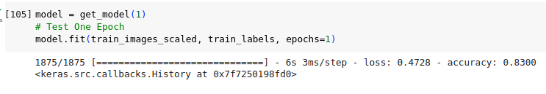
17.23 Train Model: 1 Hidden Layer with 1 Epoch
https://www.youtube.com/watch?v=YmDaqXMIoeY&list=PLeo1K3hjS3uu7CxAacxVndI4bE_o3BDtO&index=17
Train Model: 1 Hidden Layer with 1 Epoch (22:51-23:00/23:57)

Slide 19
17.24 Prediction: 1 Hidden Layer and 1 Epoch

Slide 20
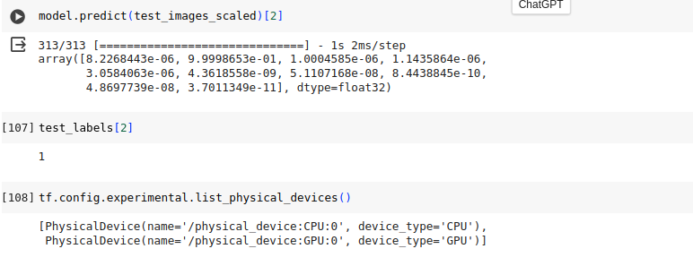
17.24 Prediction: 1 Hidden Layer and 1 Epoch
https://www.youtube.com/watch?v=YmDaqXMIoeY&list=PLeo1K3hjS3uu7CxAacxVndI4bE_o3BDtO&index=17
Prediction: 1 Hidden Layer with 1 Epoch (23:01-23:10/23:57)
Make sure the CPU/GPU devices are there.

Slide 21
17.24 Prediction: 1 Hidden Layer and 1 Epoch

Slide 22
17.24 Prediction: 1 Hidden Layer and 1 Epoch
https://www.youtube.com/watch?v=YmDaqXMIoeY&list=PLeo1K3hjS3uu7CxAacxVndI4bE_o3BDtO&index=17
Prediction: 1 Hidden Layer with 1 Epoch (23:11-23:20/23:57)

Slide 23
17.25 Benchmark: CPU, 1 Hidden Layer, and 5 Epochs

Slide 24
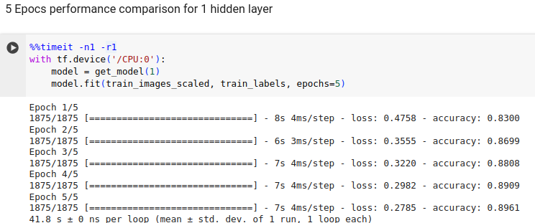
17.25 Benchmark: CPU, 1 Hidden Layer, and 5 Epochs
https://www.youtube.com/watch?v=YmDaqXMIoeY&list=PLeo1K3hjS3uu7CxAacxVndI4bE_o3BDtO&index=17
Benchmark: CPU, 1 Hidden Layer with 5 Epochs (23:21-23:30/23:57)

Slide 25
17.25 Benchmark: GPU, 1 Hidden Layer, and 5 Epochs

Slide 26
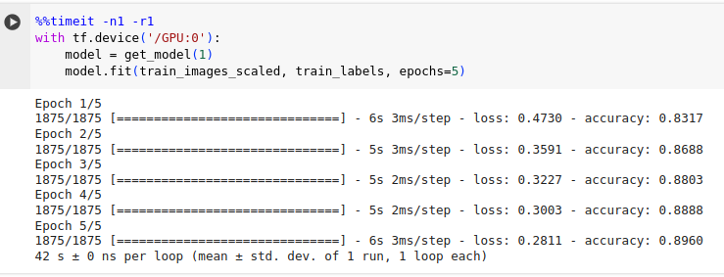
17.25 Benchmark: CPU, 1 Hidden Layer, and 5 Epochs
https://www.youtube.com/watch?v=YmDaqXMIoeY&list=PLeo1K3hjS3uu7CxAacxVndI4bE_o3BDtO&index=17
Benchmark: GPU, 1 Hidden Layer with 5 Epochs (23:31-23:40/23:57)

Slide 27
17.26 Benchmark: GPU, 5 Hidden Layer, and 5 Epochs

Slide 28
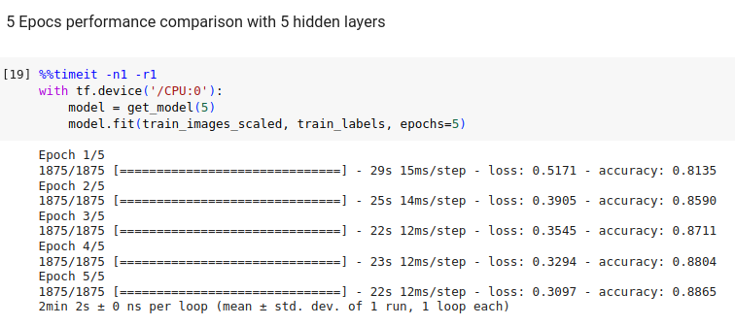
17.25 Benchmark: CPU, 5 Hidden Layer, and 5 Epochs
https://www.youtube.com/watch?v=YmDaqXMIoeY&list=PLeo1K3hjS3uu7CxAacxVndI4bE_o3BDtO&index=17
Benchmark: CPU, 5 Hidden Layer with 5 Epochs (23:41-23:50/23:57)

Slide 29
17.26 Benchmark: GPU, 5 Hidden Layer, and 5 Epochs

Slide 30
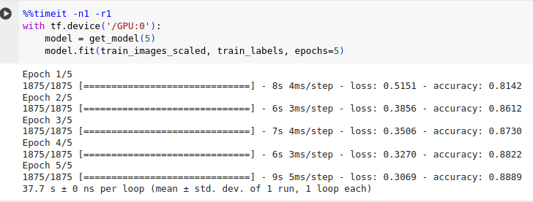
17.26 Benchmark: GPU, 5 Hidden Layer, and 5 Epochs
https://www.youtube.com/watch?v=YmDaqXMIoeY&list=PLeo1K3hjS3uu7CxAacxVndI4bE_o3BDtO&index=17
Benchmark: GPU, 5 Hidden Layer with 5 Epochs (23:51-23:55/23:57)

Slide 31
17.27 Benchmark: Exercise Summary

Slide 32
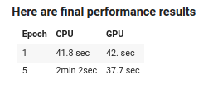
17.27 Benchmark: Exercise Summary
https://www.youtube.com/watch?v=YmDaqXMIoeY&list=PLeo1K3hjS3uu7CxAacxVndI4bE_o3BDtO&index=17
Benchmark: Exercise Summary (23:56-23:57/23:57)
Results

Slide 33
End

