Slide 1

47 BERT: Text Classification
Peter H. Chen

Slide 2
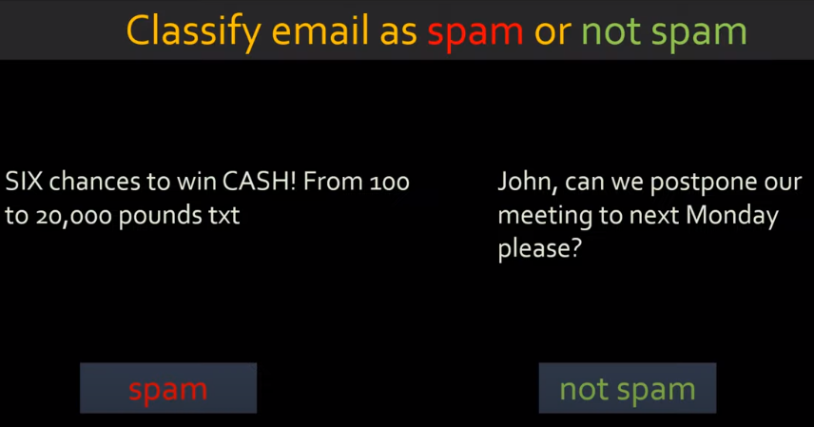
47 BERT: Text Classification
https://www.youtube.com/watch?v=hOCDJyZ6quA&list=PLeo1K3hjS3uu7CxAacxVndI4bE_o3BDtO&index=47
BERT: Text Classification (0:00-0:10/29:23)
We implement BERT for Text Classification.
We are going to use BERT to classify Spam or not spam of email.

Slide 3
47.1 BERT: Text Classification Theory

Slide 4
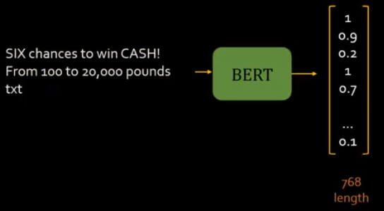
47.1 BERT: Text Classification Theory
https://www.youtube.com/watch?v=hOCDJyZ6quA&list=PLeo1K3hjS3uu7CxAacxVndI4bE_o3BDtO&index=47
BERT: Text Classification Theory (0:15-0:30/29:23)
When we input words of sentences into BERT, BERT will convert the whole email into an embedding vector.
The purpose of BERT is to generate embedding vector for entire sentences.

Slide 5
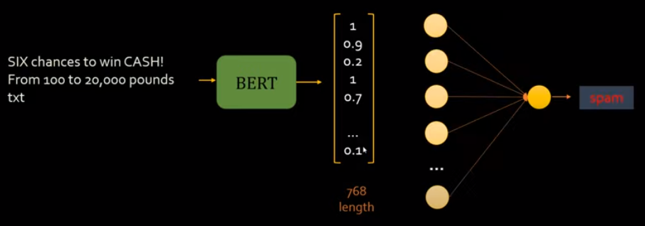
47.1 BERT: Text Classification Theory
https://www.youtube.com/watch?v=hOCDJyZ6quA&list=PLeo1K3hjS3uu7CxAacxVndI4bE_o3BDtO&index=47
BERT: Text Classification Theory (0:35-1:00/29:23)
The converted embedding vector are input into the neural network and do the training.
The length of embedding vector is 768.
Below is a simple one hidden layer of neuron with dropout to prevent the overfitting.
https://www.saltdatalabs.com/blog/bert-how-to-handle-long-documents#:~:text=The%20Problem%20with%20BERT&text=However%2C%20BERT%20can%20only%20take,much%20longer%20than%20512%20words.
It is very common that documents is longer than 768 words.
The “trimming the input sequence” into 512 words block is required.

Slide 6
47.1 BERT: Text Classification Theory
https://www.youtube.com/watch?v=hOCDJyZ6quA&list=PLeo1K3hjS3uu7CxAacxVndI4bE_o3BDtO&index=47
BERT: Text Classification Theory (1:01-1:03/29:23)
1. What size of BERT Embedding vector?
768-dimensional: These integers map into vectors using BERT's embedding matrix (which is initialized randomly and trained during pre-training) and is 768-dimensional.
The learned representation is this 768-dimensional vector for each subword in BERT's vocabulary.
2. Why embedding vector size is 768?
768 comes from the embedding of ViT (Vision Transform) used by OpenAI CLIP (Constraint Language-Image Pre-train).
In ViT, it transform the input image of 224 * 224 pixels, to patches of size 16 * 16 pixels. Therefore, when you embed (flatten and use an NLP) the patches with size 16 * 16 * 3 (RGB) = 768.

Slide 7
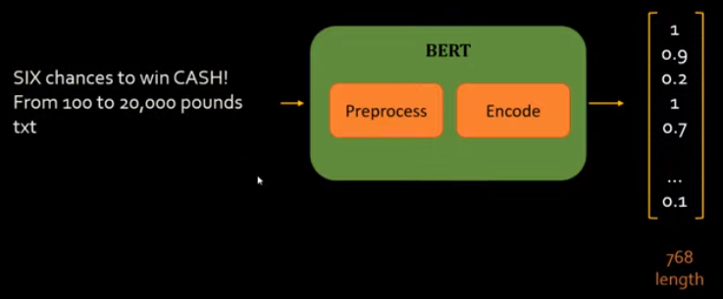
47.1 BERT: Text Classification Theory
https://www.youtube.com/watch?v=hOCDJyZ6quA&list=PLeo1K3hjS3uu7CxAacxVndI4bE_o3BDtO&index=47
BERT: Text Classification Theory (1:02-1:03/29:23)
The BERT includes two components: Preprocess (Google preprocess_text) and Encoder (Google bert model)

Slide 8
47.2 BERT: Text Classification Coding

Slide 9
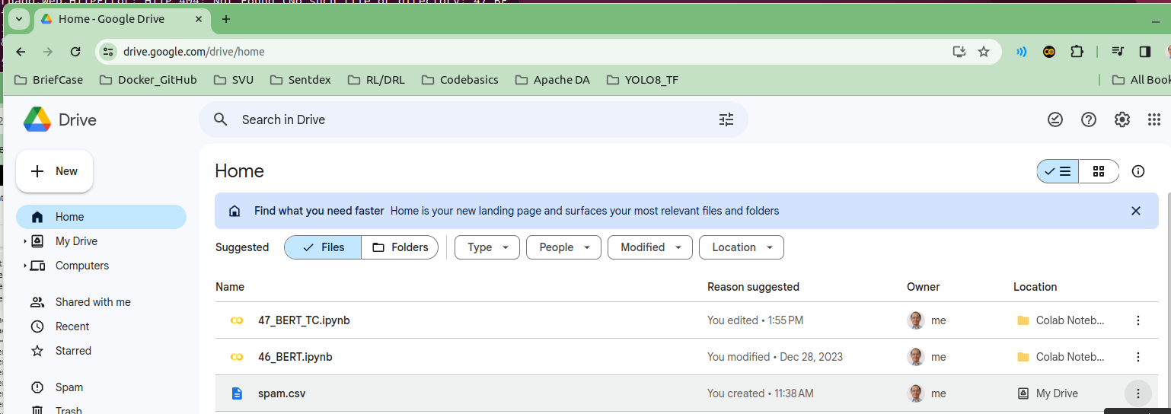
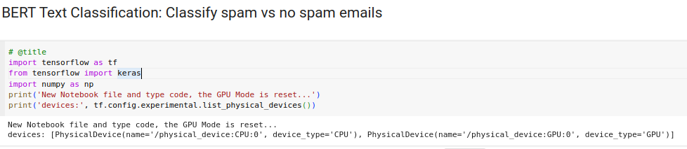
47.2 BERT: Text Classification Coding
https://www.youtube.com/watch?v=hOCDJyZ6quA&list=PLeo1K3hjS3uu7CxAacxVndI4bE_o3BDtO&index=47
BERT: Text Classification Coding (1:04-1:05/29:23)
1. We copy “46_BERT.ipynb” to “47_BERT_TC.ipynb”.
2. Copy the “spam.csv” to google drive Home directory.
3. Make sure, notebook can run GPU mode.

Slide 10
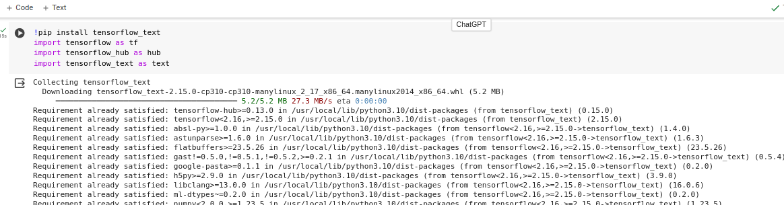
47.2 BERT: Text Classification Coding
https://www.youtube.com/watch?v=hOCDJyZ6quA&list=PLeo1K3hjS3uu7CxAacxVndI4bE_o3BDtO&index=47
BERT: Text Classification Coding (1:06-1:07/29:23)
1. Check the CPU/GPU device run on Colab.
2. Install tensorflow_text
3. Import tensorflow_hub and tensorflow_text

Slide 11
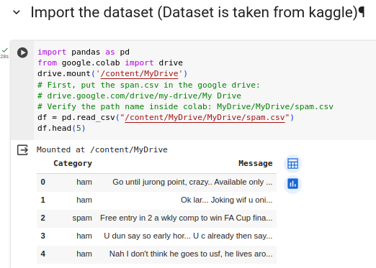
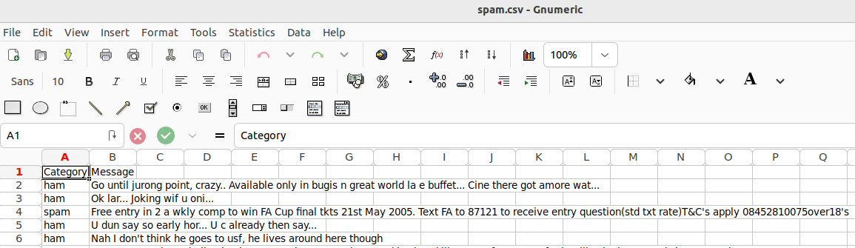
47.2 BERT: Text Classification Coding
https://www.youtube.com/watch?v=hOCDJyZ6quA&list=PLeo1K3hjS3uu7CxAacxVndI4bE_o3BDtO&index=47
BERT: Text Classification Coding (1:10-1:38/29:23)
1. import pandas and drive class of google.colab
2. Mount the google drive:
> drive.mount (’/content/MyDrive’)
3. read spam.csv from Google home directory:
> df = pd.read,csv (‘/mount/MyDrive/MyDrive/spam.csv’)
4. Print the first five lines of spam.csv
5. Verify the print out with spam.csv.

Slide 12
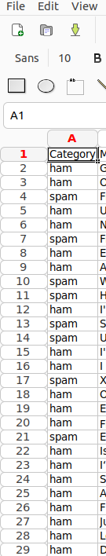
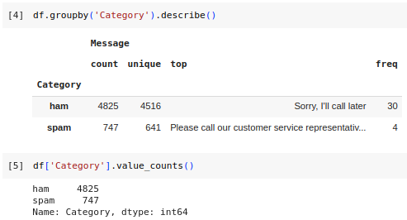
47.2 BERT: Text Classification Coding
https://www.youtube.com/watch?v=hOCDJyZ6quA&list=PLeo1K3hjS3uu7CxAacxVndI4bE_o3BDtO&index=47
BERT: Text Classification Coding (1:40-3:50/29:23)
We Check the imbalance in dataset.
1. In ‘Category’ column, we have ‘ham’ count = 4825 and ‘spam’ count = 747. This means most of mail are ‘ham’ (not spam). Only 747 cases are spam.
2. We use df’’Category’].value_counts() to count ‘ham’ and ‘spam’ for 4825 and 747, respectively.

Slide 13
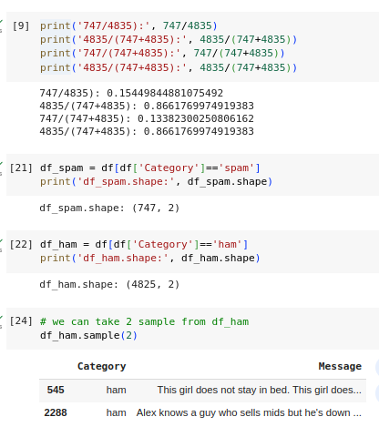
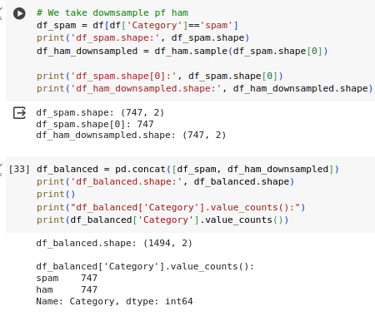
47.2 BERT: Text Classification Coding
https://www.youtube.com/watch?v=hOCDJyZ6quA&list=PLeo1K3hjS3uu7CxAacxVndI4bE_o3BDtO&index=47
BERT: Text Classification Coding (3:56-7:00/29:23)
1. The ratio of Spam and Ham: 747/4835 = 15%. The samples imbalance. When we take the down-sampling of the Ham to make the same size of sample.
2. This dataset is imbalance, we can split into the “spam” and “ham” dataset.

Slide 14
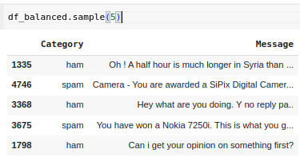
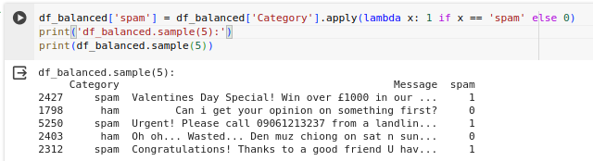
47.2 BERT: Text Classification Coding
https://www.youtube.com/watch?v=hOCDJyZ6quA&list=PLeo1K3hjS3uu7CxAacxVndI4bE_o3BDtO&index=47
BERT: Text Classification Coding (7:01-7:16/29:23)
1. We can take 5-samples from balanced samples.
2. We create another ’spam’ column for ‘spam’ = 1 and ‘ham’ = 0

Slide 15
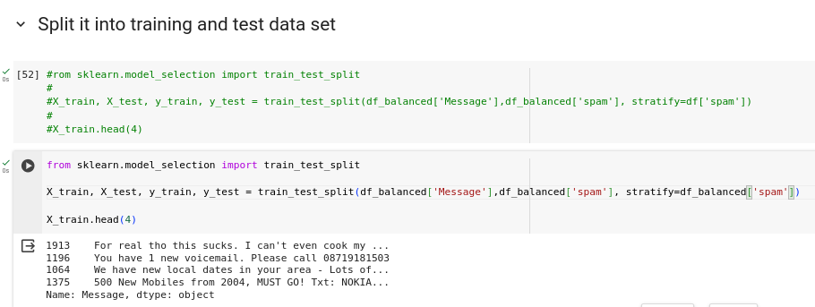
47.2 BERT: Text Classification Coding
https://www.youtube.com/watch?v=hOCDJyZ6quA&list=PLeo1K3hjS3uu7CxAacxVndI4bE_o3BDtO&index=47
BERT: Text Classification Coding (7:16-10:01/29:23)
Now, we use the sklearn to split the balanced dataset into X_train, X_test, y_train, and y_test.

Slide 16
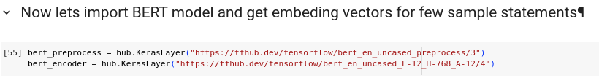
47.2 BERT: Text Classification Coding
https://www.youtube.com/watch?v=hOCDJyZ6quA&list=PLeo1K3hjS3uu7CxAacxVndI4bE_o3BDtO&index=47
BERT: Text Classification Coding (10:09-11:00/29:23)
Now, we apply the BERT model for preprocess and encoder.
We download the BERT model (preprocess and encoder) from URL.

Slide 17
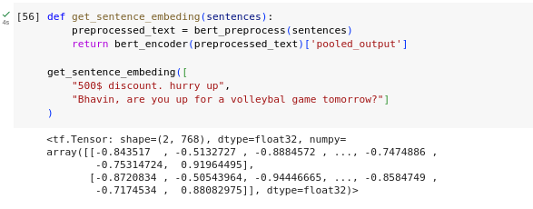
47.2 BERT: Text Classification Coding
https://www.youtube.com/watch?v=hOCDJyZ6quA&list=PLeo1K3hjS3uu7CxAacxVndI4bE_o3BDtO&index=47
BERT: Text Classification Coding (11:18-14:13/29:23)
We do the encoding for sentence.

Slide 18
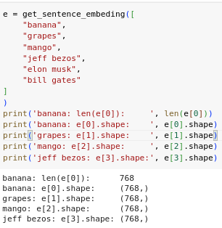
47.2 BERT: Text Classification Coding
https://www.youtube.com/watch?v=hOCDJyZ6quA&list=PLeo1K3hjS3uu7CxAacxVndI4bE_o3BDtO&index=47
BERT: Text Classification Coding (11:18-14:13/29:23)
In BERT, each word is encoded into length 768.

Slide 19
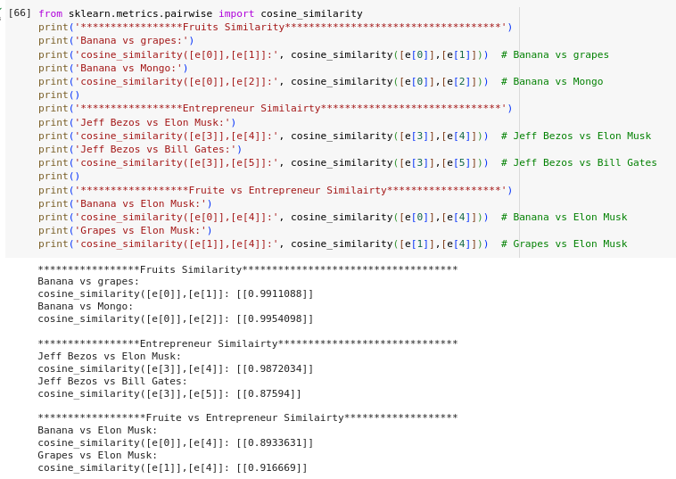
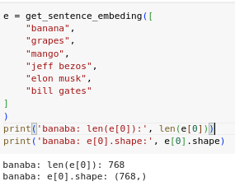
47.2 BERT: Text Classification Coding
https://www.youtube.com/watch?v=hOCDJyZ6quA&list=PLeo1K3hjS3uu7CxAacxVndI4bE_o3BDtO&index=47
BERT: Text Classification Coding (11:18-18:00/29:23)
We test with few samples
1. Fruits: Banana, grapes, and mango: similarity > 99%
2. Entrepreneurs: Jeff Bezos, Elon Musk, and Bill Gates: Similarity > 99%
3. Fruit to Entrepreneurs: Similarity < 91%

Slide 20
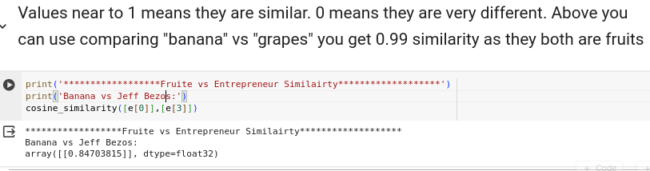
47.2 BERT: Text Classification Coding
https://www.youtube.com/watch?v=hOCDJyZ6quA&list=PLeo1K3hjS3uu7CxAacxVndI4bE_o3BDtO&index=47
BERT: Text Classification Coding (18:18-19:30/29:23)
Compare Banana to Jeff Bezos.

Slide 21

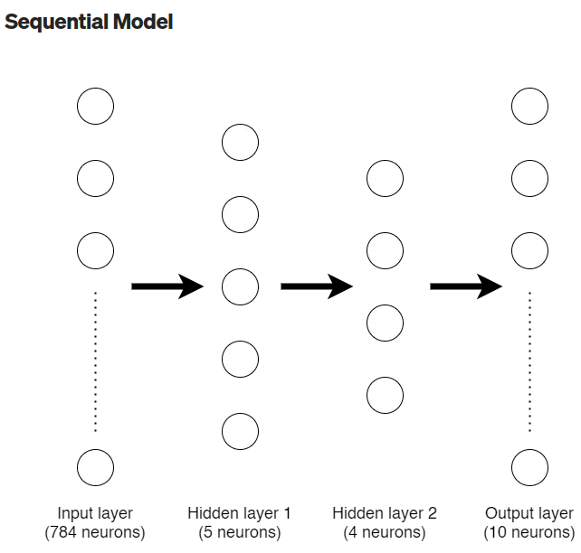
47.2 BERT: Text Classification Coding
https://www.youtube.com/watch?v=hOCDJyZ6quA&list=PLeo1K3hjS3uu7CxAacxVndI4bE_o3BDtO&index=47
BERT: Text Classification Coding (19:31-20:30/29:23)
https://becominghuman.ai/sequential-vs-functional-model-in-keras-20684f766057
Keras to create neural network:

Slide 22
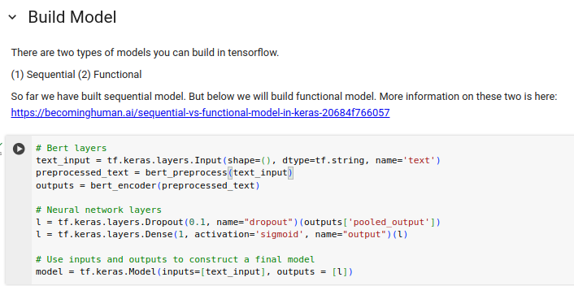
47.2 BERT: Text Classification Coding
https://www.youtube.com/watch?v=hOCDJyZ6quA&list=PLeo1K3hjS3uu7CxAacxVndI4bE_o3BDtO&index=47
BERT: Text Classification Coding (21:31-23:30/29:23)
We create our Neural Network based on BERT Model.
1. BERT Layers:
1.1 Create text_input layer by Keras:
1.2 Create preprocess_text based based on BERT Model preprocess
1.3 Create outputs with BERT encoder.
2. Neural Network layers:
2.1 Create Dropout layer to prevent overfit.
2.2 Create Sigmoid layer for neural network outputs
3. Create Our Model with BERT Model and Neural Network Model:
Inputs is BERT Layers (1.1 to 1.3) and outputs is Neural Network Layers (2.1 and 2,.2).

Slide 23
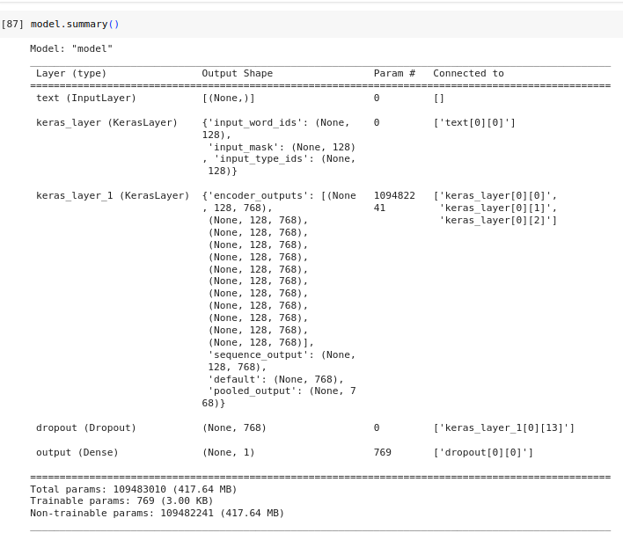
47.2 BERT: Text Classification Coding
https://www.youtube.com/watch?v=hOCDJyZ6quA&list=PLeo1K3hjS3uu7CxAacxVndI4bE_o3BDtO&index=47
BERT: Text Classification Coding (23:59-24:30/29:23)
> model.summary()

Slide 24
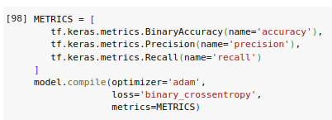
47.2 BERT: Text Classification Coding
https://www.youtube.com/watch?v=hOCDJyZ6quA&list=PLeo1K3hjS3uu7CxAacxVndI4bE_o3BDtO&index=47
BERT: Text Classification Coding (24:31-24:50/29:23)
1. Define the metric
2. model.compile:

Slide 25
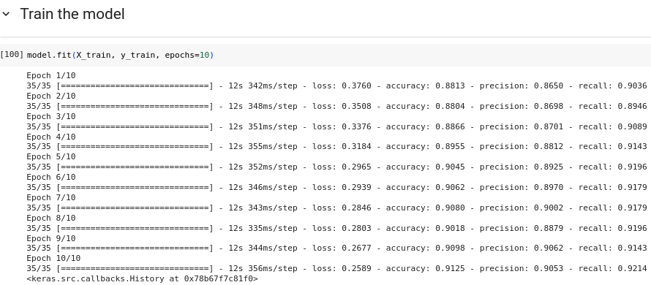
47.2 BERT: Text Classification Coding
https://www.youtube.com/watch?v=hOCDJyZ6quA&list=PLeo1K3hjS3uu7CxAacxVndI4bE_o3BDtO&index=47
BERT: Text Classification Coding (24:51-25:00/29:23)
1. Set epochs = 10.
2. Train our neural network model based on BERT Model (input preprocess and output encoder).
3. We have accuracy= 91%, precision = 90%, and recall = 92%

Slide 26
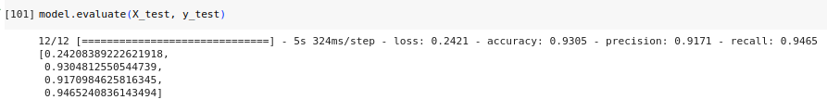
47.2 BERT: Text Classification Coding
https://www.youtube.com/watch?v=hOCDJyZ6quA&list=PLeo1K3hjS3uu7CxAacxVndI4bE_o3BDtO&index=47
BERT: Text Classification Coding (25:01-25:20/29:23)
1. Run Evaluate:
We have output:
[ loss = 24%, accuracy = 93%, precision = 91%, recall = 94.6%]

Slide 27
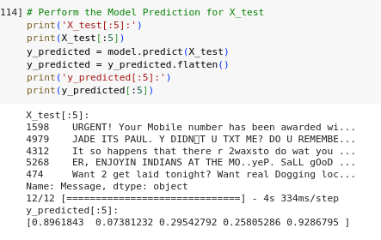
47.2 BERT: Text Classification Coding
https://www.youtube.com/watch?v=hOCDJyZ6quA&list=PLeo1K3hjS3uu7CxAacxVndI4bE_o3BDtO&index=47
BERT: Text Classification Coding (25:21-25:30/29:23)
Perform the model prediction for X_test (Ham/Spam mail)

Slide 28
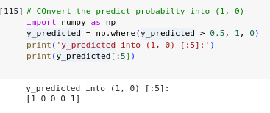
47.2 BERT: Text Classification Coding
https://www.youtube.com/watch?v=hOCDJyZ6quA&list=PLeo1K3hjS3uu7CxAacxVndI4bE_o3BDtO&index=47
BERT: Text Classification Coding (25:31-26:00/29:23)
Convert the output probability into (1, 0)

Slide 29
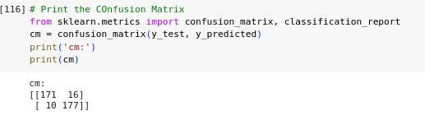
47.2 BERT: Text Classification Coding
https://www.youtube.com/watch?v=hOCDJyZ6quA&list=PLeo1K3hjS3uu7CxAacxVndI4bE_o3BDtO&index=47
BERT: Text Classification Coding (26:01-26:30/29:23)
Print the confusion matrix

Slide 30
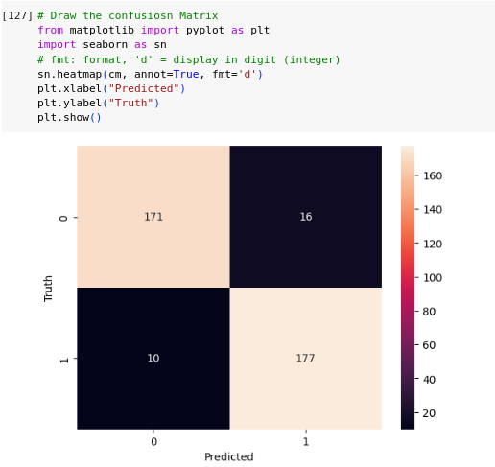
47.2 BERT: Text Classification Coding
https://www.youtube.com/watch?v=hOCDJyZ6quA&list=PLeo1K3hjS3uu7CxAacxVndI4bE_o3BDtO&index=47
BERT: Text Classification Coding (26:31-28:00/29:23)
Plot the confusion matrix

Slide 31
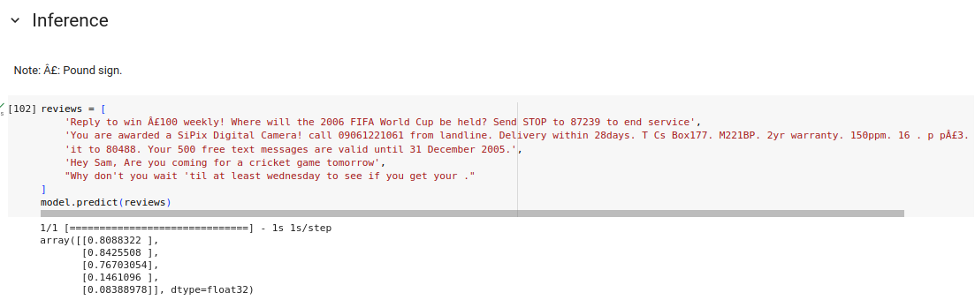
47.2 BERT: Text Classification Coding
https://www.youtube.com/watch?v=hOCDJyZ6quA&list=PLeo1K3hjS3uu7CxAacxVndI4bE_o3BDtO&index=47
BERT: Text Classification Coding (28:01-28:30/29:23)
We do some sentence inference.

Slide 32
47.3 BERT: Text Classification Exercise

Slide 33
47.3 BERT: Text Classification Exercise
https://www.youtube.com/watch?v=hOCDJyZ6quA&list=PLeo1K3hjS3uu7CxAacxVndI4bE_o3BDtO&index=47
ERT: Text Classification Exercise (28:31-29:23/29:23)
https://www.tensorflow.org/text/tutorials/classify_text_with_bert
Use BERT to classify the movie review.
1. Load the IMDB dataset
2. Load a BERT model from TensorFlow Hub
3. Build your own model by combining BERT with a classifier
4. Train your own model, fine-tuning BERT as part of that
5. Save your model and use it to classify sentences

Slide 34
End

