Slide 1

21.07 Python: Imbalanced Data
Peter H. Chen

Slide 2
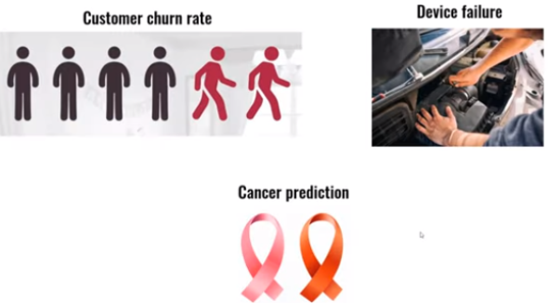
21.07 Python: Imbalanced Data
https://www.youtube.com/watch?v=JnlM4yLFNuo&list=PLeo1K3hjS3uu7CxAacxVndI4bE_o3BDtO&index=21
Python: Imbalanced Data (4:01-4:30/38:25)
We have some imbalanced datasets for customer churn rate, device failure, and cancer prediction.
1. For customer churn, most customer stay. Only few customer leave.
2. device failure: most device are good device. Only very few device are failed.
3. for cancer prediction, only very few patients have cancer.

Slide 3
21.08 Imbalanced Churn Data: Coding

Slide 4
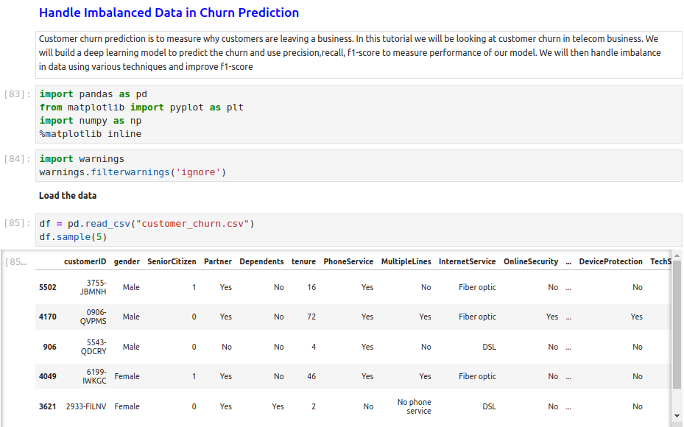
21.08 Imbalanced Churn Data: Coding
https://www.youtube.com/watch?v=JnlM4yLFNuo&list=PLeo1K3hjS3uu7CxAacxVndI4bE_o3BDtO&index=21
Imbalanced Churn Data: Coding (4:01-6:00/38:25)
Read in imbalanced Dataset of Customer Churn.

Slide 5
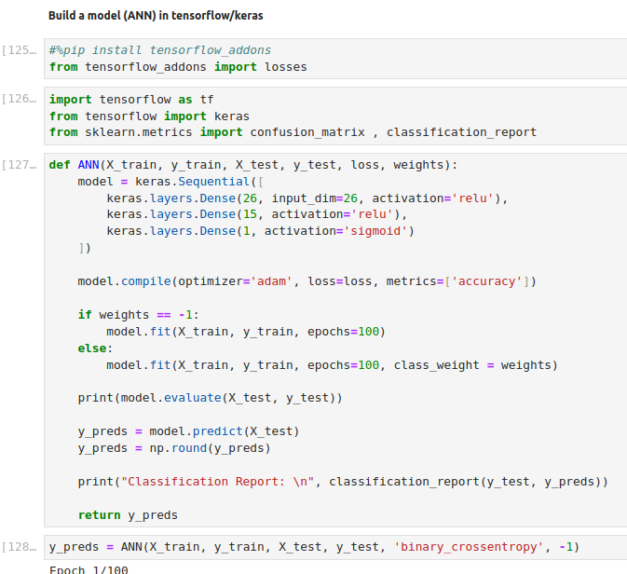
21.08 Imbalanced Churn Data: Coding
https://www.youtube.com/watch?v=JnlM4yLFNuo&list=PLeo1K3hjS3uu7CxAacxVndI4bE_o3BDtO&index=21
Imbalanced Churn Data: Coding (4:01-7:16/38:25)
Train churn customer with ANN.

Slide 6
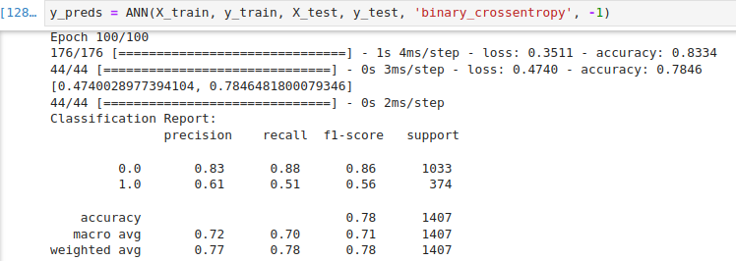
21.08 Imbalanced Churn Data: Coding
https://www.youtube.com/watch?v=JnlM4yLFNuo&list=PLeo1K3hjS3uu7CxAacxVndI4bE_o3BDtO&index=21
Imbalanced Churn Data: Coding (7:10-7:30/38:25)
Here, Our goal is too improve the f1-score for both Yes (Leave) and No (Stay) classes of Churn Customers.
So, model can predict equally well for precision and recall of both classes (Yes/No).

Slide 7
21.09 Method 1: Under-Sampling

Slide 8
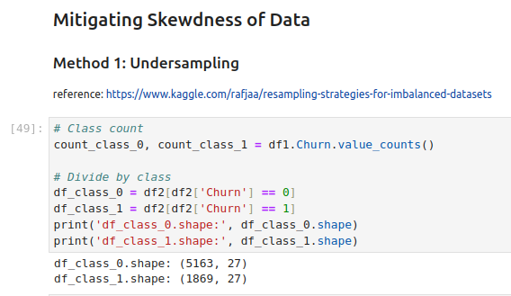

21.09 Method 1: Under-Sampling
https://www.youtube.com/watch?v=JnlM4yLFNuo&list=PLeo1K3hjS3uu7CxAacxVndI4bE_o3BDtO&index=21
Method 1: Under-Sampling (7:10-7:30/38:25)
The first method we are going to do is method 1: Under-Sampling.
We can see y_test.value_counts()
No (0) Stay: 1033
Yes (1) Leave: 374
The data is imbalanced. Most (1033) customer stay. 374 customer leaves.
We have 5163 stay customers and 1869 leave customers. We can the imbalanced samples.

Slide 9
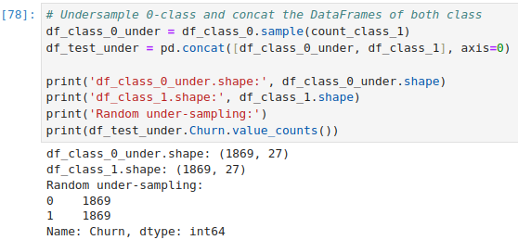
21.09 Method 1: Under-Sampling
https://www.youtube.com/watch?v=JnlM4yLFNuo&list=PLeo1K3hjS3uu7CxAacxVndI4bE_o3BDtO&index=21
Method 1: Under-Sampling (8:01-11:30/38:25)
We can randomly select samples from majority class 0 (with the number of minority class 1).
Now, under sampling class 0 and class 1 are the same size now.

Slide 10
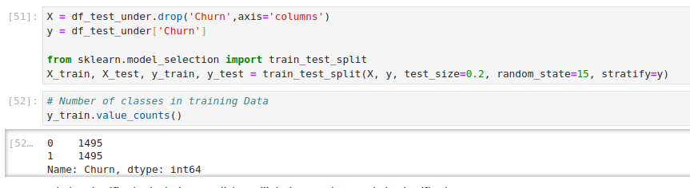
21.09 Method 1: Under-Sampling
https://www.youtube.com/watch?v=JnlM4yLFNuo&list=PLeo1K3hjS3uu7CxAacxVndI4bE_o3BDtO&index=21
Method 1: Under-Sampling (11:01-11:45/38:25)
We drop the churn of X and move churn into y.

Slide 11
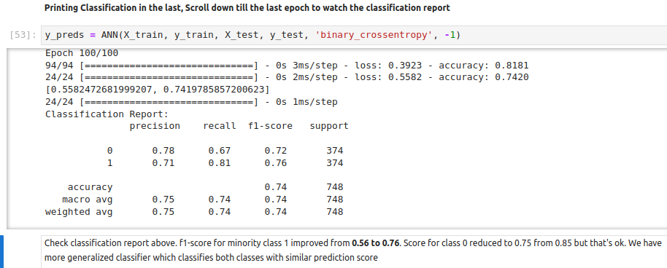
21.09 Method 1: Under-Sampling
https://www.youtube.com/watch?v=JnlM4yLFNuo&list=PLeo1K3hjS3uu7CxAacxVndI4bE_o3BDtO&index=21
Method 1: Under-Sampling (11:01-14:00/38:25)
We improve the class (0 = Stay customer, 1 = Leave customer) from (0.86, 0.56) to (0.72, 0.76)

Slide 12
21.10 Method 2: Over-Sampling

Slide 13
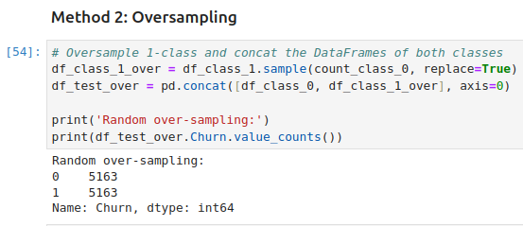
21.10 Method 2: Over-Sampling
https://www.youtube.com/watch?v=JnlM4yLFNuo&list=PLeo1K3hjS3uu7CxAacxVndI4bE_o3BDtO&index=21
Method 2: Over-Sampling (14:01-17:30/38:25)
Now, we do the over-sampling for class 1.

Slide 14
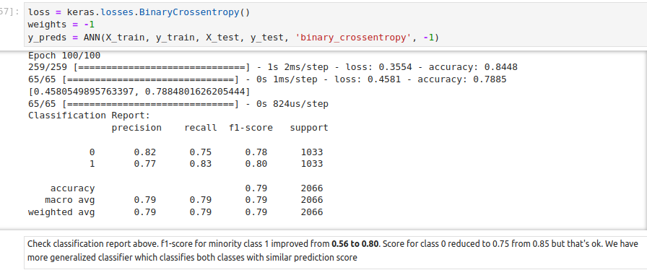
21.10 Method 2: Over-Sampling
https://www.youtube.com/watch?v=JnlM4yLFNuo&list=PLeo1K3hjS3uu7CxAacxVndI4bE_o3BDtO&index=21
Method 2: Over-Sampling (17:31-20:45/38:25)
We improve class 1 from 0.56 60 0.80.

Slide 15
21.11 Method 3: SMOTE

Slide 16
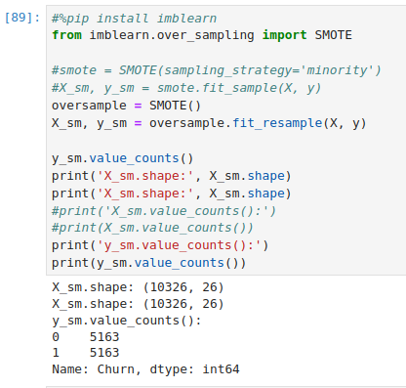
21.11 Method 3: SMOTE
https://www.youtube.com/watch?v=JnlM4yLFNuo&list=PLeo1K3hjS3uu7CxAacxVndI4bE_o3BDtO&index=21
Method 3: SMOTE (21:01-22:45/38:25)
Google the SMOTE to check how to install SMOTE.
> pip install imblearn
Now, we move to SMOTE (Synthetic Minority Over-Sampling Technique).
We use SMOTE() to over-sample the new samples: X_sm and y_sm.
We y_sm have same samples in class 0 and class 1.

Slide 17
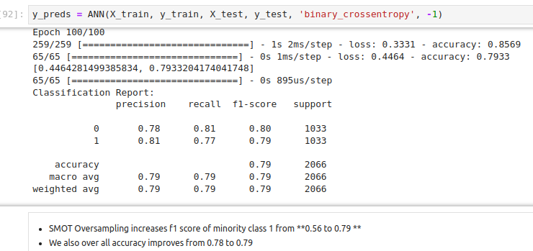
21.11 Method 3: SMOTE
https://www.youtube.com/watch?v=JnlM4yLFNuo&list=PLeo1K3hjS3uu7CxAacxVndI4bE_o3BDtO&index=21
Method 3: SMOTE (23:01-24:15/38:25)
We have improvement in f1-score of class 1 and accuracy improvement.

Slide 18
21.12 Method 4: Ensemble with Under-Sampling

Slide 19
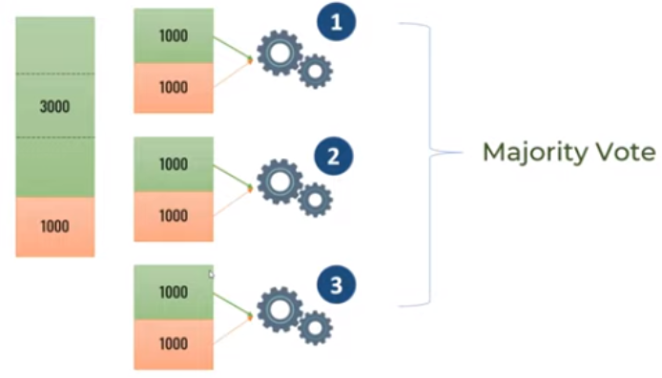
21.12 Method 4: Ensemble with Under-Sampling
https://www.youtube.com/watch?v=JnlM4yLFNuo&list=PLeo1K3hjS3uu7CxAacxVndI4bE_o3BDtO&index=21
Method 4: Ensemble with Under-Sampling (23:01-27:15/38:25)
We will divide the dataset into several smaller datasets.

Slide 20
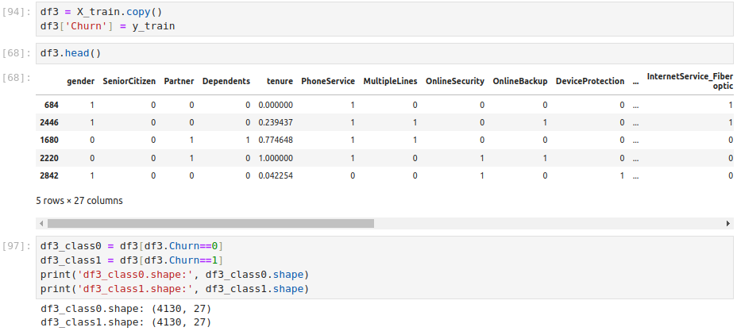
21.12 Method 4: Ensemble with Under-Sampling
https://www.youtube.com/watch?v=JnlM4yLFNuo&list=PLeo1K3hjS3uu7CxAacxVndI4bE_o3BDtO&index=21
Method 4: Ensemble with Under-Sampling (28:01-29:00/38:25)
We copy data into df3.

Slide 21
21.12 Method 4: Ensemble with Under-Sampling
https://www.youtube.com/watch?v=JnlM4yLFNuo&list=PLeo1K3hjS3uu7CxAacxVndI4bE_o3BDtO&index=21
Method 4: Ensemble with Under-Sampling (28:01-29:00/38:25)
We copy data into df3.

Slide 22
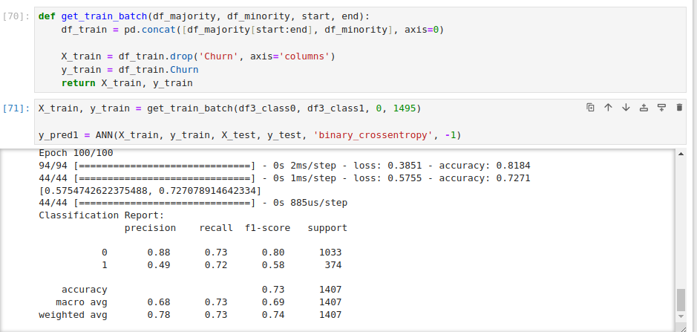
21.12 Method 4: Ensemble with Under-Sampling
https://www.youtube.com/watch?v=JnlM4yLFNuo&list=PLeo1K3hjS3uu7CxAacxVndI4bE_o3BDtO&index=21
Method 4: Ensemble with Under-Sampling (29:01-30:00/38:25)
We separate into three batches 0 to 1495)

Slide 23
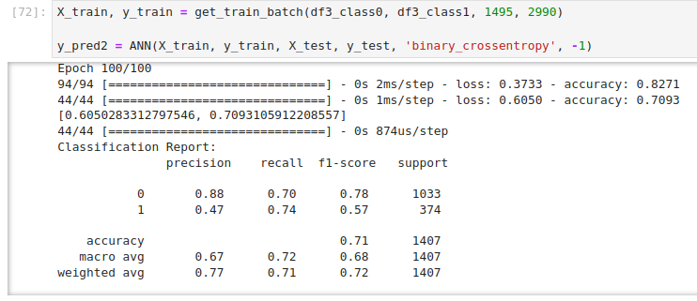
21.12 Method 4: Ensemble with Under-Sampling
https://www.youtube.com/watch?v=JnlM4yLFNuo&list=PLeo1K3hjS3uu7CxAacxVndI4bE_o3BDtO&index=21
Method 4: Ensemble with Under-Sampling (30:01-31:00/38:25)
We separate into three batches 1495 to 2999)

Slide 24
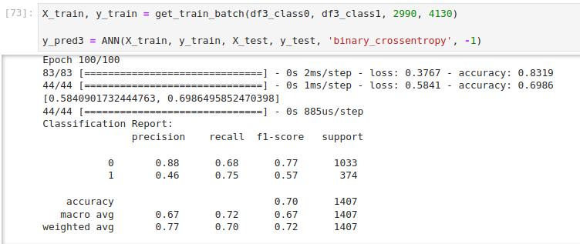
21.12 Method 4: Ensemble with Under-Sampling
https://www.youtube.com/watch?v=JnlM4yLFNuo&list=PLeo1K3hjS3uu7CxAacxVndI4bE_o3BDtO&index=21
Method 4: Ensemble with Under-Sampling (31:01-32:00/38:25)
We separate into three batches 2999 to 4130)

Slide 25
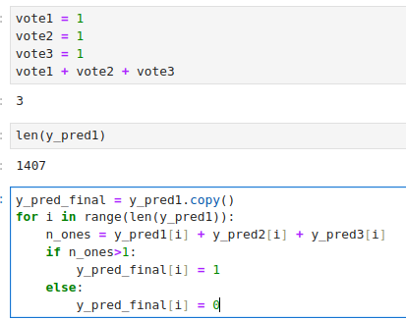
21.12 Method 4: Ensemble with Under-Sampling
https://www.youtube.com/watch?v=JnlM4yLFNuo&list=PLeo1K3hjS3uu7CxAacxVndI4bE_o3BDtO&index=21
Method 4: Ensemble with Under-Sampling (33:01-34:00/38:25)
We pick up the majority vote. Any one predict 1 (leave), then we set to 1.

Slide 26
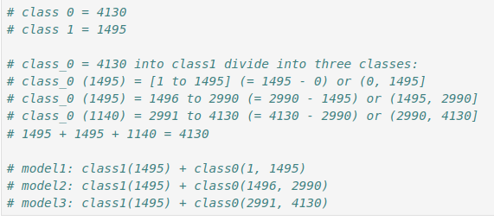
21.12 Method 4: Ensemble with Under-Sampling
https://www.youtube.com/watch?v=JnlM4yLFNuo&list=PLeo1K3hjS3uu7CxAacxVndI4bE_o3BDtO&index=21
Method 4: Ensemble with Under-Sampling (34:01-34:30/38:25)
We the result for Ensemble with Under-Sampling

Slide 27
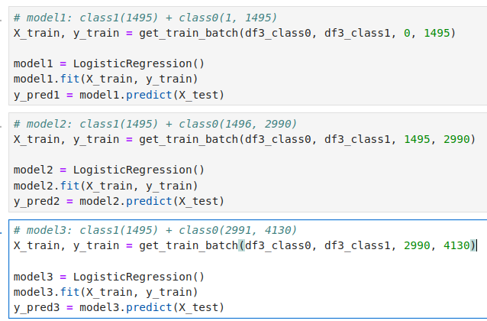
21.12 Method 4: Ensemble with Under-Sampling
https://www.youtube.com/watch?v=JnlM4yLFNuo&list=PLeo1K3hjS3uu7CxAacxVndI4bE_o3BDtO&index=21
Method 4: Ensemble with Under-Sampling (34:31-34:40/38:25)
We the result for Ensemble with Under-Sampling

Slide 28
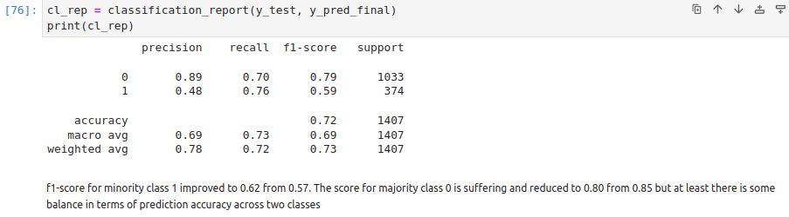
21.12 Method 4: Ensemble with Under-Sampling
https://www.youtube.com/watch?v=JnlM4yLFNuo&list=PLeo1K3hjS3uu7CxAacxVndI4bE_o3BDtO&index=21
Method 4: Ensemble with Under-Sampling (34:41-35:15/38:25)
We the result for Ensemble with Under-Sampling

Slide 29
21.6 Exercise

Slide 30
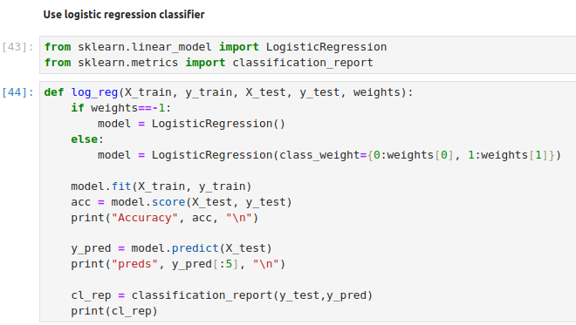
21.6 Exercise
https://www.youtube.com/watch?v=JnlM4yLFNuo&list=PLeo1K3hjS3uu7CxAacxVndI4bE_o3BDtO&index=21
Exercise (36:01-37:00/38:25)
Do the same example with Logistic Regression.

Slide 31
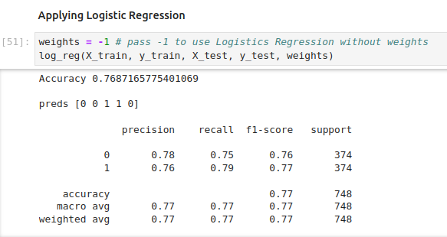
21.6 Exercise
https://www.youtube.com/watch?v=JnlM4yLFNuo&list=PLeo1K3hjS3uu7CxAacxVndI4bE_o3BDtO&index=21
Exercise (37:01-38:25/38:25)
Do the same example with Logistic Regression.

Slide 32
End

