Slide 1

15.0 Week 05 Review
Peter H. Chen

Slide 2
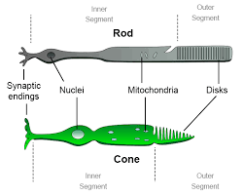
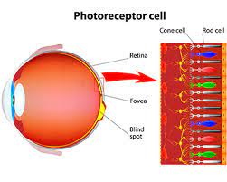
15.0 week 05 Review
https://github.com/peterhchen/AIU_CS512_DL/tree/main/000_Lecture_Project/week03
Week 4 Review
https://ai.stackexchange.com/questions/6099/what-activation-function-does-the-human-brain-use
Biological Neuron vs. Neural Network Neuron:
Biological Image cells:
Rod cells (视网膜杆) and Cone cell (视锥细胞) are cells in retina (视网膜).
1. Rod cells are highly sensitive to light and under dark light. Rod only sensitive to one color (Dark Purple).
2. Cone cells only work in bright lighting conditions. Cones are sensitive to three colors (RGB). They responses very fast to in light intensity change, very shape in color vision and change.
In Neural network, we use CNN (Convolutional Neural Network, for example, moving windows of edges, such as, vertical, horizontal, slope, circle, rectangular, patterns, etc.) to extract features to reduce the computations.

Slide 3
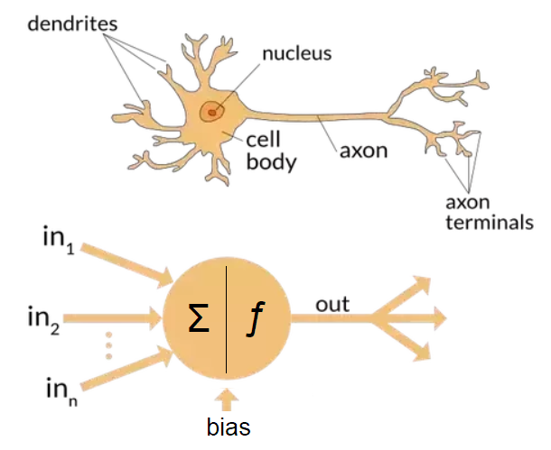
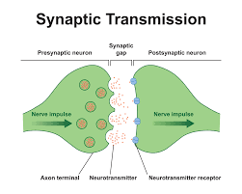
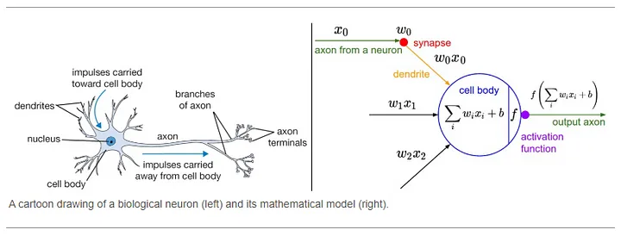
15.0 week 05 Review
https://github.com/peterhchen/AIU_CS512_DL/tree/main/000_Lecture_Project/week03
Week 4 Review
https://ai.stackexchange.com/questions/6099/what-activation-function-does-the-human-brain-use
Biological Neuron vs. Neural Network Neuron:
Brain Cell:
1. Dendrite: weight (multiplication)
2. Cell Body: summation
3. Synapse: Transmitter for ion (Sodium or Chloride) channel.
Note:
1. The brains of mammals do not use an activation function.
2. Only machine learning model have activation function.

Slide 4
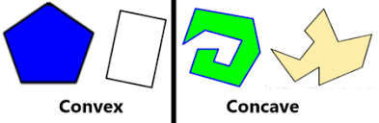
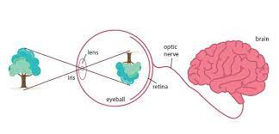
15.0 week 05 Review
https://github.com/peterhchen/AIU_CS512_DL/tree/main/000_Lecture_Project/week03
Week 4 Review
1. Why neural network?
Neural Network is Linear Stack of Layers of Neurons. It reduces the complexity of non-convex (i.e., concave) of polynomial modeling problem.
2. Biological Reinforcement Learning?
2.1 Human being is learn by experience (trial and error), brain wave is 0V-4V, and never go under or beyond.
2.2 Eye to brain mapping: When eyes see line and map into curve in the brain; eyes see curve and map into line in the brain; eyes see up and map into down in the brain; eyes see down and map into up in the brain; left eye map into right brain; right eye map into left brain; eyes see the circle, brain maps into square; eyes see the square, brain map into circle.
2.3 Fish learn by experience (trial and error) as well: When you feed the baby fish, the baby fish eat the food by trial and error (can be upside down). They get used to in few weeks. However, when we rotate the fish eye 180 degree, the upside-down happen again for few weeks and then get used to again.

Slide 5
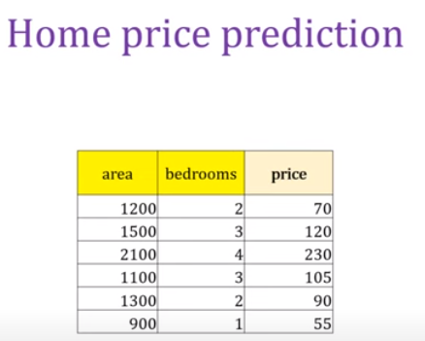
15.0 week 05 Review
https://github.com/peterhchen/AIU_CS512_DL/tree/main/000_Lecture_Project/week03
Week 4 Review
Given a table as below.
a. How many input features of ANN (Artificial Neural Network)?
Answer: Number of input Features = 2 (Area, bedrooms)
b. What is target label of ANN?
Answer: Target label = 1 (output Price)
c. How many samples of ANN?
Answer: 6 rows (or 6 samples)

Slide 6
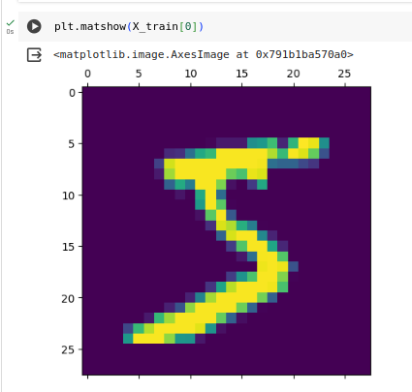
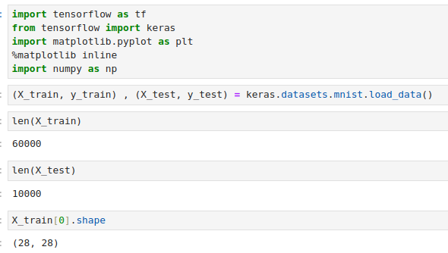
15.0 week 05 Review
https://github.com/peterhchen/AIU_CS512_DL/tree/main/000_Lecture_Project/week03
Week 4 Review
Given input input image and predict the digit (0-9):
a. How many input features of ANN (Artificial Neural Network)?
Answer: Number of input Features = 28 x 28 = 784 (pixels).
b. We have 3 x 3 filter for CNN (Convolutional Neural Network), how many input features?
Answer: Input Features = 9 (reduce from 784 to 9). Vertical, horizontal, etc. generate different samples..
c. What is output categories of CNN?
Answer: categories = 10 (from digit 0 to digit 9).
d. How many training samples of CNN?
Answer: 60000 rows (or 60000 samples)

Slide 7
15.0 week 05 Review
https://github.com/peterhchen/AIU_CS512_DL/tree/main/000_Lecture_Project/week03
Week 4 Review
For the multi-objective optimization with given CPU, GPU, cache-1, cache-2, VRAM, output PAT (power, area, timing), and user input hyperparameters P1 (0.3), P2 (0.1), P3 (0.5).
a. What is input features?
Answer: 5 (CPU, GPU, Cache-1, Cache-2, VRAM)
b. How many samples?
Answer: 5 rows (or 5 samples)
c. What is output target labels for MOO (Multi-Objective Optimization)?
Answer: Power, Area, Time. Each output has their own optimal wave front. The optimal answer are a curve along the wave front.
d. What is the output target?
Answer: P1 * Power + P2 * Area + P3 * Time
CPU (num) | GPU (num) | Cache-1 (GB) | Cache-2 (GB) | VRAM (GB) | Power (watts) | Area (um2) | Time Interval (nsec) | P1 * Power + P2 * Area + P3 * Time
1 | 1 | 10 | 1 | 10 | 100 | 100 | 100 | 90
4 | 4 | 20 | 2 | 200 | 200 | 200 | 10 | 85
8 | 8 | 40 | 4 | 400 | 400 | 400 | 6 | 163
16 | 16 | 80 | 8 | 800 | 800 | 800 | 4 | 322
16 | 16 | 160 | 8 | 800 | 1000 | 860 | 2 | 387

Slide 8
15.0 week 05 Review
https://github.com/peterhchen/AIU_CS512_DL/tree/main/000_Lecture_Project/week03
Week 4 Review
chatBot Application technology stack
ChatBot Integration | ChatBot | LLM (Large Language Model) | API | Private Database | Real-time Information | GUI | Host
Open Source: LangChain | Open Source: 1. Google Gemini 2. Google Bard | Open Source: 1. Google Gemini 2. Google PaLM 2 (Pathway Language Model) | fastAPI, etc (flask) | Open Source: MySQL, MongoDB, etc. | Google Real-time Search Engine (SerpApi) | Meta ReactJS (Chrome), Meta React Native (App), Google Angular, streamlit | Render.com, Heroku, HuggingFace, GCP (Google Cloud Platform), AWS
Same as above | Open Source: Meta AI | Open Source: Meta Llama 2 (Large Langue Model for Meta AI) | Same as above | Same as above | Same as above | Same as above | Same as above
Same as above | Non-Open Source: ChatGPT | Non-Open Source: GPT | Same as above | Same as above | Same as above | Same as above | Same as above

Slide 9
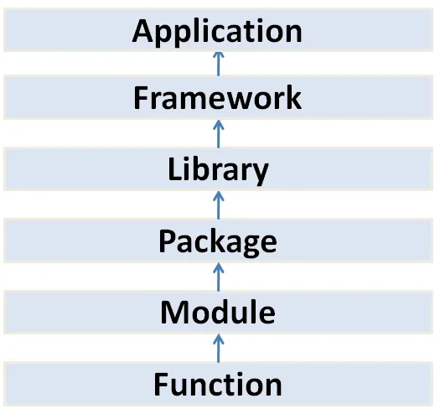
15.0 Mount Google Drive
https://www.youtube.com/watch?v=pXGBHV3y8rs&list=PLeo1K3hjS3uu7CxAacxVndI4bE_o3BDtO&index=12
Mount Google Drive (17:13-17:15/41:33)
Use classes as blueprints for objects that model your problem domain. Class contains methods.
Use modules to collect functionality into logical units.
Python package means “folder”.
Tensorflow Playground
(Browser-based Application)
Google Tensorflow, Google Gemini, Google Angular, Meta Llama
Meta PyTorch, Meta ReactJS, Keras, Meta FAISS (Facebook AI Similarity Search)
Folder/Directory with __init__.py
Tensorboard, numpy, pandas, Matplotlib, Seaborn,
GUI Tkinter, Nokia PyQt, ...
File
class
math
Method
sqrt()

Slide 10
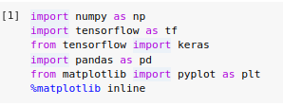
15.0 Mount Google Drive
https://www.youtube.com/watch?v=pXGBHV3y8rs&list=PLeo1K3hjS3uu7CxAacxVndI4bE_o3BDtO&index=12
Mount Google Drive (17:13-17:15/41:33)
Examples:
> from tensorflow (framework) import keras (library)
> from keras (library) import layers, sequential, … (package)
> from matplotlib (Package) import pyplot (module) as plt
> from math (module) import sqrt (function)
Tensorflow Playground
(Browser-based Application)
Google Tensorflow, Google Angular, Keras
Meta PyTorch, Meta ReactJS
Tensorboard, numpy, pandas, Matplotlib, Seaborn,
GUI Tkinter, Nokia PyQt, ...
Math, pyplot
sqrt()

Slide 11

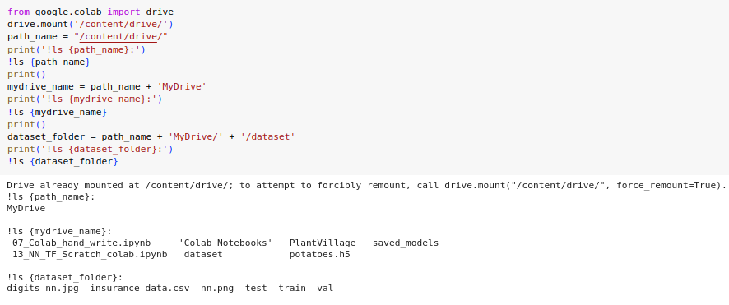
15.0 Mount Google Drive
https://www.youtube.com/watch?v=pXGBHV3y8rs&list=PLeo1K3hjS3uu7CxAacxVndI4bE_o3BDtO&index=12
Mount Google Drive (17:13-17:15/41:33)
1. Mount google drive from colab.
2. Read dataset from the paths.

Slide 12
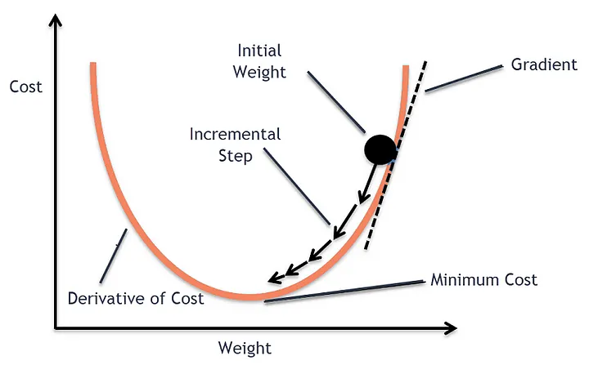
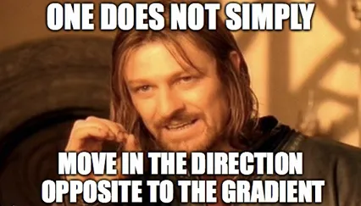
15.0 BGD, SGB, and MBGD
https://www.youtube.com/watch?v=IU5fuoYBTAM&list=PLeo1K3hjS3uu7CxAacxVndI4bE_o3BDtO&index=14
BGD, SGD, and MBGD (0:00-0:10/36:46)
We already known the GD (Gradient Descent):
Gradient descent is a first-order iterative optimization algorithm for finding the minimum of a function.
The goal of the gradient descent is to minimize a given function which, in our case, is the loss function of the neural network.
To achieve this goal, it performs two steps iteratively.
1. Compute the slope (gradient) that is the first-order derivative of the function at the current point
2. Move-in the opposite direction of the slope increase from the current point by the computed amount

Slide 13
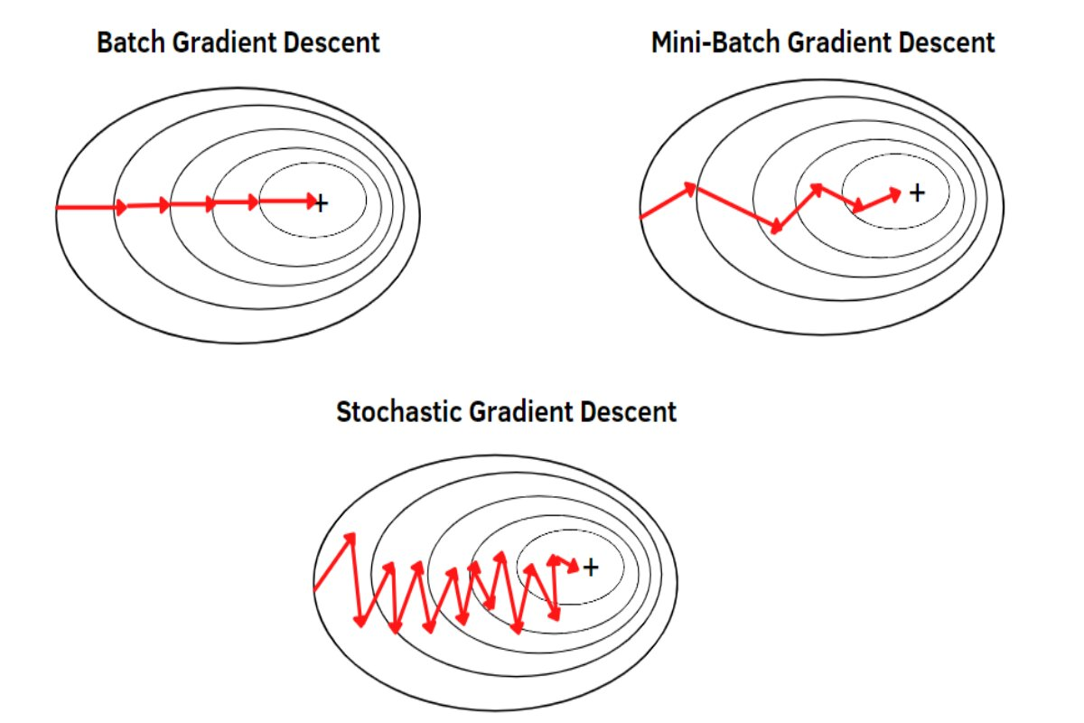
15.0 BGD, SGB, and MBGD
https://www.youtube.com/watch?v=IU5fuoYBTAM&list=PLeo1K3hjS3uu7CxAacxVndI4bE_o3BDtO&index=14
BGD, SGD, and MBGD (0:11-0:30/36:46)
We already known the GD (Gradient Descent).
Now, we discuss the difference between BGD (Batch Gradient Descent), SGD (Stochastic Gradient Descent), and MBGD (Mini-Batch Gradient Descent) with Python implementation.

Slide 14
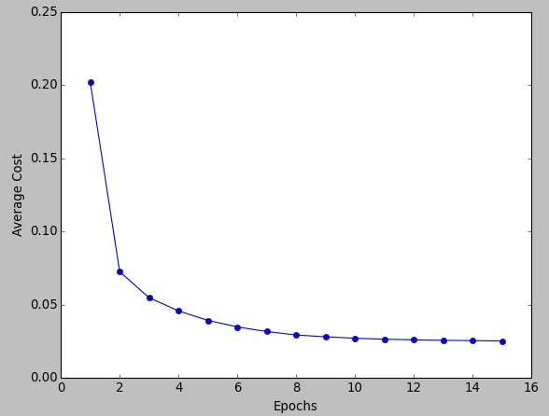
15.0 BGD
https://www.youtube.com/watch?v=IU5fuoYBTAM&list=PLeo1K3hjS3uu7CxAacxVndI4bE_o3BDtO&index=14
BGD (0:31-0:40/36:46)
In BGD (Batch Gradient Descent), all the training data is taken into consideration to take a single Batch.
We take the average of the gradients of all the training examples and then use that mean gradient to update our parameters.
So that’s just one Batch of gradient descent in one epoch.
The graph of cost vs epochs is very smooth because we are averaging over all the gradients of training data for a single step.
The cost keeps on decreasing over the epochs.

Slide 15
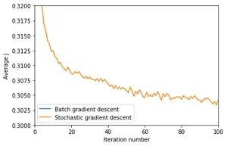
15.0 SGD
https://www.youtube.com/watch?v=IU5fuoYBTAM&list=PLeo1K3hjS3uu7CxAacxVndI4bE_o3BDtO&index=14
SGD (Stochastic Gradient Descent) (3:11-3:30/36:46)
Since we are considering just one example at a time the cost will fluctuate over the training samples and it will not necessarily decrease.
But in the long run, you will see the cost decreasing with fluctuations.

Slide 16
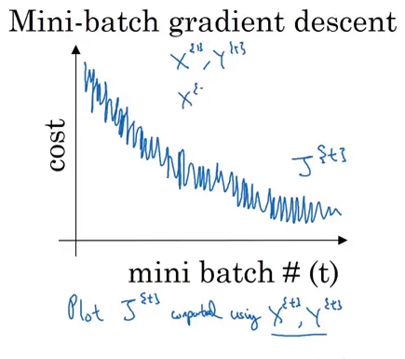
15.0 MBGD
https://www.youtube.com/watch?v=IU5fuoYBTAM&list=PLeo1K3hjS3uu7CxAacxVndI4bE_o3BDtO&index=14
MBGD (Mini-Batch Gradient Descent) (6:01-6:05/36:46)
We have seen the BGD (Batch Gradient Descent) and SGD (Stochastic Gradient Descent).
1. Batch Gradient Descent can be used for smoother curves. SGD can be used when the dataset is large.
2. Batch Gradient Descent converges directly to minima. SGD converges faster for larger datasets.
Since in SGD we use only one sample at a time, SGD is very slow in computations.
To tackle this problem, we use a mixture of BGD (Batch Gradient Descent) and SGD (Stochastic Gradient Descent).
Here, we split the huge dataset into several Mini-Batches.
We do the following steps in one epoch:
1. Pick a mini-batch
2. Feed it to Neural Network
3. Calculate the mean gradient of the mini-batch
4. Use the mean gradient we calculated in step 3 to update the weights
5. Repeat steps 1–4 for the mini-batches we created.

Slide 17
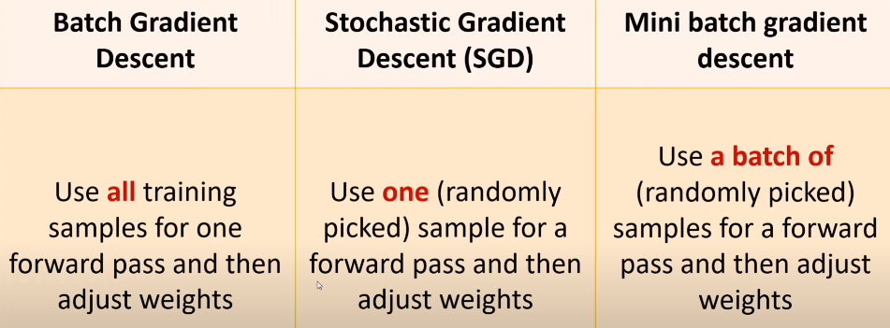
15.0 MBGD
https://www.youtube.com/watch?v=IU5fuoYBTAM&list=PLeo1K3hjS3uu7CxAacxVndI4bE_o3BDtO&index=14
MBGD (Mini-Batch Gradient Descent) (6:31-7:30/36:46)
What is Mini-Batch Gradient Descent?
Similar to SGD (Stochastic Gradient Descent) which randomly pick up one sample, the MBGD (Mini-Batch Gradient Descent) randomly pick up several samples (for example, 20 samples as a bag) for the forward pass and find the error for the bag (20 samples).
Below are the summary of BGD, SGD, and MBGD.

Slide 18
End

