Slide 1

39 Word Embedding
Peter H. Chen

Slide 2
39 Word Embedding
https://www.youtube.com/watch?v=sZGuyTLjsco&list=PLeo1K3hjS3uu7CxAacxVndI4bE_o3BDtO&index=39
Word Embedding (0:00-0:20/11:31)
We discussed how to convert words into numbers.
In NLP (Natural Language Processing), our inputs are texts.
The Machine Learning model cannot understand the texts, so we have to convert into a number.

Slide 3
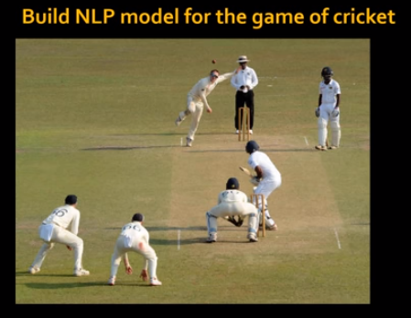
39 Word Embedding
https://www.youtube.com/watch?v=sZGuyTLjsco&list=PLeo1K3hjS3uu7CxAacxVndI4bE_o3BDtO&index=39
Word Embedding (0:20-0:25/11:31)
Let’s build a NLP model for game of cricket.

Slide 4
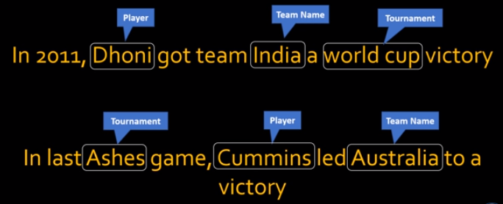
39 Word Embedding
https://www.youtube.com/watch?v=sZGuyTLjsco&list=PLeo1K3hjS3uu7CxAacxVndI4bE_o3BDtO&index=39
Word Embedding (0:28-0:35/11:31)
We have sentences as below:
“Dhoni” is player name, “India” is team name, “world cup” is the tournament name.
“Ashes” is tournament name, “Cummins” is the player name, and “Australia” is a team name.

Slide 5
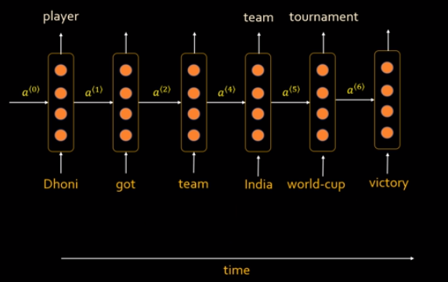
39 Word Embedding
https://www.youtube.com/watch?v=sZGuyTLjsco&list=PLeo1K3hjS3uu7CxAacxVndI4bE_o3BDtO&index=39
Word Embedding (0:44-0:35/11:31)
If we build a RNN, we have the following diagram.

Slide 6
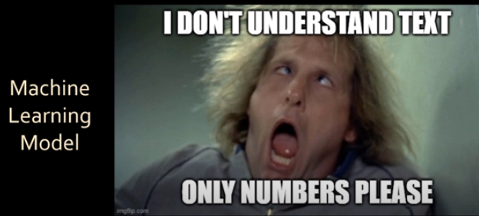
39 Word Embedding
https://www.youtube.com/watch?v=sZGuyTLjsco&list=PLeo1K3hjS3uu7CxAacxVndI4bE_o3BDtO&index=39
Word Embedding (1:00-1:10/11:31)
The machine can not understand the text. Machine can only understand the number.
We have to convert the text into the number. How do we do that?

Slide 7
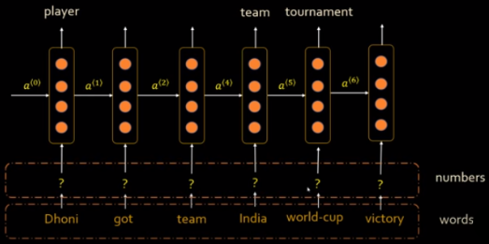
39 Word Embedding
https://www.youtube.com/watch?v=sZGuyTLjsco&list=PLeo1K3hjS3uu7CxAacxVndI4bE_o3BDtO&index=39
Word Embedding (1:17-1:30/11:31)
How to convert the text into number to let machine understand?
We create an extra layer to convert the input texts into the numbers.

Slide 8
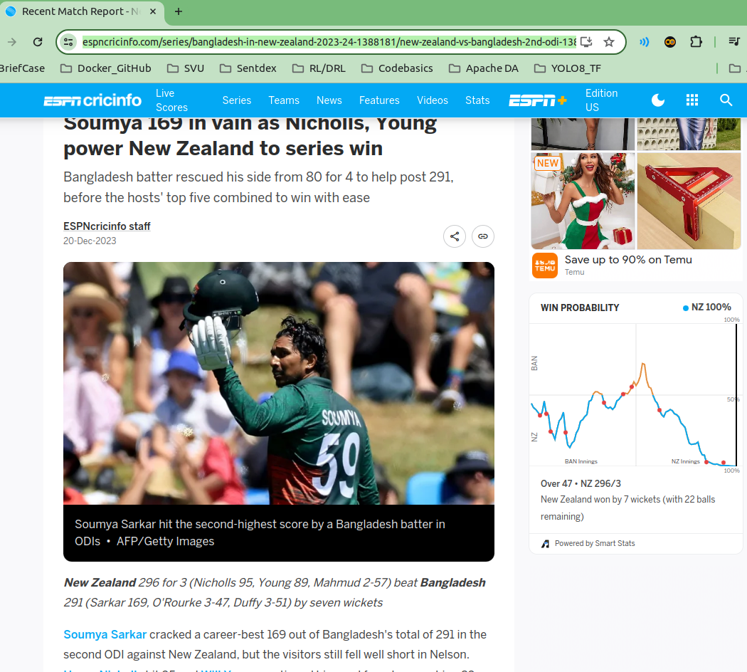
39 Word Embedding
https://www.youtube.com/watch?v=sZGuyTLjsco&list=PLeo1K3hjS3uu7CxAacxVndI4bE_o3BDtO&index=39
Word Embedding (1:31-1:50/11:31)
When you go to ESPN, we grab all the articles to build our language model.
https://www.espncricinfo.com/series/bangladesh-in-new-zealand-2023-24-1388181/new-zealand-vs-bangladesh-2nd-odi-1388211/match-report

Slide 9
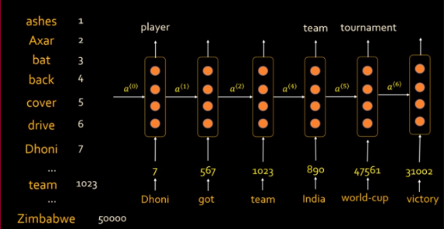
39 Word Embedding
https://www.youtube.com/watch?v=sZGuyTLjsco&list=PLeo1K3hjS3uu7CxAacxVndI4bE_o3BDtO&index=39
Word Embedding (1:48-2:20/11:31)
We read the articles and translate all the vocabularies into numbers.
For examples, we have 50,000 of words (vocabularies).
Because we need to do the set operation for each word, each word need to assign a unique number in the set.

Slide 10
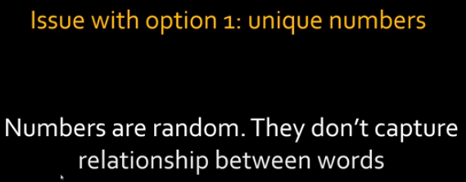
39 Word Embedding
https://www.youtube.com/watch?v=sZGuyTLjsco&list=PLeo1K3hjS3uu7CxAacxVndI4bE_o3BDtO&index=39
Word Embedding (2:22-2:30/11:31)
There are issues here. The first issue here is:
1. numbers are random without relationship. For example, “ashes” and “Dhoni” are players but they are far apart in the list.

Slide 11
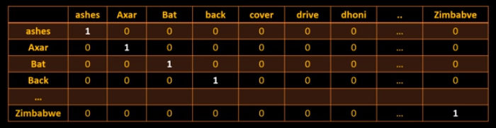
39 Word Embedding
https://www.youtube.com/watch?v=sZGuyTLjsco&list=PLeo1K3hjS3uu7CxAacxVndI4bE_o3BDtO&index=39
Word Embedding (2:22-3:10/11:31)
The second issue is:
2. one-hot encoding: For set operation (intersect, union, etc), each vector occupies “1” in unique position.

Slide 12
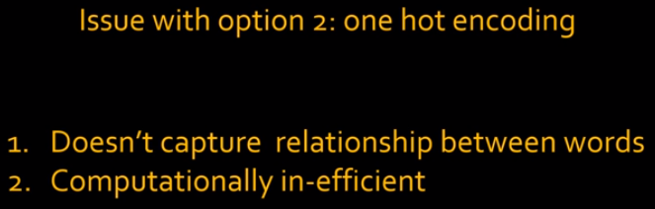
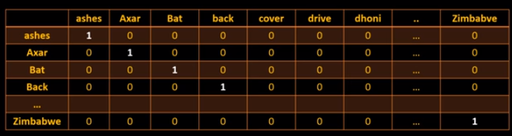
39 Word Embedding
https://www.youtube.com/watch?v=sZGuyTLjsco&list=PLeo1K3hjS3uu7CxAacxVndI4bE_o3BDtO&index=39
Word Embedding (3:27-4:20/11:31)
The second issue also have issues:
1. No relation between words.
2. 50,000 words take a lot of time to compute: In machine learning, we have billion of billion words.

Slide 13
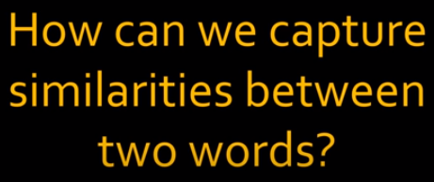
39 Word Embedding
https://www.youtube.com/watch?v=sZGuyTLjsco&list=PLeo1K3hjS3uu7CxAacxVndI4bE_o3BDtO&index=39
Word Embedding (4:26-4:40/11:31)
The word embedding capture the relationship between two words.
How to get the relationships (similarities) between two words?
What is Word Embeddings?
1. In machine learning, we want to reduce the dimension of words by similarity.
2. Word Embeddings in NLP is a technique where individual words are represented as real-valued vectors in a lower-dimensional space and captures inter-word semantics.
3. Each word is represented by a real-valued vector with tens or hundreds of dimensions.

Slide 14
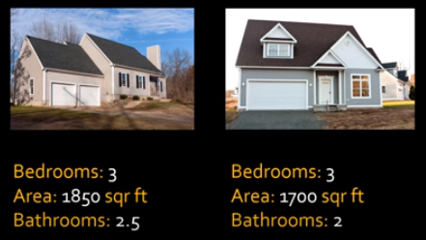
39 Word Embedding
https://www.youtube.com/watch?v=sZGuyTLjsco&list=PLeo1K3hjS3uu7CxAacxVndI4bE_o3BDtO&index=39
Word Embedding (4:48-5:20/11:31)
If we have two homes and we want to figure out these two homes are similar or not.
How do we do that? We look at the feature of the home.
We compare the feature of the home: bedroom number, square feet, bathrooms, etc.
Then, we can say these two homes are similar based on the features.

Slide 15
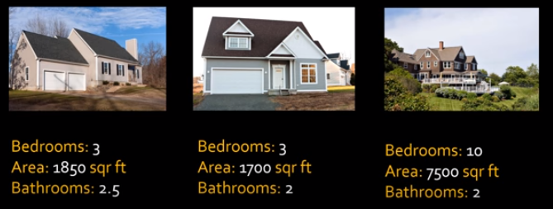
39 Word Embedding
https://www.youtube.com/watch?v=sZGuyTLjsco&list=PLeo1K3hjS3uu7CxAacxVndI4bE_o3BDtO&index=39
Word Embedding (5:29-5:40/11:31)
If we look at very big home with 10 bedroom, 7500 square feet, and 2 bathrooms.
We know these homes are not similar.

Slide 16
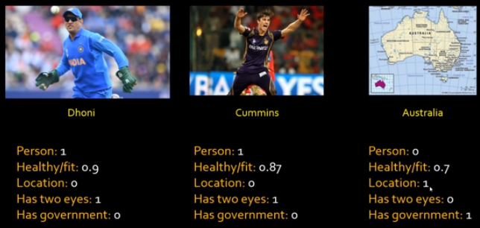
39 Word Embedding
https://www.youtube.com/watch?v=sZGuyTLjsco&list=PLeo1K3hjS3uu7CxAacxVndI4bE_o3BDtO&index=39
Word Embedding (5:44-8:00/11:31)
We apply the same concept to the words.
Here “Dhoni” and “Cummins” are players. They are players and similar.
“Dhoni” is India player but Cummins is Australia player. They are different countries.
Is there a way to extract the features from the words?

Slide 17
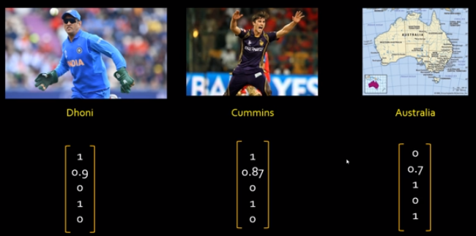
39 Word Embedding
https://www.youtube.com/watch?v=sZGuyTLjsco&list=PLeo1K3hjS3uu7CxAacxVndI4bE_o3BDtO&index=39
Word Embedding (8:02-8:57/11:31)
1. We convert the words into the feature vector and
2. extract the features from feature vector for comparison.
From the feature vector, we can find the player Dhoni and player Cummins have similar features.
But country Australia is different in features.

Slide 18
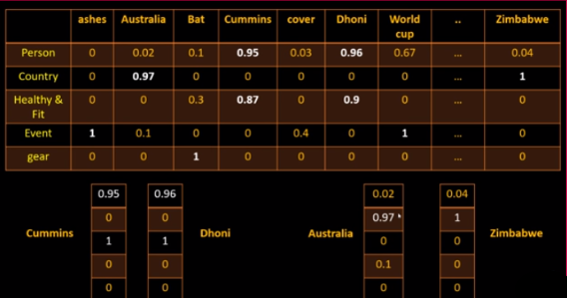
39 Word Embedding
https://www.youtube.com/watch?v=sZGuyTLjsco&list=PLeo1K3hjS3uu7CxAacxVndI4bE_o3BDtO&index=39
Word Embedding (9:00-11:03/11:31)
In machine learning, we
1. convert the words into the feature vector.
2. extract features for comparison (for example, player features and country features are different).
3. We put the feature vectors into the RNN for sentiment classification or NER (Named Entity Recognition), etc, a variety of NLP tasks.

Slide 19
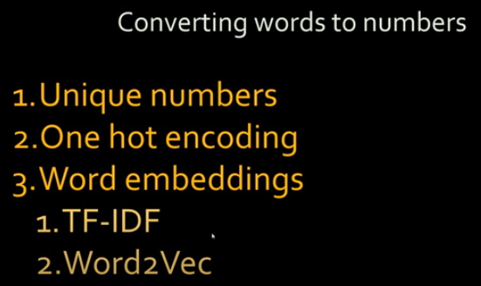
39 Word Embedding
https://www.youtube.com/watch?v=sZGuyTLjsco&list=PLeo1K3hjS3uu7CxAacxVndI4bE_o3BDtO&index=39
Word Embedding (11:04-11:31/11:31)
Summary:
1. Unique Numbers: Each words is represented by a unique number in the vector.
2. One Hot Encoding: We need to the set operation (intersect or union), each word occupy one position in vector.
3. Word Embeddings:
3.1 TF-IDF (Term Frequency – Inverse Document Frequency): Statistical method to reduce word dimension
3.2 Word2Vec: Convert the word into vector.

Slide 20
End

