Slide 1

40 Word Embedding with Keras
Peter H. Chen

Slide 2
40 Word Embedding with Keras
https://www.youtube.com/watch?v=Fuw0wv3X-0o&list=PLeo1K3hjS3uu7CxAacxVndI4bE_o3BDtO&index=40
Word Embedding with Keras (0:00-0:20/21:34)
We discuss how Word Embedding by Python Code:
1. Supervised Learning for Word Embedding.
2. We implement by Python code.

Slide 3
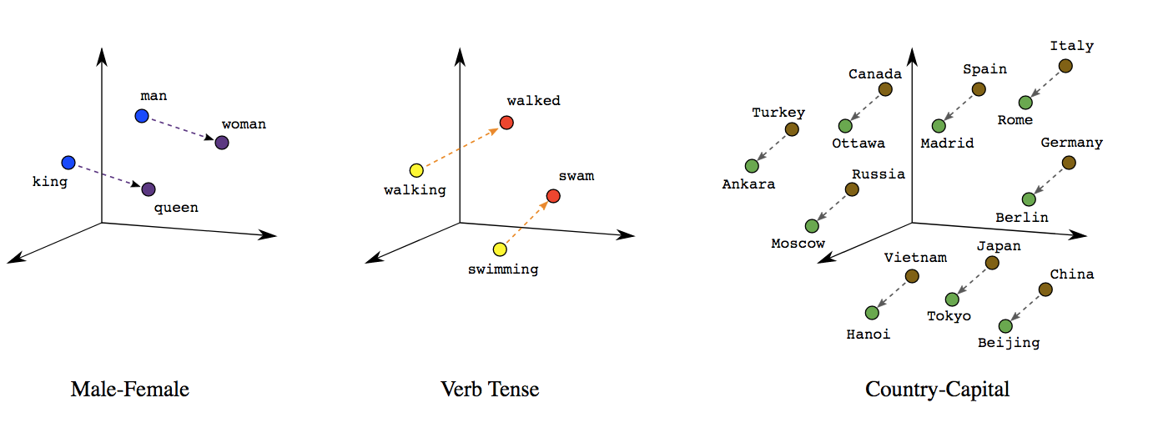
40 Word Embedding with Keras
https://www.youtube.com/watch?v=Fuw0wv3X-0o&list=PLeo1K3hjS3uu7CxAacxVndI4bE_o3BDtO&index=40
Word Embedding with Keras (0:21-0:23/21:34)
What is “Word Embeddings”?
1. Word Embeddings in NLP is a technique where individual words are represented as real-valued vectors in a lower-dimensional space and captures inter-word semantics.
2. Each word is represented by a real-valued vector with tens or hundreds of dimensions.

Slide 4
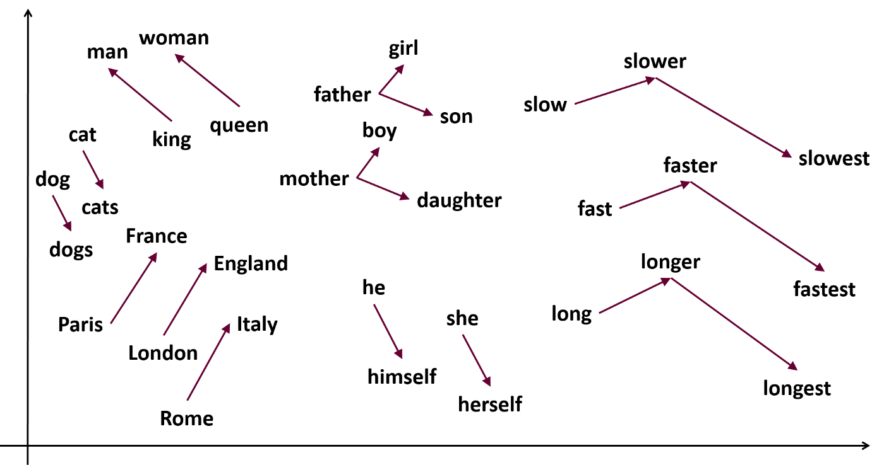
40 Word Embedding with Keras
https://www.youtube.com/watch?v=Fuw0wv3X-0o&list=PLeo1K3hjS3uu7CxAacxVndI4bE_o3BDtO&index=40
Word Embedding with Keras (0:24-0:25/21:34)
What is “word2vec”?
1. Word2vec is a technique in natural language processing (NLP) for obtaining vector representations of words.
2. These vectors capture information about the meaning of the word and their usage in context.
3. The word2vec algorithm estimates these representations by modeling text in a large corpus.

Slide 5
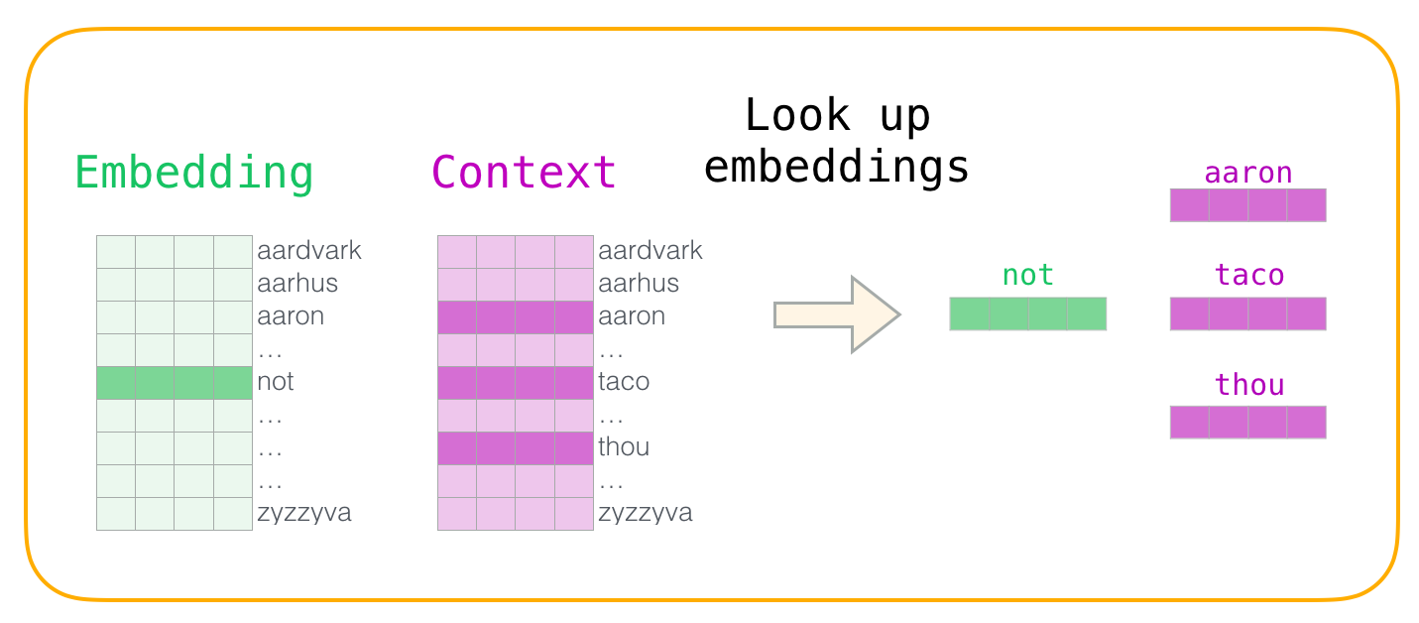
40 Word Embedding with Keras
https://www.youtube.com/watch?v=Fuw0wv3X-0o&list=PLeo1K3hjS3uu7CxAacxVndI4bE_o3BDtO&index=40
Word Embedding with Keras (0:26-0:30/21:34)
What is difference between the “Word Embeddings” and “word2vec”?
1. Word embeddings are a collection of numerical vectors (embeddings) that represent words.
2. Word2vec and Word Embeddings are two strategies of natural language processing (NLP). Word2vec is a two-layer neural network used to generate distributed representations of words called word embeddings.

Slide 6
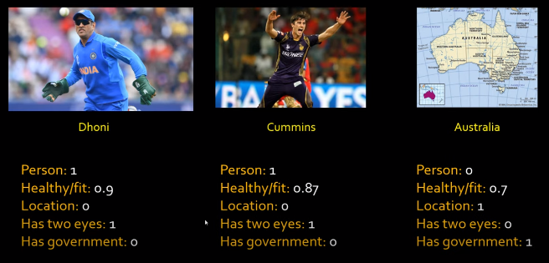
40 Word Embedding with Keras
https://www.youtube.com/watch?v=Fuw0wv3X-0o&list=PLeo1K3hjS3uu7CxAacxVndI4bE_o3BDtO&index=40
Word Embedding with Keras (0:37-1:00/21:34)
We have example in word embedding for cricket players: India Player “Dhoni”, Australia player “Cummins”, and country name “Australia”.

Slide 7
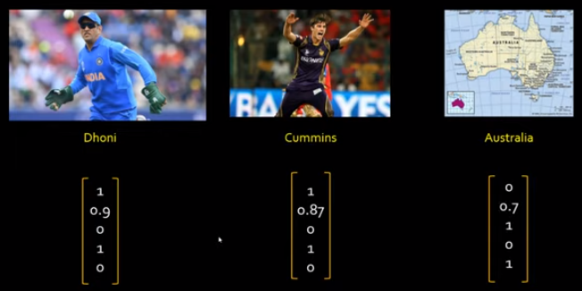
40 Word Embedding with Keras
https://www.youtube.com/watch?v=Fuw0wv3X-0o&list=PLeo1K3hjS3uu7CxAacxVndI4bE_o3BDtO&index=40
Word Embedding with Keras (1:01-1:11/21:34)
We represent into the vector forms.

Slide 8
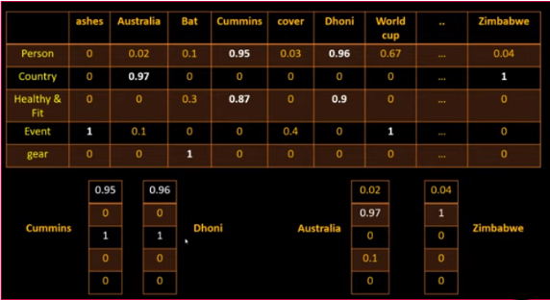
40 Word Embedding with Keras
https://www.youtube.com/watch?v=Fuw0wv3X-0o&list=PLeo1K3hjS3uu7CxAacxVndI4bE_o3BDtO&index=40
Word Embedding with Keras (1:20-1:40/21:34)
We can find the similarities relation of extracted features.

Slide 9
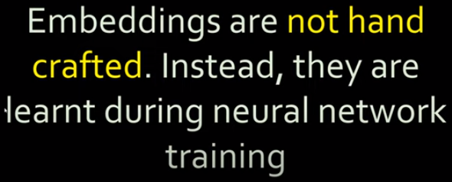
40 Word Embedding with Keras
https://www.youtube.com/watch?v=Fuw0wv3X-0o&list=PLeo1K3hjS3uu7CxAacxVndI4bE_o3BDtO&index=40
Word Embedding with Keras (1:20-1:40/21:34)
The embeddings are not hand crafted. They cannot make by hand.
The embedding is made by training.

Slide 10
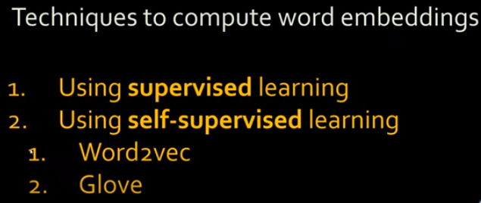
40 Word Embedding with Keras
https://www.youtube.com/watch?v=Fuw0wv3X-0o&list=PLeo1K3hjS3uu7CxAacxVndI4bE_o3BDtO&index=40
Word Embedding with Keras (1:55-2:00/21:34)
The embeddings are made by supervised learning or self-supervised learning.
First, we discuss embeddings by supervised learning.

Slide 11
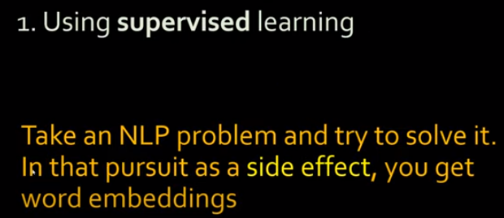
40 Word Embedding with Keras
https://www.youtube.com/watch?v=Fuw0wv3X-0o&list=PLeo1K3hjS3uu7CxAacxVndI4bE_o3BDtO&index=40
Word Embedding with Keras (2:08-2:20/21:34)
The embeddings are made by supervised learning or self-supervised learning.
Here, we discuss embeddings by supervised learning.
When we use supervised learning to solve NLP problem, we need to train the neural network.
We get the side effect of word embeddings after the neural network is trained.

Slide 12
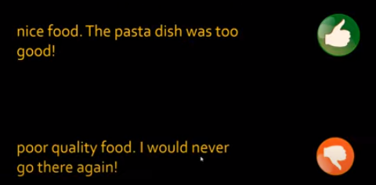
40 Word Embedding with Keras
https://www.youtube.com/watch?v=Fuw0wv3X-0o&list=PLeo1K3hjS3uu7CxAacxVndI4bE_o3BDtO&index=40
Word Embedding with Keras (2:26-3:00/21:34)
For example, we review the food classification.
When we do the food classification, we have to train the neural network.
After the neural network is trained, we will get the word embeddings.
The word embeddings are the the side effect of the trained neural network.

Slide 13
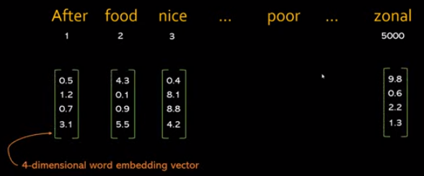
40 Word Embedding with Keras
https://www.youtube.com/watch?v=Fuw0wv3X-0o&list=PLeo1K3hjS3uu7CxAacxVndI4bE_o3BDtO&index=40
Word Embedding with Keras (3:04-3:30/21:34)
Now, we have 5,000 words in the inputs and 100 food for review.
For example, we have 4 dimension for word embedding vector.

Slide 14
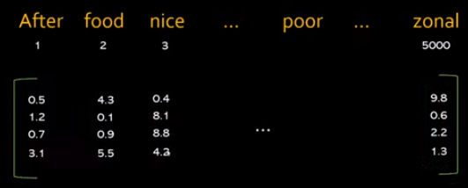
40 Word Embedding with Keras
https://www.youtube.com/watch?v=Fuw0wv3X-0o&list=PLeo1K3hjS3uu7CxAacxVndI4bE_o3BDtO&index=40
Word Embedding with Keras (3:47-4:10/21:34)
Now, we have
1. 5,000 feature words in the inputs and
2. 100 food for review.
3. In the RNN (Recurrent Neural Network), we have 4 dimension for weights.
In the machine learning, we can think the weights matrix as below.

Slide 15
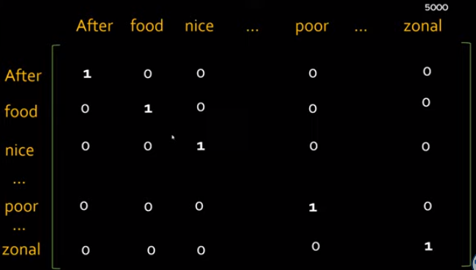
40 Word Embedding with Keras
https://www.youtube.com/watch?v=Fuw0wv3X-0o&list=PLeo1K3hjS3uu7CxAacxVndI4bE_o3BDtO&index=40
Word Embedding with Keras (4:13-4:30/21:34)
We also have the one-hot encoding similarity matrix (5,000 x 5, 000) as below.

Slide 16
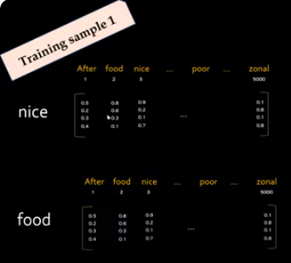
40 Word Embedding with Keras
https://www.youtube.com/watch?v=Fuw0wv3X-0o&list=PLeo1K3hjS3uu7CxAacxVndI4bE_o3BDtO&index=40
Word Embedding with Keras (4:30-4:50/21:34)
1. We select two keywords (“nice” “food”) from all features for training.
2. At first, we also have random assign the weight and train for each selected keyword.

Slide 17
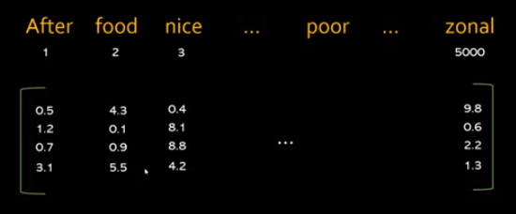
40 Word Embedding with Keras
https://www.youtube.com/watch?v=Fuw0wv3X-0o&list=PLeo1K3hjS3uu7CxAacxVndI4bE_o3BDtO&index=40
Word Embedding with Keras (4:54-4:54/21:34)
After the training, we will have 4 x 5,000 embedding weight matrix E as below.

Slide 18
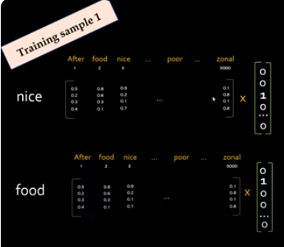
40 Word Embedding with Keras
https://www.youtube.com/watch?v=Fuw0wv3X-0o&list=PLeo1K3hjS3uu7CxAacxVndI4bE_o3BDtO&index=40
Word Embedding with Keras (4:54-4:54/21:34)
During the training, we trained the weights matrix with selected keywords (one word by another word).
We have two meaningful keywords “nice” and “food” from all feature words (5,000 features).
We train the random weights multiply with the one-hot encoding vector.

Slide 19
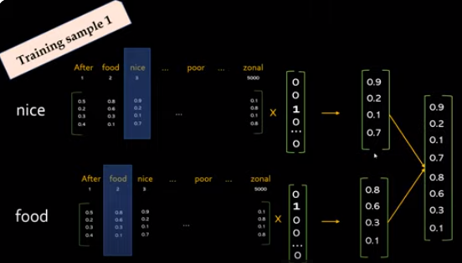
40 Word Embedding with Keras
https://www.youtube.com/watch?v=Fuw0wv3X-0o&list=PLeo1K3hjS3uu7CxAacxVndI4bE_o3BDtO&index=40
Word Embedding with Keras (5:38-5:54/21:34)
During the training, we multiply the embedding keyword vector and we have forward estimate matrix.
We combine the forward estimate matrix and fatten the forward matrix.

Slide 20
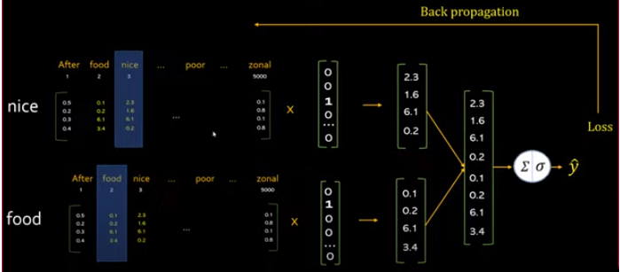
40 Word Embedding with Keras
https://www.youtube.com/watch?v=Fuw0wv3X-0o&list=PLeo1K3hjS3uu7CxAacxVndI4bE_o3BDtO&index=40
Word Embedding with Keras (5:38-7:20/21:34)
During the training, we use the label to subtract the forward estimate matrix ŷ to get the loss (y – ŷ).
Then, we do the back propagation.
When we do the back propagation, the weight will be updated into the new weights.

Slide 21
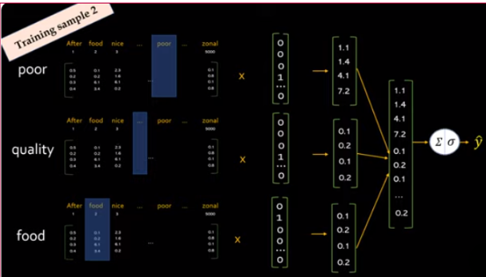
40 Word Embedding with Keras
https://www.youtube.com/watch?v=Fuw0wv3X-0o&list=PLeo1K3hjS3uu7CxAacxVndI4bE_o3BDtO&index=40
Word Embedding with Keras (7:27-7:50/21:34)
Now, we train another set of selected keywords (“poor”, “quality”, and “food”) for weights.

Slide 22
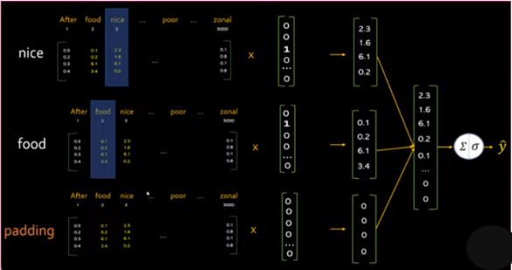
40 Word Embedding with Keras
https://www.youtube.com/watch?v=Fuw0wv3X-0o&list=PLeo1K3hjS3uu7CxAacxVndI4bE_o3BDtO&index=40
Word Embedding with Keras (7:58-8:20/21:34)
We trained for the remaining words (“nice”, “food”, “padding”)
The “padding” is a special keyword for the maximum length sentence.
The “padding” has all zero in the one-hot encoding vector.

Slide 23
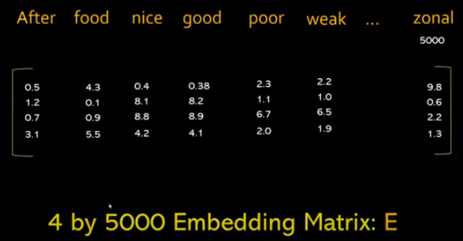
40 Word Embedding with Keras
https://www.youtube.com/watch?v=Fuw0wv3X-0o&list=PLeo1K3hjS3uu7CxAacxVndI4bE_o3BDtO&index=40
Word Embedding with Keras (8:31-8:40/21:34)
Eventually, we will get the final Embedding Matrix: E​ for 4 x 5,000 matrix for 4 neurons and 5,000 keywords.

Slide 24
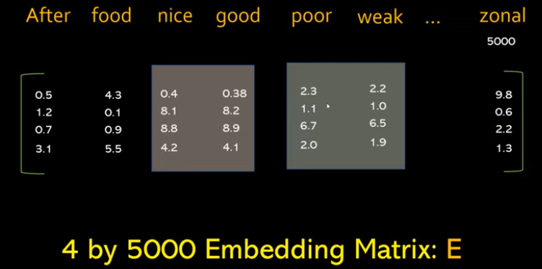
40 Word Embedding with Keras
https://www.youtube.com/watch?v=Fuw0wv3X-0o&list=PLeo1K3hjS3uu7CxAacxVndI4bE_o3BDtO&index=40
Word Embedding with Keras (8:43-9:20/21:34)
In this particular example, we have
1. “nice” and “good” columns are very similar.
2. “poor” and “weak” columns are very similar.
If we look at the similarities of these vectors, we will find the numbers of vectors are very close.
Nowadays, the word2vec is more popular then word embeddings.

Slide 25
40.1 Word Embedding by Keras: Coding

Slide 26
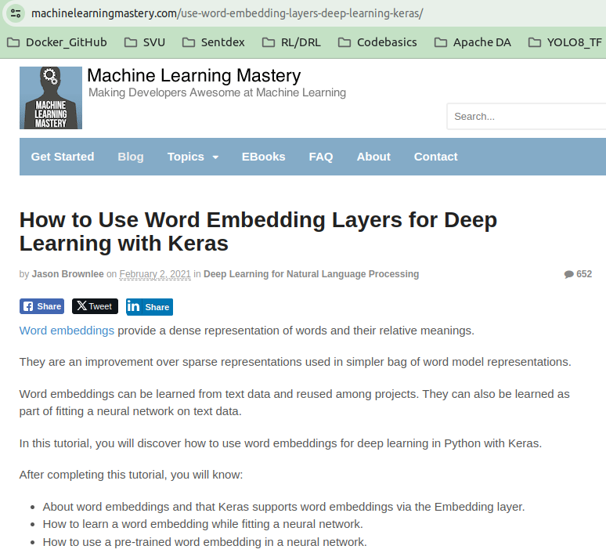
40.1 Word Embedding by Keras: Coding
https://www.youtube.com/watch?v=Fuw0wv3X-0o&list=PLeo1K3hjS3uu7CxAacxVndI4bE_o3BDtO&index=40
Word Embedding by Keras: Coding (9:41-9:50/21:34)
https://machinelearningmastery.com/use-word-embedding-layers-deep-learning-keras/
By Jason Brownlee

Slide 27
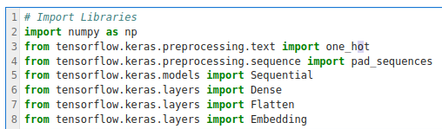
40.1 Word Embedding by Keras: Coding
https://www.youtube.com/watch?v=Fuw0wv3X-0o&list=PLeo1K3hjS3uu7CxAacxVndI4bE_o3BDtO&index=40
Word Embedding by Keras: Coding (10:08-10:10/21:34)
We import libraries.

Slide 28
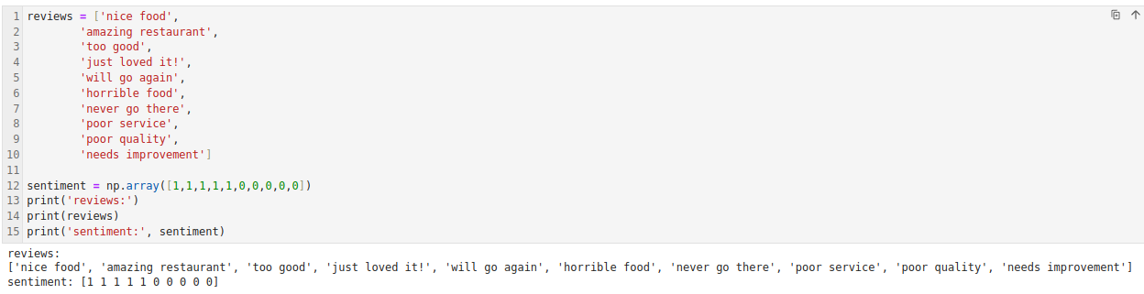
40.1 Word Embedding by Keras: Coding
https://www.youtube.com/watch?v=Fuw0wv3X-0o&list=PLeo1K3hjS3uu7CxAacxVndI4bE_o3BDtO&index=40
Word Embedding by Keras: Coding (10:11-10:12/21:34)
We are going to review the food.
1. We define the review list,
2. Give east list a number: 1 (positive), 0 (negative)

Slide 29
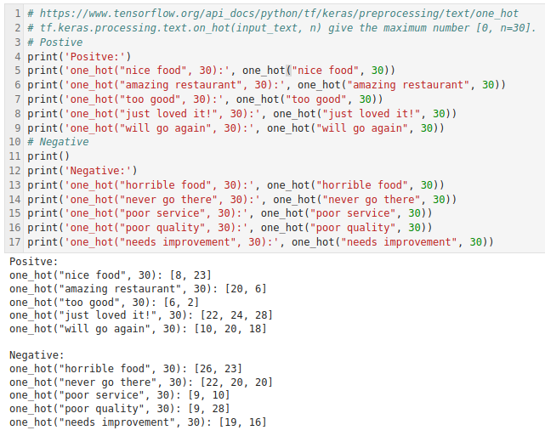
40.1 Word Embedding by Keras: Coding
https://www.youtube.com/watch?v=Fuw0wv3X-0o&list=PLeo1K3hjS3uu7CxAacxVndI4bE_o3BDtO&index=40
Word Embedding by Keras: Coding (10:11-12:20/21:34)
keras.processing.txt.one_hot(“...”, 30) will give each words a unique ID between 0 to 30.

Slide 30
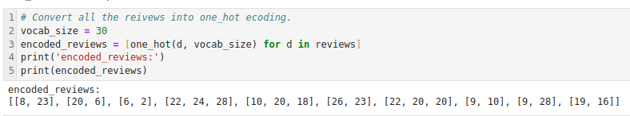
40.1 Word Embedding by Keras: Coding
https://www.youtube.com/watch?v=Fuw0wv3X-0o&list=PLeo1K3hjS3uu7CxAacxVndI4bE_o3BDtO&index=40
Word Embedding by Keras: Coding (12:21-12:30/21:34)
Convert all the reviews into one hot encoding.

Slide 31
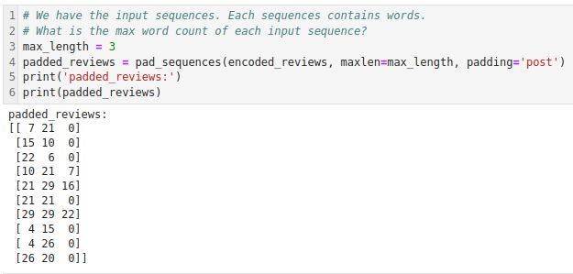
40.1 Word Embedding by Keras: Coding
https://www.youtube.com/watch?v=Fuw0wv3X-0o&list=PLeo1K3hjS3uu7CxAacxVndI4bE_o3BDtO&index=40
Word Embedding by Keras: Coding (12:53-14:40/21:34)
Keras.processing.sequence():
1. Specify the maximum word count (maxlen = 3) for each sequence.
2. padding: “pre” or “post”, pad before or post after maxlen.

Slide 32
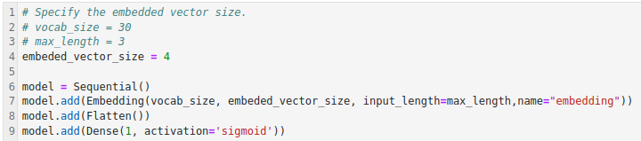
40.1 Word Embedding by Keras: Coding
https://www.youtube.com/watch?v=Fuw0wv3X-0o&list=PLeo1K3hjS3uu7CxAacxVndI4bE_o3BDtO&index=40
Word Embedding by Keras: Coding (14:50-15:20/21:34)
1. Encoding vector: Vocabulary size = 30, encoding r max length = 3.
2. Neural network: Embedded vector size = 4.

Slide 33
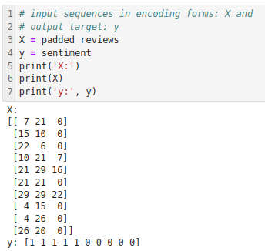
40.1 Word Embedding by Keras: Coding
https://www.youtube.com/watch?v=Fuw0wv3X-0o&list=PLeo1K3hjS3uu7CxAacxVndI4bE_o3BDtO&index=40
Word Embedding by Keras: Coding (15:27-15:30/21:34)
Input sequences and encode into X.
Output y.

Slide 34
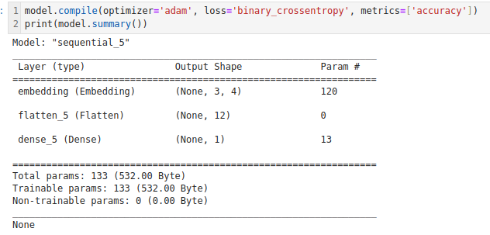
40.1 Word Embedding by Keras: Coding
https://www.youtube.com/watch?v=Fuw0wv3X-0o&list=PLeo1K3hjS3uu7CxAacxVndI4bE_o3BDtO&index=40
Word Embedding by Keras: Coding (15:30-16:30/21:34)
Input X: (3, 5)
Hidden flatten: 4 x 5 = 20
Output: 1
Input encode vector of Neural Network: (3, 10)
Output target Neural Network: (10, ...)

Slide 35
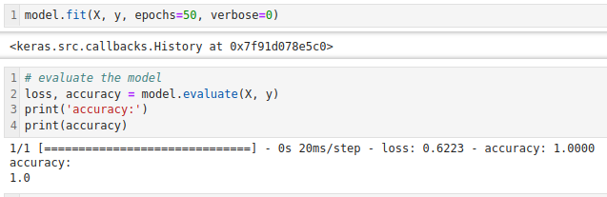
40.1 Word Embedding by Keras: Coding
https://www.youtube.com/watch?v=Fuw0wv3X-0o&list=PLeo1K3hjS3uu7CxAacxVndI4bE_o3BDtO&index=40
Word Embedding by Keras: Coding (16:30-17:30/21:34)
1. Regress embedding Model.
2. Print accuracy.

Slide 36
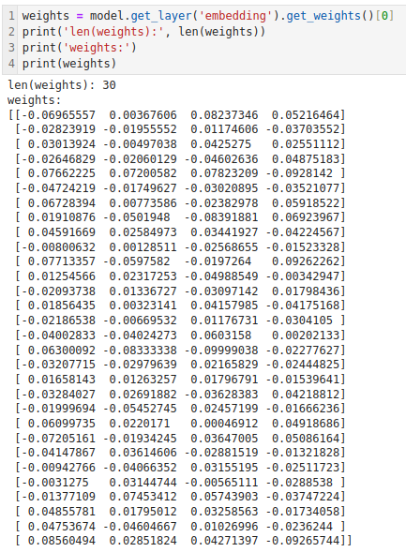
40.1 Word Embedding by Keras: Coding
https://www.youtube.com/watch?v=Fuw0wv3X-0o&list=PLeo1K3hjS3uu7CxAacxVndI4bE_o3BDtO&index=40
Word Embedding by Keras: Coding (17:50-19:00/21:34)
Print all the weights: 4 x 30.
The 4 is size of neural network, 30 is the size of neural network.

Slide 37
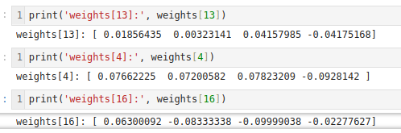
40.1 Word Embedding by Keras: Coding
https://www.youtube.com/watch?v=Fuw0wv3X-0o&list=PLeo1K3hjS3uu7CxAacxVndI4bE_o3BDtO&index=40
Word Embedding by Keras: Coding (19:01-21:34/21:34)
Check the weights inside the neural network.

Slide 38
End

