Slide 1

41 Word2Vec
Peter H. Chen

Slide 2

41 Word2Vec
https://www.youtube.com/watch?v=hQwFeIupNP0&list=PLeo1K3hjS3uu7CxAacxVndI4bE_o3BDtO&index=41
Word2Vec (0:00-1:20/18:27)
We discuss the Word2Vec.
One-hot encoding can be used in set operation:
“King – man + Woman = Queen”
How the computer do that the number for texts meaning operation.

Slide 3
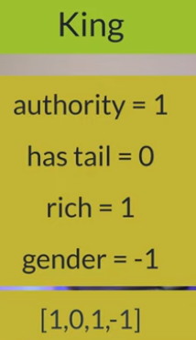
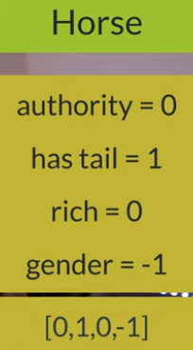
41 Word2Vec
https://www.youtube.com/watch?v=hQwFeIupNP0&list=PLeo1K3hjS3uu7CxAacxVndI4bE_o3BDtO&index=41
Word2Vec (2:00-2:20/18:27)
How to represent the texts “king” and “horse” by number in dictionary (or vector) format?
one-hot encoding for “King” = [Authority: 1, has_tail: 0, rich: 1, gender: -1]
one-hot encoding for “Horse” = [Authority: 0, has_tail: 1, rich: 0, gender: -1]
If we represent all the words into the number (dictionary or vector), then we can do the math for words. This is super cool.

Slide 4
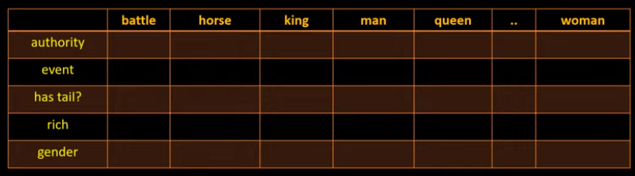
41 Word2Vec
https://www.youtube.com/watch?v=hQwFeIupNP0&list=PLeo1K3hjS3uu7CxAacxVndI4bE_o3BDtO&index=41
Word2Vec (2:28-2:50/18:27)
The words in in this table can be a vector.
What are the number can be?

Slide 5
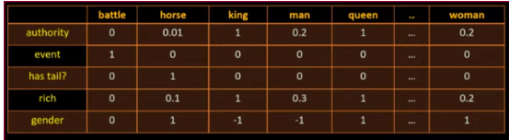
41 Word2Vec
https://www.youtube.com/watch?v=hQwFeIupNP0&list=PLeo1K3hjS3uu7CxAacxVndI4bE_o3BDtO&index=41
Word2Vec (3:01-3:20/18:27)
We can represent the words into a vector and do the math.
“battle” = {authority: 0, event: 1, has_tail: 0, rich: 0, gender: 0}
“Horse” = {authority: 0.01, event: 0, has_tail: 1, rich: 0.1, gender: -1}

Slide 6
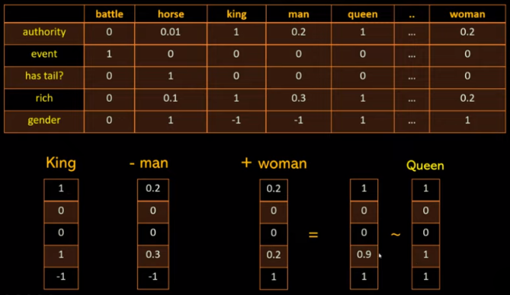
41 Word2Vec
https://www.youtube.com/watch?v=hQwFeIupNP0&list=PLeo1K3hjS3uu7CxAacxVndI4bE_o3BDtO&index=41
Word2Vec (3:21-3:47/18:27)
We can do the math with words: “queen” = “King” – “man” + “woman”
= {Authority: 1, event: 0, has_tail: 0, rich: 1, gender: -1} - {Authority: 0.2. event: 0, has_tail: 0, rich: 0.3, gender: -1} + {Authority: 0.2. event: 0, has_tail: 0, rich: 0.2, gender: 1}
= {Authority: 1. event: 0, has_tail: 0, rich: 0.9, gender: 1}
≈ “Queen” = {Authority: 1. event: 0, has_tail: 0, rich: 1, gender: 1}

Slide 7
41 Word2Vec
https://www.youtube.com/watch?v=hQwFeIupNP0&list=PLeo1K3hjS3uu7CxAacxVndI4bE_o3BDtO&index=41
Word2Vec (4:01-4:20/18:27)
Convert the words into dictionary (vector) and do the math operation is powerful.
To represent all the words into vector is very difficult.

Slide 8
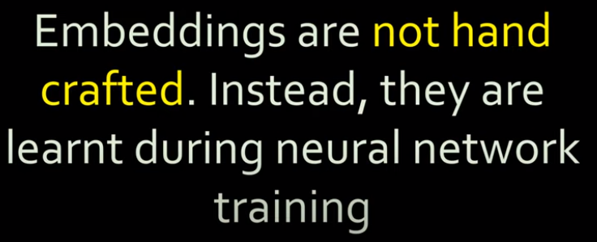
41 Word2Vec
https://www.youtube.com/watch?v=hQwFeIupNP0&list=PLeo1K3hjS3uu7CxAacxVndI4bE_o3BDtO&index=41
Word2Vec (4:21-4:30/18:27)
In NLP, we do not want to hand-crafted (made by hand), we learned from the neural network.
What is hand-crafted?
Answer: Made by hand, not made by machine, computer, or neural network.

Slide 9
41 Word2Vec
https://www.youtube.com/watch?v=hQwFeIupNP0&list=PLeo1K3hjS3uu7CxAacxVndI4bE_o3BDtO&index=41
Word2Vec (4:31-5:00/18:27)
In the table, these numbers are called the featured vector.
In Machine Learning, the “authority”, “event”, “rich”, and “gender” are called features.
Using neural network, we can learn words from the these feature vectors.
We don’t have to hand crafted for all the words.

Slide 10
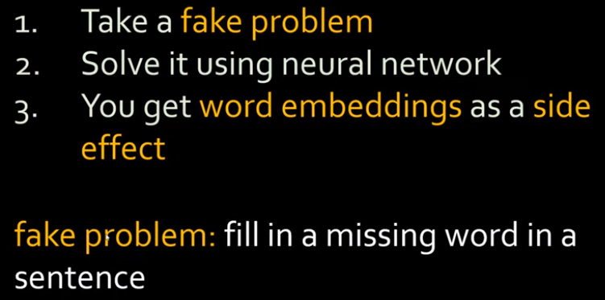
41 Word2Vec
https://www.youtube.com/watch?v=hQwFeIupNP0&list=PLeo1K3hjS3uu7CxAacxVndI4bE_o3BDtO&index=41
Word2Vec (5:01-5:30/18:27)
https://insights.sei.cmu.edu/library/anomaly-detection-on-devices-dns-queries-using-deep-learning/
What is the “fake problem”?
Our goal is to “learn or fill the missing words in the neural network” is called the “fake problem”.

Slide 11
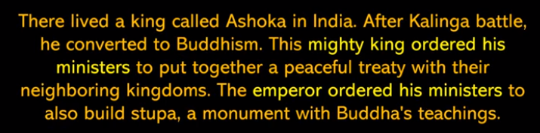
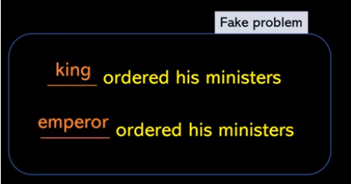
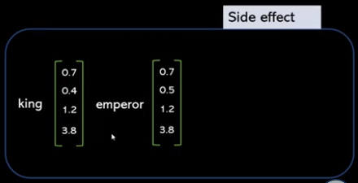
41 Word2Vec
https://www.youtube.com/watch?v=hQwFeIupNP0&list=PLeo1K3hjS3uu7CxAacxVndI4bE_o3BDtO&index=41
Word2Vec (5:37-5:50/18:27)
https://insights.sei.cmu.edu/library/anomaly-detection-on-devices-dns-queries-using-deep-learning/
We read the story below and we want to complete the sentence in the “Fake Problem”.
We have a “Side Effect” (number vector for word embedding) when we solve this “Fake Problem”.
Stupa (佛塔)

Slide 12
41 Word2Vec
https://www.youtube.com/watch?v=hQwFeIupNP0&list=PLeo1K3hjS3uu7CxAacxVndI4bE_o3BDtO&index=41
Word2Vec (6:40-7:10/18:27)
For example, “eating something is very healthy”.
When we fill in the missing word, most likely is “apple” or “walnut”.
“pizza” is food but not very healthy. “table”, “angry”, and “truck” cannot be digested.

Slide 13
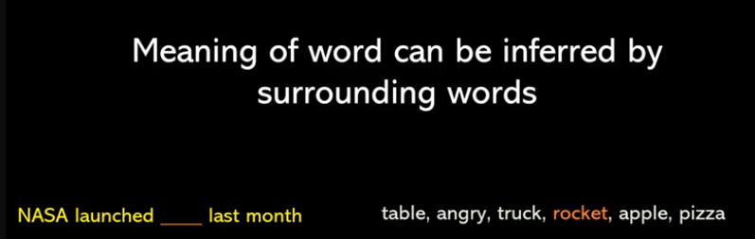
41 Word2Vec
https://www.youtube.com/watch?v=hQwFeIupNP0&list=PLeo1K3hjS3uu7CxAacxVndI4bE_o3BDtO&index=41
Word2Vec (7:11-7:40/18:27)
Below, example, we can fill “NASA launched rocket last month”.
The meaningful word can be inferred by surrounding words.
If someone give you the surrounding words, these surrounding words are also called “Context”.
Based on the “Context”, we can figured out what words are missing.

Slide 14
41 Word2Vec
https://www.youtube.com/watch?v=hQwFeIupNP0&list=PLeo1K3hjS3uu7CxAacxVndI4bE_o3BDtO&index=41
Word2Vec (7:41-7:50/18:27)
Look the example paragraph, fill in the missing words is the “Fake Problem“. It is not our interest.
We are interested in the word embeddings: The vectors which can represent these words.

Slide 15
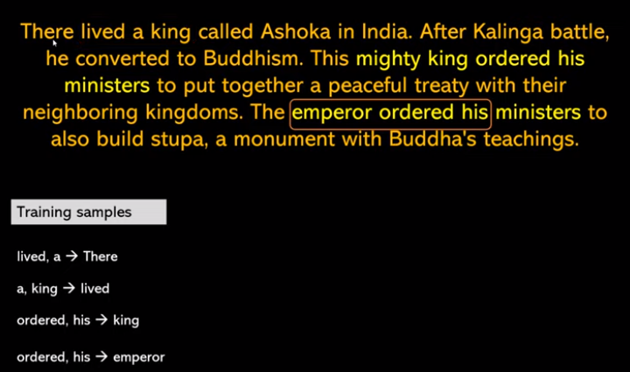
41 Word2Vec
https://www.youtube.com/watch?v=hQwFeIupNP0&list=PLeo1K3hjS3uu7CxAacxVndI4bE_o3BDtO&index=41
Word2Vec (8:11-8:50/18:27)
If we have second and third word “Lived a”, we want to predict the first word “There”.
We have the training samples as below.
The words on the left is X and the words on the right are y.
We create the neural network and use neural network to predict.

Slide 16
41 Word2Vec
https://www.youtube.com/watch?v=hQwFeIupNP0&list=PLeo1K3hjS3uu7CxAacxVndI4bE_o3BDtO&index=41
Word2Vec (9:01-9:40/18:27)
The problem we have is “self-supervised learning”.
We input the paragraph and the neural network will sample and train based on the paragraph.
We do not have X and y. From the paragraph, we generate the training samples, and use training samples to train the neural network.

Slide 17
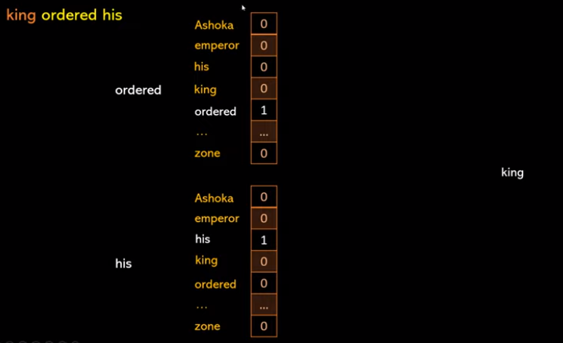
41 Word2Vec
https://www.youtube.com/watch?v=hQwFeIupNP0&list=PLeo1K3hjS3uu7CxAacxVndI4bE_o3BDtO&index=41
Word2Vec (9:45-9:50/18:27)
“king ordered his”. We have 5,000 vocabularies. “ordered” and “his” are two words of the 5,000 words.

Slide 18
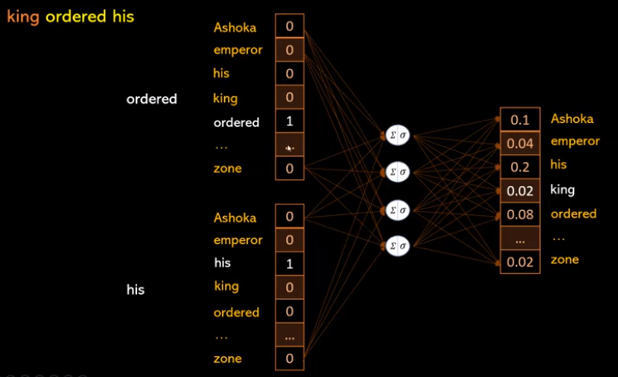
41 Word2Vec
https://www.youtube.com/watch?v=hQwFeIupNP0&list=PLeo1K3hjS3uu7CxAacxVndI4bE_o3BDtO&index=41
Word2Vec (9:51-10:30/18:27)
We feed forward two words “ordered” and “his” into the neural network and get the labeled output “king”.

Slide 19
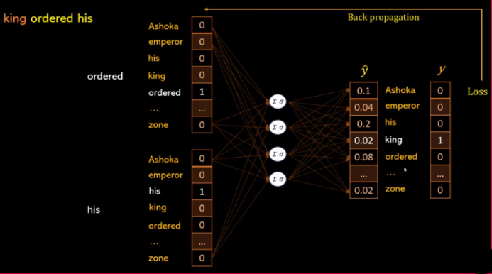
41 Word2Vec
https://www.youtube.com/watch?v=hQwFeIupNP0&list=PLeo1K3hjS3uu7CxAacxVndI4bE_o3BDtO&index=41
Word2Vec (10:31-11:50/18:27)
Then, we do the back-propagation for these two samples.

Slide 20
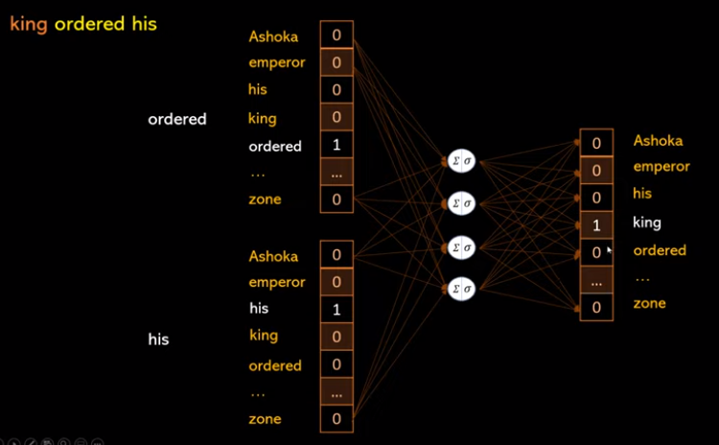
41 Word2Vec
https://www.youtube.com/watch?v=hQwFeIupNP0&list=PLeo1K3hjS3uu7CxAacxVndI4bE_o3BDtO&index=41
Word2Vec (12:01-12:20/18:27)
When we train all millions of sample. We can predict king based on input words “ordered” and “his”.

Slide 21
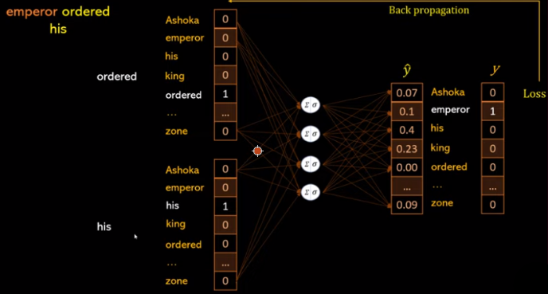
41 Word2Vec
https://www.youtube.com/watch?v=hQwFeIupNP0&list=PLeo1K3hjS3uu7CxAacxVndI4bE_o3BDtO&index=41
Word2Vec (12:29-12:50/18:27)
Now, we do the “emperor ordered his”.

Slide 22
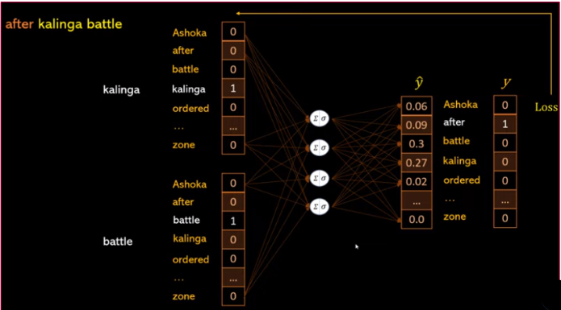
41 Word2Vec
https://www.youtube.com/watch?v=hQwFeIupNP0&list=PLeo1K3hjS3uu7CxAacxVndI4bE_o3BDtO&index=41
Word2Vec (12:51-13:10/18:27)
Now, we do the “after Kalinga (訶陵) battle”.

Slide 23
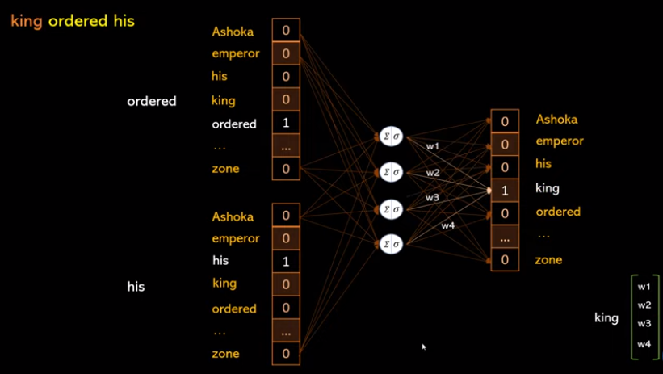
41 Word2Vec
https://www.youtube.com/watch?v=hQwFeIupNP0&list=PLeo1K3hjS3uu7CxAacxVndI4bE_o3BDtO&index=41
Word2Vec (12:51-13:37/18:27)
After millions of training, we can predict the king vector = [w1, w2, w3, w4].

Slide 24
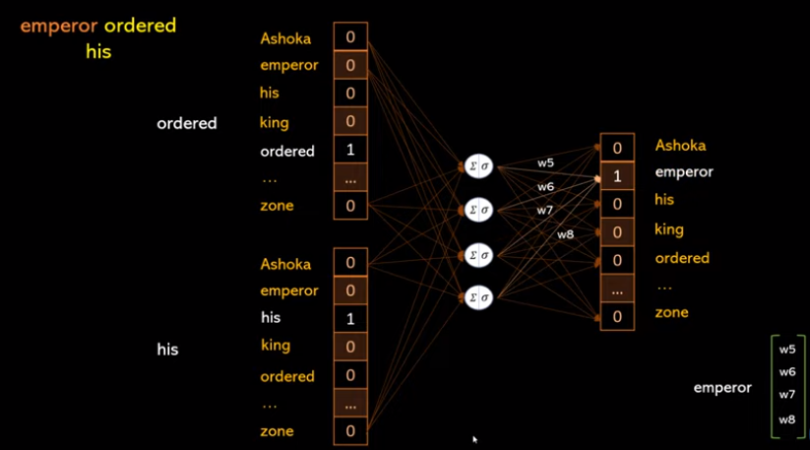
41 Word2Vec
https://www.youtube.com/watch?v=hQwFeIupNP0&list=PLeo1K3hjS3uu7CxAacxVndI4bE_o3BDtO&index=41
Word2Vec (12:51-13:37/18:27)
Similarly, we can predict the emperor vector = [w5, w6, w7, w8].

Slide 25
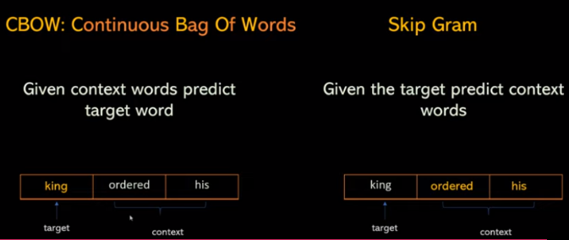
41 Word2Vec
https://www.youtube.com/watch?v=hQwFeIupNP0&list=PLeo1K3hjS3uu7CxAacxVndI4bE_o3BDtO&index=41
Word2Vec (14:09-14:37/18:27)
We have two approaches:
1. CBOW (Continuous Bag of Words): Given context words “ordered” and “his”, predict target “king”
2. Skip Gram: Given target “king”, predict context words “ordered” and “his”.

Slide 26
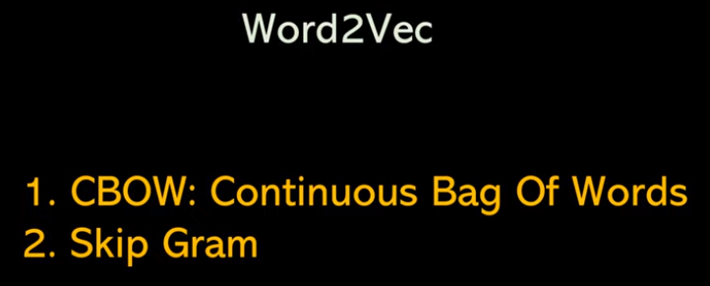
41 Word2Vec
https://www.youtube.com/watch?v=hQwFeIupNP0&list=PLeo1K3hjS3uu7CxAacxVndI4bE_o3BDtO&index=41
Word2Vec (14:56-15:20/18:27)
In summary, Word2Vec is the revolutionary in computer science. Word2Vec contains two methods:
1. CBOW (Continuous Bag Of Words)
2. Skip Gram
We use CROW or “Skip Gram” to learn the word embeddings mean convert the words into a vector.
We represent the words into vectors in a very accurate way for words computation.
What are difference between CROW and “Skip Gram”?
1. CBOW predicts a target word on the based on its neighbors
2. Skip Gram predict the neighbors of based on target

Slide 27
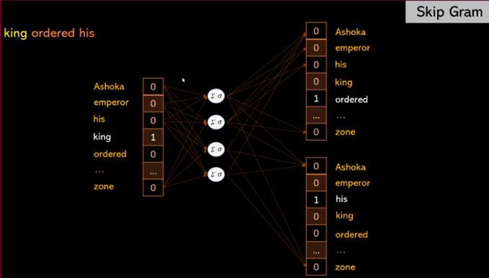
41 Word2Vec
https://www.youtube.com/watch?v=hQwFeIupNP0&list=PLeo1K3hjS3uu7CxAacxVndI4bE_o3BDtO&index=41
Word2Vec (15:27-16:20/18:27)
In Skip gram, we give target “king” to predict the context words “ordered” and “his”.

Slide 28
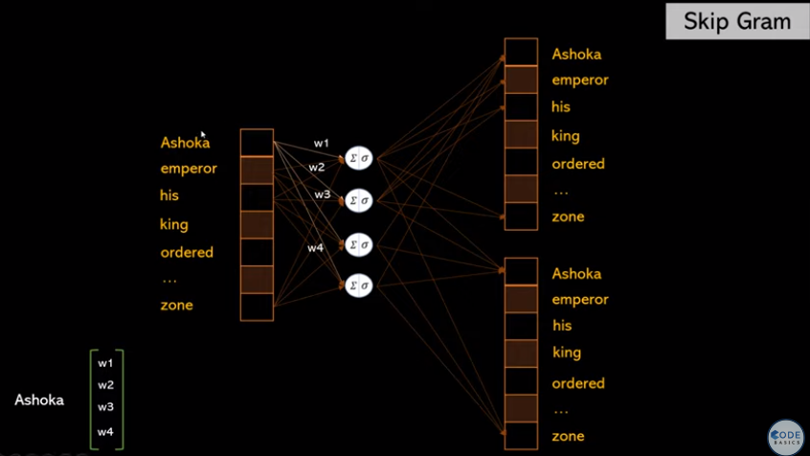
41 Word2Vec
https://www.youtube.com/watch?v=hQwFeIupNP0&list=PLeo1K3hjS3uu7CxAacxVndI4bE_o3BDtO&index=41
Word2Vec (16:21-18:25/18:27)
In Skip gram, we give target “Ashoka” to predict the context words.

Slide 29
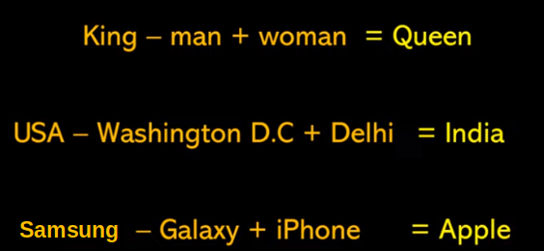
41 Word2Vec
https://www.youtube.com/watch?v=hQwFeIupNP0&list=PLeo1K3hjS3uu7CxAacxVndI4bE_o3BDtO&index=41
Word2Vec (16:31-17:00/18:27)
We can do the text operation for the below words:
1. King – man + woman = Queen
2. USA – Washington DC + Delhi = India
3. Samsung – Galaxy + iPhone = Apple

Slide 30
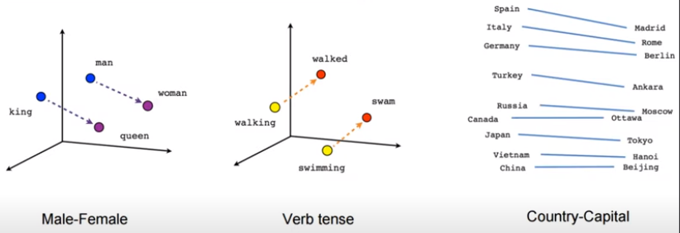
41 Word2Vec
https://www.youtube.com/watch?v=hQwFeIupNP0&list=PLeo1K3hjS3uu7CxAacxVndI4bE_o3BDtO&index=41
Word2Vec (17:01-18:27/18:27)
Neural network can learn from different relationship between the words.

Slide 31
End

