Slide 1

26 Data Augmentation
Peter H. Chen

Slide 2
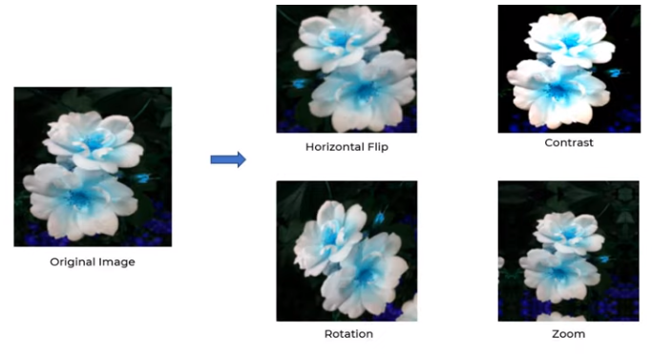
26 Data Augmentation
https://www.youtube.com/watch?v=mTVf7BN7S8w&list=PLeo1K3hjS3uu7CxAacxVndI4bE_o3BDtO&index=26
Data Augmentation (0:00-1:30/31:32)
When we do the CNN, the original data may not perform well.
For example, below is the original flower and can not predict well.
To improve the prediction accuracy, we can do data augmentation: 1. Horizontal flip, 2, contrast, 3. Rotation, 4. Zoom
This is very effective.

Slide 3
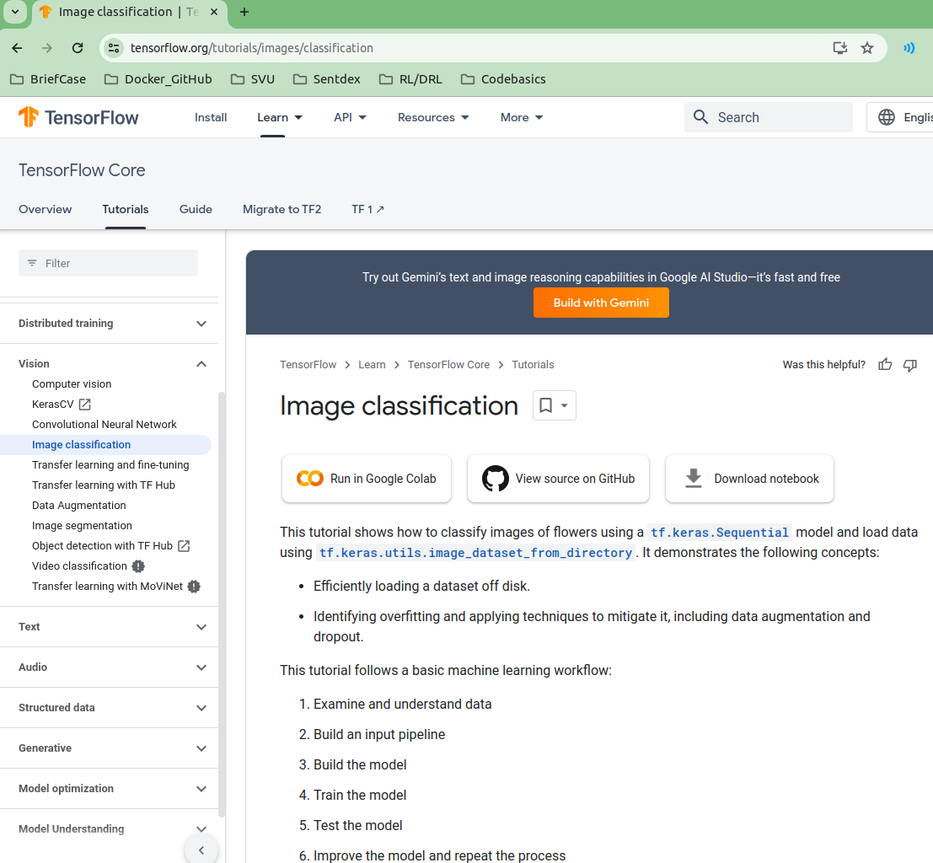
26 Data Augmentation
https://www.youtube.com/watch?v=mTVf7BN7S8w&list=PLeo1K3hjS3uu7CxAacxVndI4bE_o3BDtO&index=26
Data Augmentation (1:31-2:30/31:32)
https://www.tensorflow.org/tutorials/images/classification
We have the tensorflow core:

Slide 4
26.1 Colab: Import Libraries

Slide 5
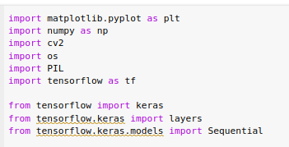
26.1 Colab: Import Libraries
https://www.youtube.com/watch?v=mTVf7BN7S8w&list=PLeo1K3hjS3uu7CxAacxVndI4bE_o3BDtO&index=26
Colab: Import Libraries (1:31-2:30/31:32)
https://www.tensorflow.org/tutorials/images/classification
Import Libraries:

Slide 6
26.1 Load Flower Dataset

Slide 7
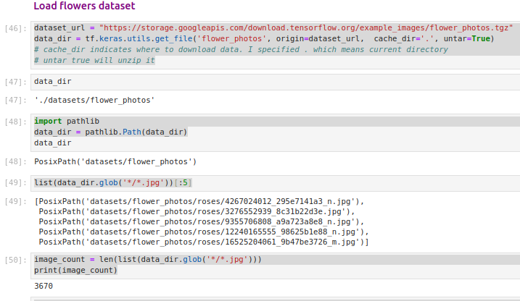
26.1 Load Flower Dataset
https://www.youtube.com/watch?v=mTVf7BN7S8w&list=PLeo1K3hjS3uu7CxAacxVndI4bE_o3BDtO&index=26
Load Flowers Dataset (2:31-3:30/31:32)
We read image file on google colab.
Image count: 3670

Slide 8
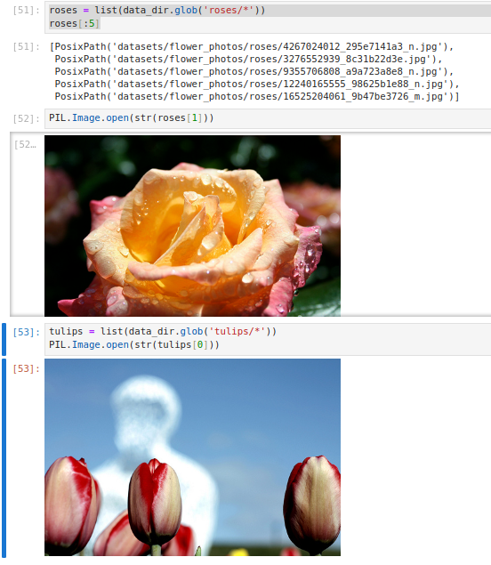
26.1 Load Flower Dataset
https://www.youtube.com/watch?v=mTVf7BN7S8w&list=PLeo1K3hjS3uu7CxAacxVndI4bE_o3BDtO&index=26
Load Flowers Dataset (3:31-4:30/31:32)
Check Images.

Slide 9
26.2 Colab: Read Flower Images from Disk

Slide 10
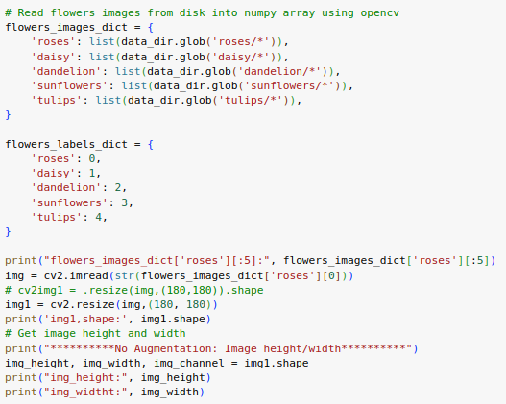
26.2 Colab: Read Flower Images from Disk
https://www.youtube.com/watch?v=mTVf7BN7S8w&list=PLeo1K3hjS3uu7CxAacxVndI4bE_o3BDtO&index=26
Read Flower Images From Disk (4:31-5:30/31:32)
Resize the image size: 180 x 180.

Slide 11
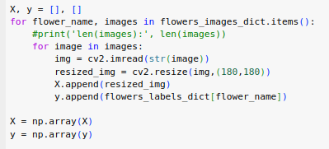
26.2 Colab: Read Flower Images from Disk
https://www.youtube.com/watch?v=mTVf7BN7S8w&list=PLeo1K3hjS3uu7CxAacxVndI4bE_o3BDtO&index=26
Read Flower Images From Disk (5:31-6:30/31:32)
Put into X and y.

Slide 12
26.3 Split Train and Test Data

Slide 13
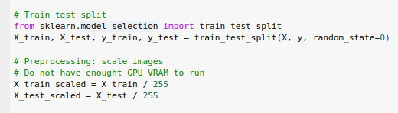
26.3 Split Train and Test Data
https://www.youtube.com/watch?v=mTVf7BN7S8w&list=PLeo1K3hjS3uu7CxAacxVndI4bE_o3BDtO&index=26
Split Train and Test Data (6:31-7:30/31:32)
Put into X and y.

Slide 14
26.4 No Data Augment: Build/Train Model

Slide 15
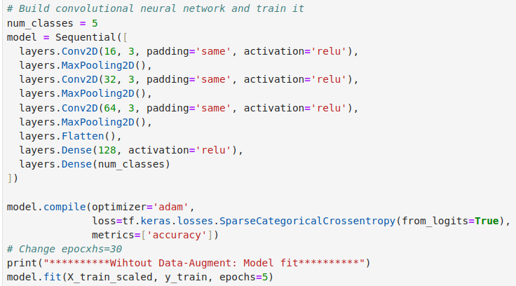
26.4 No Data Augment: Build/Train Model
https://www.youtube.com/watch?v=mTVf7BN7S8w&list=PLeo1K3hjS3uu7CxAacxVndI4bE_o3BDtO&index=26
No Data Augment: Build/Train Model (7:31-11:30/31:32)

Slide 16
26.5 No Data Augment: Evaluate/Test Model

Slide 17
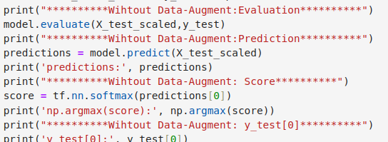
26.5 No Data Augment: Evaluate/Test Model
https://www.youtube.com/watch?v=mTVf7BN7S8w&list=PLeo1K3hjS3uu7CxAacxVndI4bE_o3BDtO&index=26
No Data Augment: Evaluate/Test Model (11:31-15:30/31:32)

Slide 18
26.6 No Data Augment: Result

Slide 19
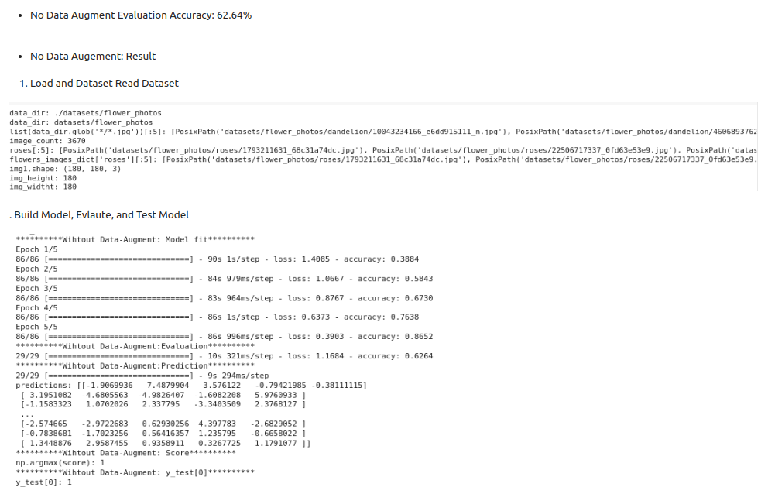
26.6 No Data Augment: Result
https://www.youtube.com/watch?v=mTVf7BN7S8w&list=PLeo1K3hjS3uu7CxAacxVndI4bE_o3BDtO&index=26
No Data Augment: Result (15:31-19:30/31:32)

Slide 20
26.7 Data Augment: Flip, Rotation, and Zoom

Slide 21
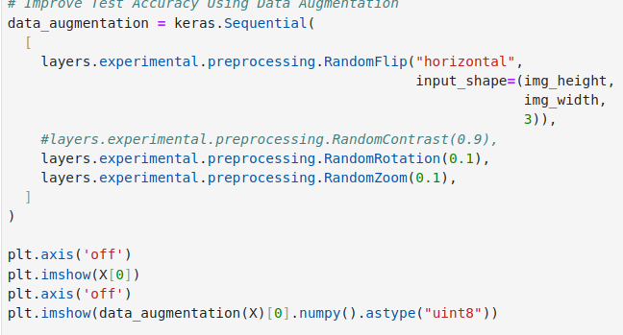
26.7 Data Augment: Flip, Rotation, and Zoom
https://www.youtube.com/watch?v=mTVf7BN7S8w&list=PLeo1K3hjS3uu7CxAacxVndI4bE_o3BDtO&index=26
Data Augment: Flip, Rotation, and Zoom (19:31-23:30/31:32)
Remove Contrast.

Slide 22
26.8 Data Augment: Build/Train Model

Slide 23
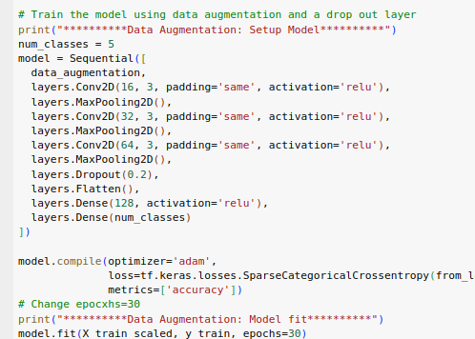
26.8 Data Augment: Build/Train Model
https://www.youtube.com/watch?v=mTVf7BN7S8w&list=PLeo1K3hjS3uu7CxAacxVndI4bE_o3BDtO&index=26
No Data Augment: Build/Train Model (23:31-27:30/31:32)

Slide 24
26.9 Data Augment: Evaluate/Test Model

Slide 25
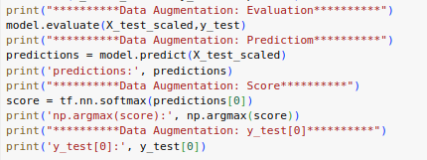
26.9 Data Augment: Evaluate/Test Model
https://www.youtube.com/watch?v=mTVf7BN7S8w&list=PLeo1K3hjS3uu7CxAacxVndI4bE_o3BDtO&index=26
No Data Augment: Evaluate/Test Model (27:31-30:30/31:32)

Slide 26
26.10 Data Augment: Result

Slide 27
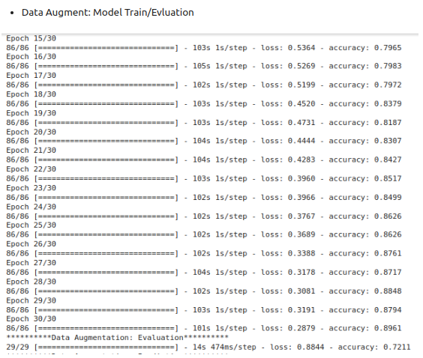
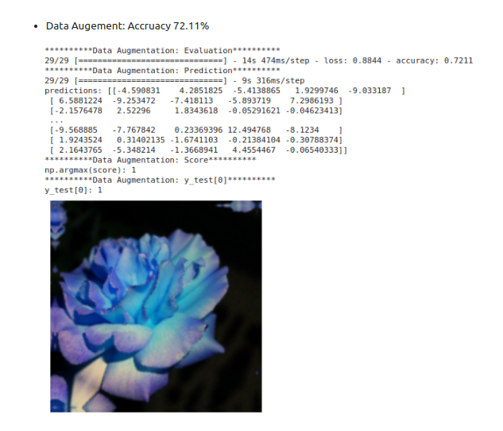
26.10 Data Augment: Result
https://www.youtube.com/watch?v=mTVf7BN7S8w&list=PLeo1K3hjS3uu7CxAacxVndI4bE_o3BDtO&index=26
No Data Augment: Result (30:31-31:32/31:32)
Accuracy: 72.11%

Slide 28
End

