Slide 1

20.1 Without Dropout: Coding
Peter H. Chen

Slide 2
20.02 With Dropout: Code

Slide 3
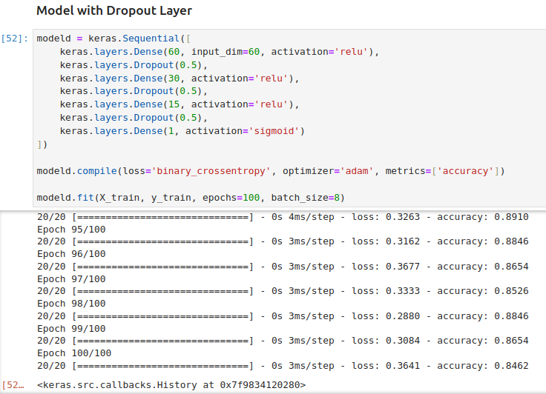
20.02 With Dropout: Code
https://www.youtube.com/watch?v=lcI8ukTUEbo&list=PLeo1K3hjS3uu7CxAacxVndI4bE_o3BDtO&index=20
With Dropout: Coding (14:01-15:30/19:01)
Now, we want to add the Dropout layer. We have 50% dropout.
We can put 0.25 for 25% dropout. We can try and error for the best percentage.
Here, we have 91% accuracy.

Slide 4
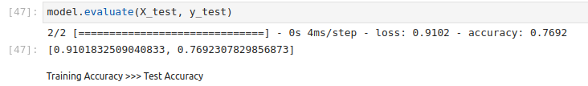
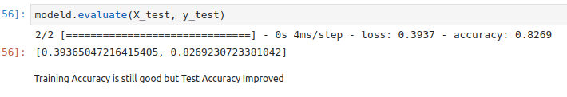
20.02 With Dropout: Code
https://www.youtube.com/watch?v=lcI8ukTUEbo&list=PLeo1K3hjS3uu7CxAacxVndI4bE_o3BDtO&index=20
With Dropout: Coding (15:31-16:30/19:01)
Previously, without dropout, we have 76.9% accuracy in test dataset.
With dropout, we improve to 82.6% accuracy in test dataset.

Slide 5
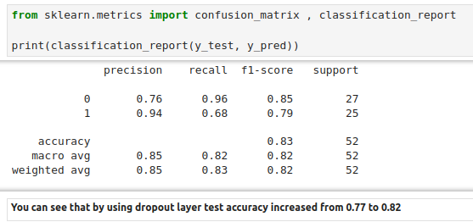
20.02 With Dropout: Code
https://www.youtube.com/watch?v=lcI8ukTUEbo&list=PLeo1K3hjS3uu7CxAacxVndI4bE_o3BDtO&index=20
With Dropout: Coding (16:31-18:01/19:01)
Use dropout, we improve the test accuracy from 77% to 82%.

Slide 6
20.02 With Dropout: Code
https://www.youtube.com/watch?v=lcI8ukTUEbo&list=PLeo1K3hjS3uu7CxAacxVndI4bE_o3BDtO&index=20
With Dropout: Coding (18:01-19:01/19:01)
Previously, without dropout, we have 76.9% accuracy in test dataset.
With dropout, we improve to 82.6% accuracy in test dataset.

Slide 7
End

