Slide 1

25 CNN Padding and Stride
Peter H. Chen

Slide 2

25 CNN Padding and Stride
https://www.youtube.com/watch?v=oDAPkZ53zKk&list=PLeo1K3hjS3uu7CxAacxVndI4bE_o3BDtO&index=25
CNN Padding and Stride (0:00-0:05/6:34)
We discuss the convolution padding and stride.

Slide 3
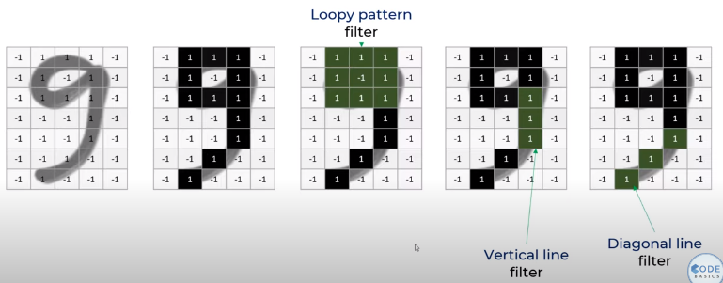
25 CNN Padding and Stride
https://www.youtube.com/watch?v=oDAPkZ53zKk&list=PLeo1K3hjS3uu7CxAacxVndI4bE_o3BDtO&index=25
CNN Padding and Stride (0:07-0:30/6:34)
In the digit recognition, we come up with three different filters or feature detectors.
These filters are loopy pattern detector, vertical line detector, and diagonal line detector.
These detectors detect the head, middle part, and tail part of digit “9”.

Slide 4
25.1 Valid vs. Same Convolution

Slide 5
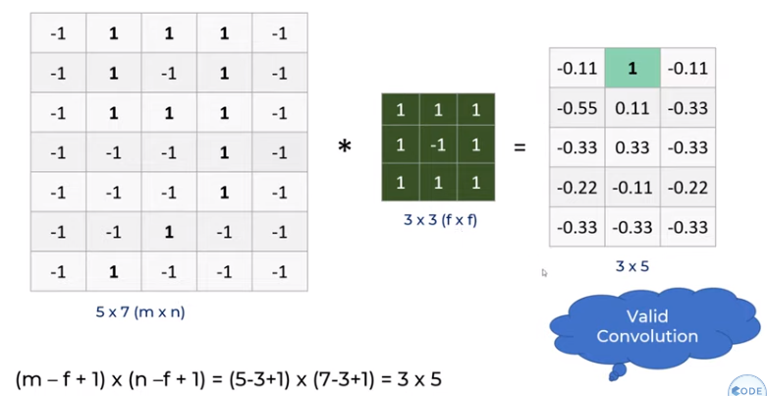
25.1 Valid vs. Same Convolution
https://www.youtube.com/watch?v=oDAPkZ53zKk&list=PLeo1K3hjS3uu7CxAacxVndI4bE_o3BDtO&index=25
Valid vs. Same Convolution (0:40-1:20/6:34)
When we apply these filters,
We have 5 x 7(m x n) image, 3 x 3 (f x f) filters, and feature map 3 x 5.
How do we get the feature map size?
(m – f + 1) x (n – f + 1) = (5 - 3 + 1) x (7 – 3 + 1) = 3 x 5.
The convolution with the original image (without padding) is called “Valid Convolution.”

Slide 6
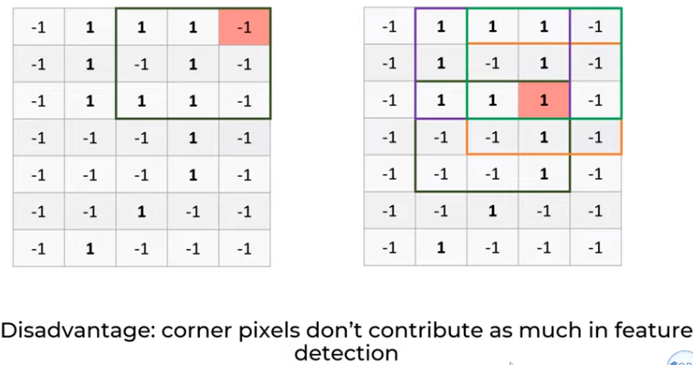
25.1 Valid vs. Same Convolution
https://www.youtube.com/watch?v=oDAPkZ53zKk&list=PLeo1K3hjS3uu7CxAacxVndI4bE_o3BDtO&index=25
Valid vs. Same Convolution (1:25-1:50/6:34)
There is a padding problem at the corner.
The pixels on the corner do not play important role in feature detection.
For example, the color high-lite below only in one convolution operation.
In order to let high-lite pixel to participate on convolution, we can pad pixel on the boundary.

Slide 7
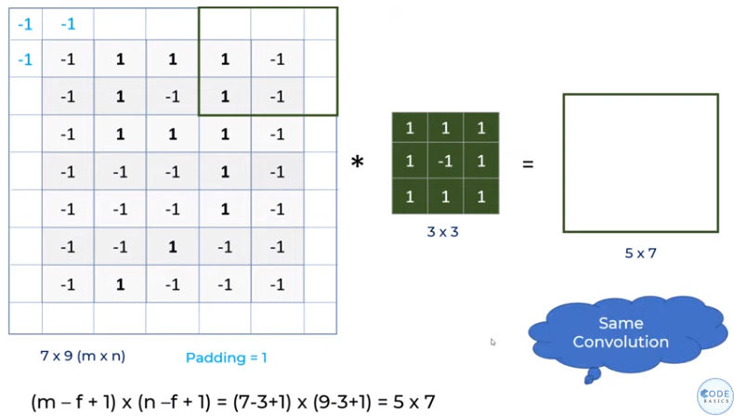
25.1 Valid vs. Same Convolution
https://www.youtube.com/watch?v=oDAPkZ53zKk&list=PLeo1K3hjS3uu7CxAacxVndI4bE_o3BDtO&index=25
Valid vs. Same Convolution (2:25-4:00/6:34)
Below, we put some value on the boundary.
The pad padding convolution is called “Same Convolution”.

Slide 8
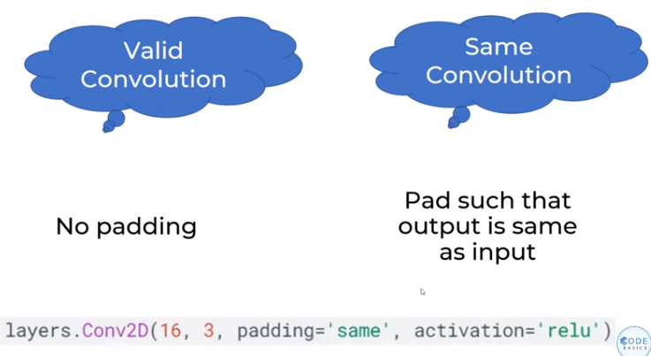
25.1 Valid vs. Same Convolution
https://www.youtube.com/watch?v=oDAPkZ53zKk&list=PLeo1K3hjS3uu7CxAacxVndI4bE_o3BDtO&index=25
Valid vs. Same Convolution (4:16-4:31/6:34)
Valid Convolution: No Padding convolution.
Same Convolution: Pad the input, such that the output is the same dimension as input.
In tensorflow, the padding parameters can be “same” or “valid”.

Slide 9
25.2 Stride

Slide 10
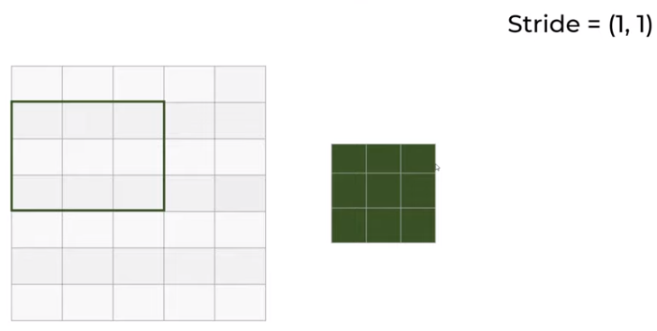
25.2 Stride
https://www.youtube.com/watch?v=oDAPkZ53zKk&list=PLeo1K3hjS3uu7CxAacxVndI4bE_o3BDtO&index=25
Stride (4:42-5:00/6:34)
When we have stride = (1, 1), stride one 1 by 1.
The window move right 1 step horizontally and then move down 1 in vertical.

Slide 11
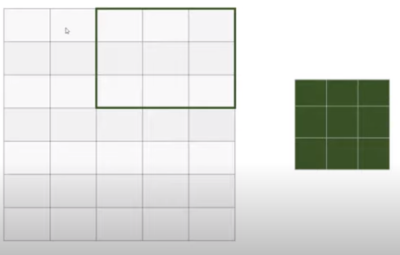
25.2 Stride
https://www.youtube.com/watch?v=oDAPkZ53zKk&list=PLeo1K3hjS3uu7CxAacxVndI4bE_o3BDtO&index=25
Stride (5:01-5:20/6:34)
When we have stride = (2, 1), stride one 2 by 1.
The window move right 2 steps horizontally and then move down 1 step in vertical.

Slide 12
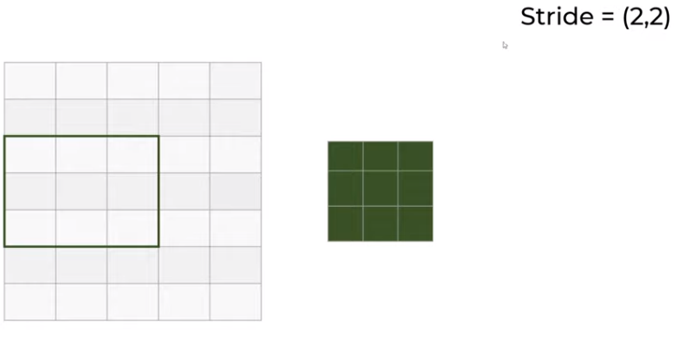
25.2 Stride
https://www.youtube.com/watch?v=oDAPkZ53zKk&list=PLeo1K3hjS3uu7CxAacxVndI4bE_o3BDtO&index=25
Stride (5:21-5:30/6:34)
When we have stride = (2, 2), stride one 2 by 2.
The window move right 2 steps horizontally and then move down 2 steps in vertical.

Slide 13
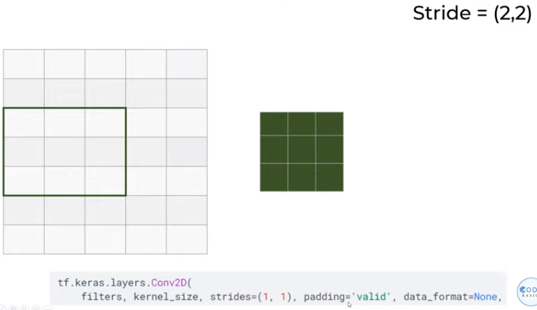
25.2 Stride
https://www.youtube.com/watch?v=oDAPkZ53zKk&list=PLeo1K3hjS3uu7CxAacxVndI4bE_o3BDtO&index=25
Stride (5:31-6:00/6:34)
In TensorFlow, specify stride = (2, 2), padding = ‘valid’
(2, 2)

Slide 14
End

