Slide 1

27 Transfer Learning
Peter H. Chen

Slide 2
27 Transfer Learning
https://www.youtube.com/watch?v=LsdxvjLWkIY&list=PLeo1K3hjS3uu7CxAacxVndI4bE_o3BDtO&index=27
Transfer Learning (0:00-1:30/25:54)
Transfer Learning has become popular in image classification and NLP (Natural Language Processing),
We have a pre-trained Model, we try to re-train it for new problem.
In the last data augmentation discussion, we have flower dataset which we classify five types of flowers.
In this discussion, we use a MobileNet pre-trained model from Google Tensorflow Hub.
We will use this pre-trained model to classify google flower dataset.
Previously, we used to take 30 epochs to train the model and achieve the high accuracy.
If we use the transfer learning with pre-trained model, we just need less than 5 epochs to achieve the same high accuracy.
Transfer learning use pre-trained model to save a lot of computation power.
The pre-trained model is available at tensorflow hub (Tensorflow > resources). These pre-trained model are trained by millions of images.
If you try to train your model to the pre-trained model, it will take days and months to reach that accuracy.
To save time, you can download the pre-trained model, get the pre-trained weights and bias, and then you can train the last layers or last few layers for your new problem and get the super high accuracy.

Slide 3
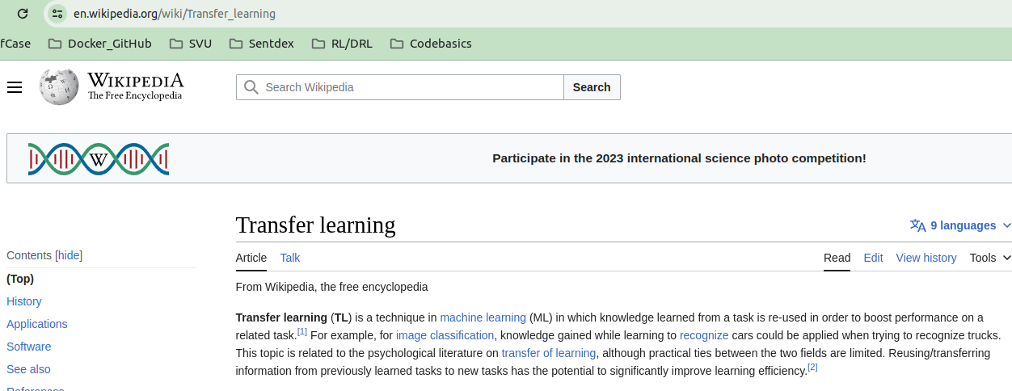
27 Transfer Learning
https://www.youtube.com/watch?v=LsdxvjLWkIY&list=PLeo1K3hjS3uu7CxAacxVndI4bE_o3BDtO&index=27
Transfer Learning (1:41-2:10/25:54)
Below is the wiki definition for Transfer Learning.
We focus on stored and gained knowledge and apply the different but related problem.
For example, we have a model that can recognize cars, we can use this model to recognize the truck as well because the basic features, for example, tires, steering wheel, some components, etc. between cars and trucks are similar.
We can use this knowledge of visual world and transfer the knowledge to solve different problem.

Slide 4
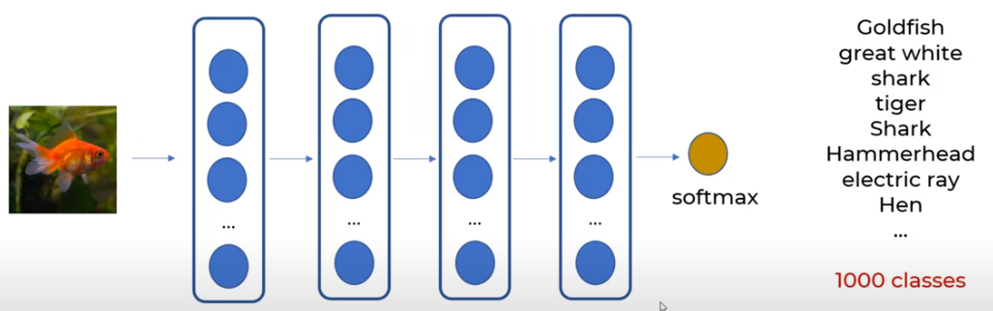
27 Transfer Learning
https://www.youtube.com/watch?v=LsdxvjLWkIY&list=PLeo1K3hjS3uu7CxAacxVndI4bE_o3BDtO&index=27
Transfer Learning (2:20-3:00/25:54)
We take Google MobileNet V2 Model for transfer learning coding.
Google pre-trained MobileNet V2 Model contains 1.4 million images and total 1000 classes.
Google take a long time (months to years) and lots of computational resources to train MobileNet V2 Model.
MobileNet V2 Model is the Deep Learning Model with huge dataset.
The output is 1,000 classes. It is a very diverse with Goldfish, great white shark, some animal, hammerhead shark, military uniform, etc.

Slide 5
27 Transfer Learning
https://www.youtube.com/watch?v=LsdxvjLWkIY&list=PLeo1K3hjS3uu7CxAacxVndI4bE_o3BDtO&index=27
Transfer Learning (3:01-3:20/25:54)
Google MobileNet V2 Model is not just animals. It contains 1,000 classes of objects.
When MobileNet Model is trained, it has input layers, hidden layers, output layer, and softmax layer, and classify the input objects into 1,000 categories.
In the below of the deep learning model, all the layers are pre-trained and frozen except the last layer. All the layers are frozen to classify the gold fish.

Slide 6
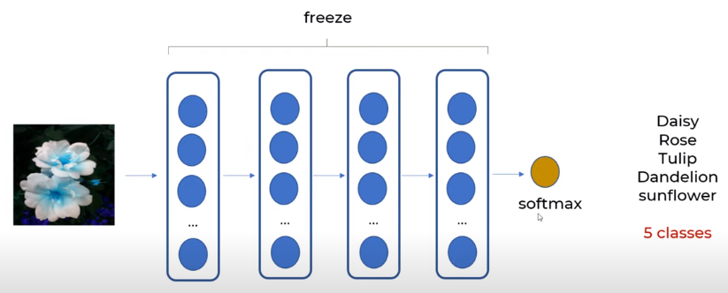
27 Transfer Learning
https://www.youtube.com/watch?v=LsdxvjLWkIY&list=PLeo1K3hjS3uu7CxAacxVndI4bE_o3BDtO&index=27
Transfer Learning (3:21-4:50/25:54)
Now, we will use the all the frozen layers to classify the flowers. The pre-trained model is used to classify 1000 classes is frozen, the model weights will not change.
When we perform the new training, the frozen weights of model do not changed.
The frozen pre-trained model looks like a non-liner regression equation. This pre-trained model is used to classify 1,000 classes.
We pass the flower into the non-linear regression equation to get feature vectors, then we use the softmax layer to classify five classes instead of thousand.
We use the frozen layer to classify the new classes, during the training, non of the weights is change, only the weights of last layer, last two layers, or last three layers, etc are changed.

Slide 7
27.1 TF Transfer Learning

Slide 8
27.1 TF Transfer Learning
https://www.tensorflow.org/hub/tutorials/tf2_image_retraining
TF Transfer Learning (6:31-7:30/25:54)
Image classification models have millions of parameters.
Training them from scratch requires a lot of labeled training data and a lot of computing power.
Transfer learning is a technique that shortcuts much of this by taking a piece of a model that has already been trained on a related task and reusing it in a new model.
This Colab demonstrates how to build a Keras model for classifying five species of flowers by using a pre-trained TF2 SavedModel from TensorFlow Hub for image feature extraction, trained on the much larger and more general ImageNet dataset.
Optionally, the feature extractor can be trained ("fine-tuned") alongside the newly added classifier.

Slide 9
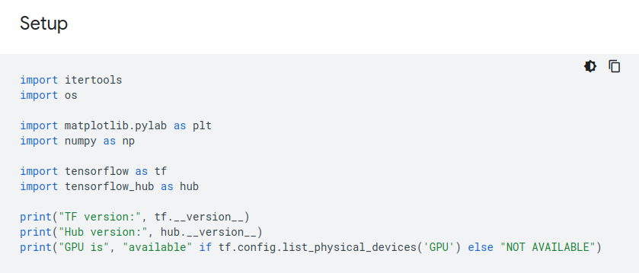
27.1 TF Transfer Learning
https://www.tensorflow.org/hub/tutorials/tf2_image_retraining
TF Transfer Learning (7:31-10:30/25:54)

Slide 10
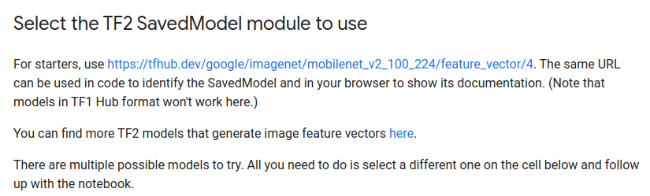
27.1 TF Transfer Learning
https://www.tensorflow.org/hub/tutorials/tf2_image_retraining
TF Transfer Learning (10:31-13:30/25:54)

Slide 11
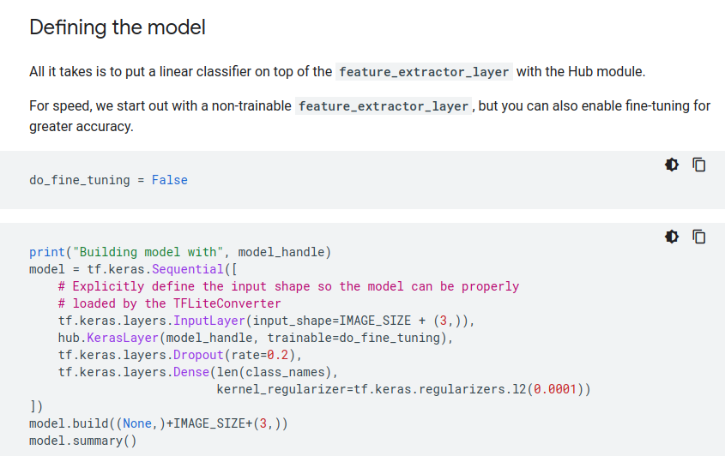
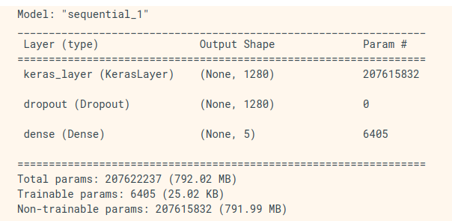
27.1 TF Transfer Learning
https://www.tensorflow.org/hub/tutorials/tf2_image_retraining
TF Transfer Learning (`3:31-16:30/25:54)
Define the Model: We add the new transfer learning model at the end of the original pre-trained model.

Slide 12
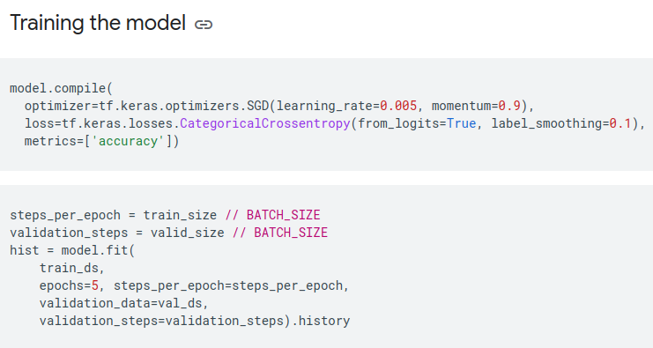
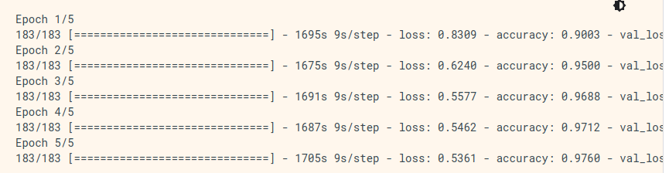
27.1 TF Transfer Learning
https://www.tensorflow.org/hub/tutorials/tf2_image_retraining
TF Transfer Learning (16:31-19:30/25:54)
Re-Compile the new transfer model.

Slide 13
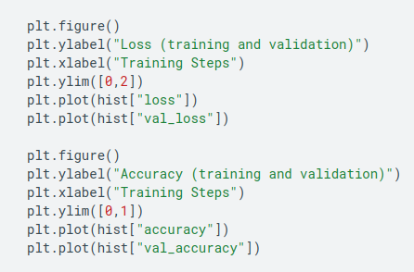
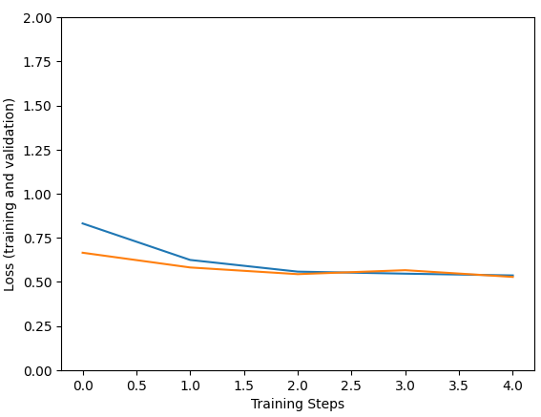
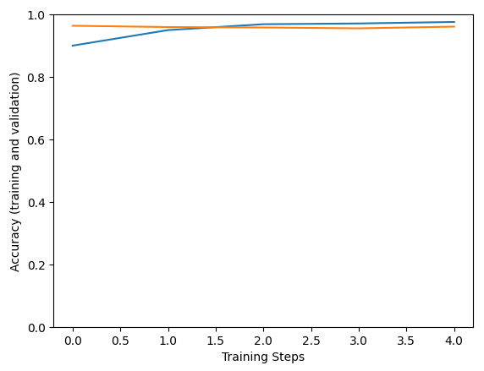
27.1 TF Transfer Learning
https://www.tensorflow.org/hub/tutorials/tf2_image_retraining
TF Transfer Learning (19:31-22:30/25:54)
Plot the result for loss/validate-loss and accuracy/validate-accuracy for new transfer model.

Slide 14
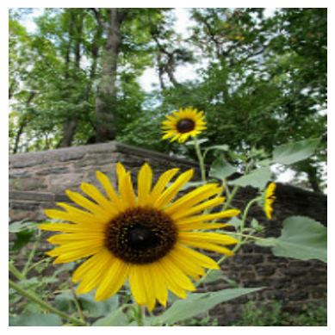
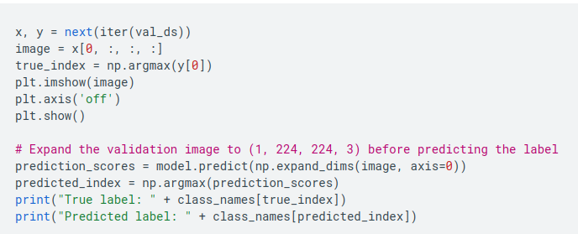
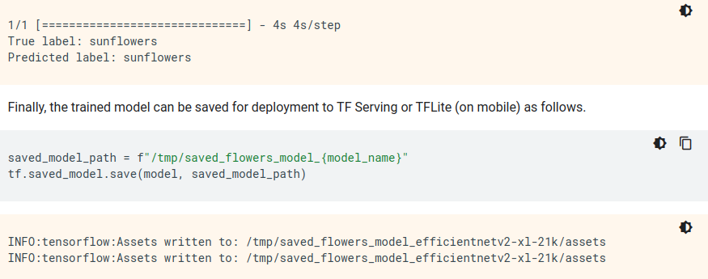
27.1 TF Transfer Learning
https://www.tensorflow.org/hub/tutorials/tf2_image_retraining
TF Transfer Learning (22:31-25:54/25:54)
Try out the model on an image from the validation data:

Slide 15
End

