Slide 1

21.00 Review Week 10: Dropout
Peter H. Chen

Slide 2
21.00 Dropout Regularization
https://www.youtube.com/watch?v=lcI8ukTUEbo&list=PLeo1K3hjS3uu7CxAacxVndI4bE_o3BDtO&index=20
Dropout Regularization (0:00-0:10/19:01)
What is difference from statistical/regressional Machine Learning and Neural Network.
1. Statistical/Regressional machine learning models are trained using algorithms to learn patterns from data. Statistical Machine learning is the Polynomial/Equation based modeling. The sci-learn is the library for statistical machine learning.
2. Neural networks use multiple layers of neurons to model and train with backpropagation, adjusting the weights and biases. Google Tensorflow framework and Meta Pytorch library are used for Neural Network programming.
Three layers of neural network model is called shallow neural network. Shallow neural network is equivalent to statistical machine learning.
More than four layers neural network is deep neural network for learning. Totally different from statistical Machine Learning.

Slide 3
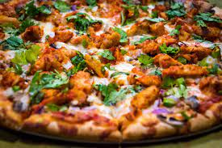


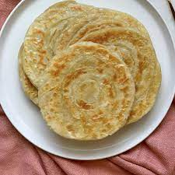
21.00 Dropout Regularization
https://www.youtube.com/watch?v=lcI8ukTUEbo&list=PLeo1K3hjS3uu7CxAacxVndI4bE_o3BDtO&index=20
Dropout Regularization (0:21-0:30/19:01)
When we go out to buy clothe, we will try to buy the right size to your body.
If clothe size is too small (overfit fit, fit exactly, use high order of polynomials to fit, too tight), then we do not have space to fit when we eat some food, such as, we eat Pizza, Parathan, or Biryani.
The clothe become too tight.
Pizza
Cannot eat any food
Clothe too tight
Biryani (Mixed Rice Dish)
Paratha (flat bread)

Slide 4


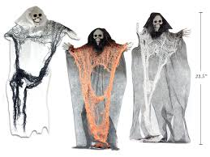
21.00 Dropout Regularization
https://www.youtube.com/watch?v=lcI8ukTUEbo&list=PLeo1K3hjS3uu7CxAacxVndI4bE_o3BDtO&index=20
Dropout Regularization (0:31-0:40/19:01)
If clothe size is too large (underfit, fit too loose, e.g. degree to one to fit everything), it will look like a clothe hanging on the skeleton.
The clothe is similar to model of neural network.
We try to buy the right size of clothe when we buy the clothe.

Slide 5
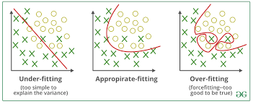
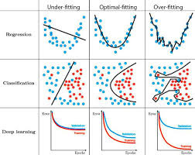
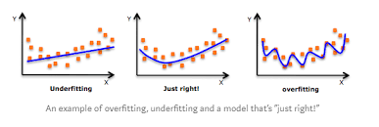
21.00 Dropout Overfitting
https://www.youtube.com/watch?v=lcI8ukTUEbo&list=PLeo1K3hjS3uu7CxAacxVndI4bE_o3BDtO&index=20
Dropout Overfitting (0:41-0:50/19:01)
The overfitting and underfitting of model in the machine learning is similar to wear the clothe too large or too small.
Below are examples of overfitting, underfitting, and optimal-fitting in machine learning, deep learning, and classification.

Slide 6
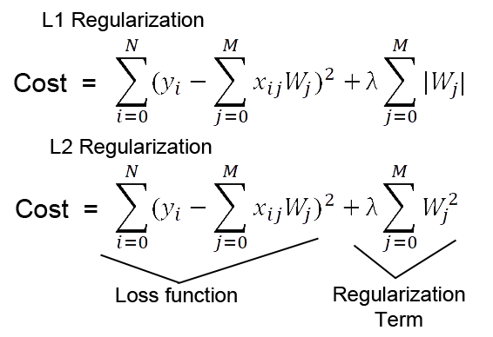
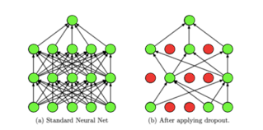
21.00 Dropout Regularization
https://www.youtube.com/watch?v=lcI8ukTUEbo&list=PLeo1K3hjS3uu7CxAacxVndI4bE_o3BDtO&index=20
Dropout Regularization (0:11-0:20/19:01)
What is difference from Regularization in Machine Learning and Dropout in Neural Network?
1. Regularization is used in statistical/regressional machine learning to reduced the overfit problem. Below is the example of regularization (L1 regularization). There is regularization terms with hyperparameter lambda (λ) added to Loss function to avoid the overfit. The small coefficients (i.e., slopes) will be removed.
2. Neural Network does not have mathematical formula. The regularization concept is converted into the dropout regularization (or dropout in short) for the overfit. The small weights (by trial and errors) of neuron will be removed from the neural networks.

Slide 7
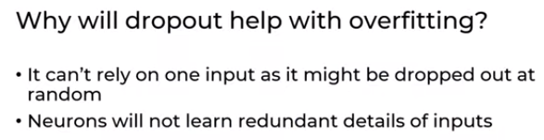
21.00 Dropout Overfitting
https://www.youtube.com/watch?v=lcI8ukTUEbo&list=PLeo1K3hjS3uu7CxAacxVndI4bE_o3BDtO&index=20
Dropout Overfitting (4:33-5:20/19:01)
Will dropout help the overfitting?
When we drop the neurons, the neurons cannot see the connected input layers.
Then, it cannot create the associated bias for inputs as well.
When we drop some neuron, the bias will not affect by the inputs.
The inputs will not impact as much as before.
Question:
When we drop some neurons, some of input parameters are not used at all. What is that mean in the thinking with statistical/regressional machine learning?
Answer:
1. The unused parameters is no longer used, i.e., no weights and bias associated with that parameters.
2. In statistical machine learning of thinking, the degree of polynomial or degree of freedom (degree of equation and number of variables in statistical machine learning) and coefficients of equations are reduced.

Slide 8
21.01 Review Week 10: Read Sonar Dataset

Slide 9
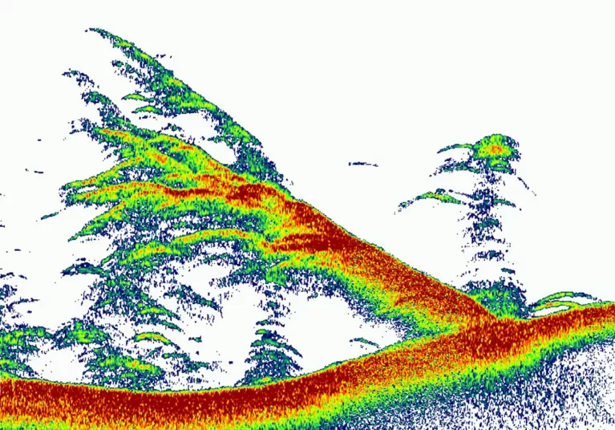
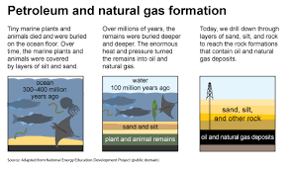
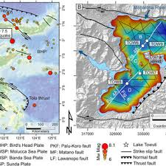
20.01 Read Dataset
https://www.youtube.com/watch?v=lcI8ukTUEbo&list=PLeo1K3hjS3uu7CxAacxVndI4bE_o3BDtO&index=20
Read Dataset (5:28-6:00/19:01)
Now, we look at python code for Dropout Regularization for Sonar Chirp (Noise).
Question:
What is the use of Sonar Chirp?
CHIRP (Compressed High Intensity Radar Pulse) examples:
1. Fish in the water (Fish or Water)
2. Petroleum/Gas Detection (Petroleum, Natural Gas, or None)
3. Geo-structure (Fault or Non-Fault)
4. Mines/Rocks Detection [Mines or None (Rock)]
5. Submarine Detection (Submarine or none)
2
3
1

Slide 10
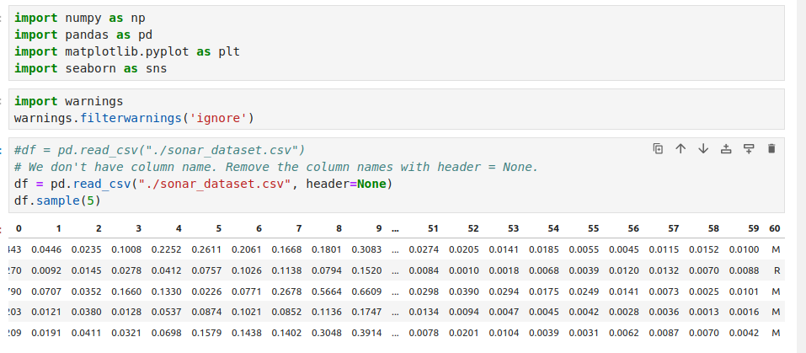
21.01 Read Dataset
https://www.youtube.com/watch?v=lcI8ukTUEbo&list=PLeo1K3hjS3uu7CxAacxVndI4bE_o3BDtO&index=20
Review Week 10: Dropout
In the Sonar database, the last column is R (Rock) or M (Mines).
These are non-numeric (not integer or not float). We need to convert them into integer or one-hot-encoding.

Slide 11
21.02 Review Week 10: Convert Text into Numeric

Slide 12
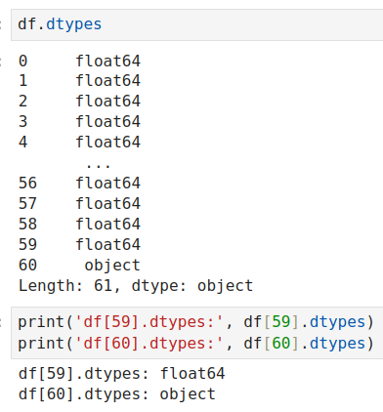
21.02 Review Week 10: Convert Text into Numeric
https://www.youtube.com/watch?v=lcI8ukTUEbo&list=PLeo1K3hjS3uu7CxAacxVndI4bE_o3BDtO&index=20
Review Week 10: Convert Text into Numeric
We have column 60 which is object (Text: not integer and not float).

Slide 13
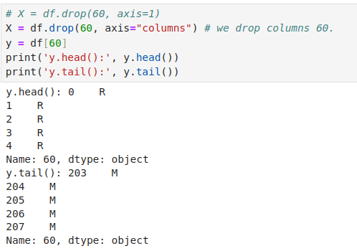
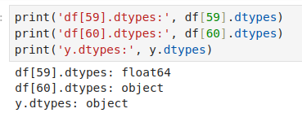
21.02 Review Week 10: Convert Text into Numeric
https://www.youtube.com/watch?v=lcI8ukTUEbo&list=PLeo1K3hjS3uu7CxAacxVndI4bE_o3BDtO&index=20
Review Week 10: Convert Text into Numeric
We drop column 60 in X and put column 60 in y. Now, y.dtypes is object. We need to convert text into integer or one-hot-encoding.

Slide 14
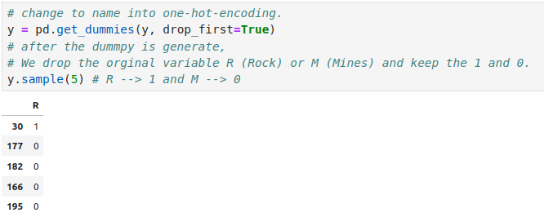
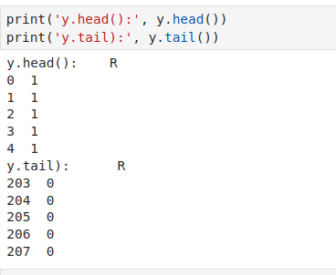
21.02 Review Week 10: Convert Text into Numeric
https://www.youtube.com/watch?v=lcI8ukTUEbo&list=PLeo1K3hjS3uu7CxAacxVndI4bE_o3BDtO&index=20
Review Week 10: Convert Text into Numeric
We use pandas get_dummies (y) to convert into integers.
What is pandas get_dummies() do?
1. Convert categorical variable into dummy/indicator variables. Each variable is converted in as many 0/1 variables as there are different values.
2. Columns in the output are each named after a value. If the input is a DataFrame, the name of the original variable is prepended to the value.

Slide 15
21.02 Dropout Input Layers

Slide 16
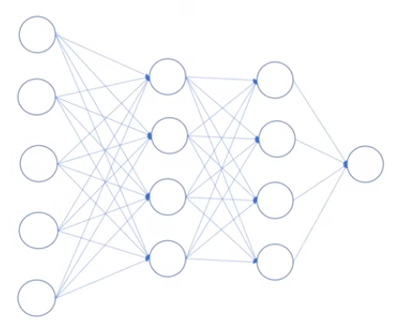
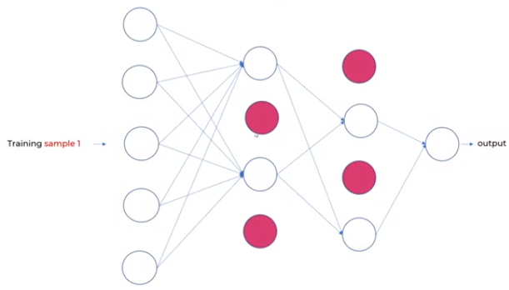
21.0 Dropout Input Layer
https://www.youtube.com/watch?v=lcI8ukTUEbo&list=PLeo1K3hjS3uu7CxAacxVndI4bE_o3BDtO&index=20
Dropout Input Layer
Can we dropout the input layer?
1. Dropout can be applied to input neurons called the visible layer.
If the number of drop neurons is round into integer number., e.g., 2.5 neurons will be round into 2 neurons.
https://machinelearningmastery.com/dropout-regularization-deep-learning-models-keras/#:~:text=Dropout%20can%20be%20applied%20to,excluded%20from%20each%20update%20cycle.
Without Dropout Overfitting
Neural Network Without dropout.
With Dropout Overfitting
Neural Network Dropout input layer.

Slide 17
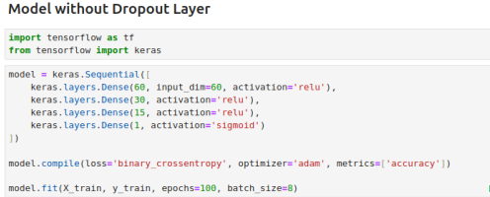
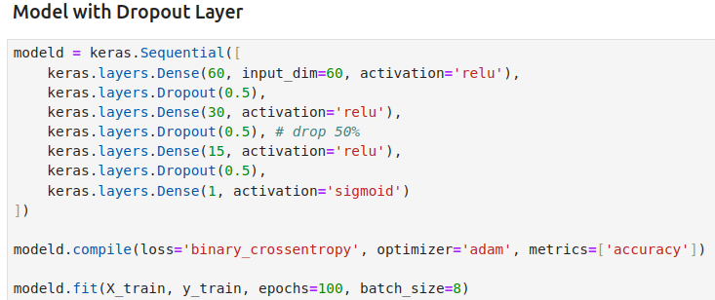
21.0 Dropout Input Layer
https://www.youtube.com/watch?v=lcI8ukTUEbo&list=PLeo1K3hjS3uu7CxAacxVndI4bE_o3BDtO&index=20
Without Dropout Overfitting
Neural Network Without dropout.
With Dropout Overfitting
Neural Network Dropout input layer.

Slide 18
21.03 Drop vs. Dropout Result Comparison

Slide 19
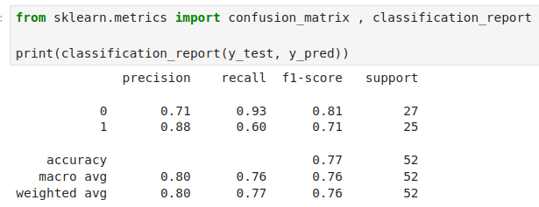
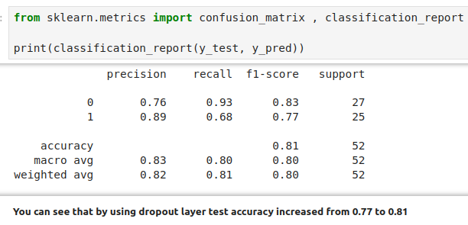
21.03 Drop vs. Dropout Result Comparison
https://www.youtube.com/watch?v=lcI8ukTUEbo&list=PLeo1K3hjS3uu7CxAacxVndI4bE_o3BDtO&index=20
Without Dropout Overfitting
Neural Network Without dropout.
Accuracy = 0.77
With Dropout Overfitting
Neural Network Dropout input layer.
Accuracy = 0.83
The dropout improve Accuracy from 0.77 to 0.81.

Slide 20
End

