Slide 1

16 Tensorboard
Peter H. Chen

Slide 2
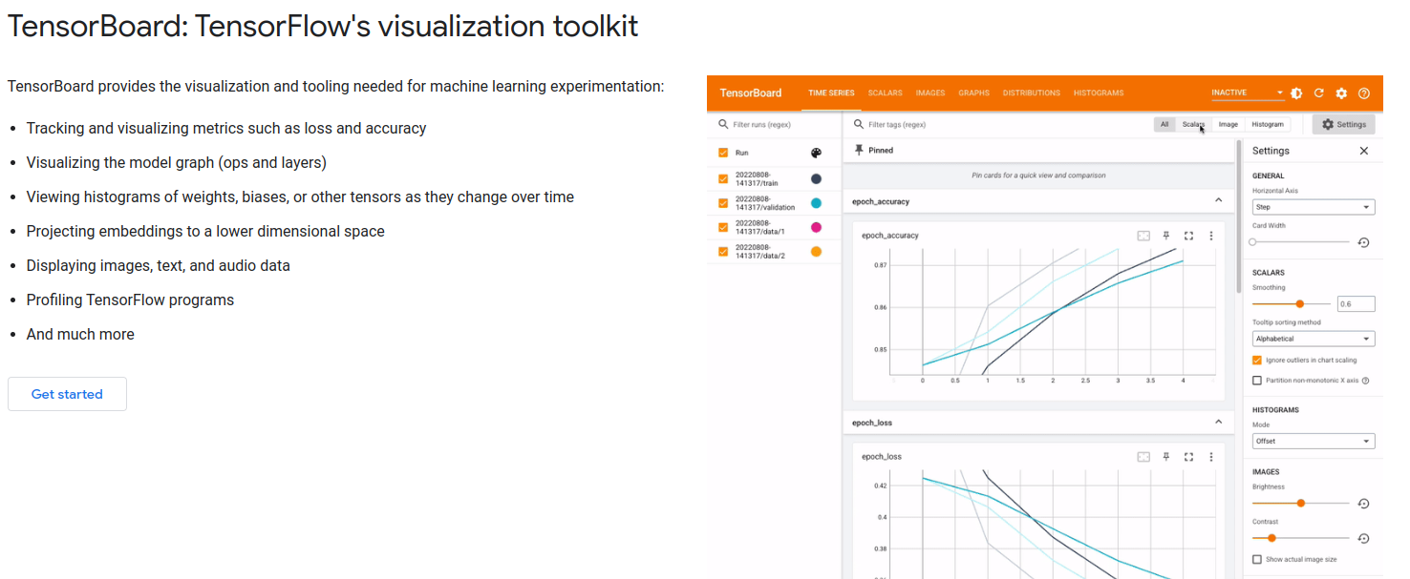
16 Tensorboard
https://www.youtube.com/watch?v=9SdLOcGnebU&list=PLeo1K3hjS3uu7CxAacxVndI4bE_o3BDtO&index=16
Tensorboard (0:00-0:20/14:55)
https://www.tensorflow.org/tensorboard
TensorBoard is a toolkit that provides the visualization and tool needed for machine learning and deep learning. Tensorboard:
1. Track and visualize metrics, such as, loss and accuracy
2. Visualize the model graph (ops and layers)
3. View histograms of weights, biases, or other tensors as they change over time
4. Project embeddings (inside view) to a lower dimensional space
5. Display images, text, and audio data
6. Profile/outline TensorFlow programs

Slide 3
16 Tensorboard
https://www.youtube.com/watch?v=9SdLOcGnebU&list=PLeo1K3hjS3uu7CxAacxVndI4bE_o3BDtO&index=16
Tensorboard (0:00-0:01/14:55)
If yo have duplicate tensorboard installed (one from nightly, one from normal)
Namely:
pip uninstall tb-nightly tensorboard tensorflow tensorflow-estimator tf-estimator-nightly tf-nightly
# Repleat above command several times to remove nightly version.
pip install tensorflow # or `tensorflow-gpu`, or `tf-nightly`, ...

Slide 4
16 Tensorboard
https://www.youtube.com/watch?v=9SdLOcGnebU&list=PLeo1K3hjS3uu7CxAacxVndI4bE_o3BDtO&index=16
Tensorboard (0:21-0:30/14:55)
TensorBoard comes with tensorflow.
You do not have to install tensorboard separately.

Slide 5
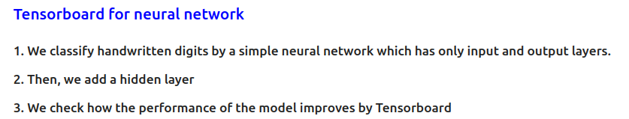
16 Tensorboard
https://www.youtube.com/watch?v=9SdLOcGnebU&list=PLeo1K3hjS3uu7CxAacxVndI4bE_o3BDtO&index=16
Tensorboard (0:31-0:32/14:55)
We use the hand written digits classification and improve the performance by tensorboard.

Slide 6
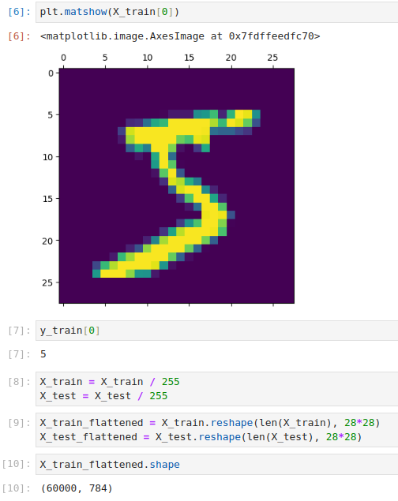
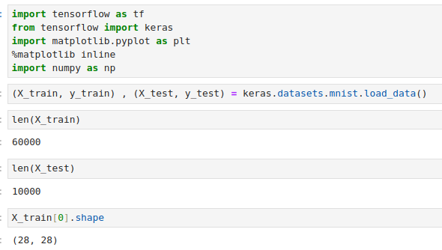
16 Tensorboard
https://www.youtube.com/watch?v=9SdLOcGnebU&list=PLeo1K3hjS3uu7CxAacxVndI4bE_o3BDtO&index=16
Tensorboard (0:32-0:33/14:55)
Display Data.

Slide 7
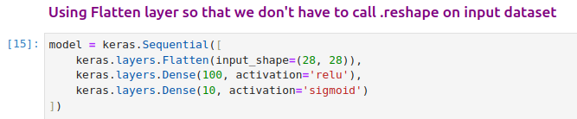
16 Tensorboard
https://www.youtube.com/watch?v=9SdLOcGnebU&list=PLeo1K3hjS3uu7CxAacxVndI4bE_o3BDtO&index=16
Tensorboard (0:33-0:51/14:55)
We have neural network that
1. One input layer are flatten.
2. One hidden layer with 100 neurons and activation function ReLU.
3. One output layer with sigmoid function that output 10 digits.

Slide 8
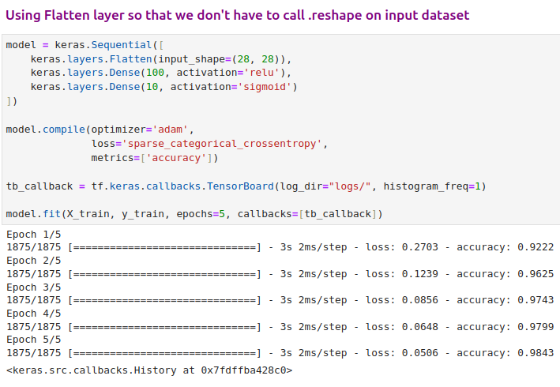
16 Tensorboard
https://www.youtube.com/watch?v=9SdLOcGnebU&list=PLeo1K3hjS3uu7CxAacxVndI4bE_o3BDtO&index=16
Tensorboard (01:01-01:40/14:55)
We have 5 epochs.
Each epoch have loss and accuracy for the training dataset.
We have model parameters, optimizer = ‘adam’, loss = ‘sparse_categorical_crossentropy’, and metrics = ‘accuracy’.

Slide 9
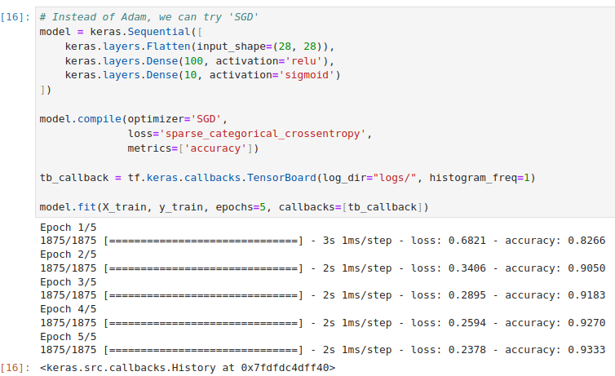
16 Tensorboard
https://www.youtube.com/watch?v=9SdLOcGnebU&list=PLeo1K3hjS3uu7CxAacxVndI4bE_o3BDtO&index=16
Tensorboard (01:41-02:09/14:55)
Instead of ‘adam’, we can try ‘SGD’. For 5 epochs, the result of adam (loss = 0.05, accuracy = 98.4%) is better than SGD (loss = 0.23, accuracy = 93%).
For longer run, the result maybe different. Tensorboard allow us to view the results.

Slide 10
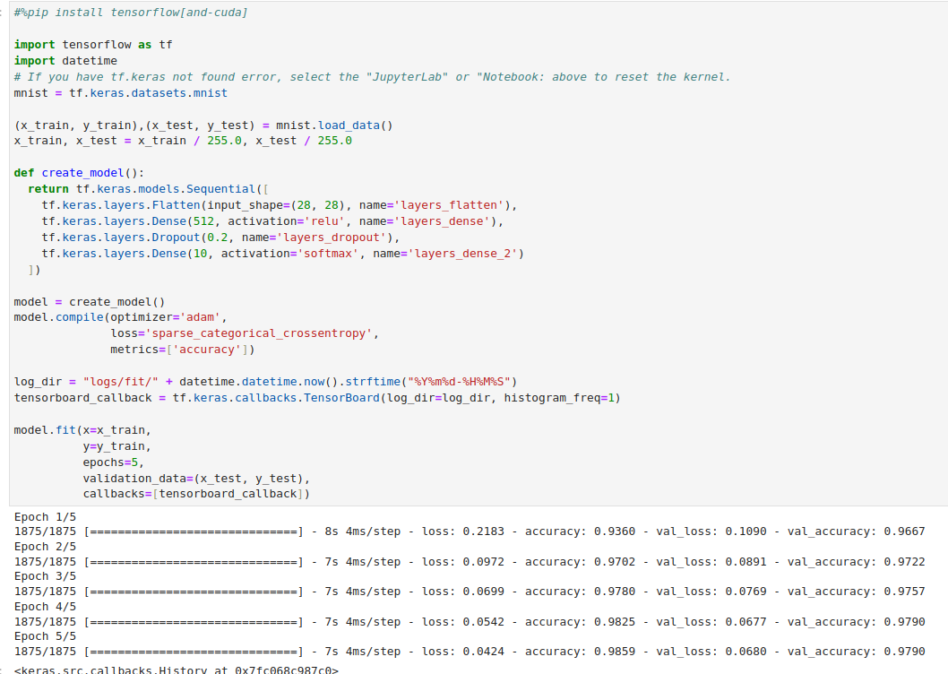
16 Tensorboard
https://www.youtube.com/watch?v=9SdLOcGnebU&list=PLeo1K3hjS3uu7CxAacxVndI4bE_o3BDtO&index=16
Tensorboard (02:10-04:55/14:55)
We create the directory ‘logs’ to store the results for tensorflow.
There is a callback function write the epoch information

Slide 11
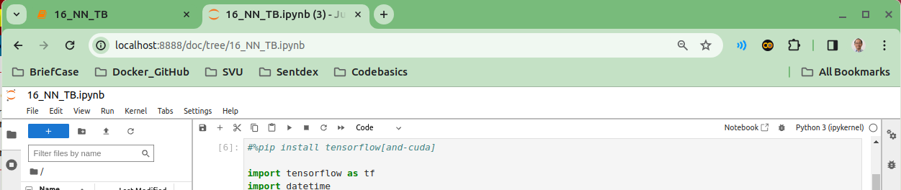
16 Tensorboard
https://www.youtube.com/watch?v=9SdLOcGnebU&list=PLeo1K3hjS3uu7CxAacxVndI4bE_o3BDtO&index=16
Tensorboard (02:46-04:47/14:55)
We create the directory ‘logs’ to store the results for tensorflow.
If you have keras not found in tensorflow in Jupyter Notebook and work fine in Python script, this error come from Jupyter pick up the wrong tensorflow 1.0.
To pick up the tensorflow 2.0, on the jupyter browser, you restart/reset the jupyter kernel and pickup the current tensorflow 2.0 for you.

Slide 12
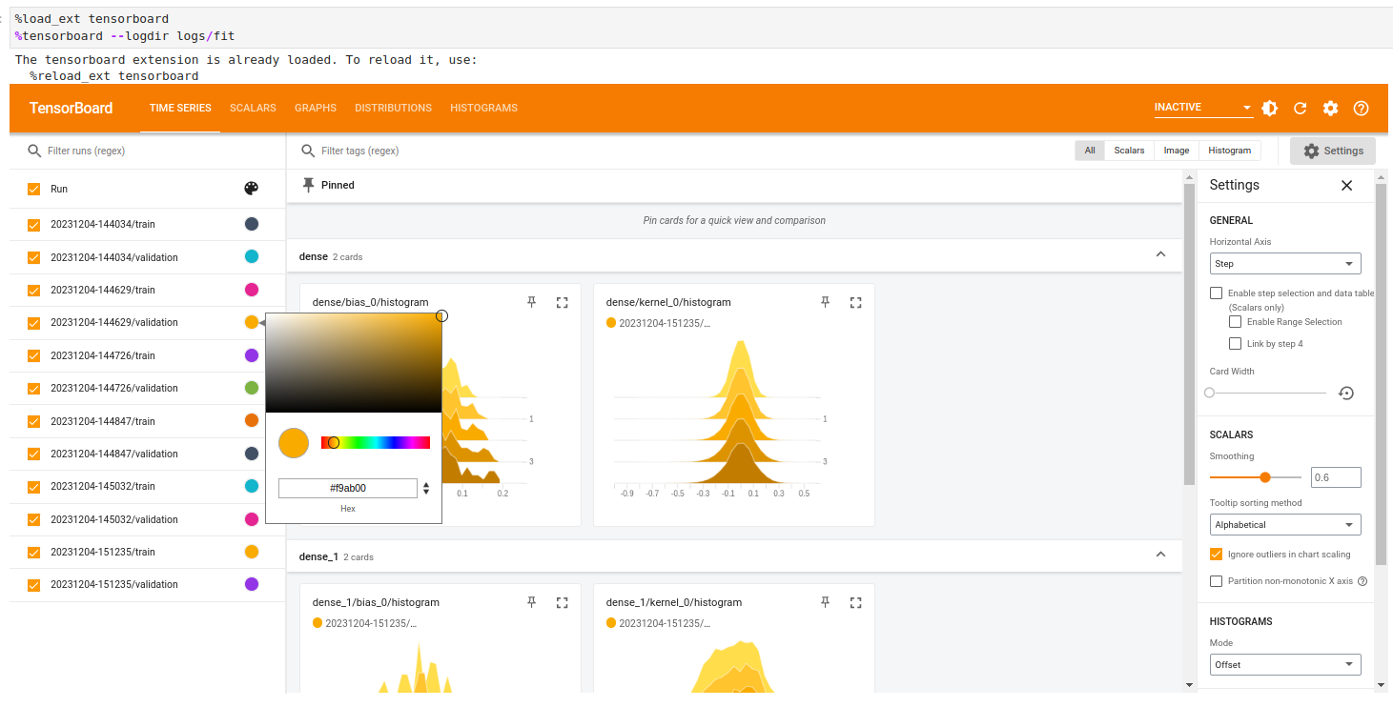
16 Tensorboard
https://www.youtube.com/watch?v=9SdLOcGnebU&list=PLeo1K3hjS3uu7CxAacxVndI4bE_o3BDtO&index=16
Tensorboard (05:57-06:57/14:55)
You also can launch them in the jupyter notebook.
> %load_ext tensorboard
> %tensorboard --logdir logs/fit

Slide 13
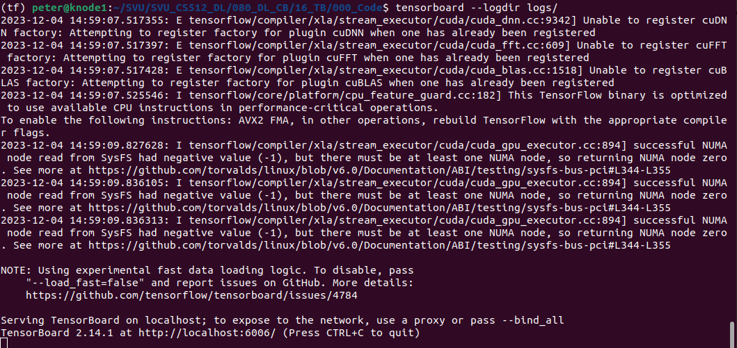
16 Tensorboard
https://www.youtube.com/watch?v=9SdLOcGnebU&list=PLeo1K3hjS3uu7CxAacxVndI4bE_o3BDtO&index=16
Tensorboard (04:57-05:57/14:55)
Either run above inline magic or go to git bash or your command prompt and type below to run it,¶
> tensorboard --logdir logs/
This will launch tensorboard at this url which you can open in your browser http://localhost:6006/
Note:
If you encounter the “Duplicate Projector” message, this means you have duplicate tensorboard installed, for example, one come from nightly version, one installation come from regular installation version.
Follow the error messages and remove both versions first and then install the regular version.

Slide 14
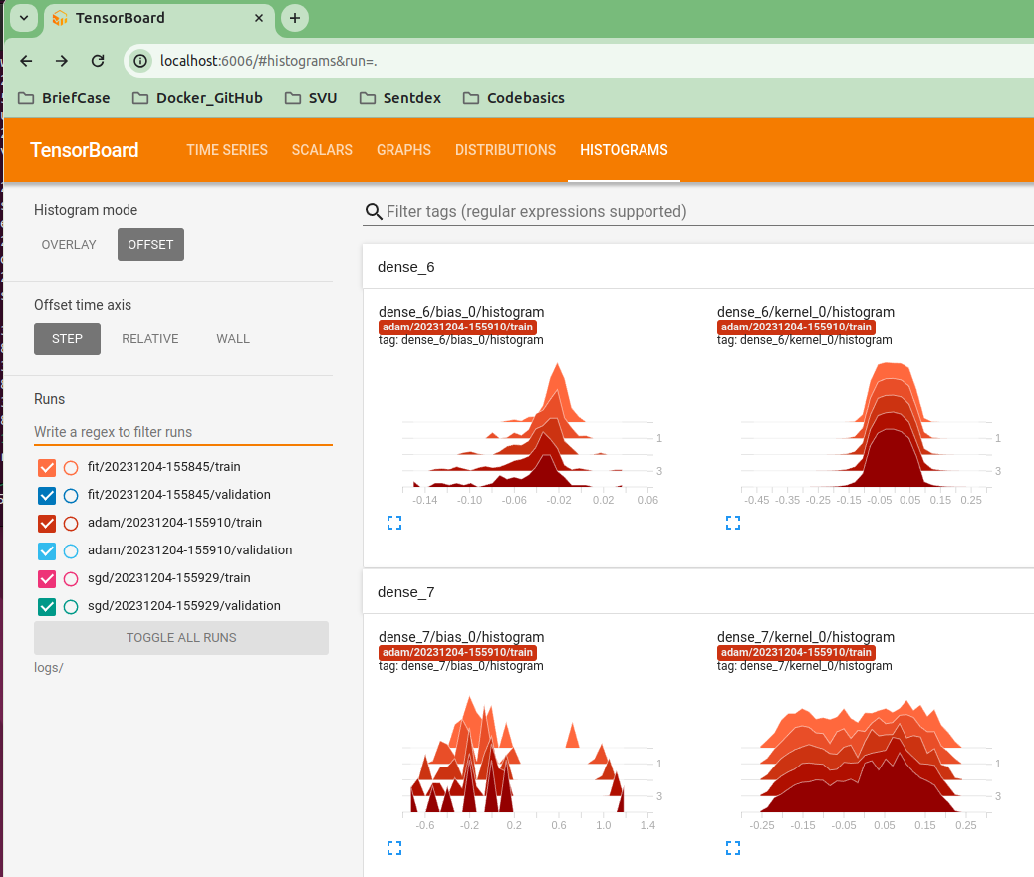
16 Tensorboard
https://www.youtube.com/watch?v=9SdLOcGnebU&list=PLeo1K3hjS3uu7CxAacxVndI4bE_o3BDtO&index=16
Tensorboard (05:57-08:50/14:55)
On the broswer, enter
> hpp:http://localhost:6006
We have several runs:
Search “adam” to filter out “fit” and “sgd”
> adam

Slide 15
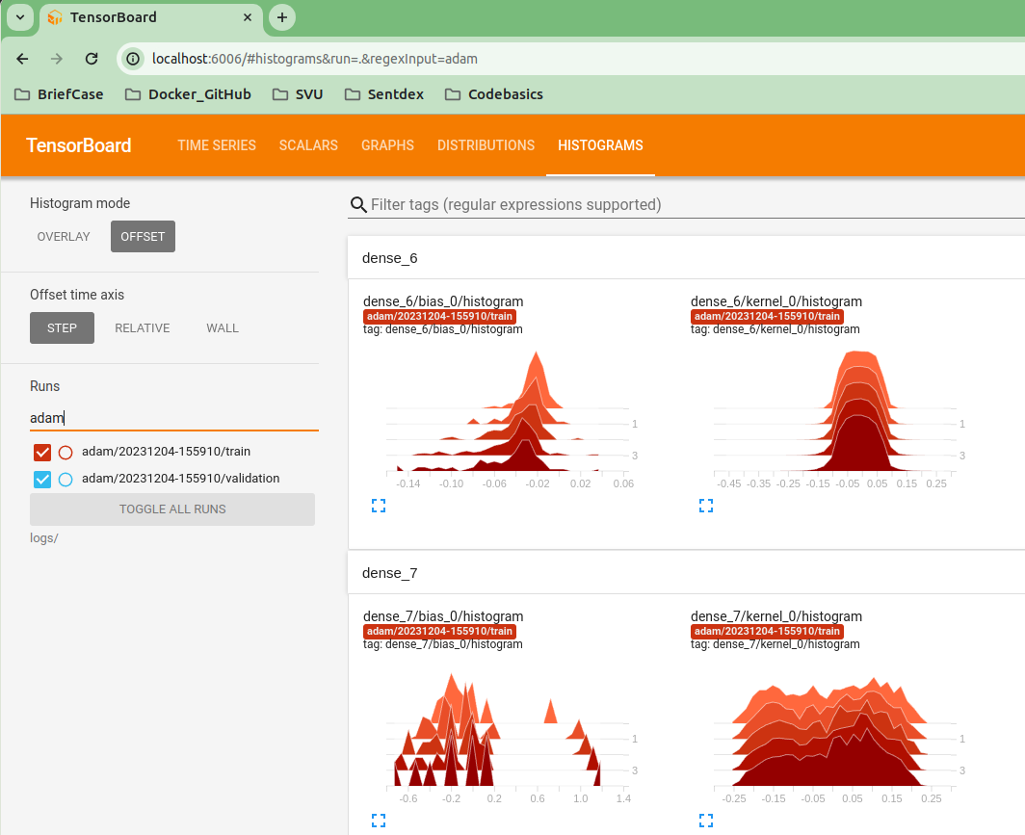
16 Tensorboard
https://www.youtube.com/watch?v=9SdLOcGnebU&list=PLeo1K3hjS3uu7CxAacxVndI4bE_o3BDtO&index=16
Tensorboard (08:57-9:30/14:55)
Search “adam”
> adam

Slide 16
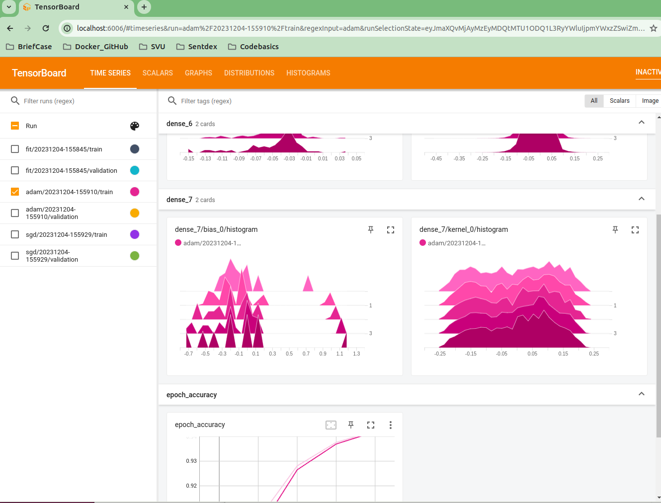
16 Tensorboard
https://www.youtube.com/watch?v=9SdLOcGnebU&list=PLeo1K3hjS3uu7CxAacxVndI4bE_o3BDtO&index=16
Tensorboard (09:31-09:50/14:55)
We can select “train” or “validation”

Slide 17
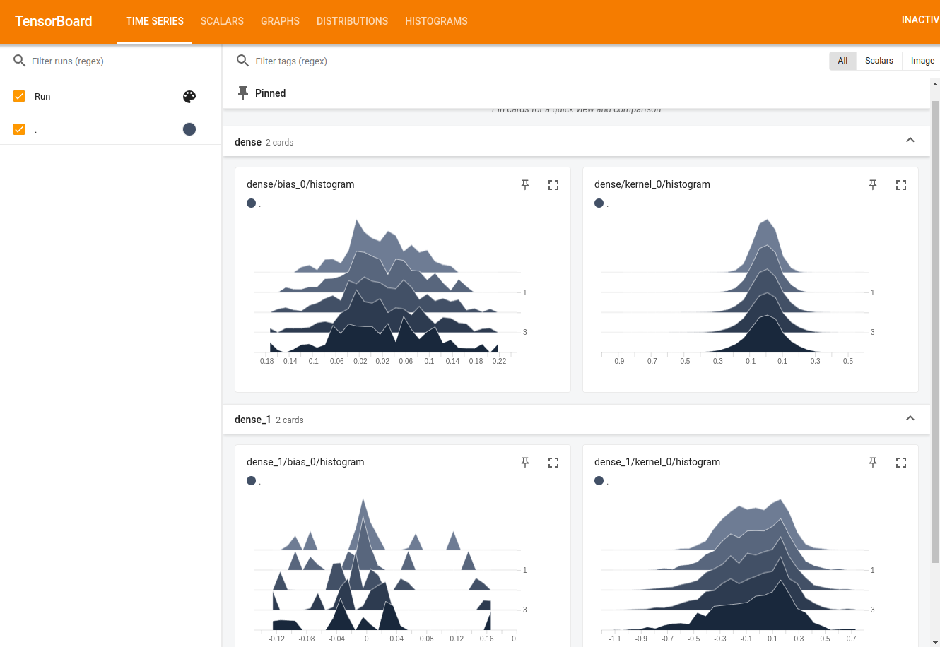
16 Tensorboard
https://www.youtube.com/watch?v=9SdLOcGnebU&list=PLeo1K3hjS3uu7CxAacxVndI4bE_o3BDtO&index=16
Tensorboard (09:51-10:50/14:55)
Click “Time Series”

Slide 18
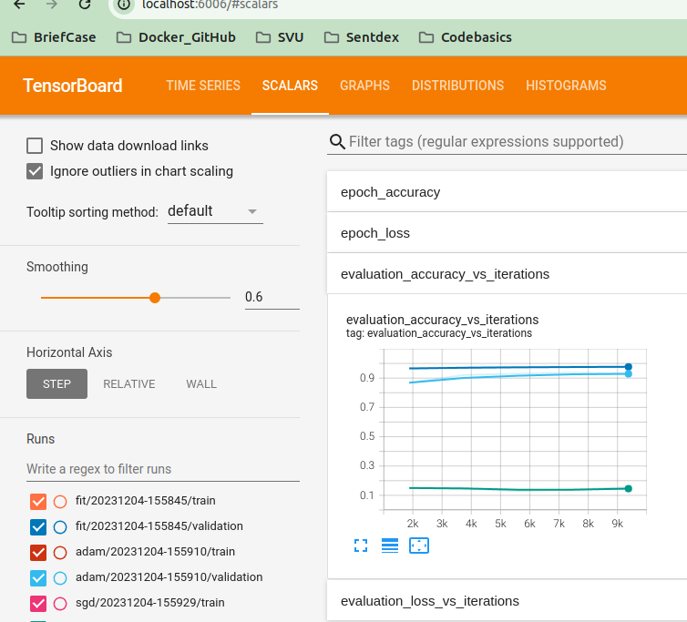
16 Tensorboard
https://www.youtube.com/watch?v=9SdLOcGnebU&list=PLeo1K3hjS3uu7CxAacxVndI4bE_o3BDtO&index=16
Tensorboard (10:51-11:50/14:55)
Click “Scalars”

Slide 19
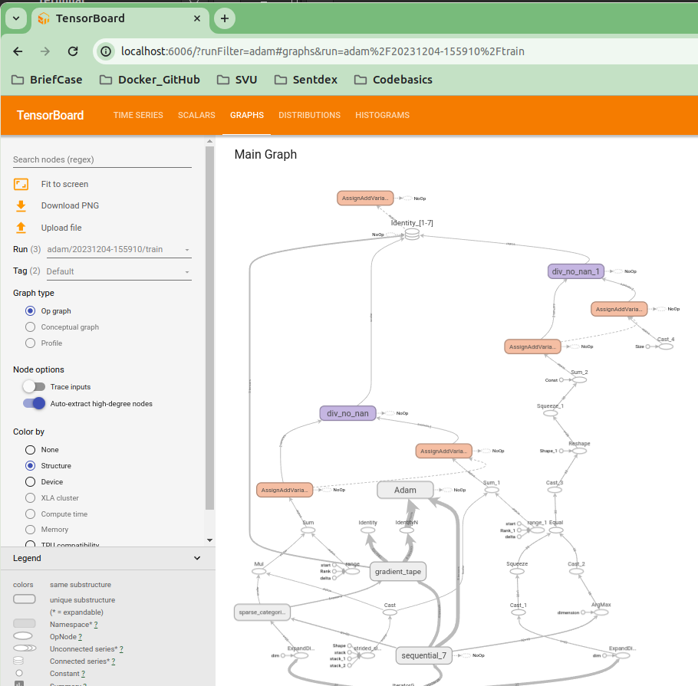
16 Tensorboard
https://www.youtube.com/watch?v=9SdLOcGnebU&list=PLeo1K3hjS3uu7CxAacxVndI4bE_o3BDtO&index=16
Tensorboard (11:51-12:50/14:55)
Click “Graph”

Slide 20
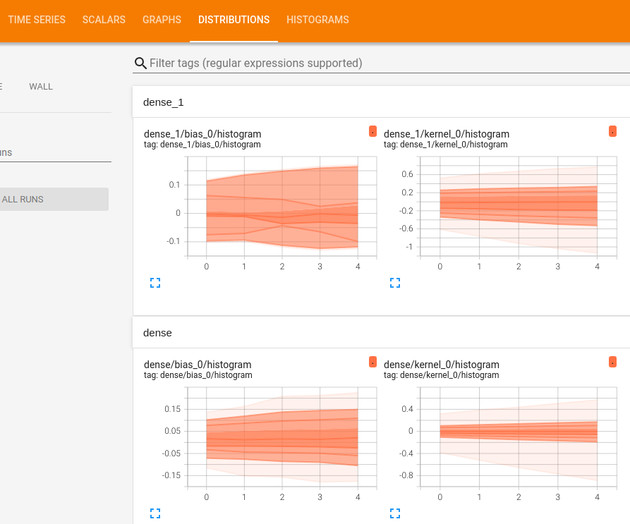
16 Tensorboard
https://www.youtube.com/watch?v=9SdLOcGnebU&list=PLeo1K3hjS3uu7CxAacxVndI4bE_o3BDtO&index=16
Tensorboard (12:51-13:50/14:55)
Click “Distribution”

Slide 21
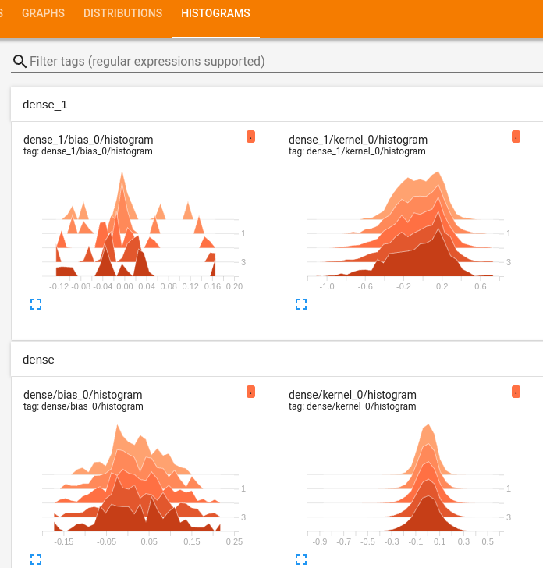
16 Tensorboard
https://www.youtube.com/watch?v=9SdLOcGnebU&list=PLeo1K3hjS3uu7CxAacxVndI4bE_o3BDtO&index=16
Tensorboard (13:51-14:55/14:55)
Click “Histogram”

Slide 22
End

