Slide 1

17 CPU vs. GPU Benchmark
Peter H. Chen

Slide 2
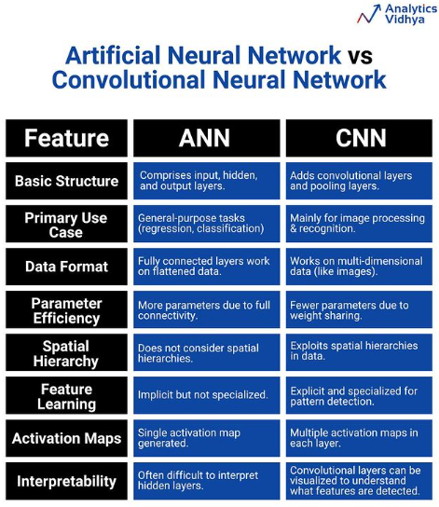
17 CPU vs. GPU Benchmark
https://www.youtube.com/watch?v=YmDaqXMIoeY&list=PLeo1K3hjS3uu7CxAacxVndI4bE_o3BDtO&index=17
CPU vs. GPU Benchmark (0:00-0:20/23:57)
We have 60,000 images to classify by ANN (Artificial Neural network) instead of CNN (Convolutional Neural Network). In ANN, we do not extract the image features.
We train model by CPU and then by GPU. We will bench mark the result.

Slide 3
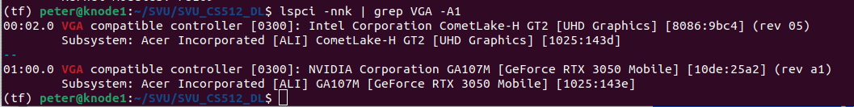
17 CPU vs. GPU Benchmark
https://www.youtube.com/watch?v=YmDaqXMIoeY&list=PLeo1K3hjS3uu7CxAacxVndI4bE_o3BDtO&index=17
CPU vs. GPU Benchmark (0:21-1:00/23:57)
Google Search: Command to find hardware details on Ubuntu?
https://askubuntu.com/questions/31618/how-can-i-find-my-hardware-details
First, we check VGA display and GPU Accelerator on your system:
> lspci -nnk | grep VGA -A1
1. lspci: List all PCI devices
2. nn: Show number and name
3. k: kernel drives handling each device
4. VGA: Video Graphic Adapter. Intel display card, NVIDIA GeForce RTX 3050 accelerator card.
5. -A1: print one trailing context after matching lines. Place a group separator (--).

Slide 4
17.1 Cuda, CuDNN, and TF Version

Slide 5
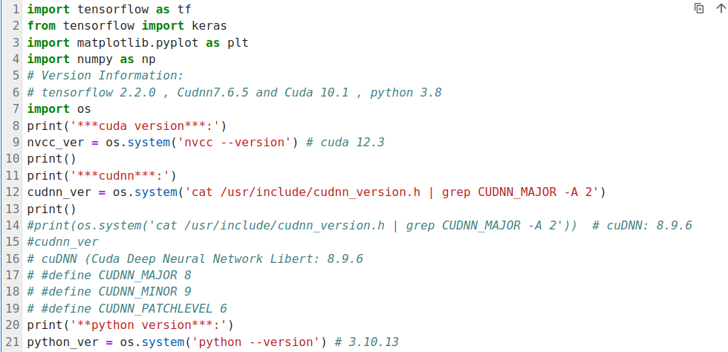
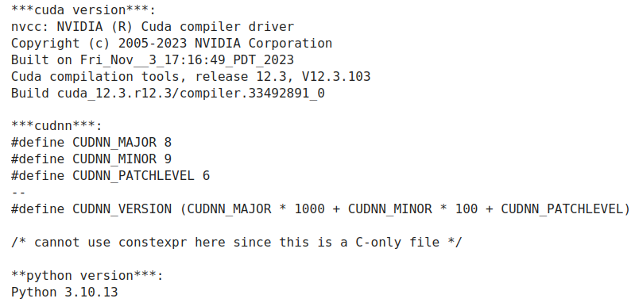
17.1 Cuda, CuDNN, and TF Version
https://www.youtube.com/watch?v=YmDaqXMIoeY&list=PLeo1K3hjS3uu7CxAacxVndI4bE_o3BDtO&index=17
Cuda, CuDNN, and TF Version (1:01-1:20/23:57)
Below, we check
1. nvcc (CUDA) Version,
2. cuDNN (Cuda Deep Neural Network) version
3. Python version.
1
2
3

Slide 6
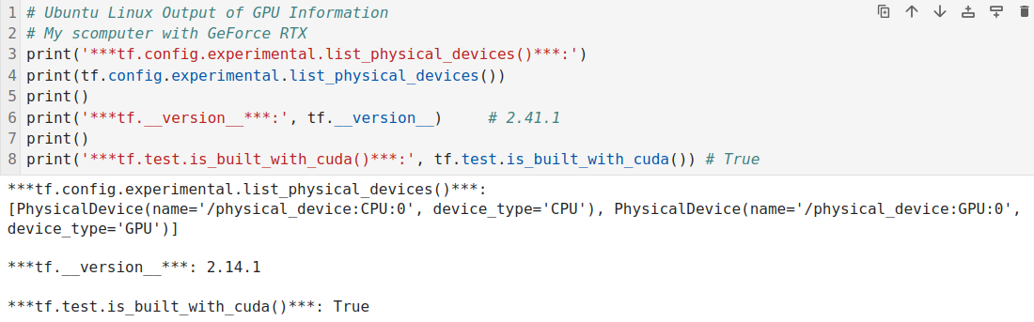
17.1 Cuda, CuDNN, and TF Version
https://www.youtube.com/watch?v=YmDaqXMIoeY&list=PLeo1K3hjS3uu7CxAacxVndI4bE_o3BDtO&index=17
Cuda, CuDNN, and TF Version (1:20-1:21/23:57)
https://www.cherryservers.com/blog/install-cuda-ubuntu#what-is-cuda
1. Check tensorflow can see Cuda GPU.
2. Check the tensorflow version: 2.14.1.
3. Check tensorflow is built with Cuda: True
1
2
3

Slide 7
17.2 Local CPU: 1/10 Epoch

Slide 8
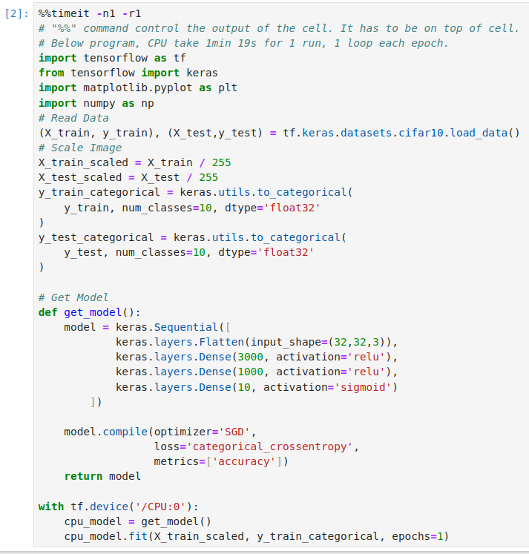
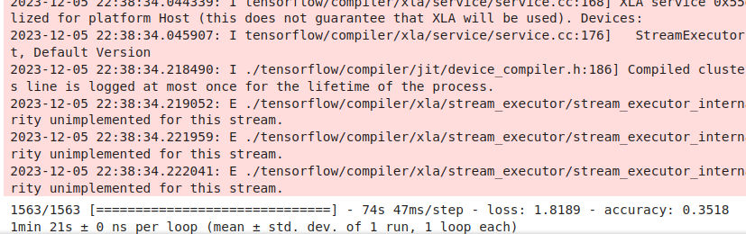
17.2 Local CPU
https://www.youtube.com/watch?v=YmDaqXMIoeY&list=PLeo1K3hjS3uu7CxAacxVndI4bE_o3BDtO&index=17
1 Epoch on my Computer (1:20-1:21/23:57)
I do not have enough VRAM to run this application.
Below is CPU mode only. For GPU, I used Google Colab to run in section 17.1 and section 17.2.
CPU mode, 1 Epoch on my computer: 1 min 21 sec.

Slide 9
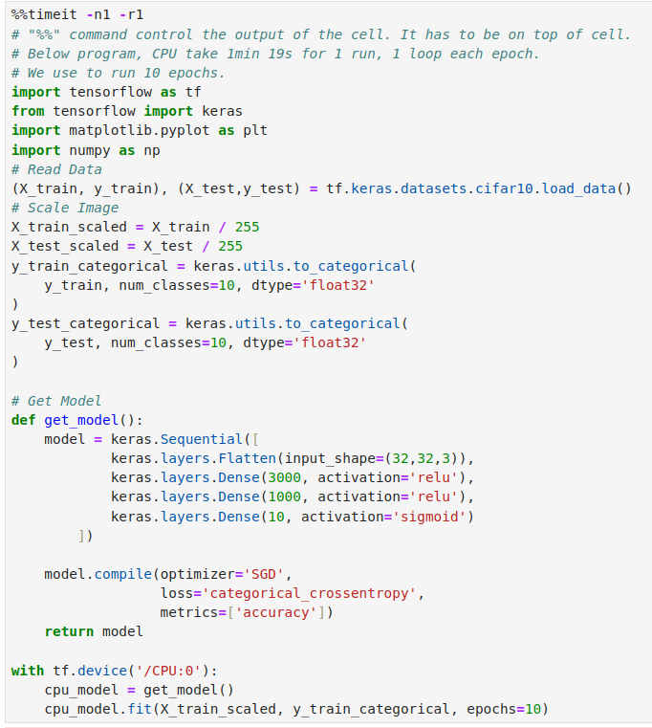
17.2 Local CPU
https://www.youtube.com/watch?v=YmDaqXMIoeY&list=PLeo1K3hjS3uu7CxAacxVndI4bE_o3BDtO&index=17
10 Epochs on my Computer (1:21-1:22/23:57)
I do not have enough VRAM to run this application.
Below is CPU mode only. For GPU, I used Google Colab to run in section 17.1 and section 17.2.
CPU mode, 10 Epochs on my computer: 17 min 44 sec

Slide 10
17.3 Colab CPU vs. GPU: 1 Epoch

Slide 11
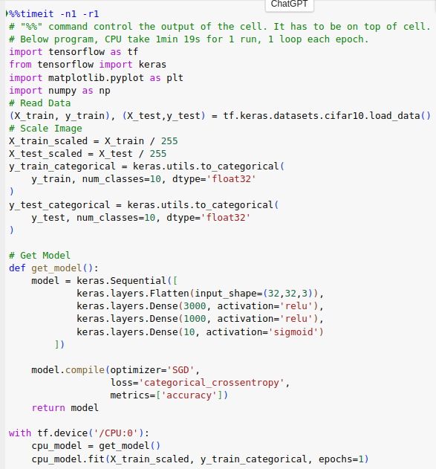
17.3 Colab for CPU vs. GPU: 1 Epoch
https://www.youtube.com/watch?v=YmDaqXMIoeY&list=PLeo1K3hjS3uu7CxAacxVndI4bE_o3BDtO&index=17
Colab for CPU vs. GPU Benchmark (1:25-5:21/23:57)
https://colab.research.google.com/drive/1T8d67--2lKkoLjxHbR7CSwXi65TrQZQI#scrollTo=RxsMm7m6yzM6
Google colab CPU Mode, 1 Epochs: takes 2 min 35 sec.

Slide 12
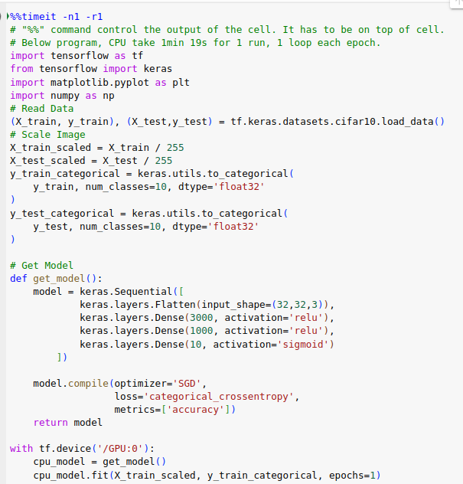
17.3 Colab for CPU vs. GPU: 1 Epoch
https://www.youtube.com/watch?v=YmDaqXMIoeY&list=PLeo1K3hjS3uu7CxAacxVndI4bE_o3BDtO&index=17
Colab for CPU vs. GPU Benchmark (5:20-10:21/23:57)
https://colab.research.google.com/drive/1T8d67--2lKkoLjxHbR7CSwXi65TrQZQI#scrollTo=RxsMm7m6yzM6
Google colab GPU mode, 1 Epoch: takes 3 min 31 sec for one epoch.

Slide 13
17.4 Colab CPU vs. GPU: 10 Epochs

Slide 14
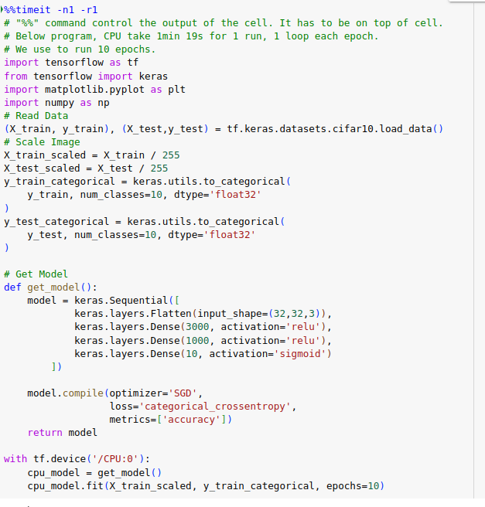
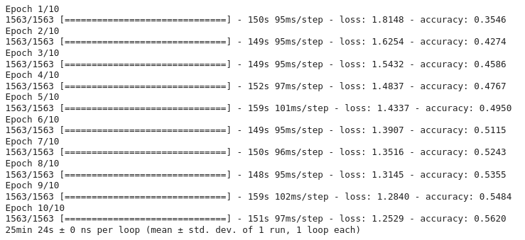
17.4 Colab for CPU vs. GPU: 10 Epochs
https://www.youtube.com/watch?v=YmDaqXMIoeY&list=PLeo1K3hjS3uu7CxAacxVndI4bE_o3BDtO&index=17
Colab for CPU vs. GPU: 10 Epochs (10:20-15:21/23:57)
https://colab.research.google.com/drive/1T8d67--2lKkoLjxHbR7CSwXi65TrQZQI#scrollTo=RxsMm7m6yzM6
Google colab CPU Mode, 10 Epochs: takes: 25 min 24 sec .

Slide 15
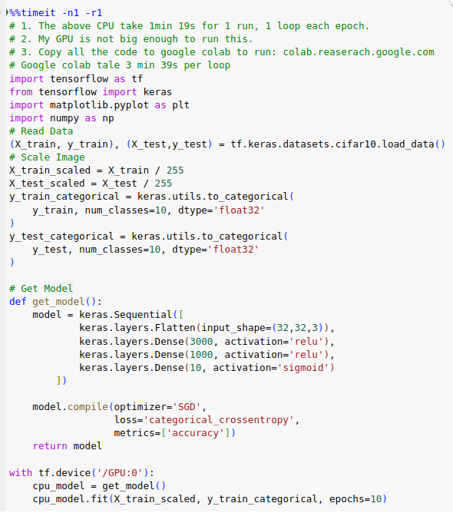
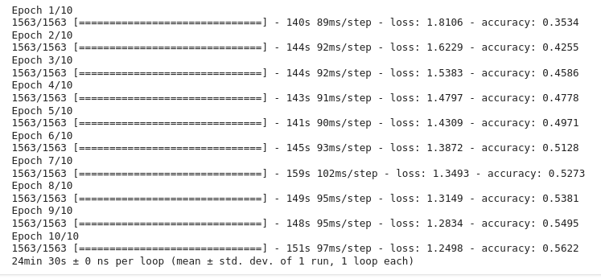
17.4 Colab for CPU vs. GPU: 10 Epochs
https://www.youtube.com/watch?v=YmDaqXMIoeY&list=PLeo1K3hjS3uu7CxAacxVndI4bE_o3BDtO&index=17
Colab CPU vs. GPU: 10 Epoch (15:20-20:21/23:57)
https://colab.research.google.com/drive/1T8d67--2lKkoLjxHbR7CSwXi65TrQZQI#scrollTo=RxsMm7m6yzM6
Google Colab GPU Mode, 10 epoch: 24 min, 30sec.

Slide 16
17.5 Sumamry

Slide 17
17.5 Summary
https://www.youtube.com/watch?v=YmDaqXMIoeY&list=PLeo1K3hjS3uu7CxAacxVndI4bE_o3BDtO&index=17
Summary (21:21-23:57/23:57)
Here is the performance comparison for 1 epoch and 10 epochs based on Google Colab
From the official benchmark, GPU is almost 15 times faster.
This is the reason why GPUs are becoming popular in the field of deep learning.
Note:
I do not have enough GPU Memory (VRAM) to run.
From Google Colab, we do not see much difference.
The number of shared users and network congestion may cause the slowness.
Epoch | CPU | GPU
1 | 2 min 35 sec | 3 min 31 sec
10 | 25 mon 24 sec | 24 min 30 sec

Slide 18
End

