Slide 1

7 Driver
Peter H. Chen

Slide 2
7 Driver
https://www.tensorflow.org/agents/tutorials/4_drivers_tutorial
Driver
A common pattern in reinforcement learning is to execute a policy in an environment for a specified number of steps or episodes.
This happens, for example, during data collection, evaluation and generating a video of the agent.
While this is relatively straightforward to write in python, it is much more complex to write and debug in TensorFlow because it involves tf.while loops, tf.cond, and tf.control_dependencies.
Therefore, we abstract this notion of a run loop into a class called driver, and provide well tested implementations both in Python and TensorFlow.
Additionally, the data encountered by the driver at each step is saved in a named tuple called Trajectory and broadcast to a set of observers, such as, replay buffers and metrics.
This data includes the observation from the environment, the action recommended by the policy, the reward obtained, the type of the current, the next step, and etc.

Slide 3
7.1 Setup

Slide 4
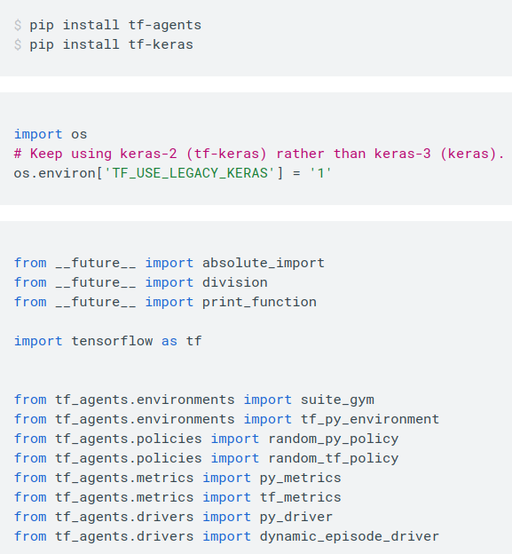
7.1 Setup
https://www.tensorflow.org/agents/tutorials/4_drivers_tutorial
Setup
Install the tf-agents, tf-keras, tf-drivers, etc as on the right.

Slide 5
7.2 Python Driver

Slide 6
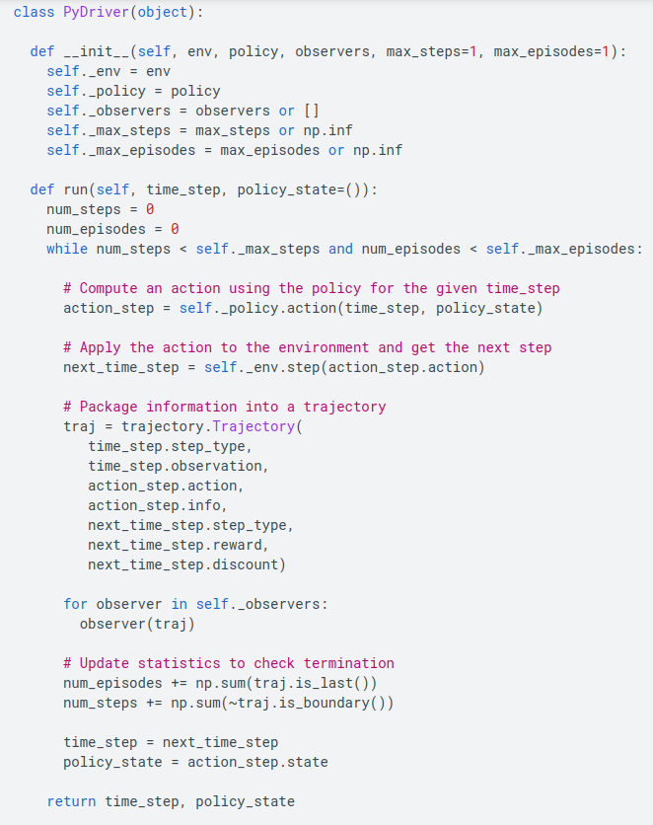
7.2 Python Driver
https://www.tensorflow.org/agents/tutorials/4_drivers_tutorial
Python Driver
The PyDriver class takes a python environment, a python policy and a list of observers to update at each step.
The main method is run(), which steps the environment using actions from the policy until at least one of the following termination criteria is met:
The number of steps reaches max_steps or the number of episodes reaches max_episodes.
PyDriver class is on the right.
1. init: input env, policy, observer, max_steps, max_episodes
2. run(): Takes care step, trajectory, and opisodes.

Slide 7
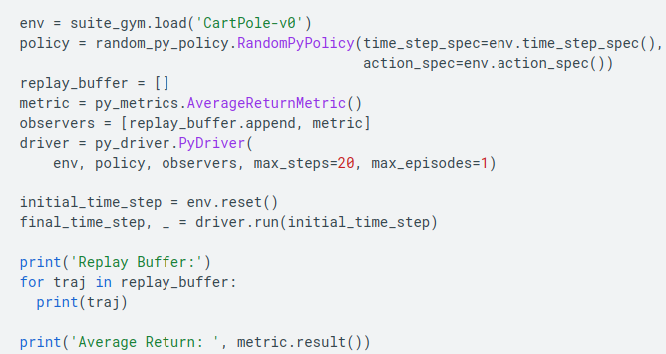
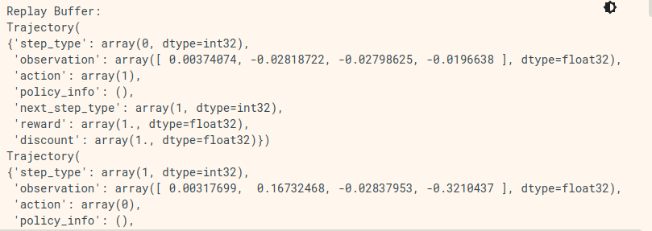
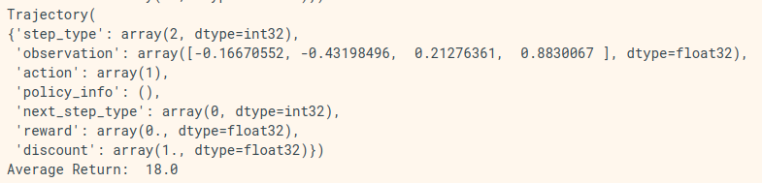
7.2 Python Driver
https://www.tensorflow.org/agents/tutorials/4_drivers_tutorial
Python Driver
Look at example of running a random policy on the CartPole environment, saving the results to a replay buffer and computing some metrics.

Slide 8
7.3 TF Driver

Slide 9
7.3 TF Driver
https://www.tensorflow.org/agents/tutorials/4_drivers_tutorial
TF Driver
We also have drivers in TensorFlow which are functionally similar to Python drivers, but use TF environments, TF policies, TF observers etc.
We currently have 2 TensorFlow drivers:
  1. DynamicStepDriver, which terminates after a given number of (valid) environment steps and
  2. DynamicEpisodeDriver, which terminates after a given number of episodes.

Slide 10
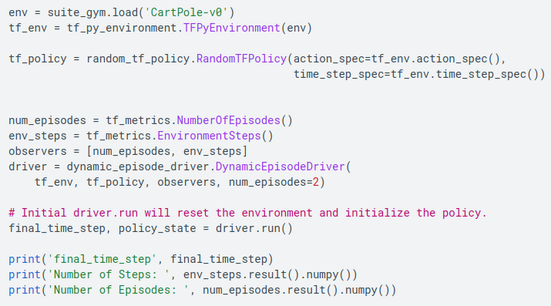
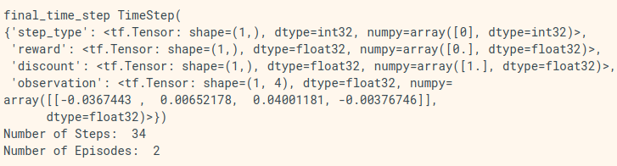
7.3 TF Driver
https://www.tensorflow.org/agents/tutorials/4_drivers_tutorial
TF Driver
Below is an example of the DynamicEpisode in action.

Slide 11
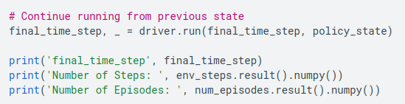
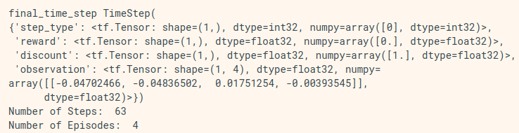
7.3 TF Driver
https://www.tensorflow.org/agents/tutorials/4_drivers_tutorial
TF Driver
Below is an example of the DynamicEpisode in action (cont).

Slide 12
End

