Slide 1

1 Create Our Own Environment: Part 1
Peter H. Chen

Slide 2
1 Create Our Own Environment: Part 1
https://www.youtube.com/watch?v=vmrqpHldAQ0&t=2s
Create Our Own Environment: Part 1 (00:00-01:00/20:58)
We discuss how to create our own environment. Previously, we use library to create environment.
Why do we want to create our own environment? We want to know what does the library do for us. We will understand how to convert the state into the reward, policy, etc.
With understand environment creation, it will help us thinking how to solve the problem.
We create a simplest reinforcement learning with
1. Create our own environment (without using Gymnasium environment to create)
2. Calculate with CPU numpy (without CPU from PyTorch or Tensorflow)
3. Plot with our own plot (without using render from gymnasium environment)

Slide 3
1.1 Import Library

Slide 4

1.1 Import Library
https://www.youtube.com/watch?v=vmrqpHldAQ0&t=2s
Import Library (01:01-02:20/20:58)
We explain the code line by line:
1. We import CPU Mode numpy. We do not use any GPU to do calculation.
> import numpy as np
2. We do not use gym render. We plot with matplotlib by ourselves.
> import matplotlib.pyplot as plt

Slide 5
1.2 Class GridWorld

Slide 6
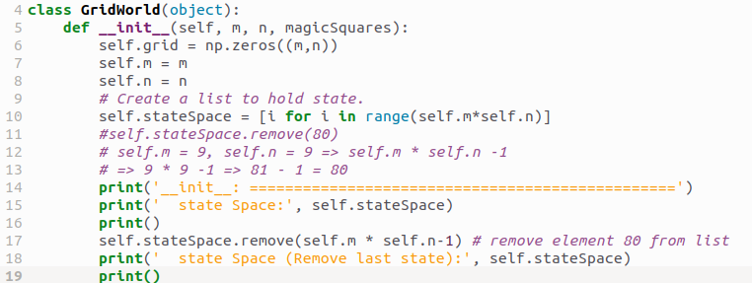
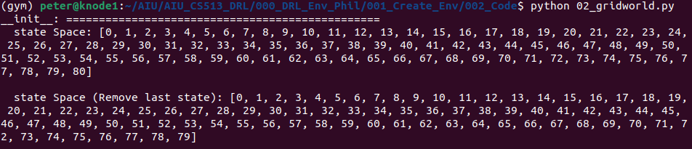
1.2 Class GridWorld
https://www.youtube.com/watch?v=vmrqpHldAQ0&t=2s
Class GridWorld (02:21-05:00/20:58)
Define class called GridWorld. Our initializer passed in M and N which is the shape of the grid, Magic Squares {1: 54, 63: 14}: Map magic square to their connecting square.
1. Initialize the grid with shape m x n.
2. Remove (m x n) - 1 # remove last element from stateSpace and make it to m x n -1

Slide 7
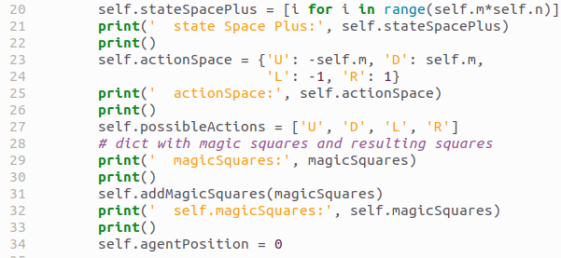
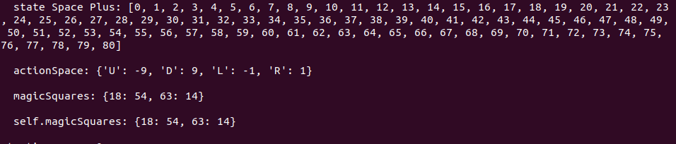
1.2 Class GridWorld
https://www.youtube.com/watch?v=vmrqpHldAQ0&t=2s
Class GridWorld (05:01-05:30/20:58)
1. Initialize sateSpacePlus: m x n
2. Initialize actionSpace: U = -9, D: +9, L= -1, R = 1
3. possibleAction = [‘U’, ‘D’, ‘L’, ‘R’)
4. magicSquares: more complicated to explain here.
5. agentPosition = 0

Slide 8
1.3 addMagicSquares

Slide 9
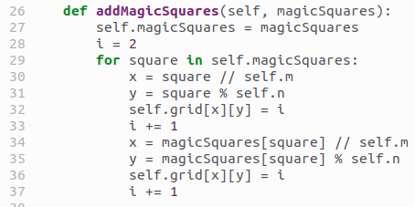
1.3 addMagicSquares
https://www.youtube.com/watch?v=vmrqpHldAQ0&t=2s
addMagicSquares (05:31-08:20/20:58)
Store the magicSquares object.
The agent is 0
magicSquares are represented by 1. ???

Slide 10
1.4 isTerminalState

Slide 11
1.4 isTerminalState
https://www.youtube.com/watch?v=vmrqpHldAQ0&t=2s
IsTerminalState (08:21-09:10/20:58)

Slide 12
1.5 getAgentRowAndColumn

Slide 13

1.5 getAgentRowAndColumn
https://www.youtube.com/watch?v=vmrqpHldAQ0&t=2s
getAgentRowAndColumn (09:11-09:40/20:58)

Slide 14
1.6 setState

Slide 15
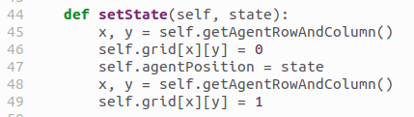
1.6 setState
https://www.youtube.com/watch?v=vmrqpHldAQ0&t=2s
setState (09:41-10:50/20:58)

Slide 16
1.7 offGridMove

Slide 17
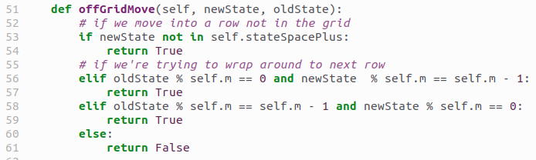
1.7 offGridMove
https://www.youtube.com/watch?v=vmrqpHldAQ0&t=2s
offGridMove (10:51-13:20/20:58)

Slide 18
1.8 step

Slide 19
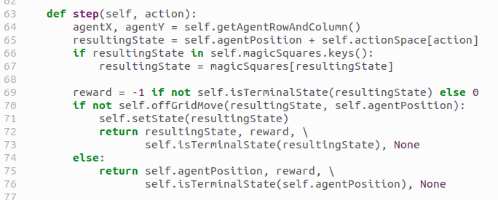
1.8 step
https://www.youtube.com/watch?v=vmrqpHldAQ0&t=2s
step (13:21-16:50/20:58)

Slide 20
1.9 reset

Slide 21
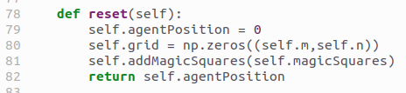
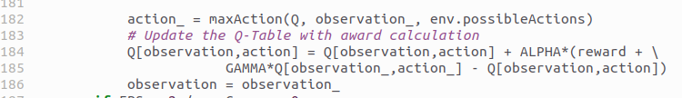
1.9 reset
https://www.youtube.com/watch?v=vmrqpHldAQ0&t=2s
reset (16:51-17:35/20:58)

Slide 22
1.10 Q-Table Award Calculation

Slide 23
1.10 Q-Table Award Calculation
https://www.youtube.com/watch?v=vmrqpHldAQ0&t=2s
Q-Table Award Calculation (16:51-17:35/20:58)

Slide 24
1.11 render

Slide 25
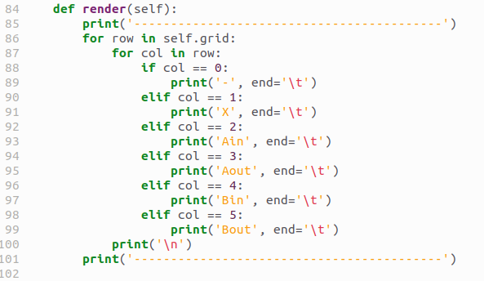
1.11 render
https://www.youtube.com/watch?v=vmrqpHldAQ0&t=2s
render (17:36-20:58/20:58)

Slide 26
End

