Slide 1

2 Create Our Own Environment: Part 2
Peter H. Chen

Slide 2
2 Create Our Own Environment: Part 2
https://www.youtube.com/watch?v=vmrqpHldAQ0&t=2s
Create Our Own Environment: Part 2 (00:00-01:00/12:40)
We finished the GridWorld class.
We continue the main program.

Slide 3
2.1 Hyperparamter

Slide 4
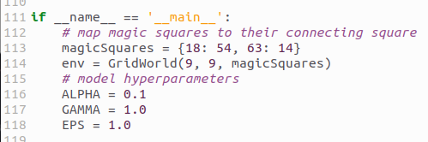
2.1 Hyperparamter
https://www.youtube.com/watch?v=vmrqpHldAQ0&t=2s
Hyperparameter (01:01-02:00/12:40)

Slide 5
2.2 Q Table

Slide 6

2.2 Q Table
https://www.youtube.com/watch?v=vmrqpHldAQ0&t=2s
Q Table (01:01-03:00/12:40)

Slide 7
2.3 Episode

Slide 8
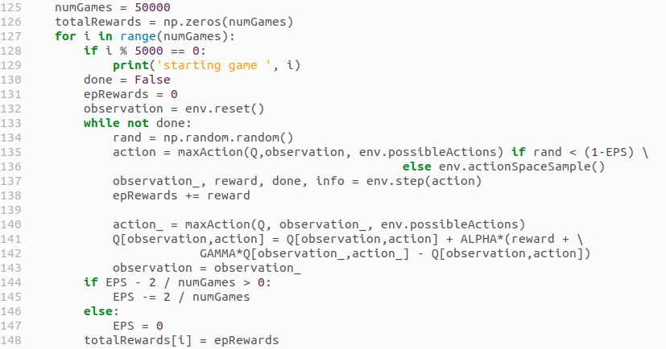
2.3 Episode
https://www.youtube.com/watch?v=vmrqpHldAQ0&t=2s
Episode (03:01-05:00/12:40)

Slide 9
2.4 While Loop

Slide 10
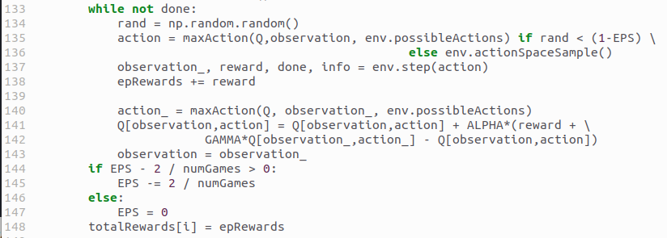
2.4 While Loop
https://www.youtube.com/watch?v=vmrqpHldAQ0&t=2s
While Loop (05:01-09:50/12:40)

Slide 11
2.5 Plot

Slide 12

2.5 Plot
https://www.youtube.com/watch?v=vmrqpHldAQ0&t=2s
Plot (09:51-10:00/12:40)

Slide 13
2.6 Run

Slide 14
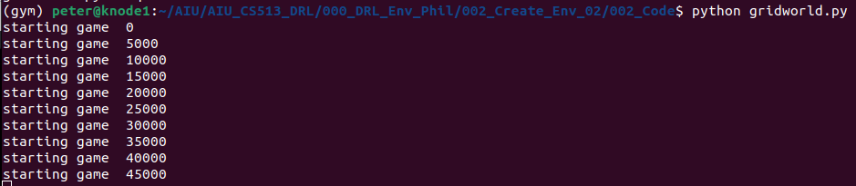
2.6 Run
https://www.youtube.com/watch?v=vmrqpHldAQ0&t=2s
Run (10:01-12:00/12:40)

Slide 15
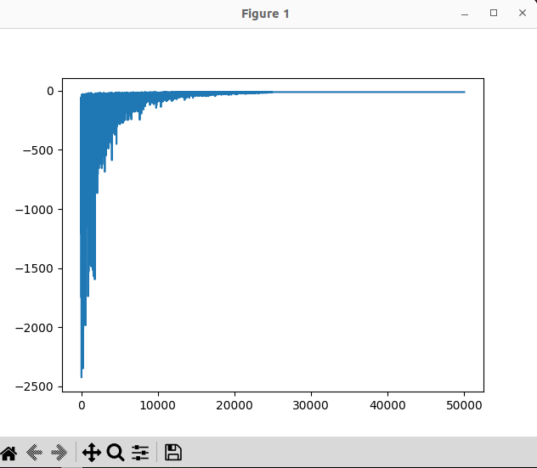
2.6 Run
https://www.youtube.com/watch?v=vmrqpHldAQ0&t=2s
Run (11:11-12:40/12:40)

Slide 16
End

