Slide 1

8 FSM
Peter H. Chen

Slide 2
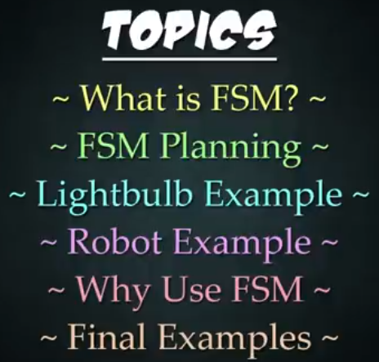
8 FSM
https://www.youtube.com/watch?v=E45v2dD3IQU&list=PL82YdDfxhWsC-3kdTKK2_mwbNdBfVvb_M&index=8
FSM (00:00-00:20/22:10)
We discuss Python FSM (Finite State Machine).

Slide 3
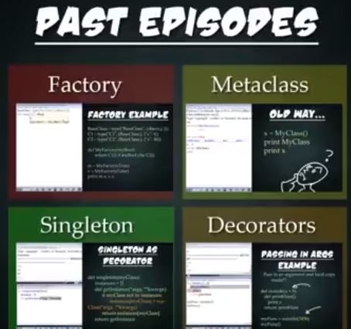
8 FSM
https://www.youtube.com/watch?v=E45v2dD3IQU&list=PL82YdDfxhWsC-3kdTKK2_mwbNdBfVvb_M&index=8
FSM (00:21-00:30/22:10)
We have discussed Python Factory, Meta-class, Singleton, and Decorator.

Slide 4
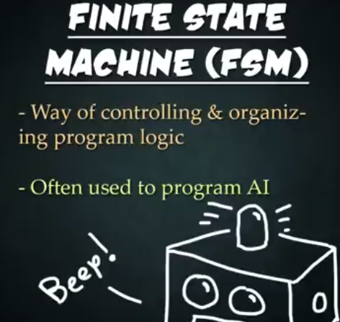
8 FSM
https://www.youtube.com/watch?v=E45v2dD3IQU&list=PL82YdDfxhWsC-3kdTKK2_mwbNdBfVvb_M&index=8
FSM (00:31-00:40/22:10)
Now, we discuss about FSM (Finite State Machine).
FSM is the way to control or organize logic in the program.
FSM is commonly used in AI (Artificial Intelligence). FSM can be used for game or algorithm.

Slide 5
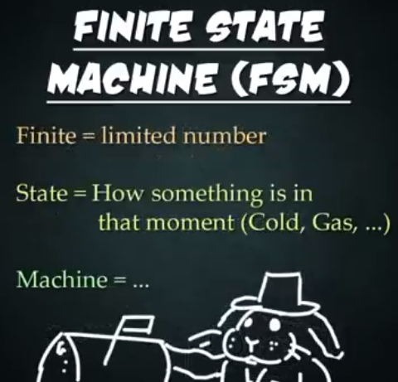
8 FSM
https://www.youtube.com/watch?v=E45v2dD3IQU&list=PL82YdDfxhWsC-3kdTKK2_mwbNdBfVvb_M&index=8
FSM (00:41-01:10/22:10)
1. What is Finite?
Finite mean limited number, such as, 5, 10, etc. But not infinity number.
2. What is State?
State is how something is in that moment. If you think about the real world, something could be hot or cold, could be liquid, could be gas, or could be on or off in the case of a light build.
3. What is a machine?
Machine is something automated.

Slide 6
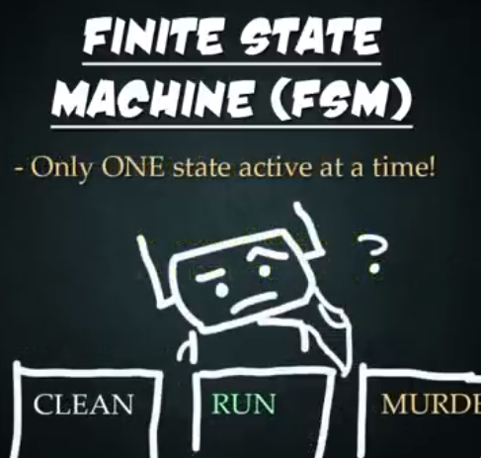
8 FSM
https://www.youtube.com/watch?v=E45v2dD3IQU&list=PL82YdDfxhWsC-3kdTKK2_mwbNdBfVvb_M&index=8
FSM (01:11-01:30/22:10)
What is FSM (Finite State Machine)?
The program can have only ONE state active at a time.

Slide 7
8.1 Planning

Slide 8
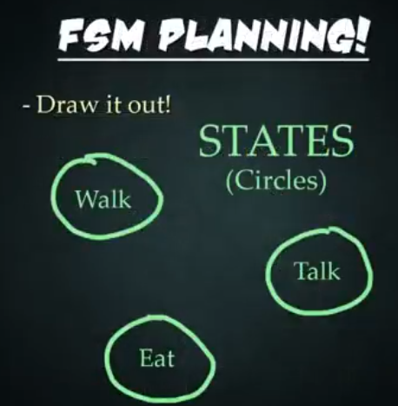
8.1 Planning
https://www.youtube.com/watch?v=E45v2dD3IQU&list=PL82YdDfxhWsC-3kdTKK2_mwbNdBfVvb_M&index=8
Planning (01:31-01:55/22:10)
How to use FSM?
First step, you plan.
Create Finite State Machine is tough and it is imperative that you organize all your thoughts and get them down on paper, pen, etc, whatever it maybe visually see how everything is going to lay out.
Here is the way of planning out Finite State Machine.
Let’s draw several circles for all the different states need to create.

Slide 9
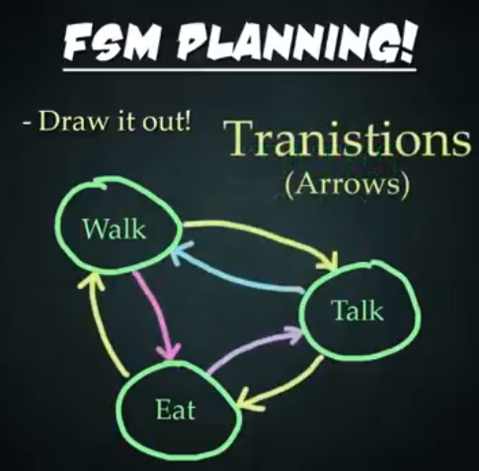
8.1 Planning
https://www.youtube.com/watch?v=E45v2dD3IQU&list=PL82YdDfxhWsC-3kdTKK2_mwbNdBfVvb_M&index=8
Planning (01:56-02:05/22:10)
Second Step: We need to draw arrows that represent transitions, the arrow is one way to connect different state, connecting them and creating a network.

Slide 10
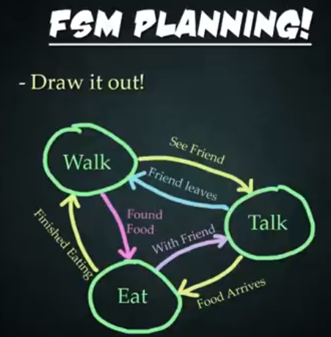
8.1 Planning
https://www.youtube.com/watch?v=E45v2dD3IQU&list=PL82YdDfxhWsC-3kdTKK2_mwbNdBfVvb_M&index=8
Planning (02:06-02:15/22:10)
Third Step: Each Arrow describes a condition which describes why one state changed to another.
It is important to label the arrows so that you know exactly what triggers the transition between states.

Slide 11
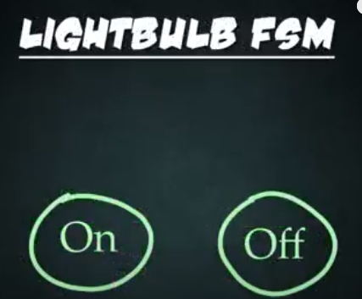
8.1 Planning
https://www.youtube.com/watch?v=E45v2dD3IQU&list=PL82YdDfxhWsC-3kdTKK2_mwbNdBfVvb_M&index=8
Planning (02:16-02:25/22:10)
For example, when we look at a finite state machine of light bulb, it has an On and an Off state.
We create these states with circles.

Slide 12
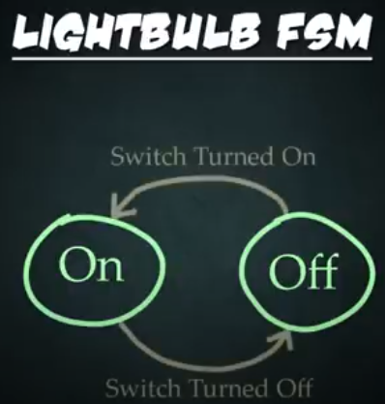
8.1 Planning
https://www.youtube.com/watch?v=E45v2dD3IQU&list=PL82YdDfxhWsC-3kdTKK2_mwbNdBfVvb_M&index=8
Planning (02:26-02:30/22:10)
Next, we have the transitions which describe how one state changes into another.
The labels say: Someone turn the light switch on or someone turn the light switch off.

Slide 13
End

