Slide 1

8.2 Light Bulb Example
Peter H. Chen

Slide 2
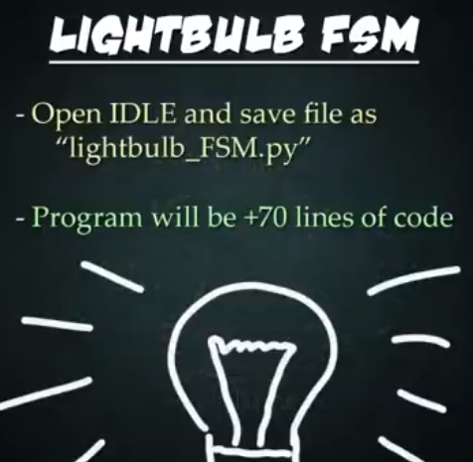
8.2 Light Bulb Example
https://www.youtube.com/watch?v=E45v2dD3IQU&list=PL82YdDfxhWsC-3kdTKK2_mwbNdBfVvb_M&index=8
Light Bulb Example (02:31-03:00/22:10)
Create a file: lightbulb_FSM.py

Slide 3
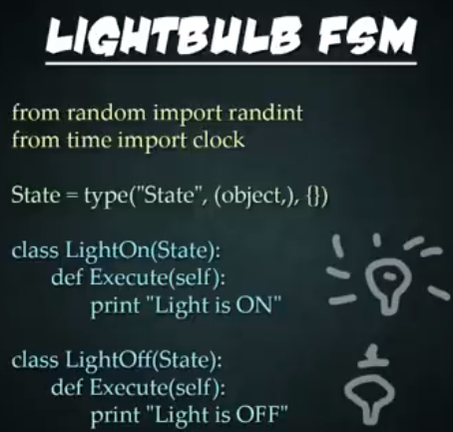
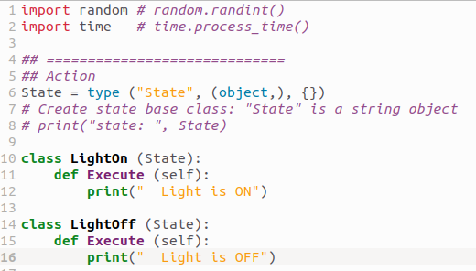
8.2 Light Bulb Example
https://www.youtube.com/watch?v=E45v2dD3IQU&list=PL82YdDfxhWsC-3kdTKK2_mwbNdBfVvb_M&index=8
Light Bulb Example (03:01-04:30/22:10)
Create a file: lightbulb_FSM.py
1. Import the random # for random.randint()
2. import time # for time.process_time()
3. Create base class “State”.
4. Create class lightOn (State)
# Pass in base class “State”
5. Create class LightOff (State)

Slide 4
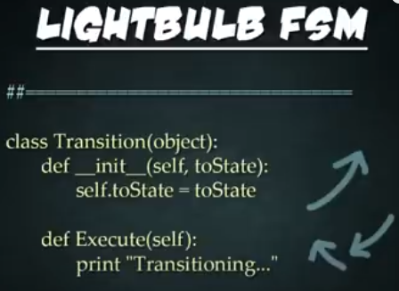
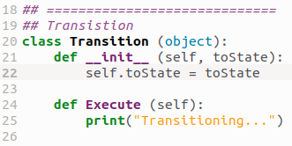
8.2 Light Bulb Example
https://www.youtube.com/watch?v=E45v2dD3IQU&list=PL82YdDfxhWsC-3kdTKK2_mwbNdBfVvb_M&index=8
Light Bulb Example (04:31-05:30/22:10)
Define Transition class:
1. __init__ (self, toState)
2. Execute (self)

Slide 5
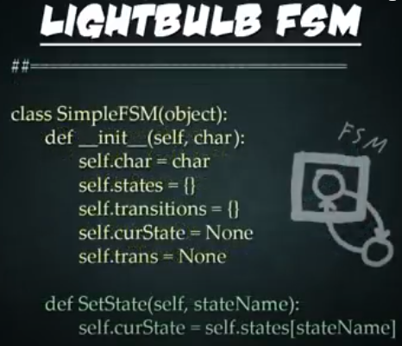
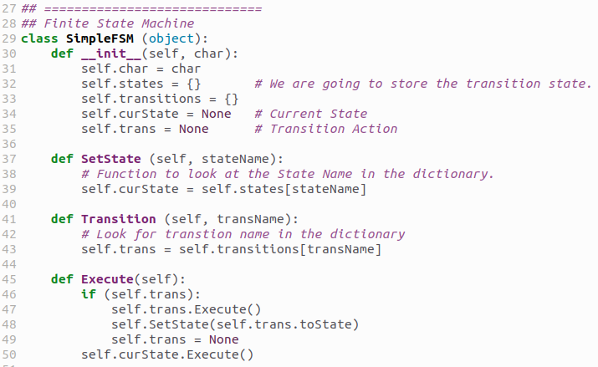
8.2 Light Bulb Example
https://www.youtube.com/watch?v=E45v2dD3IQU&list=PL82YdDfxhWsC-3kdTKK2_mwbNdBfVvb_M&index=8
Light Bulb Example (05:31-07:30/22:10)
Create Finite State Machine:
1. __init__(self, char): char is a passed in character.
char, states = {}, transitions = {}, curState, trans
2. SetState (stateName):

Slide 6
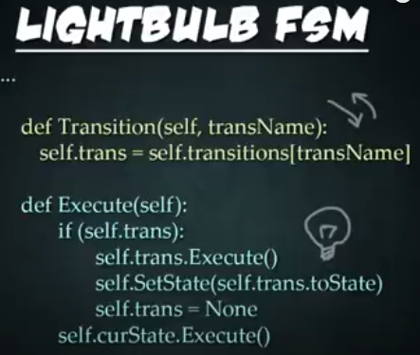
8.2 Light Bulb Example
https://www.youtube.com/watch?v=E45v2dD3IQU&list=PL82YdDfxhWsC-3kdTKK2_mwbNdBfVvb_M&index=8
Light Bulb Example (07:31-09:05/22:10)
1. Transition (transName):
2. Execute ():

Slide 7
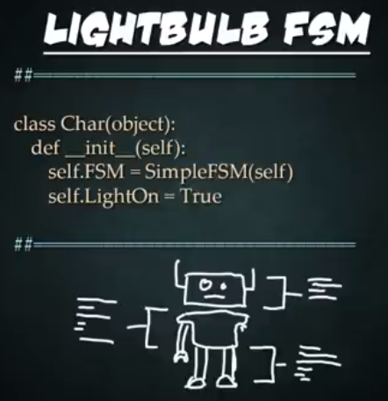
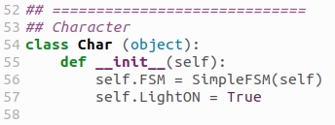
8.2 Light Bulb Example
https://www.youtube.com/watch?v=E45v2dD3IQU&list=PL82YdDfxhWsC-3kdTKK2_mwbNdBfVvb_M&index=8
Light Bulb Example (09:06-10:15/22:10)
Create character class.
This character class will hold all the character attributes and properties.
We have all the data and functions store in class character. The finite state machine will be also store within the character class.
1. create and store FSM.
2. store LightOn = True.

Slide 8
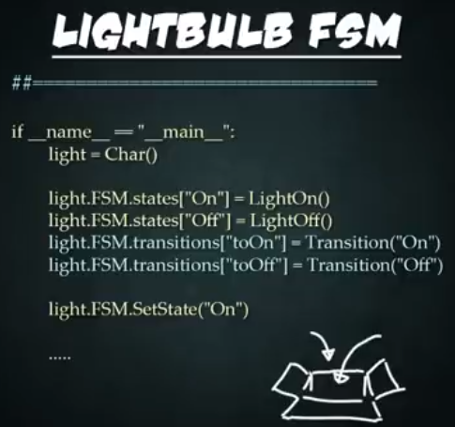
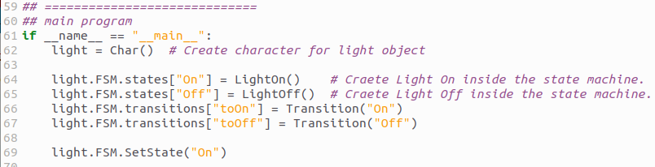
8.2 Light Bulb Example
https://www.youtube.com/watch?v=E45v2dD3IQU&list=PL82YdDfxhWsC-3kdTKK2_mwbNdBfVvb_M&index=8
Light Bulb Example (10:16-12:00/22:10)
main()
1. Create light object with class Char()
2. light.FSM.states[“On”] = LightOn()
3. light.FSM.states[“Off”] = LightOff()
4. light.FSM.transitions[“toOn”] = Transition(“On”)
5. light.FSM.transitions[“Off”] = Transition(“Off”)
6. light.FSM.SetState(“On”)

Slide 9
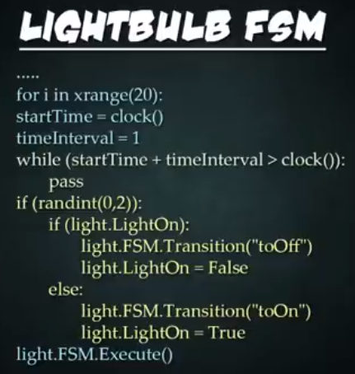
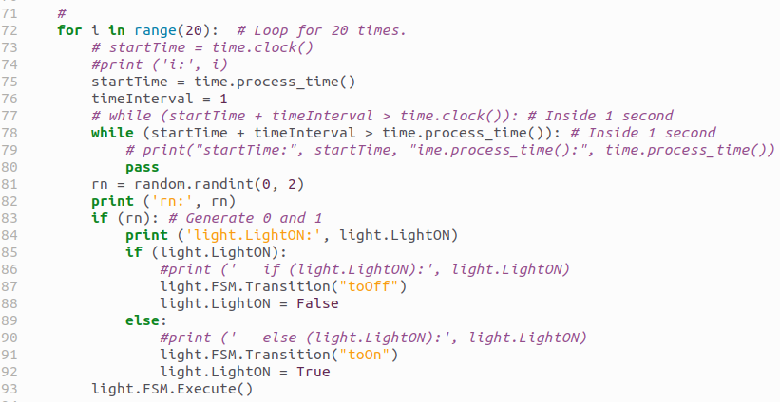
8.2 Light Bulb Example
https://www.youtube.com/watch?v=E45v2dD3IQU&list=PL82YdDfxhWsC-3kdTKK2_mwbNdBfVvb_M&index=8
Light Bulb Example (12:01-13:00/22:10)
1. For loop for 20 times:
2. Generate random number 0, 1, or 2.
3. If random number is1 and 2, then turn ON Light.
4. if rnadom number is 0, then turn OFF Light
5. Run.

Slide 10
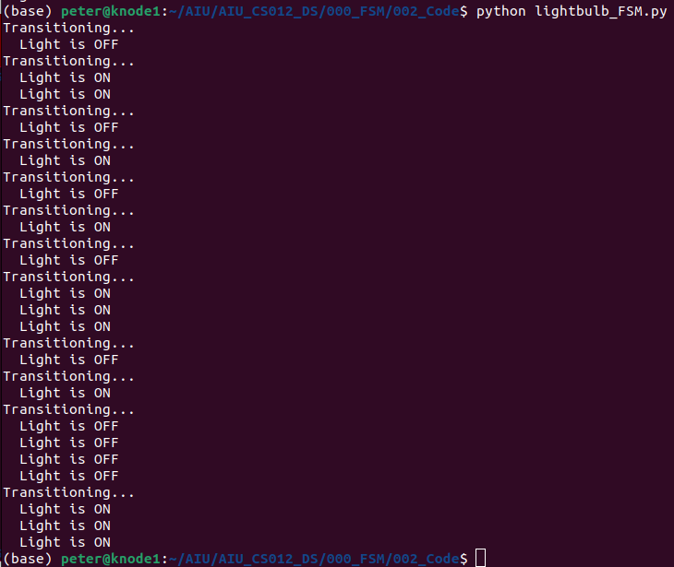
8.2 Light Bulb Example
https://www.youtube.com/watch?v=E45v2dD3IQU&list=PL82YdDfxhWsC-3kdTKK2_mwbNdBfVvb_M&index=8
Light Bulb Example (13:01-14:50/22:10)
Run lightbulb_FSM.py
> python lightbulb_FSM.py

Slide 11
End

