Slide 1

8.3 Robot Maid Example
Peter H. Chen

Slide 2
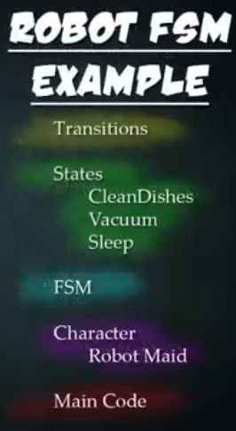
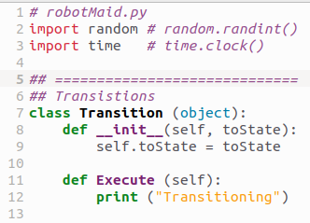
8.3 Robot Maid Example
https://www.youtube.com/watch?v=E45v2dD3IQU&list=PL82YdDfxhWsC-3kdTKK2_mwbNdBfVvb_M&index=8
Robot Maid Example (14:51-15:30/22:10)
Below is the Robot Maid Example: robotMaid.py.
These are the transition. Same as we created for light bulb example.

Slide 3
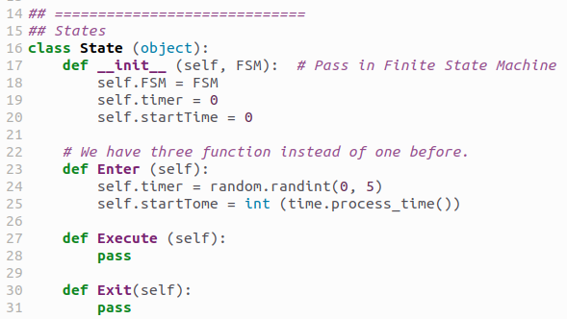
8.3 Robot Maid Example
https://www.youtube.com/watch?v=E45v2dD3IQU&list=PL82YdDfxhWsC-3kdTKK2_mwbNdBfVvb_M&index=8
Robot Maid Example (15:31-16:30/22:10)
We define the class State.
We have three functions: Enter, Execute, and Exit rather than one function in light bulb State object which we created from “type”.
> State = type ("State", (object,), {})
Right now, we “pass” the Execute and Exit in class State.
Class state is the base class for class CleanDishes, class Vacuum, and class Sleep.

Slide 4
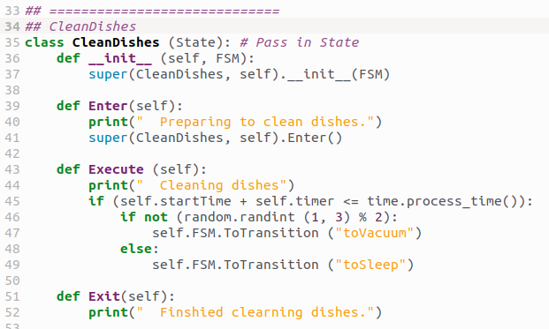
8.3 Robot Maid Example
https://www.youtube.com/watch?v=E45v2dD3IQU&list=PL82YdDfxhWsC-3kdTKK2_mwbNdBfVvb_M&index=8
Robot Maid Example (15:31-16:30/22:10)
Define the class CleanDishes.
We passed in FSM from passed in class State.
In Execute(), we check the time out or not.

Slide 5
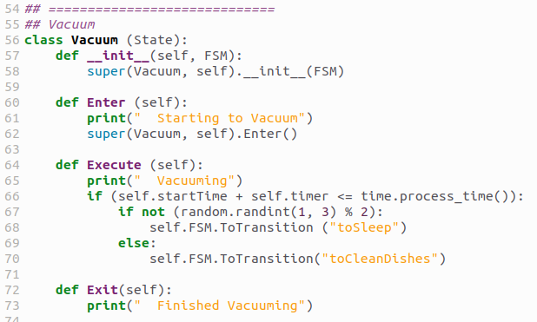
8.3 Robot Maid Example
https://www.youtube.com/watch?v=E45v2dD3IQU&list=PL82YdDfxhWsC-3kdTKK2_mwbNdBfVvb_M&index=8
Robot Maid Example (16:31-17:50/22:10)
Define the class Vacuum.
We passed in FSM from passed in class State.
In Execute(), we check the time out or not which is similar to CleanDishes.

Slide 6
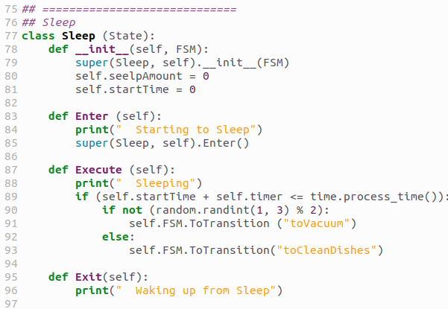
8.3 Robot Maid Example
https://www.youtube.com/watch?v=E45v2dD3IQU&list=PL82YdDfxhWsC-3kdTKK2_mwbNdBfVvb_M&index=8
Robot Maid Example (17:51-18:20/22:10)
Define the class Sleep.
Sleep is similar to class CleanDishes and class Vacuum except the Transition to different.

Slide 7
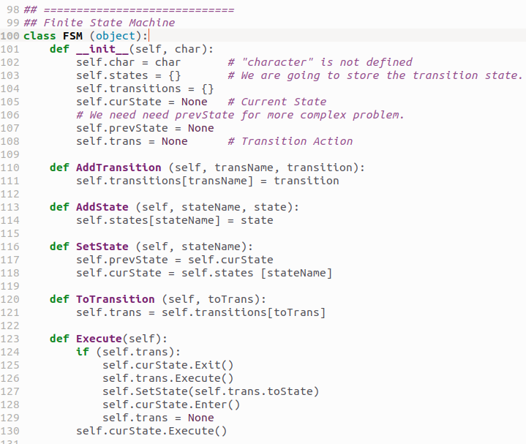
8.3 Robot Maid Example
https://www.youtube.com/watch?v=E45v2dD3IQU&list=PL82YdDfxhWsC-3kdTKK2_mwbNdBfVvb_M&index=8
Robot Maid Example (18:21-20:05/22:10)
We did not implement prevState.
In complicated cases, we need to take prevState to prevent the state movement.
In Execute, we exit the current state, run the transition, set state, enter the next state, clear the trans.
Lastly, we run current state.

Slide 8
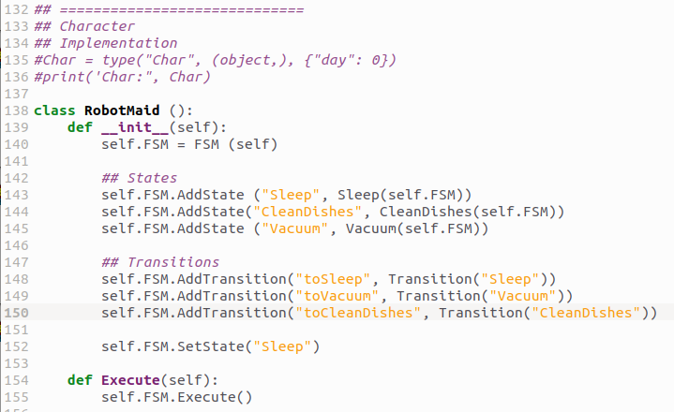
8.3 Robot Maid Example
https://www.youtube.com/watch?v=E45v2dD3IQU&list=PL82YdDfxhWsC-3kdTKK2_mwbNdBfVvb_M&index=8
Robot Maid Example (18:21-20:30/22:10)
In class RobotMaid, we init and run FSM.

Slide 9
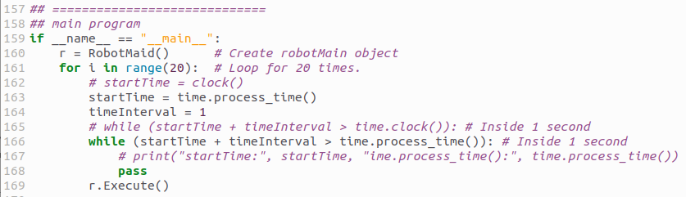
8.3 Robot Maid Example
https://www.youtube.com/watch?v=E45v2dD3IQU&list=PL82YdDfxhWsC-3kdTKK2_mwbNdBfVvb_M&index=8
Robot Maid Example (20:31-21:00/22:10)
In main program, we loop for 20 times.

Slide 10
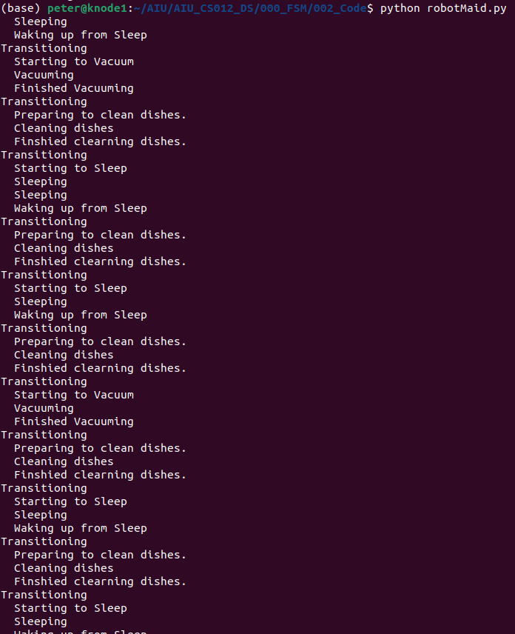
8.3 Robot Maid Example
https://www.youtube.com/watch?v=E45v2dD3IQU&list=PL82YdDfxhWsC-3kdTKK2_mwbNdBfVvb_M&index=8
Robot Maid Example (21:01-21:05/22:10)
Run
> python robotMaid.py

Slide 11
8.4 Why Use FSM?

Slide 12
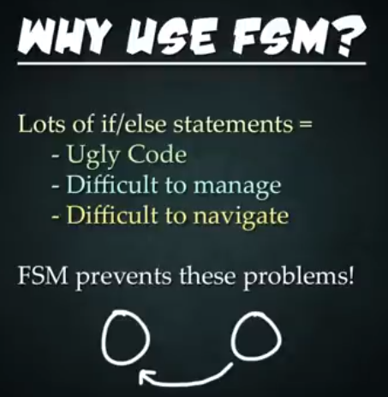
8.4 Why Use FSM?
https://www.youtube.com/watch?v=E45v2dD3IQU&list=PL82YdDfxhWsC-3kdTKK2_mwbNdBfVvb_M&index=8
Why Use FSM? (21:06-21:50/22:10)
1. Ugly Code: Huge Code
2. Difficult to manage
3. Difficult to Navigate
FSM prevent these problems.

Slide 13
8.5 Exercise

Slide 14
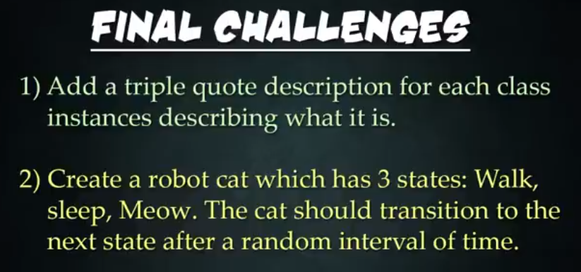
8.5 Exercise
https://www.youtube.com/watch?v=E45v2dD3IQU&list=PL82YdDfxhWsC-3kdTKK2_mwbNdBfVvb_M&index=8
Exercise (21:51-22:10/22:10)
1. Add triple quote description (“””) for documentation of each class.
2. Create a robot cat which has 3 states: Walk, Sleep, Meow. The cat should do the transition to the next state after a random internal of time.

Slide 15
End

