Slide 1

1 MuJoCo Train
Peter H. Chen

Slide 2
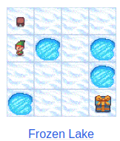
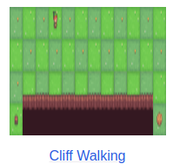
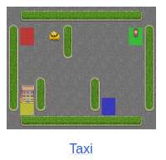
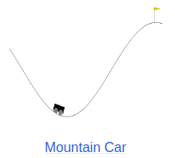
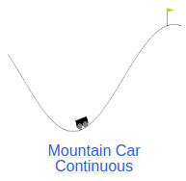
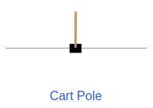
1 MuJoCo Train
https://www.youtube.com/watch?v=OqvXHi_QtT0&t=81s
MuJoCo Train (00:00-00:01/12:35)
We already discussed Q-Learning in Gymnasium environment.
1. Toy Text: Frozen Lake, Cliff Walking, Taxi
2. Classic control: Mountain Car, Mountain Car Continuous, and Cart Pole
https://www.gymlibrary.dev/environments
1
2

Slide 3

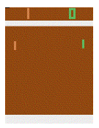
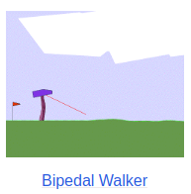
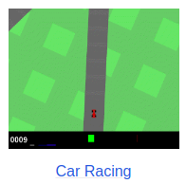
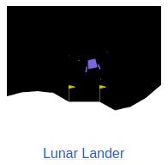
1 MuJoCo Train
https://www.youtube.com/watch?v=OqvXHi_QtT0&t=81s
MuJoCo Train (00:02-00:05/12:35)
We also look the below environments.
1. Atari: Pong
2. Box2D: Bipedal Walker, Car Racing, and Lunar Lander.
https://www.gymlibrary.dev/environments
1
2

Slide 4
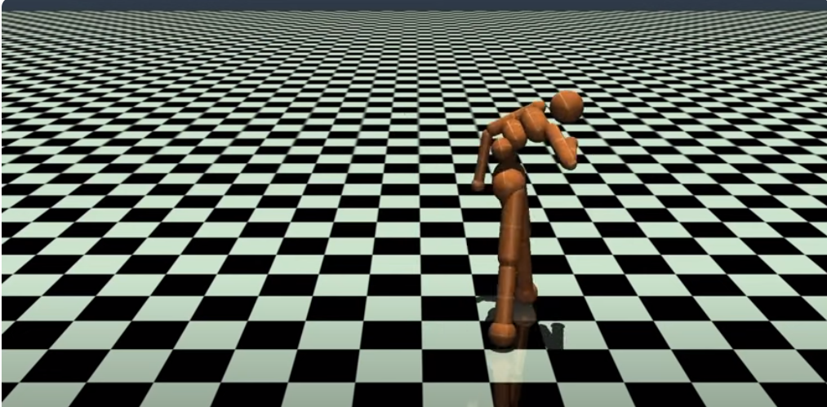
1 MuJoCo Train
https://www.youtube.com/watch?v=OqvXHi_QtT0&t=81s
MuJoCo Train (00:06-00:20/12:35)
Now, we have more complicated environment.

Slide 5
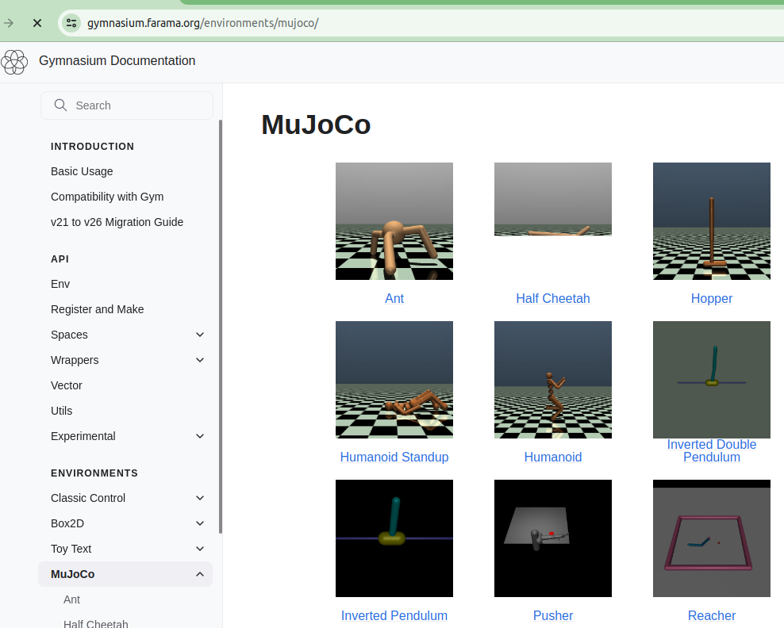
1 MuJoCo Train
https://www.youtube.com/watch?v=OqvXHi_QtT0&t=81s
MuJoCo aTrain (00:21-00:40/12:35)
Google search “Gymnasium MuJoCo”.
Mujoco (multi-Joint dynamics with contact) is a physics engine for R&D in robotics, biomechanics, graphics, animation, and fast/accurate simulation.
https://gymnasium.farama.org/environments/mujoco/

Slide 6
1.1 Install Libraries

Slide 7
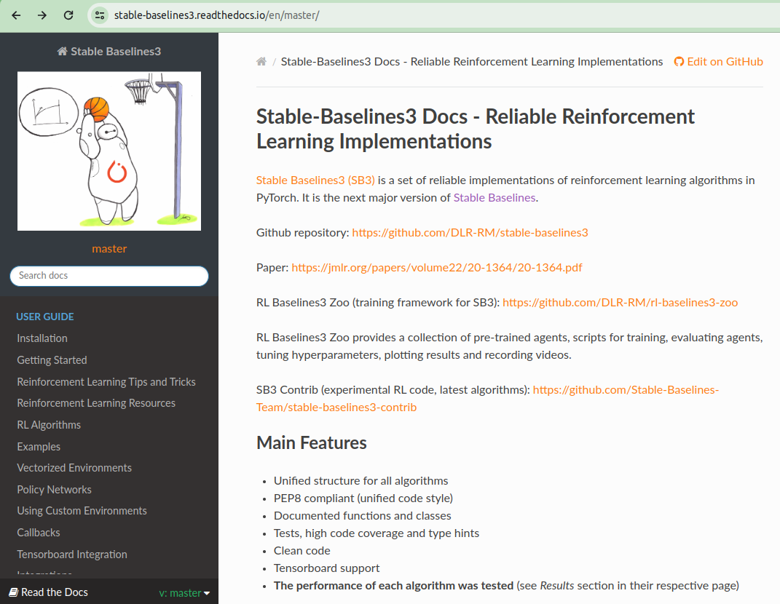
1.1 Install Libraries
https://www.youtube.com/watch?v=OqvXHi_QtT0&t=81s
Install Libraries (00:21-00:40/12:35)
We need two libraries: gymnasium[mujoco] and stable baselines.
1. Python library stable baselines 3
> pip install stable_baselines3 # OK
> pip install stable_baselines3[extra] # NG
2. Gymnasium library mujoco:
> pip install gymnasium[mujoco]
https://pypi.org/project/stable-baselines3/
https://gymnasium.farama.org/environments/mujoco/
1
2

Slide 8
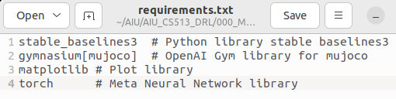
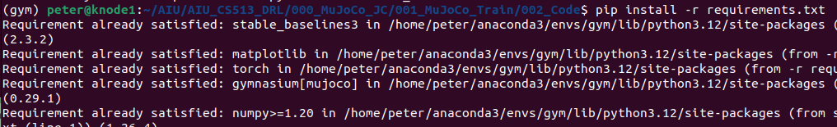
1.1 Install Libraries
https://www.youtube.com/watch?v=OqvXHi_QtT0&t=81s
Install Libraries (00:21-00:40/12:35)
1. Create/Activate Conda environment:
> conda activate gym
(gym) >
2. Install python stable baselines3 and Farama Open AI gymnasium mujoco library:
(gym) > pip install -r requirements.txt
https://pypi.org/project/stable-baselines3/
https://gymnasium.farama.org/environments/mujoco/
1
2

Slide 9
1.2 Import Libraries

Slide 10
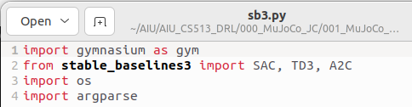
1.2 Import Libraries
https://www.youtube.com/watch?v=OqvXHi_QtT0&t=81s
Import Libraries (00:51-01:10/12:35)
1. import gymnasium environment MuJoCo library
2. import three algorithms (SAC, TD3, and A2C) for Python Library stable baseline3.
SAC: Soft Actor Critic
TD3 (Twin Delayed Deep Deterministic Policy Gradient or TD3PG): Function approximation Error in Actor-Critic Method.
A2C (Asynchronous, Deterministic Actor Critic) is a variant of A3C (Asynchronous Advantage Actor Critic).
https://gymnasium.farama.org/environments/mujoco/

Slide 11
1.3 Create Directories

Slide 12
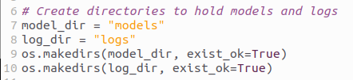
1.3 Create Directories
https://www.youtube.com/watch?v=OqvXHi_QtT0&t=81s
Create Directories (01:11-01:20/12:35)
Create directories for training models and training logs
We create two directories: One for training models and one for training logs.
https://gymnasium.farama.org/environments/mujoco/

Slide 13
1.4 Train and Test

Slide 14
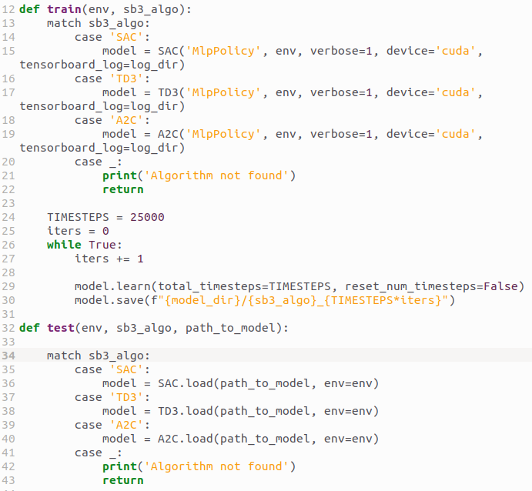
1.4 Train and Test
https://www.youtube.com/watch?v=OqvXHi_QtT0&t=81s
Train and Test (01:11-01:30/12:35)
We create two functions: Train and Test. One for training the model one for testing the model.
For the training function, we pass in two variables: environment and sb3 algorithm.
We create the model for passing parameter of sb3 algorithm.
https://stable-baselines3.readthedocs.io/en/master/

Slide 15
1.5 Create Model

Slide 16
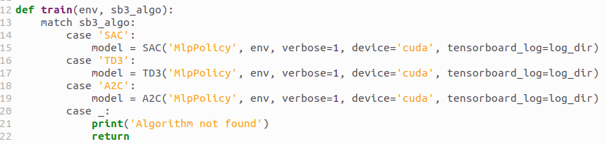
1.5 Create Model
https://www.youtube.com/watch?v=OqvXHi_QtT0&t=81s
Create Model (01:11-01:30/12:35)
The sb3 algorithm is a set of RL algorithm.
Below is a list of sb3 (Stable Baseline3) algorithm, such as, A2C, TD3, SAC. They support discrete/continuous actions and multi-processing.
https://stable-baselines3.readthedocs.io/en/master/guide/algos.html

Slide 17
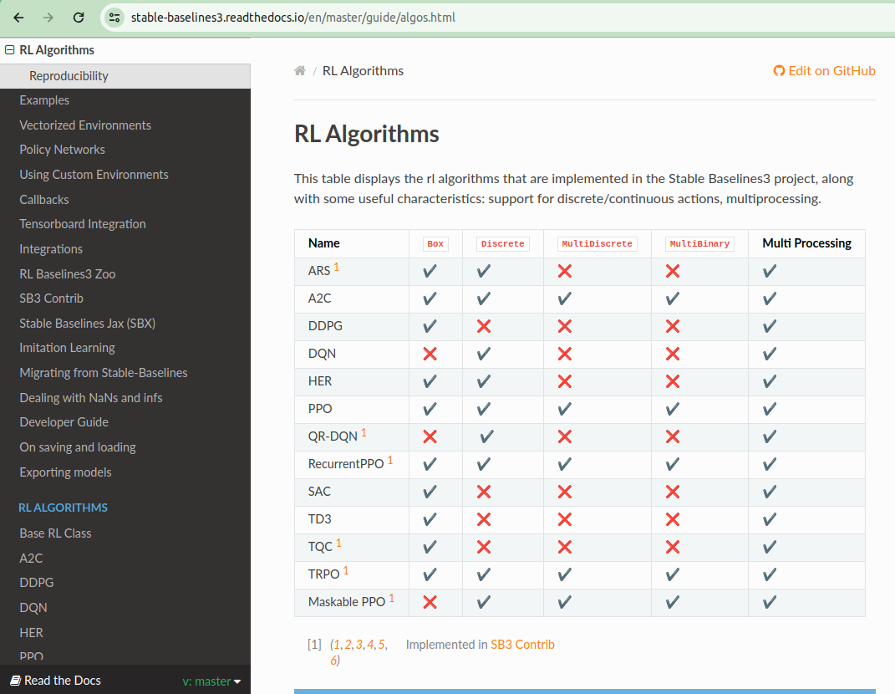
1.5 Create Model
https://www.youtube.com/watch?v=OqvXHi_QtT0&t=81s
Create Model (01:31-02:00/12:35)
The sb3 algorithm is a set of RL algorithm.
Below is a list of sb3 (Stable Baseline3) algorithm, such as, A2C, TD3, SAC. They support discrete/continuous actions and multi-processing.
https://stable-baselines3.readthedocs.io/en/master/guide/algos.html

Slide 18
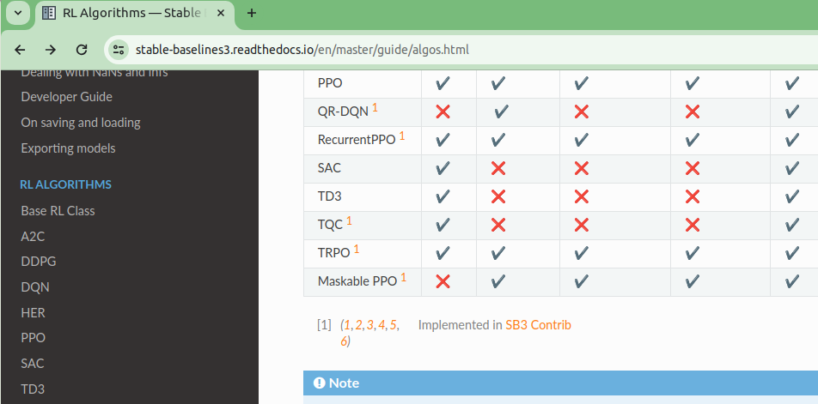
1.5 Create Model
https://www.youtube.com/watch?v=OqvXHi_QtT0&t=81s
Create Model (02:01-02:20/12:35)
We can see a list of implemented algorithms as below list.
In this discussion, we only select three algorithms, i.e., A2C, SAC, TD3 to train.
https://stable-baselines3.readthedocs.io/en/master/guide/algos.html

Slide 19
1.5 Create Model
https://www.youtube.com/watch?v=OqvXHi_QtT0&t=81s
Create Model (02:21-03:20/12:35)
Here, we declare the model for SAC, TD3, and A2C only.
1. The first parameters is the type of neural network. The default is MLPPolicy (Multi-Layer Perceptron Policy) is the one that we will use. The other one CNN (Convolutional Neural Network) is the for image recognition. We use focus on MLP (Multi-Layer Perceptron).
2. The second parameter is the gym environment.
3. We turn on verbose = 1 so that we can see some printout.
4. device=’cuda’ let us do the training on the NVIDIA GPU. If we do not have NVIDIA card, just pass device =’cpu’.
5. tensordboard_log: PyTorch Tensorboard for time.
Now, we have model for training.
https://stable-baselines3.readthedocs.io/en/master/guide/algos.html

Slide 20
1.6 Train Model

Slide 21
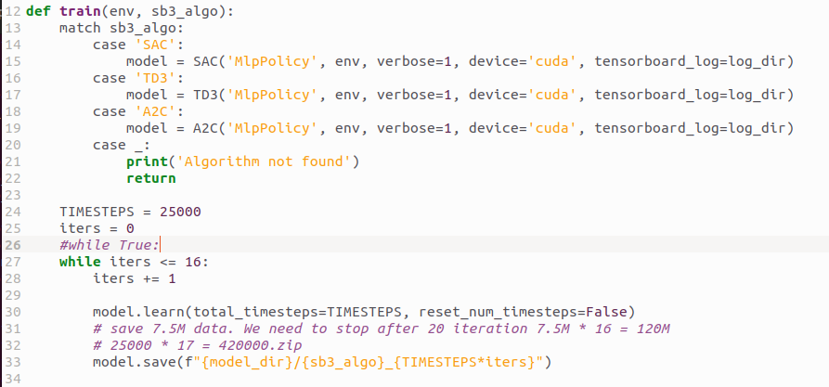
1.6 Train Model
https://www.youtube.com/watch?v=OqvXHi_QtT0&t=81s
Train Model (03:21-05:00/12:35)
We can start to train the model
1. TIMESTEPS: Number of step (episode) to train. One step is one action performed by the AI Agent. We tell the model to train 25,000 steps and save the version of the model. 25000 is the number of trial and error. We can choose 10,000 or 50,000 whatever we want.
2. We train 17 times (0 to 16). Each time around 7.5M zip file. Totally, we save around 120M (=7.5M * 17).
2. There are papers describe how the “Soft Actor Critic” work. The learning rate and discount factor.

Slide 22
1.7 Main Function

Slide 23
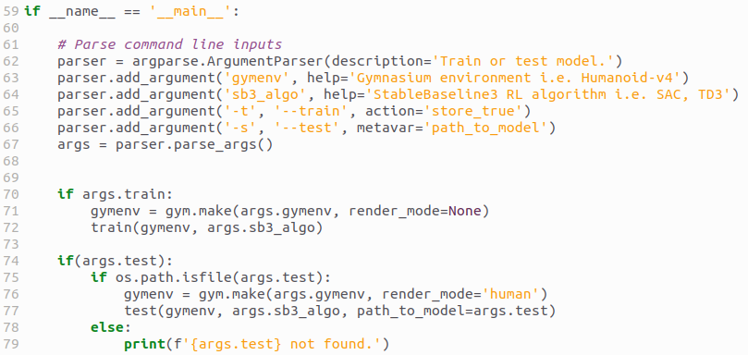
1.7 Main Function
https://www.youtube.com/watch?v=OqvXHi_QtT0&t=81s
Main Function (05:01-05:30/12:35)
In the main function, we add the options:
1. gymenv: Gymnasium environment
2. sb3_algo: Stable Baselines 3 algorithm, SAC, TD3, A2C.
3. -t, --train: training
4. -s, --test: Test
5. The command line to use:
> python sb3.py Humanoid-v4 SAC -t # -t for training

Slide 24
1.7 Main Function
https://www.youtube.com/watch?v=OqvXHi_QtT0&t=81s
Main Function (05:31-06:00/12:35)
We do the training and then exit.

Slide 25
1.8 Train

Slide 26



1.8 Train
https://www.youtube.com/watch?v=OqvXHi_QtT0&t=81s
Train (06:01-08:30/12:35)
We can choose other algorithm to do the training:
> python sb3.py Humanoid-v4 SAC -t
> python sb3.py Humanoid-v4 TC3 -t
> python sb3.py Humanoid-v4 A2C -t

Slide 27
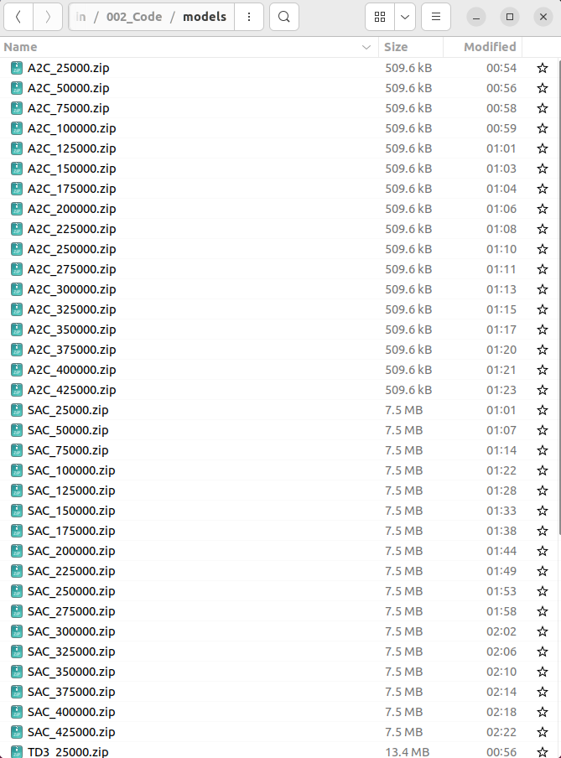
1.8 Train
https://www.youtube.com/watch?v=OqvXHi_QtT0&t=81s
Train (06:01-08:30/12:35)
Check Models:
We have iters = 17.
From itera = 0, A2C_25000.zip to itera = 17, A2C_4250000.zip (4250000 = 25000 x 17)

Slide 28
1.9 Check Tensorboard

Slide 29
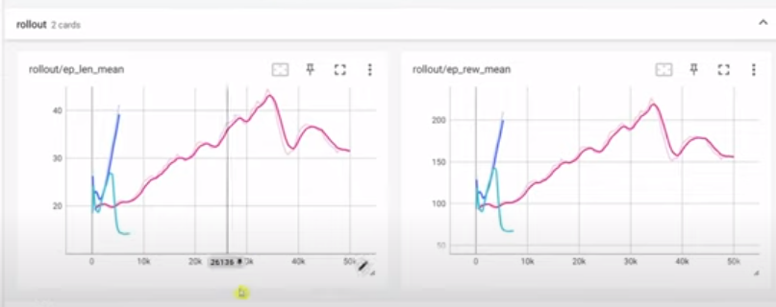
1.9 Check Tensorboard
https://www.youtube.com/watch?v=OqvXHi_QtT0&t=81s
Check Tensorboard (08:31-10:30/12:35)
Start tensorboard
> tensorboard --logdir logs
Look at the timestamp which maximum reward location.
After 420000 (= 25000 x 17 iterations), the reward is maximized.

Slide 30
1.10 Test

Slide 31



1.10 Test
https://www.youtube.com/watch?v=OqvXHi_QtT0&t=81s
Test (10:31-12:35/12:35)
We can choose other algorithm to do the training. We look at tensorboard and find out after 17 iterations (250000.zip * 17 = 420000zip). The reward are stable.
> python sb3.py Humanoid-v4 SAC -s ./models/425000.zip
> python sb3.py Humanoid-v4 TD3 -s ./models/425000.zip
> python sb3.py Humanoid-v4 A2C -s ./models/425000.zip

Slide 32
1.11 Fix Error in Mujoco Library

Slide 33
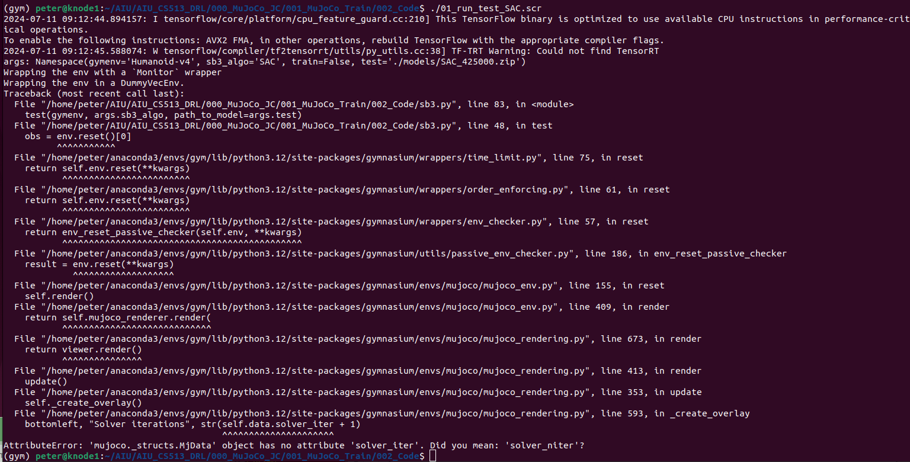
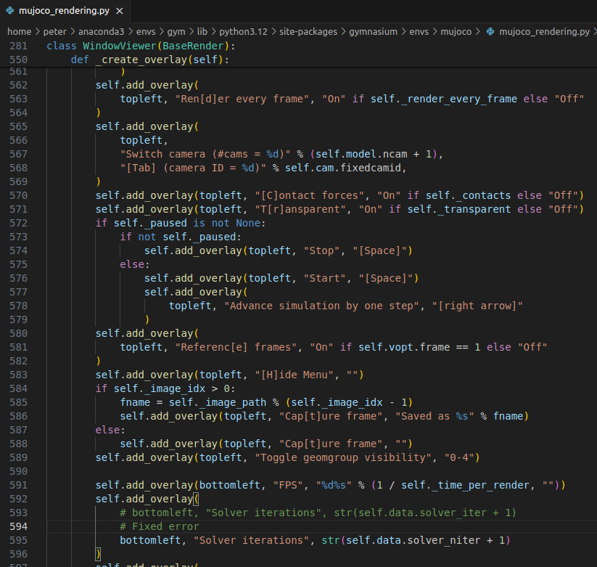
1.11 Fix Error in Mujoco Library
https://www.youtube.com/watch?v=OqvXHi_QtT0&t=81s
Fix Error in Mujoco Library (10:31-12:35/12:35)
Fixed error in mujoco library

Slide 34
1.12 Rerun Test

Slide 35
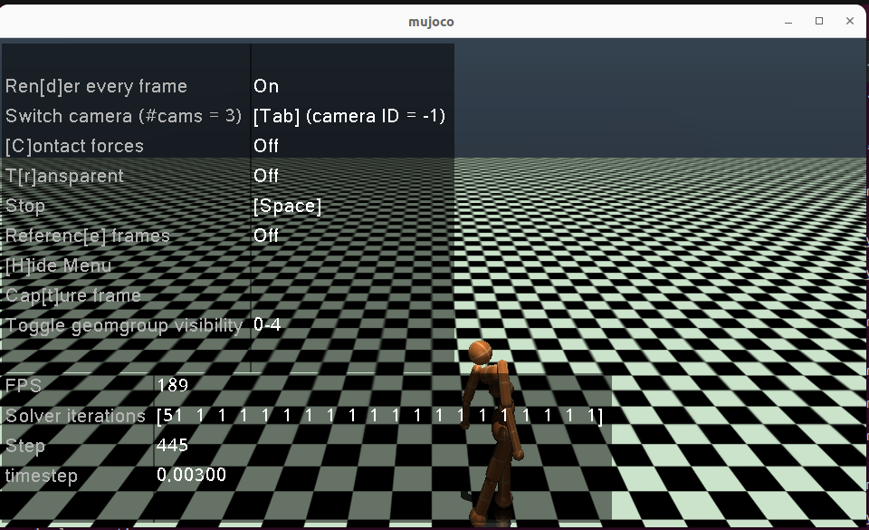
1.12 Rerun Test
https://www.youtube.com/watch?v=OqvXHi_QtT0&t=81s
Rerun Test(10:31-12:35/12:35)
> ./01_run_test_SAC.scr
Here, for Humanoid-v4, SAC (Soft Actor Critic) is stable than other TD3 (Twin Delayed Deterministic Policy Gradient) and A2C (Actor to Critic).
You can follow the robot and scroll the robot walk direction.

Slide 36
End

