Slide 1

3 CNN DQL
Peter H. Chen

Slide 2
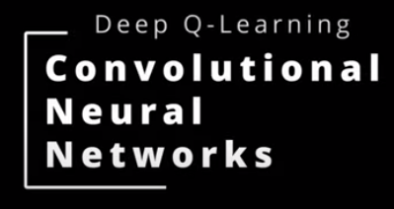
3 CNN DQL
https://www.youtube.com/watch?v=qKePPepISiA&list=PL58zEckBH8fCt_lYkmayZoR9XfDCW9hte&index=3
CNN DQL (00:00-00:05/12:305)
We discuss CNN (Convolutional Neural Network) of DQL (Deep Q-Learning).

Slide 3
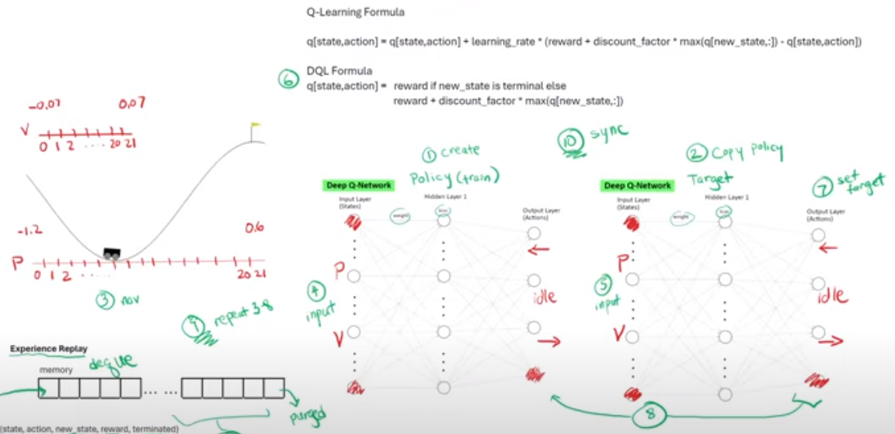
3 CNN DQL
https://www.youtube.com/watch?v=qKePPepISiA&list=PL58zEckBH8fCt_lYkmayZoR9XfDCW9hte&index=3
CNN DQL (00:06-00:15/12:305)
Last time, we walked through the steps of DQL (Deep Q learning) algorithms and code mountain car.
Experience Replay
memory
dequeue
...
...
(states, action, new_state, reward, terminated)
Purged
3a: Maximize Experience
3b: Replay

Slide 4
3.1 Pong Game

Slide 5
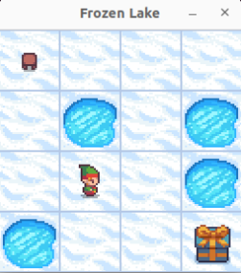
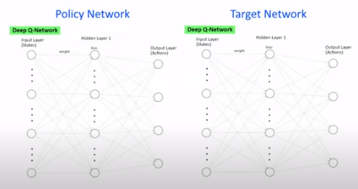
3.1 Pong Game
https://www.youtube.com/watch?v=qKePPepISiA&list=PL58zEckBH8fCt_lYkmayZoR9XfDCW9hte&index=3
Pong Game (00:06-00:20/12:305)
We have discussed the frozen lake with simple environment using simple two layers (one hidden layer and one output layer) network.

Slide 6
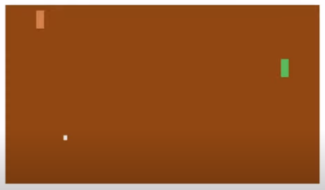
3.1 Pong Game
https://www.youtube.com/watch?v=qKePPepISiA&list=PL58zEckBH8fCt_lYkmayZoR9XfDCW9hte&index=3
Pong Game (00:21-00:40/12:305)
We will discuss how to modify the frozen lake game into pong game.
A pong game by Atari in 1972. It is the first game for “tennis like” game for two controlled paddles and a ball. The goal is try to beat your component. The game can be one player or two players.
It is much more complex environment than frozen lake.

Slide 7
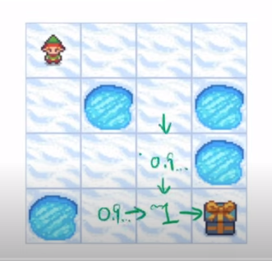
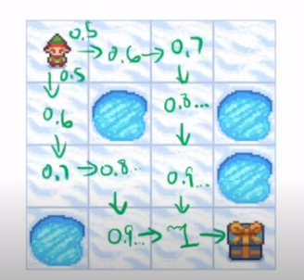
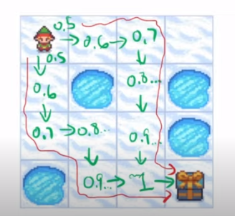
3.1 Pong Game
https://www.youtube.com/watch?v=qKePPepISiA&list=PL58zEckBH8fCt_lYkmayZoR9XfDCW9hte&index=3
Pong Game (0051-00:50/12:305)
1. When we train the agent on Frozen Lake, the Q-Leaning formula trickle trace the reward back to starting state.
2. And that is how the agent know which path is the best.
1
2

Slide 8
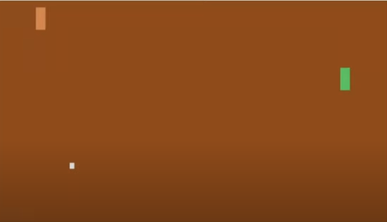
3.1 Pong Game
https://www.youtube.com/watch?v=qKePPepISiA&list=PL58zEckBH8fCt_lYkmayZoR9XfDCW9hte&index=3
Pong Game (00:51-00:55/12:305)
So, how do we apply it to a game like Pong.

Slide 9
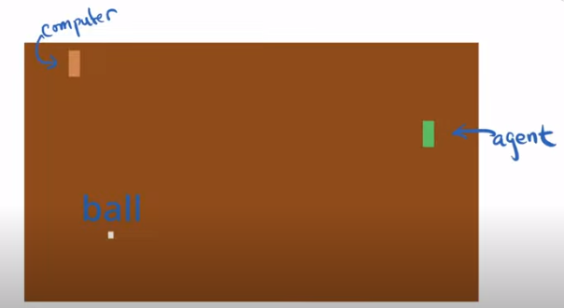
3.1 Pong Game
https://www.youtube.com/watch?v=qKePPepISiA&list=PL58zEckBH8fCt_lYkmayZoR9XfDCW9hte&index=3
Pong Game (00:56-01:00/12:305)
We have two paddlers (computer and agent) and one ball.

Slide 10
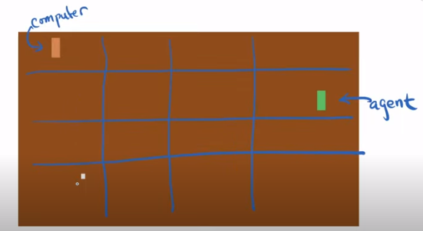
3.1 Pong Game
https://www.youtube.com/watch?v=qKePPepISiA&list=PL58zEckBH8fCt_lYkmayZoR9XfDCW9hte&index=3
Pong Game (01:01-01:10/12:305)
We divide the ball path into 4 x 4 grids.

Slide 11

3.1 Pong Game
https://www.youtube.com/watch?v=qKePPepISiA&list=PL58zEckBH8fCt_lYkmayZoR9XfDCW9hte&index=3
Pong Game (01:11-01:35/12:305)
Let’s say the ball keep traveling this way. We will win a point so we get a reward of 1.
The computer paddle is up around the top corner.
Our agent paddle is on the right, we want to keep the paddle on the right side.
We will do the ball trickle trace back to the starting point.

Slide 12
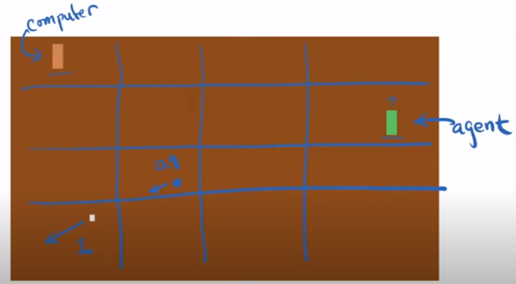
3.1 Pong Game
https://www.youtube.com/watch?v=qKePPepISiA&list=PL58zEckBH8fCt_lYkmayZoR9XfDCW9hte&index=3
Pong Game (01:36-01:40/12:305)
We might get a Q value of 0.9, might tell is to move paddle up a little bit.

Slide 13
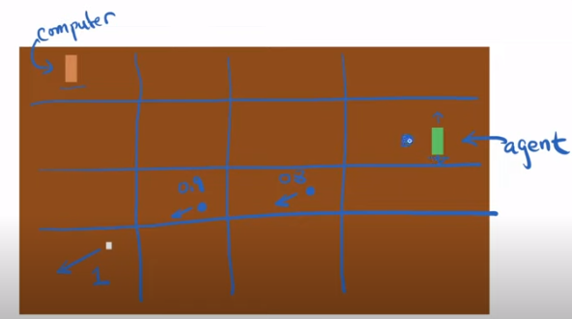
3.1 Pong Game
https://www.youtube.com/watch?v=qKePPepISiA&list=PL58zEckBH8fCt_lYkmayZoR9XfDCW9hte&index=3
Pong Game (01:41-01:45/12:305)
Let’s the ball is around here. the next time.
We might get a Q value of 0.8. This might tell us to go down a little bit.

Slide 14

3.1 Pong Game
https://www.youtube.com/watch?v=qKePPepISiA&list=PL58zEckBH8fCt_lYkmayZoR9XfDCW9hte&index=3
Pong Game (01:46-02:15/12:305)
Finally, the ball is around the agent paddle.
We might get Q-value 0.7.
Does Pong game look like Frozen Lake to us? Kind of? Right?
Obviously, a 4 x 4 grid is not going to be able to capture all the situations,
1. where the computer paddle is going to along vertical axis on the left,
2. and where the agent paddle is going to be along the vertical axis on the right.
3. and where the ball is going to be flying around.

Slide 15
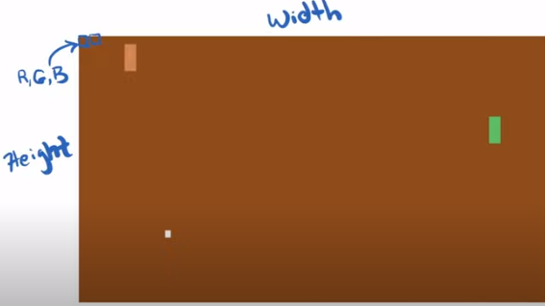
3.1 Pong Game
https://www.youtube.com/watch?v=qKePPepISiA&list=PL58zEckBH8fCt_lYkmayZoR9XfDCW9hte&index=3
Pong Game (02:16-02:45/12:305)
If we look at this image and if we think of this image at the pixel level, this pixel is basically consists of a color code of RGB (Red, Green, and Blue).
Ans the same for the next pixel.
So, image is essentially a grid consisting of height x width pixels.
We can actually send all these pixels into the neural network.

Slide 16
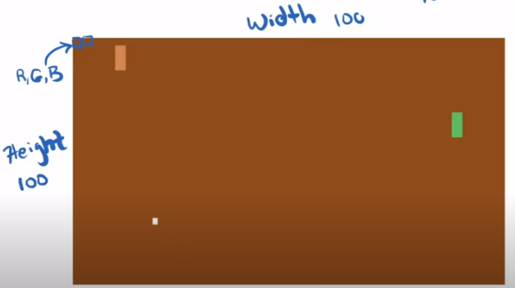
3.1 Pong Game
https://www.youtube.com/watch?v=qKePPepISiA&list=PL58zEckBH8fCt_lYkmayZoR9XfDCW9hte&index=3
Pong Game (02:46-03:00/12:305)
But, even for a small image, let’s say this image is 100 x 100 pixels.
We have 100 pixels x 100 pixels x three channels (color channels) = 30,000 input nodes.
With 30,000 input nodes, the network is going to take forever to compute.
100 x 100 x 3 = 30,000

Slide 17
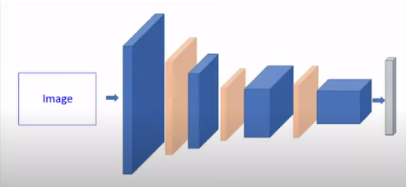
3.1 Pong Game
https://www.youtube.com/watch?v=qKePPepISiA&list=PL58zEckBH8fCt_lYkmayZoR9XfDCW9hte&index=3
Pong Game (02:46-03:05/12:305)
So, what we need is a different type of network and this is where CNN (Convolutional Neural Network) comes in.
We will use CNN to extract the features, i.e., to reduce the input dimension.

Slide 18
3.2 Review Frozen Lake DQN

Slide 19

3.2 Review Frozen Lake DQN
https://www.youtube.com/watch?v=qKePPepISiA&list=PL58zEckBH8fCt_lYkmayZoR9XfDCW9hte&index=3
Review Frozen Lake DQN (03:06-03:08/12:305)
We quickly review the Frozen Lake DQN.

Slide 20
3.2 Review Frozen Lake DQN
https://www.youtube.com/watch?v=qKePPepISiA&list=PL58zEckBH8fCt_lYkmayZoR9XfDCW9hte&index=3
Review Frozen Lake DQN (03:09-03:15/12:305)
The Frozen Lake is a simple two layers network.

Slide 21
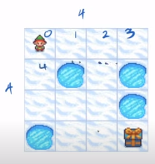
3.2 Review Frozen Lake DQN
https://www.youtube.com/watch?v=qKePPepISiA&list=PL58zEckBH8fCt_lYkmayZoR9XfDCW9hte&index=3
Review Frozen Lake DQN (03:16-03:25/12:305)
The inputs are the states. Frozen Lake is a 4 x 4 grid.
The states are labeled like this and so on.

Slide 22
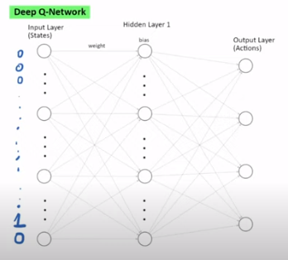
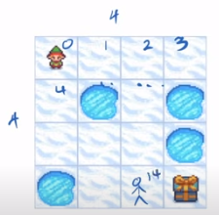
3.2 Review Frozen Lake DQN
https://www.youtube.com/watch?v=qKePPepISiA&list=PL58zEckBH8fCt_lYkmayZoR9XfDCW9hte&index=3
Review Frozen Lake DQN (03:21-03:45/12:305)
For example, if agent is a state 14, the input is encoded like this, [0, 0, 0, 0, 0, 0, 0, 0, 0, 0, 0, 0, 0, 0, 1, 0].
So, the input is 16 nodes with 15 0s and one 1.
The node with 1 is the node where the agent is located that goes into the network.

Slide 23
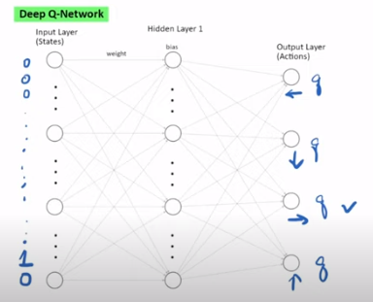
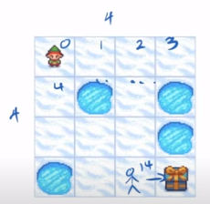
3.2 Review Frozen Lake DQN
https://www.youtube.com/watch?v=qKePPepISiA&list=PL58zEckBH8fCt_lYkmayZoR9XfDCW9hte&index=3
Review Frozen Lake DQN (03:46-04:00/12:305)
The network comes out is the four possible actions and we get a Q-value.
One of these actions is the largest Q-Value which is the best action.
In this situation, go to right is the best action.

Slide 24
End

