Slide 1

3.5 Add CNN to DQN Code
Peter H. Chen

Slide 2

3.5 Add CNN to DQN Code
https://www.youtube.com/watch?v=qKePPepISiA&list=PL58zEckBH8fCt_lYkmayZoR9XfDCW9hte&index=3
Add CNN to DQN Code (06:51-06:52/12:305)
Now, we look at the adding code of CNN to DQN.

Slide 3
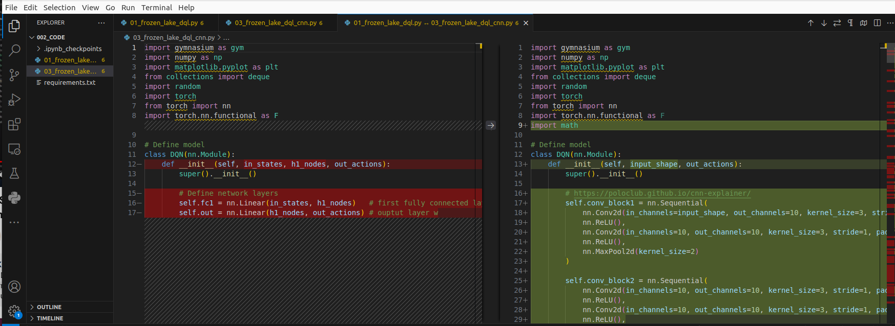
3.5 Add CNN to DQN Code
https://www.youtube.com/watch?v=qKePPepISiA&list=PL58zEckBH8fCt_lYkmayZoR9XfDCW9hte&index=3
Add CNN to DQN Code (06:53-06:55/12:305)
Go to the code folder.
> code
1. Open file 01_frozen_lake_dql.py (Select for compare)
2. open file: 03_frozen_lake_dql_cnn.py (Compare with selected)
We can see the differences of CNN modification..

Slide 4
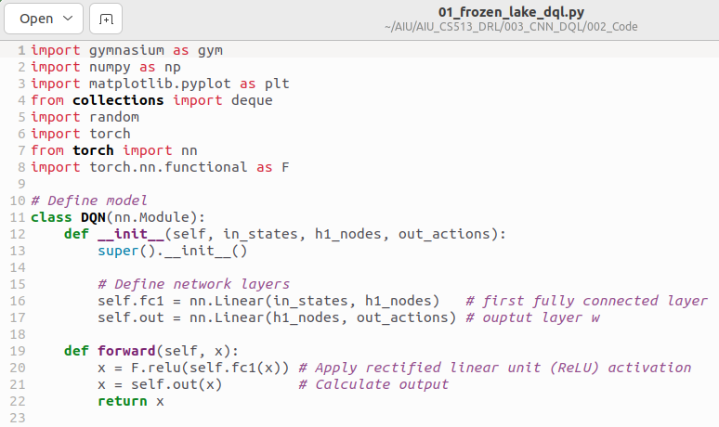
3.5 Add CNN to DQN Code
https://www.youtube.com/watch?v=qKePPepISiA&list=PL58zEckBH8fCt_lYkmayZoR9XfDCW9hte&index=3
Add CNN to DQN Code (06:56-07:10/12:305)
Below is the original code for frozen_lake_dql.py (dql: Deep Q Leaning).
It is a very simple two layers of neural network.
We are getting rid of hidden layer and replace with CNN layer.

Slide 5
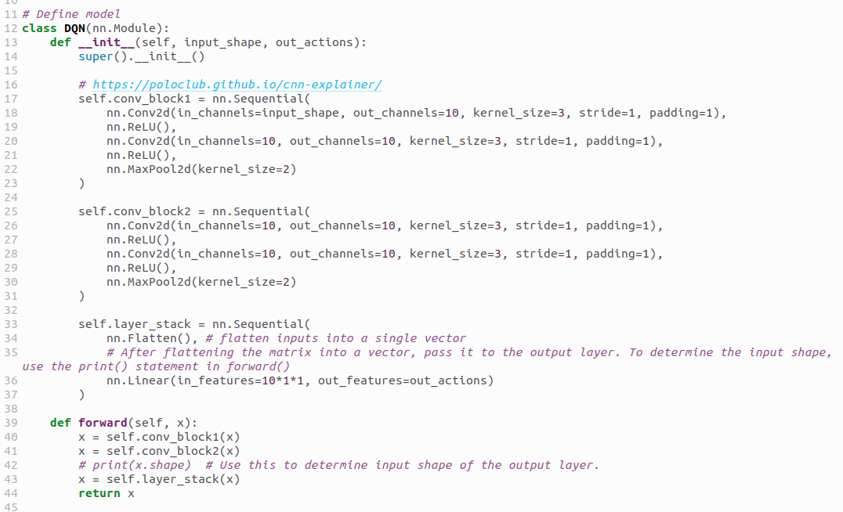
3.5 Add CNN to DQN Code
https://www.youtube.com/watch?v=qKePPepISiA&list=PL58zEckBH8fCt_lYkmayZoR9XfDCW9hte&index=3
Add CNN to DQN Code (07:11-07:30/12:305)
Here is frozen_lake_dql_cnn.py.
We can see there are two CNN blocks. Both Block 1 and block 2 have two CNN layers.

Slide 6
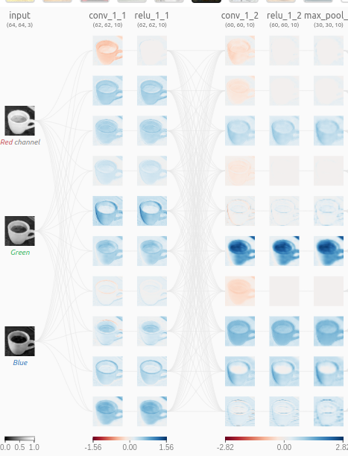
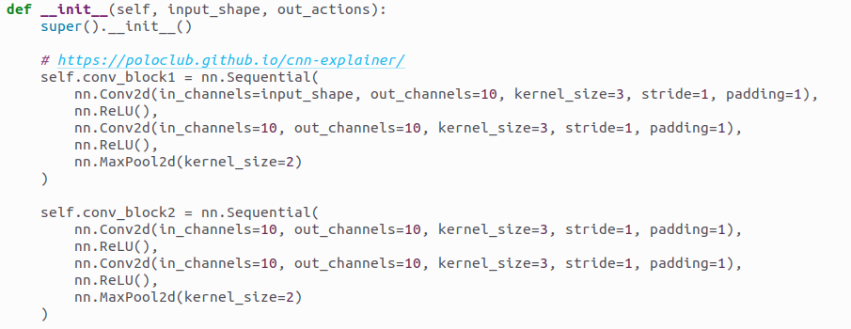
3.5 Add CNN to DQN Code
https://www.youtube.com/watch?v=qKePPepISiA&list=PL58zEckBH8fCt_lYkmayZoR9XfDCW9hte&index=3
Add CNN to DQN Code (07:31-08:05/12:305)
We have the 10 nodes in the conv_1_1
https://poloclub.github.io/cnn-explainer/

Slide 7
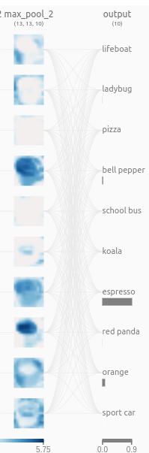
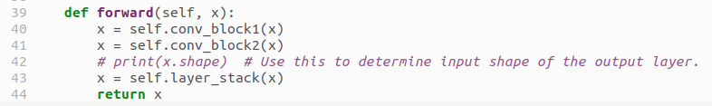
3.5 Add CNN to DQN Code
https://www.youtube.com/watch?v=qKePPepISiA&list=PL58zEckBH8fCt_lYkmayZoR9XfDCW9hte&index=3
Add CNN to DQN Code (07:31-08:00/12:305)
After we create the DQL (Deep Q-Learning) network, we can print the output layer.
https://poloclub.github.io/cnn-explainer/

Slide 8
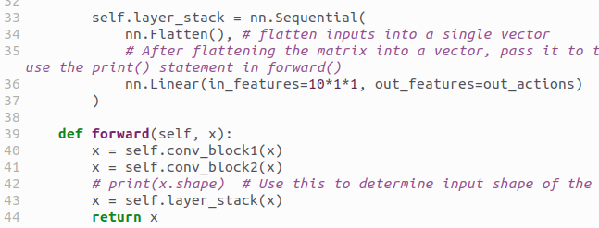
3.5 Add CNN to DQN Code
https://www.youtube.com/watch?v=qKePPepISiA&list=PL58zEckBH8fCt_lYkmayZoR9XfDCW9hte&index=3
Add CNN to DQN Code (08:01-09:10/12:305)
We have the similarity of the output layer. We have hidden layer output 10 to output layer input 10 (= 10 * 1 * 1) and action space n.
Why is “10 * 1 * 1”?
n NLP, output is batch x sequnece x embedding size, here, 10: batch, 1: sequence, 1: embedding
https://medium.com/@harshit158/how-does-linear-layer-act-on-multi-dimensional-tensor-b3689489e7c7

Slide 9
3.6 Input to DQN as Images

Slide 10
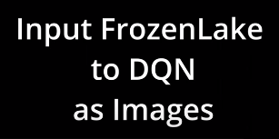
3.6 Input to DQN as Images
https://www.youtube.com/watch?v=qKePPepISiA&list=PL58zEckBH8fCt_lYkmayZoR9XfDCW9hte&index=3
Input to DQN as Images (08:01-09:10/12:305)
We have the similarity of the output layer. We have action space n.
https://poloclub.github.io/cnn-explainer/

Slide 11
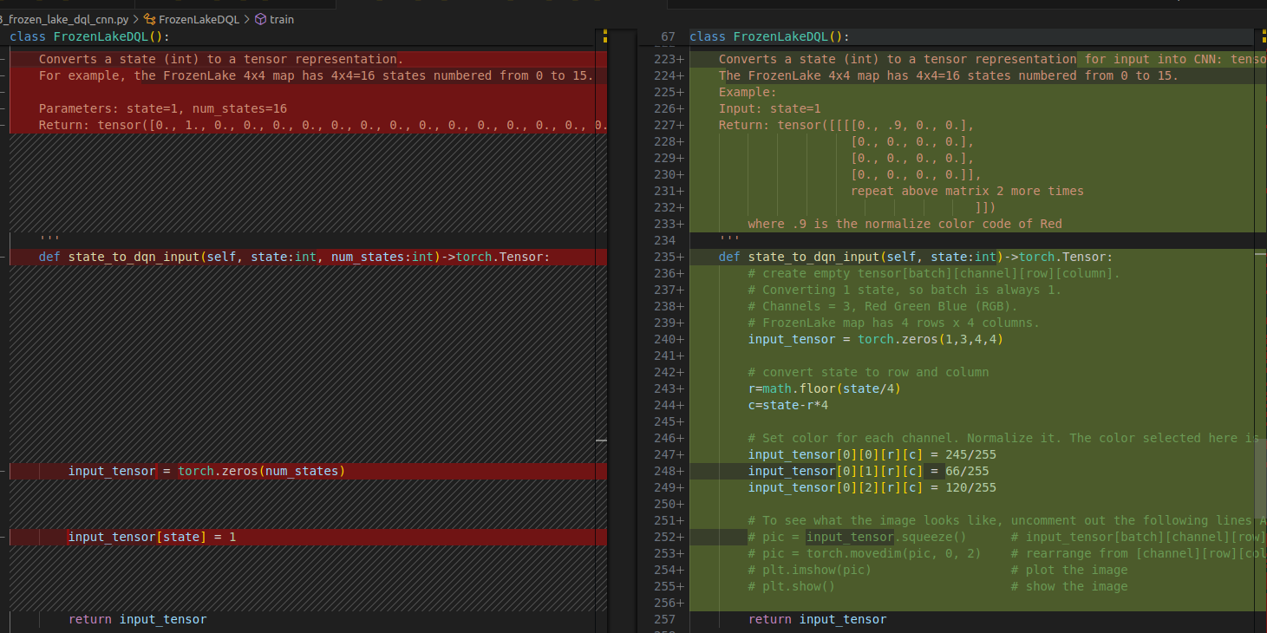
3.6 Input to DQN as Images
https://www.youtube.com/watch?v=qKePPepISiA&list=PL58zEckBH8fCt_lYkmayZoR9XfDCW9hte&index=3
Input to DQN as Images (08:01-09:10/12:305)
Previously, we send agent is a vector.
Now, we send the images.
https://poloclub.github.io/cnn-explainer/

Slide 12
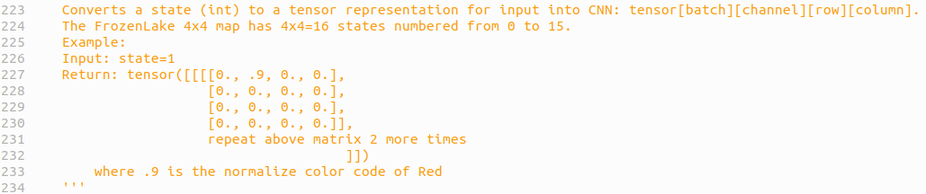
3.6 Input to DQN as Images
https://www.youtube.com/watch?v=qKePPepISiA&list=PL58zEckBH8fCt_lYkmayZoR9XfDCW9hte&index=3
Input to DQN as Images (08:01-10:00/12:305)
Previously, we send agent is a vector.
Now, we send the images. We have four matrix dimensions:
1. batch:
2. channel: channle 0: red, channel 1: green, channel 2: blue.
3. row:
4. column:
https://poloclub.github.io/cnn-explainer/

Slide 13
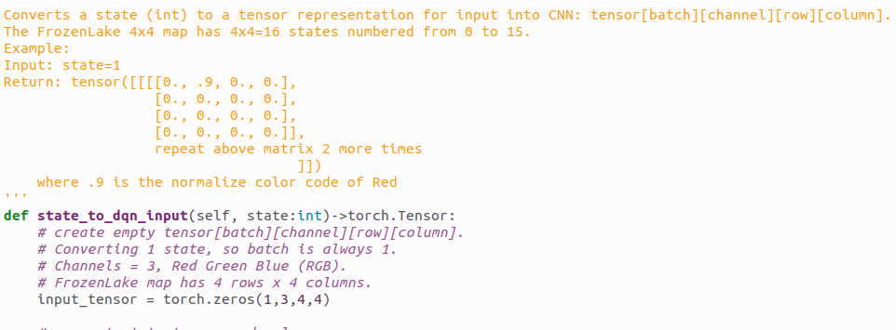
3.6 Input to DQN as Images
https://www.youtube.com/watch?v=qKePPepISiA&list=PL58zEckBH8fCt_lYkmayZoR9XfDCW9hte&index=3
Input to DQN as Images (10:01-10:30/12:305)
We create the input_tensor:
1. batch: 1 batch
2. channel: 3 channels, channel 0: red, channel 1: green, channel 2: blue.
3. row: 4 rows
4. column: 4 columns
https://poloclub.github.io/cnn-explainer/

Slide 14
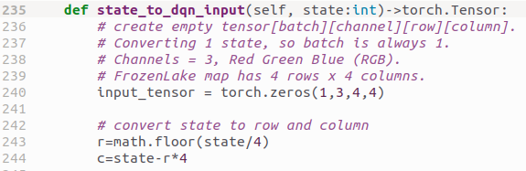
3.6 Input to DQN as Images
https://www.youtube.com/watch?v=qKePPepISiA&list=PL58zEckBH8fCt_lYkmayZoR9XfDCW9hte&index=3
Input to DQN as Images (10:21-10:30/12:305)
Convert the state into row and column.
https://poloclub.github.io/cnn-explainer/

Slide 15
3.6 Input to DQN as Images
https://www.youtube.com/watch?v=qKePPepISiA&list=PL58zEckBH8fCt_lYkmayZoR9XfDCW9hte&index=3
Input to DQN as Images (10:31-10:50/12:305)
We normalize the color code.
https://poloclub.github.io/cnn-explainer/

Slide 16
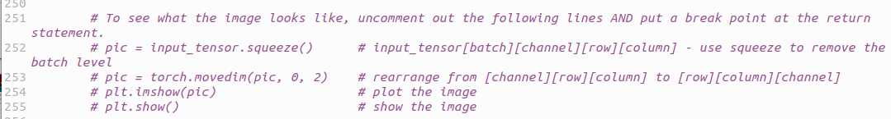
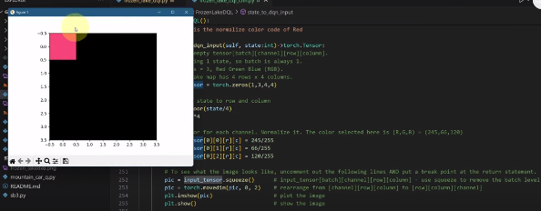
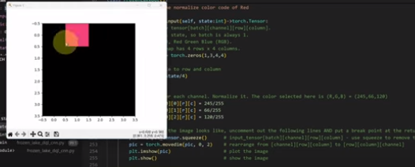
3.6 Input to DQN as Images
https://www.youtube.com/watch?v=qKePPepISiA&list=PL58zEckBH8fCt_lYkmayZoR9XfDCW9hte&index=3
Input to DQN as Images (10:51-11:25/12:305)
We can uncomment the print and pot to see what do we send to the network.
1. The agent is started from top left. Others are black color.
2. Agent moves the right.
https://poloclub.github.io/cnn-explainer/
1
2

Slide 17
3.7 main()

Slide 18
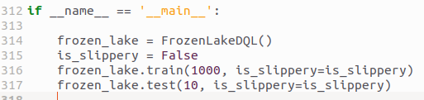
3.7 main()
https://www.youtube.com/watch?v=qKePPepISiA&list=PL58zEckBH8fCt_lYkmayZoR9XfDCW9hte&index=3
main() (10:51-11:30/12:305)
Here, we train and test the network.
Same as before. We do the slipper of train for 1000 times.
Then, we test it.

Slide 19
3.8 Create Conda Environment

Slide 20
3.8 Create Conda Environment
https://www.youtube.com/watch?v=qKePPepISiA&list=PL58zEckBH8fCt_lYkmayZoR9XfDCW9hte&index=3
Create Conda Environment (10:31-11:50/12:305)
Create/activate conda environment
> conda create --name gym
> conda activate gym
(gym) >

Slide 21
3.9 Install Library

Slide 22
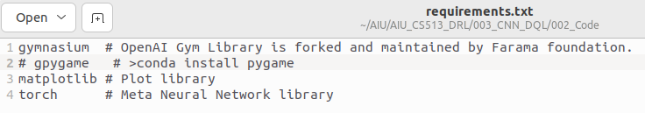
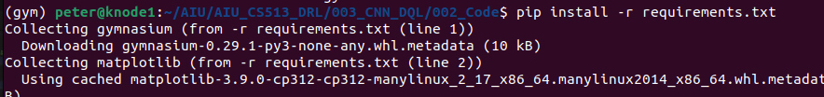
3.9 Install Library
https://www.youtube.com/watch?v=qKePPepISiA&list=PL58zEckBH8fCt_lYkmayZoR9XfDCW9hte&index=3
Install Library (10:31-11:50/12:305)
Install requirements.txt
> pip install requirements.txt

Slide 23
3.10 Install/Test pygame

Slide 24
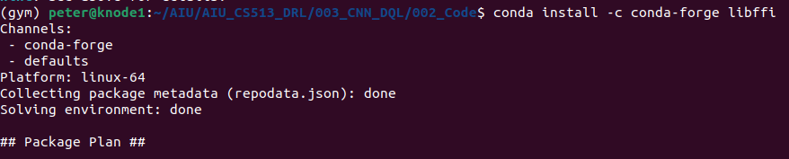
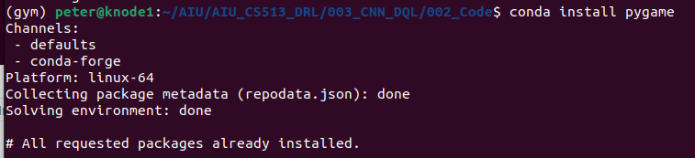
3.10 Install/Test pygame
https://www.youtube.com/watch?v=qKePPepISiA&list=PL58zEckBH8fCt_lYkmayZoR9XfDCW9hte&index=3
Install/Test pygame (10:31-11:50/12:305)
Install Pygame:
1. Clean up environment is messed up.
> conda install -c conda-forge libffi # clean up the libffi
2. Install PyGame
> pip3 install pygame
https://stackoverflow.com/questions/72110384/libgl-error-mesa-loader-failed-to-open-iris
1
1

Slide 25
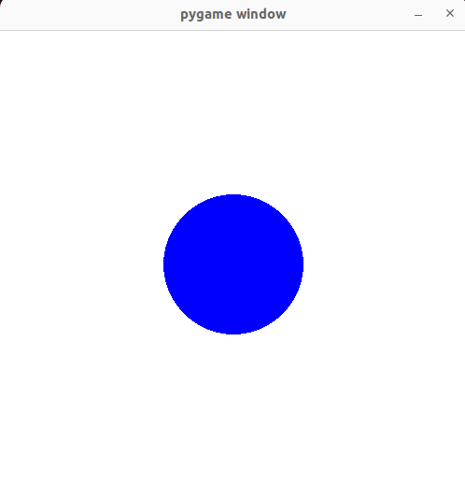
3.10 Install/Test pygame
https://www.youtube.com/watch?v=qKePPepISiA&list=PL58zEckBH8fCt_lYkmayZoR9XfDCW9hte&index=3
Install/Test pygame (10:31-11:50/12:305)
> python 03_test_pygame.py

Slide 26
3.11 Run DQL with CNN

Slide 27
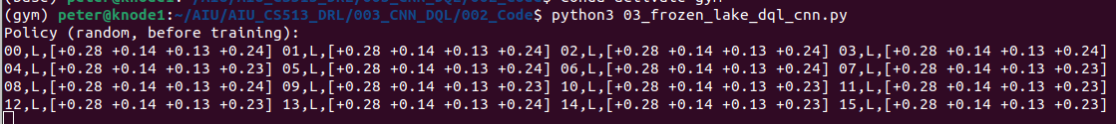
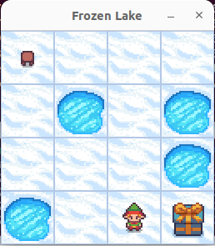
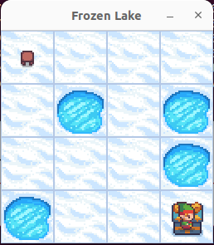
3.11 Run DQL with CNN
https://www.youtube.com/watch?v=qKePPepISiA&list=PL58zEckBH8fCt_lYkmayZoR9XfDCW9hte&index=3
Run DQL with CNN (10:31-11:50/12:305)
Run DQL (Deep Q-Learning) with CNN (Convolutional Neural Network)
> python3 03_frozen_lake_dql_cnn.py

Slide 28
End

