Slide 1

5 Environment
Peter H. Chen

Slide 2
5 Environment
https://www.tensorflow.org/agents/tutorials/2_environments_tutorial
Environment
The goal of RL (Reinforcement Learning) is to design agents that learn by interacting with an environment.
In the standard RL setting, the agent receives an observation at every time step and chooses an action.
The action is applied to the environment and the environment returns a reward and a new observation.
The agent trains a policy to choose actions to maximize the sum of rewards, also known as return.
In TF-Agents, environments can be implemented either in Python or TensorFlow.
Python environments are usually easier to implement, understand, and debug, but TensorFlow environments are more efficient and allow natural parallelization.
The most common workflow is to implement an environment in Python and use one of our wrappers to automatically convert it into TensorFlow.
Let us look at Python environments first.
TensorFlow environments follow a very similar API.

Slide 3
5.1 Setup

Slide 4
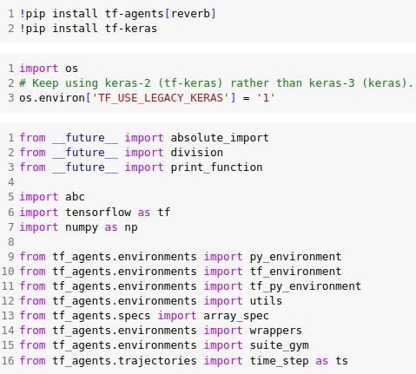
5.1 Setup
https://www.tensorflow.org/agents/tutorials/2_environments_tutorial
Setup
Run below to install tf-agents and gym.

Slide 5
5.2 Python Environment

Slide 6
5.2 Python Environment
https://www.tensorflow.org/agents/tutorials/2_environments_tutorial
Python Environment
Python environments have a step(action) -> next_time_step method that applies an action to the environment, and returns the following information about the next step:
  1. observation: This is the part of the environment state that the agent can observe to choose its actions at the next step.
  2. reward: The agent is learning to maximize the sum of these rewards across multiple steps.
  3. step_type: Interactions with the environment are usually part of a sequence/episode. e.g. multiple moves in a game of chess. step_type can be either FIRST, MID or LAST to indicate whether this time step is the first, intermediate or last step in a sequence.
  4. discount: This is a float representing how much to weight the reward at the next time step relative to the reward at the current time step.
These are grouped into a named tuple TimeStep (step_type, reward, discount, observation).

Slide 7
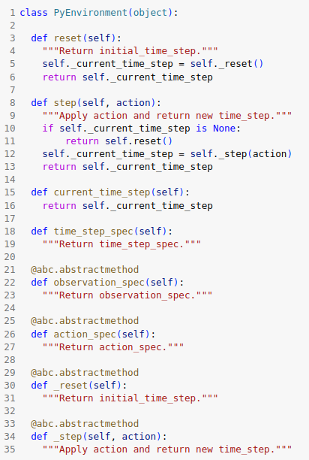
5.2 Python Environment
https://www.tensorflow.org/agents/tutorials/2_environments_tutorial
Python Environment
The interface that all Python environments must implement is in environments/py_environment.PyEnvironment.
The main methods are:

Slide 8
5.2 Python Environment
https://www.tensorflow.org/agents/tutorials/2_environments_tutorial
Python Environment
In addition to the step() method, environments also provide a reset() method that starts a new sequence and provides an initial TimeStep.
It is not necessary to call the reset method explicitly.
We assume that environments reset automatically, either when they get to the end of an episode or when step() is called the first time.
Note that subclasses do not implement step() or reset() directly.
They instead override the _step() and _reset() methods.
The time steps returned from these methods will be cached and exposed through current_time_step().
The observation_spec and the action_spec methods return a nest of (Bounded)ArraySpecs that describe the name, shape, datatype and ranges of the observations and actions respectively.
In TF-Agents we repeatedly refer to nests which are defined as any tree like structure composed of lists, tuples, named-tuples, or dictionaries.
These can be arbitrarily composed to maintain structure of observations and actions.
We have found this to be very useful for more complex environments where you have many observations and actions.

Slide 9
5.3 Standard Environment

Slide 10
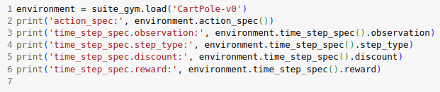
5.3 Standard Environment
https://www.tensorflow.org/agents/tutorials/2_environments_tutorial
Standard Environment
TF Agents has built-in wrappers for many standard environments like the OpenAI Gym, DeepMind-control and Atari, so that they follow our py_environment.
PyEnvironment interface.
These wrapped environments can be easily loaded using our environment suites.
Let's load the CartPole environment from the OpenAI gym and look at the action and time_step_spec.

Slide 11
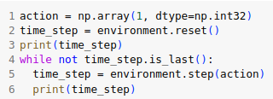
5.3 Standard Environment
https://www.tensorflow.org/agents/tutorials/2_environments_tutorial
Standard Environment
So we see that the environment expects actions of type int64 in [0, 1] and returns TimeSteps where the observations are a float32 vector of length 4 and discount factor is a float32 in [0.0, 1.0].
Now, let's try to take a fixed action (1,) for a whole episode.

Slide 12
5.4 Create Own Environment

Slide 13
5.4 Create Own Environment
https://www.tensorflow.org/agents/tutorials/2_environments_tutorial
Create Own Environment
For many clients, a common use case is to apply one of the standard agents (see agents/) in TF-Agents to their problem.
To do this, they have to frame their problem as an environment.
So let us look at how to implement an environment in Python.
Let's say we want to train an agent to play the following (Black Jack inspired) card game:
  1. The game is played using an infinite deck of cards numbered 1...10.
  2. At every turn the agent can do 2 things: get a new random card, or stop the current round.
  3. The goal is to get the sum of your cards as close to 21 as possible at the end of the round, without going over.
An environment that represents the game could look like this:
  1. Actions: We have 2 actions. Action 0: get a new card, and Action 1: terminate the current round.
  2. Observations: Sum of the cards in the current round.
  3. Reward: The objective is to get as close to 21 as possible without going over, so we can achieve this using the following reward at the end of the round: sum_of_cards - 21 if sum_of_cards <= 21, else -21

Slide 14
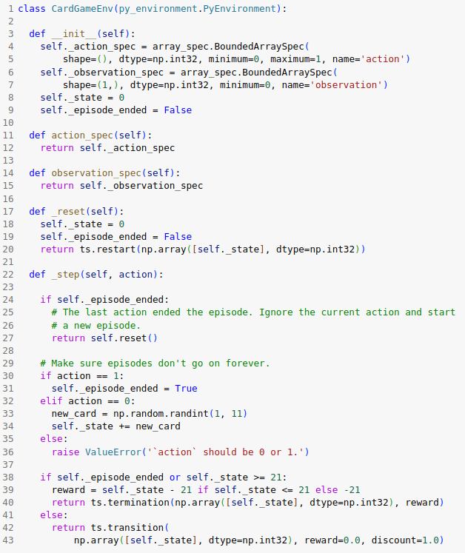
5.4 Create Own Environment
https://www.tensorflow.org/agents/tutorials/2_environments_tutorial
Create Own Environment
Own Environment includes 5 functions:
1. __init__()
2. action_spec:
3. observation_sepc:
4. reset():
5. step():
Make sure we did everything correctly defining the above environment.
When creating your own environment you must make sure the observations and time_steps generated follow the correct shapes and types as defined in your specs.
These are used to generate the TensorFlow graph and as such can create hard to debug problems if we get them wrong.

Slide 15

5.4 Create Own Environment
https://www.tensorflow.org/agents/tutorials/2_environments_tutorial
Create Own Environment
To validate our environment we will use a random policy to generate actions and we will iterate over 5 episodes to make sure things are working as intended.
An error is raised if we receive a time_step that does not follow the environment specs.

Slide 16
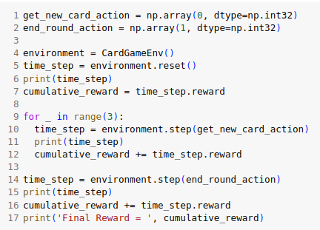
5.4 Create Own Environment
https://www.tensorflow.org/agents/tutorials/2_environments_tutorial
Create Own Environment
Now that we know the environment is working as intended, let's run this environment using a fixed policy:
ask for 3 cards and then end the round.

Slide 17
5.5 Environment Wrapper

Slide 18
5.5 Environment Wrapper
https://www.tensorflow.org/agents/tutorials/2_environments_tutorial
Environment Wrapper
An environment wrapper takes a Python environment and returns a modified version of the environment.
Both the original environment and the modified environment are instances of py_environment.PyEnvironment, and multiple wrappers can be chained together.
Some common wrappers can be found in environments/wrappers.py.
For example:
1. ActionDiscretizeWrapper: Converts a continuous action space to a discrete action space.
2. RunStats: Captures run statistics of the environment such as number of steps taken, number of episodes completed etc.
3. TimeLimit: Terminates the episode after a fixed number of steps.

Slide 19
5.6 Action Discrete Wrapper

Slide 20

5.6 Action Discrete Wrapper
https://www.tensorflow.org/agents/tutorials/2_environments_tutorial
Ex 1: Action Discrete Wrapper
InvertedPendulum is a PyBullet environment that accepts continuous actions in the range [-2, 2].
If we want to train a discrete action agent such as DQN on this environment, we have to discretize (quantize) the action space.
This is exactly what the ActionDiscretizeWrapper does.
Compare the action_spec before and after wrapping:
The wrapped discrete_action_env is an instance of py_environment.PyEnvironment and can be treated like a regular Python environment.

Slide 21
5.7 TF Environments

Slide 22
5.7 TF Environments
https://www.tensorflow.org/agents/tutorials/2_environments_tutorial
TF Environments
The interface for TF environments is defined in
  environments/tf_environment.TFEnvironment
and looks very similar to the Python environments.
TF Environments differ from Python envs in a couple of ways:
  They generate tensor objects instead of arrays
  TF environments add a batch dimension to the tensors generated when compared to the specs.
Converting the Python environments into TFEnvs allows tensorflow to parallelize operations.

Slide 23
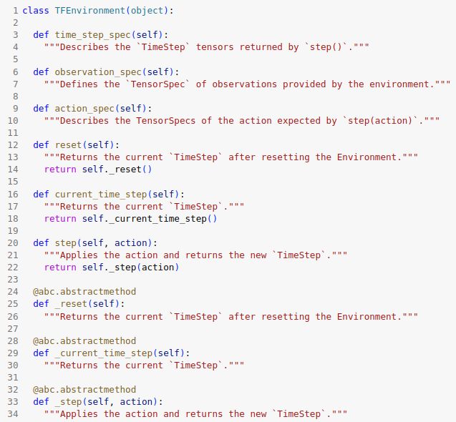
5.7 TF Environments
https://www.tensorflow.org/agents/tutorials/2_environments_tutorial
TF Environments
For example, one could define a collect_experience_op that collects data from the environment and adds to a replay_buffer, and a train_op that reads from the replay_buffer and trains the agent, and run them in parallel naturally in TensorFlow.
The current_time_step() method returns the current time_step and initializes the environment if needed.
The reset() method forces a reset in the environment and returns the current_step.
If the action doesn't depend on the previous time_step a tf.control_dependency is needed in Graph mode.
For now, let us look at how TFEnvironments are created.

Slide 24
5.8 Create Own TF Environment

Slide 25
5.8 Create Own TF Environment
https://www.tensorflow.org/agents/tutorials/2_environments_tutorial
Create Own TF Environments
Create your own TF Environment is more complicated than creating environments in Python.
The more common use case is to implement your environment in Python and wrap it in TensorFlow using our TFPyEnvironment wrapper (see below).

Slide 26
5.9 Wrap Environment

Slide 27
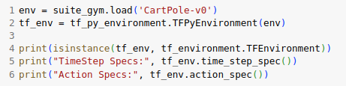
5.9 Wrap TF Environment
https://www.tensorflow.org/agents/tutorials/2_environments_tutorial
Wrap TF Environments
The more common use case is to implement your environment in Python and wrap it in TensorFlow using our TFPyEnvironment wrapper as below.
We can easily wrap any Python environment into a TensorFlow environment using the TFPyEnvironment wrapper.
Note the specs are now of type: (Bounded)TensorSpec.

Slide 28
5.10 Simple Env Example

Slide 29
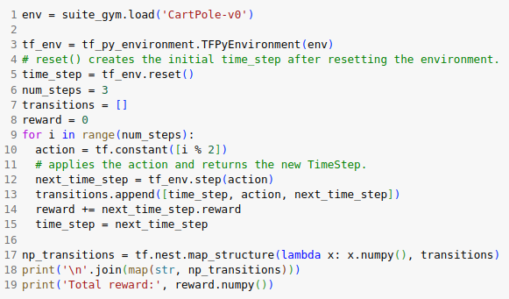
5.10 Simple Env Example
https://www.tensorflow.org/agents/tutorials/2_environments_tutorial
Simple Env Example

Slide 30
5.10 Simple Env Example

Slide 31
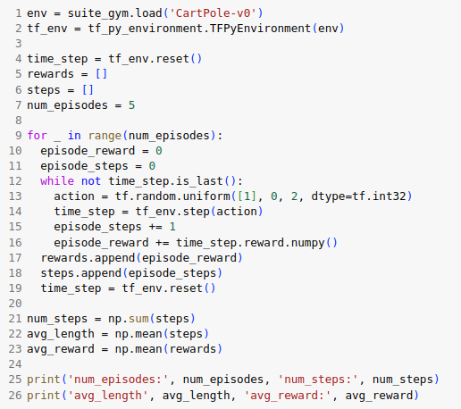
5.11 Whole Episode Example
https://www.tensorflow.org/agents/tutorials/2_environments_tutorial
Whole Episode Example

Slide 32
End

