Slide 1

6 Policy
Peter H. Chen

Slide 2
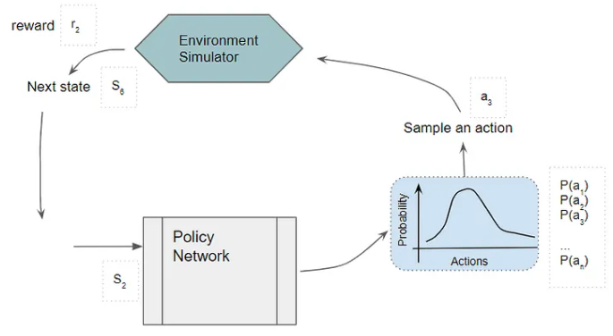
6 Policy
https://www.tensorflow.org/agents/tutorials/3_policies_tutorial
Policy
What is Policy in RL?
In RL (Reinforcement learning), a policy is a set of rules or strategy that an agent uses to make decisions in an environment.
It defines how an agent behaves and what action it takes in response to the current state of its environment. Policies can be simple or complex, and can be deterministic or stochastic.
https://towardsdatascience.com/reinforcement-learning-explained-visually-part-6-policy-gradients-step-by-step-f9f448e73754

Slide 3
6 Policy
https://www.tensorflow.org/agents/tutorials/3_policies_tutorial
Policy
In RL (Reinforcement learning), policies map an observation from the environment to an action or a distribution over actions.
In TF-Agents, observations from the environment are contained in a named tuple TimeStep ('step_type', 'discount', 'reward', 'observation'), and policies map timesteps to actions or distributions over actions.
Most policies use timestep.observation, some policies use timestep.step_type, e.g., to reset the state at the beginning of an episode in stateful policies.
The timestep.discount and timestep.reward are usually ignored.
Policies are related to other components in TF-Agents in the following way.
Most policies have a neural network to compute actions and/or distributions over actions from TimeSteps.
Agents can contain one or more policies for different purposes, e.g., a main policy that is being trained for deployment, and a noisy policy for data collection.

Slide 4
6 Policy
https://www.tensorflow.org/agents/tutorials/3_policies_tutorial
Policy
Policies can be saved/restored, and can be used dependently of the agent for data collection, evaluation, etc.
Some policies are easier to write in Tensorflow (e.g., those with a neural network), whereas others are easier to write in Python (e.g., following a script of actions).
So in TF agents, we allow both Python and Tensorflow policies.
Moreover, policies written in TensorFlow might have to be used in a Python environment, or vice versa, e.g., a TensorFlow policy is used for training but later deployed in a production Python environment.
To make this easier, we provide wrappers for converting between Python and TensorFlow policies.
Another interesting class of policies are policy wrappers, which modify a given policy in a certain way, e.g., add a particular type of noise, make a greedy or epsilon-greedy version of a stochastic policy, randomly mix multiple policies etc.

Slide 5
6.1 Setup

Slide 6
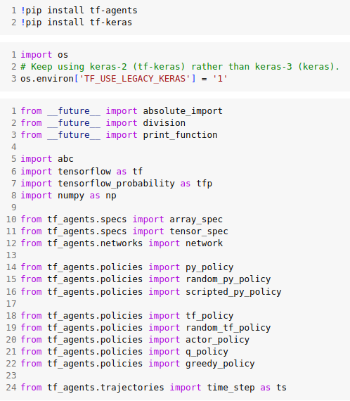
6.1 Setup
https://www.tensorflow.org/agents/tutorials/3_policies_tutorial
Setup
Use “pip install” to install library:

Slide 7
6.2 Python Policy

Slide 8
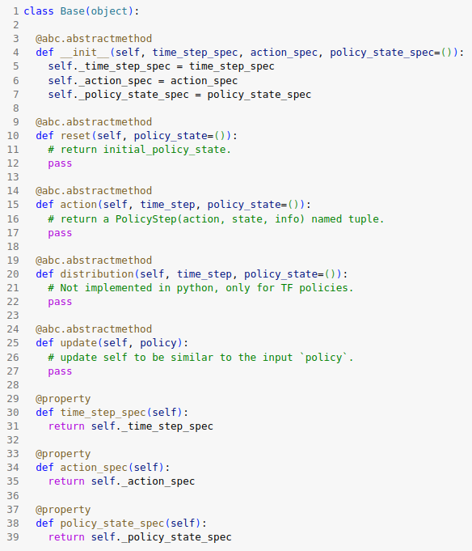
6.2 Python Policy
https://www.tensorflow.org/agents/tutorials/3_policies_tutorial
Python Policy
The interface for Python policies is defined in policies/py_policy.PyPolicy.
The main methods are:

Slide 9
6.2 Python Policy
https://www.tensorflow.org/agents/tutorials/3_policies_tutorial
Python Policy
The most important method is action (time_step) which maps a time_step containing an observation from the environment to a PolicyStep named tuple containing the following attributes:
  1. action: The action to be applied to the environment.
  2. state: The state of the policy (e.g., RNN state) to be fed into the next call to action.
  3. info: Optional side information such as action log probabilities.
The time_step_spec and action_spec are specifications for the input time step and the output action.
Policies also have a reset function which is typically used for resetting the state in stateful policies.
The update(new_policy) function updates self towards new_policy.
Now, let us look at a couple of examples of Python policies.

Slide 10
6.3 Ex 1: Random Python Policy

Slide 11
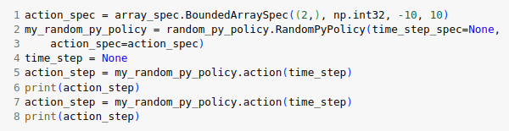
6.3 Ex 1: Random Python Policy
https://www.tensorflow.org/agents/tutorials/3_policies_tutorial
Ex 1: Random Python Policy
A simple example of a `PyPolicy` is the `RandomPyPolicy` which generates random actions for the discrete/continuous given action_spec.
The input `time_step` is ignored.

Slide 12
6.4 Ex 2: Script Python Policy

Slide 13
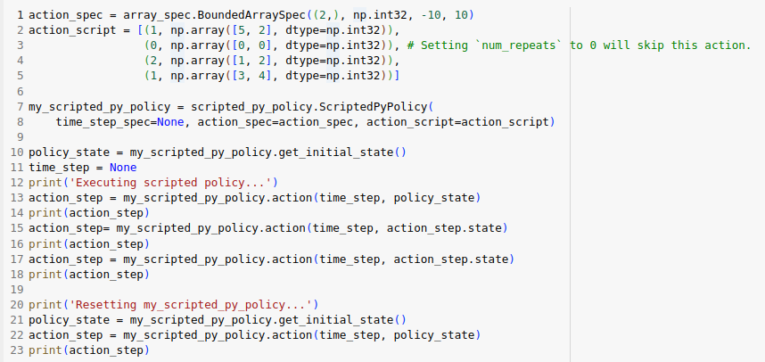
6.4 Ex 2: Script Python Policy
https://www.tensorflow.org/agents/tutorials/3_policies_tutorial
Ex 2: Script Python Policy
A scripted policy plays back a script of actions represented as a list of `(num_repeats, action)` tuples.
Every time the `action` function is called, it returns the next action from the list until the specified number of repeats is done, and then moves on to the next action in the list.
The `reset` method can be called to start executing from the beginning of the list.

Slide 14
6.5 TF Policy

Slide 15
6.5 TF Policy
https://www.tensorflow.org/agents/tutorials/3_policies_tutorial
TF Policy
TF (TensorFlow) Policies follow the same interface as Python policies.
Let us look at a few examples.

Slide 16
6.6 Ex 1: Random TF Policy

Slide 17
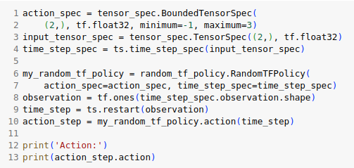
6.6 Ex 1: Random TF Policy
https://www.tensorflow.org/agents/tutorials/3_policies_tutorial
Ex 1: Random TF Policy
A RandomTFPolicy can be used to generate random actions according to a given discrete/continuous `action_spec`.
The input `time_step` is ignored.

Slide 18
6.7 Ex 2: Actor Policy

Slide 19
6.7 Ex 2: Actor Policy
https://www.tensorflow.org/agents/tutorials/3_policies_tutorial
Ex 2: Actor Policy
An actor policy can be created using either a network that maps `time_steps` to actions or a network that maps `time_steps` to distributions over actions.

Slide 20
6.8 Actor Policy Using Network

Slide 21
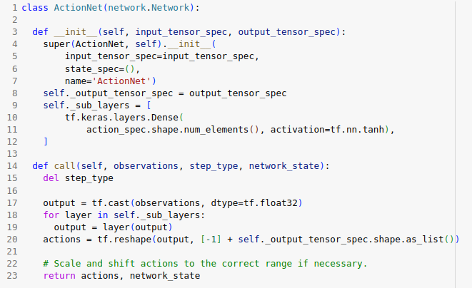
6.8 Actor Policy Using Network
https://www.tensorflow.org/agents/tutorials/3_policies_tutorial
Actor Policy Using Network
Let us define a network as follows:

Slide 22
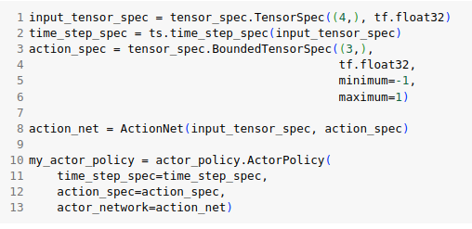
6.8 Actor Policy Using Network
https://www.tensorflow.org/agents/tutorials/3_policies_tutorial
Actor Policy Using Network
In TensorFlow most network layers are designed for batch operations, so we expect the input time_steps to be batched, and the output of the network will be batched as well.
Also the network is responsible for producing actions in the correct range of the given action_spec.
This is conventionally done using e.g. a tanh activation for the final layer to produce actions in [-1, 1] and then scaling and shifting this to the correct range as the input action_spec (e.g., see `tf_agents/agents/ddpg/networks.actor_network()`).
Now, we can create an actor policy using the above network.

Slide 23
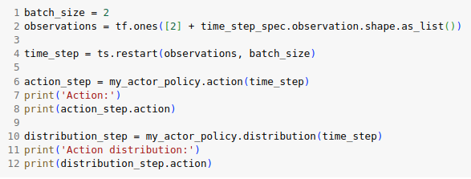
6.8 Actor Policy Using Network
https://www.tensorflow.org/agents/tutorials/3_policies_tutorial
Actor Policy Using Network
We can apply it to any batch of time_steps that follow time_step_spec:

Slide 24
6.8 Actor Policy Using Network
https://www.tensorflow.org/agents/tutorials/3_policies_tutorial
Actor Policy Using Network
In the above example, we created the policy using an action network that produces an action tensor.
In this case, `policy.distribution(time_step)` is a deterministic (delta) distribution around the output of `policy.action(time_step)`.
One way to produce a stochastic policy is to wrap the actor policy in a policy wrapper that adds noise to the actions.
Another way is to create the actor policy using an action distribution network instead of an action network as shown below.

Slide 25
6.9 Actor Policy Using Distribution Network

Slide 26
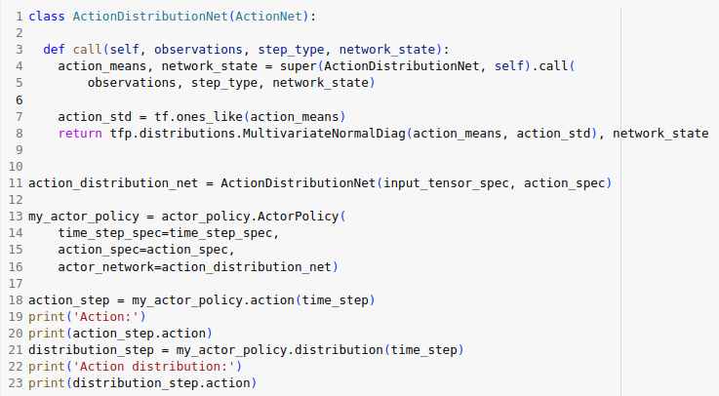
6.9 Actor Policy Using Distribution Network
https://www.tensorflow.org/agents/tutorials/3_policies_tutorial
Actor Policy Using Distribution Network

Slide 27
6.9 Actor Policy Using Distribution Network
https://www.tensorflow.org/agents/tutorials/3_policies_tutorial
Actor Policy Using Distribution Network
Note that in the above, actions are clipped to the range of the given action spec [-1, 1].
This is because a constructor argument of ActorPolicy clip=True by default. Setting this to false will return unclipped actions produced by the network.
Stochastic policies can be converted to deterministic policies using, for example, a GreedyPolicy wrapper which chooses `stochastic_policy.distribution().mode()` as its action, and a deterministic/delta distribution around this greedy action as its `distribution()`.

Slide 28
6.10 Ex 3: Q-Policy

Slide 29
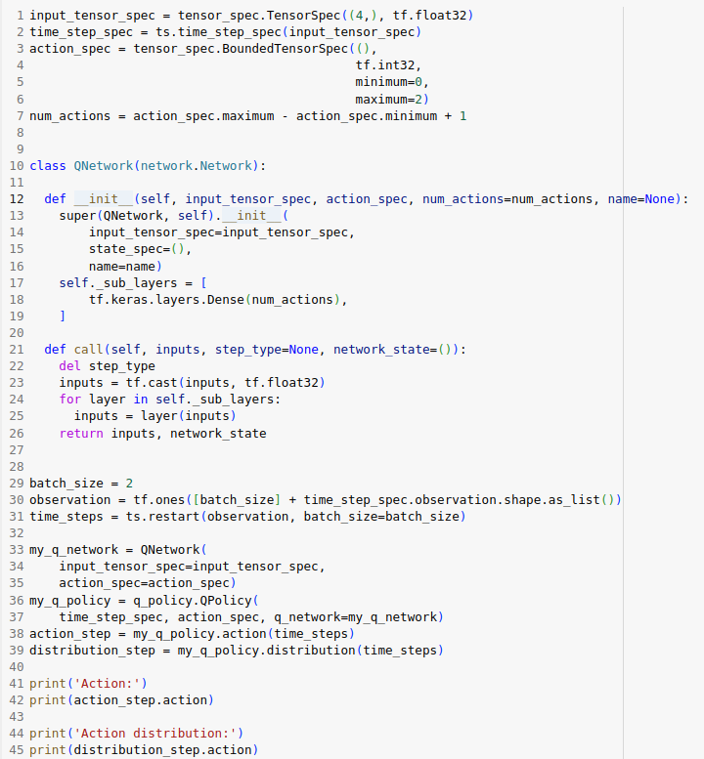
6.10 Ex 3: Q-Policy
https://www.tensorflow.org/agents/tutorials/3_policies_tutorial
Q-Policy
A Q policy is used in agents like DQN and is based on a Q network that predicts a Q value for each discrete action.
For a given time step, the action distribution in the Q Policy is a categorical distribution created using the q values as logits.

Slide 30
6.11 Policy Wrapper

Slide 31
6.11 Policy Wrapper
https://www.tensorflow.org/agents/tutorials/3_policies_tutorial
Policy Wrapper
A policy wrapper can be used to wrap and modify a given policy, e.g., add noise.
Policy wrappers are a subclass of Policy (Python/TensorFlow) and can therefore be used just like any other policy.

Slide 32
6.12 Ex: Greedy Policy

Slide 33
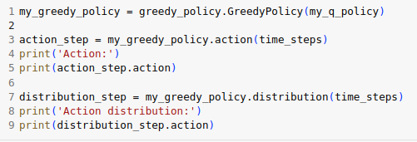
6.12 Ex: Greedy Policy
https://www.tensorflow.org/agents/tutorials/3_policies_tutorial
Ex: Greedy Policy
A greedy wrapper can be used to wrap any TensorFlow policy that implements `distribution()`.
`GreedyPolicy.action()` will return `wrapped_policy.distribution().mode()` and `GreedyPolicy.distribution()` is a deterministic/delta distribution around `GreedyPolicy.action()`:

Slide 34
End

