Slide 1

4 Train DQN
Peter H. Chen

Slide 2
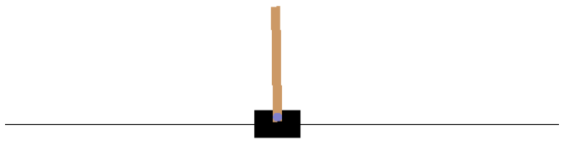
4 Train DQN
https://www.tensorflow.org/agents/tutorials/1_dqn_tutorial
Train DQN
We train a DQN (Deep Q Networks) agent on the Cartpole environment using the TF-Agents library.

Slide 3
4.1 Colab DQN

Slide 4
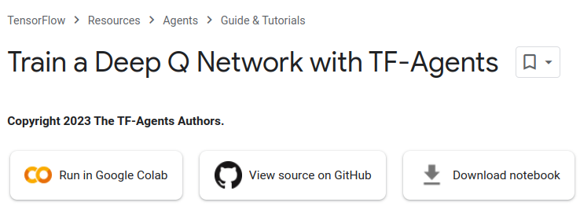
4 Colab DQN
https://www.tensorflow.org/agents/tutorials/1_dqn_tutorial
Colab DQN
We will walk you through all the components in a RL (Reinforcement Learning) pipeline for training, evaluation and data collection.
We will run through the Google Colab Code.
Click “Run in Google Colab”

Slide 5
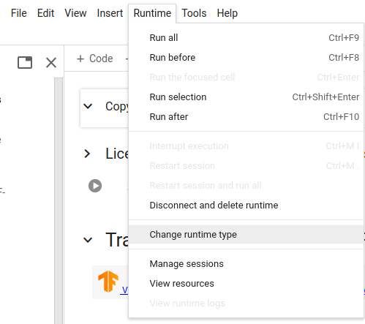
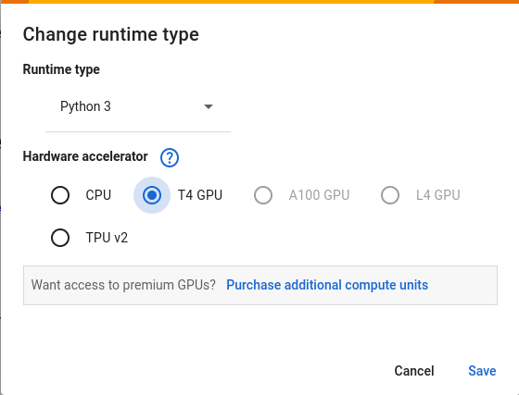
4 Colab DQN
https://colab.research.google.com/github/tensorflow/agents/blob/master/docs/tutorials/1_dqn_tutorial.ipynb#scrollTo=UX0aSKBCYmj2
https://www.tensorflow.org/agents/tutorials/1_dqn_tutorial2
Colab DQN
1. Click “Change runtime type”.
2. Select “T4 GPU”
3. Click “Save”
2
3
1

Slide 6
4.2 Install Library

Slide 7
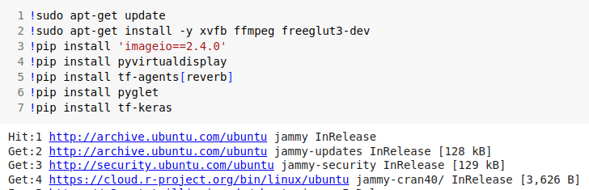
4.2 Install Library
https://www.tensorflow.org/agents/tutorials/1_dqn_tutorial
Install Library
1. update Linux OS
2. Install Linux libraries:
  ffmeg (Fast Forward Moving Picture Expert group) for Video and Audio libraries
  freeglut3-dev (free open source openGL Utility Tool Kit version 3 library for developer)
3. imageio: Python image library for read/write image data.
4. pyvirtualdisplay: Python wrapper for for x-window.
5. tf-agent[reverb]: Tensorflow -agent for reverberation ( 回荡)
6. pyglet: Cross-platform games
7. tf-keras: tensorflow keras library.

Slide 8
4.3 Set Keras-2 for Environ

Slide 9

4.3 Set Keras-2 for Environ
https://www.tensorflow.org/agents/tutorials/1_dqn_tutorial
Set Keras-2 for Environ

Slide 10
4.4 Import Library

Slide 11
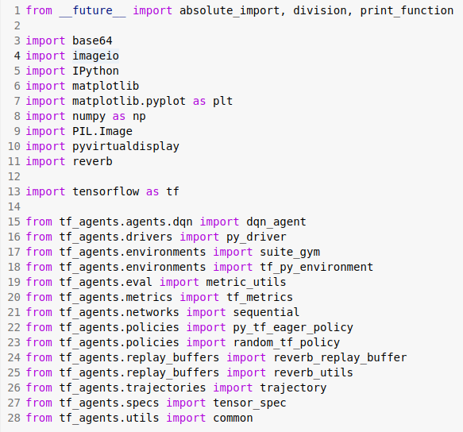
4.4 Import Library
https://www.tensorflow.org/agents/tutorials/1_dqn_tutorial
Import Library

Slide 12
4.5 Setup Display for Render

Slide 13
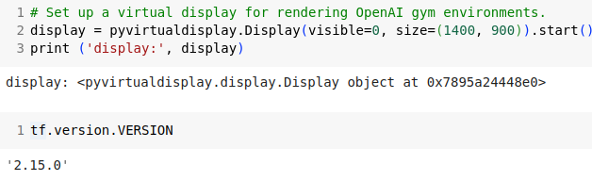
4.5 Setup Display for Render
https://www.tensorflow.org/agents/tutorials/1_dqn_tutorial
Setup Display for Render

Slide 14
4.6 Setup Hyperparameter

Slide 15
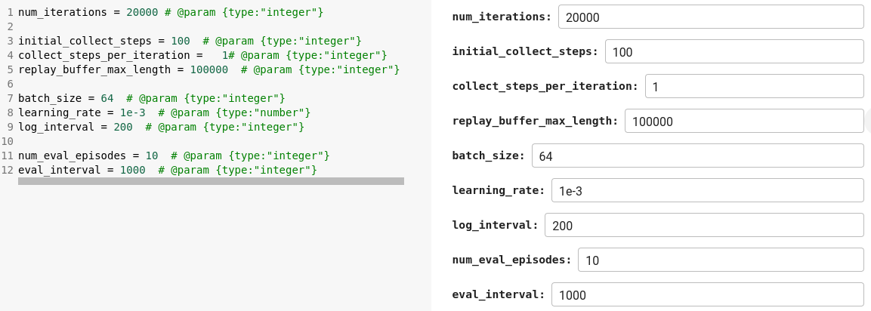
4.6 Setup Hyperparameter
https://www.tensorflow.org/agents/tutorials/1_dqn_tutorial
Setup Hyperparamter

Slide 16
4.7 Environment

Slide 17

4.7 Environment
https://www.tensorflow.org/agents/tutorials/1_dqn_tutorial
Environment
In RL (Reinforcement Learning), an environment represents the task or problem to be solved.
Standard environments can be created in TF-Agents using tf_agents.environments suites.
TF-Agents has suites for loading environments from sources such as the OpenAI Gym, Atari, and DM (Deep Mind) Control.
Load the CartPole environment from the OpenAI Gym suite.

Slide 18

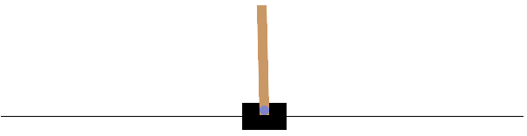
4.7 Environment
https://www.tensorflow.org/agents/tutorials/1_dqn_tutorial
Environment
We can render this environment to see how it looks.
A free-swinging pole is attached to a cart.
The goal is to move the cart right or left in order to keep the pole pointing up.

Slide 19

4.7 Environment
https://www.tensorflow.org/agents/tutorials/1_dqn_tutorial
Environment
The environment.step method takes an action in the environment and returns a TimeStep tuple containing the next observation of the environment and the reward for the action.
The time_step_spec() method returns the specification for the TimeStep tuple.
Its observation attribute shows the shape of observations, the data types, and the ranges of allowed values.
The reward attribute shows the same details for the reward.
Observation Spec:
BoundedArraySpec (
  shape=(4,),
  dtype=dtype('float32'),
  name='observation',
  minimum=[-4.8000002e+00 -3.4028235e+38 -4.1887903e-01 -3.4028235e+38],
  maximum=[4.8000002e+00 3.4028235e+38 4.1887903e-01 3.4028235e+38]
)

Slide 20

4.7 Environment
https://www.tensorflow.org/agents/tutorials/1_dqn_tutorial
Environment
Reward Sepectification.
Reward Spec:
ArraySpec (
  shape=(),
  dtype=dtype('float32'),
  name='reward'
)

Slide 21

4.7 Environment
https://www.tensorflow.org/agents/tutorials/1_dqn_tutorial
Environment
The action_spec() method returns the shape, data types, and allowed values of valid actions.
Action Spec:
BoundedArraySpec (
  shape=(),
  dtype=dtype('int64'),
  name='action',
  minimum=0,
  Maximum=1
)

Slide 22
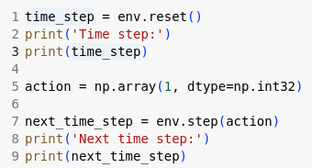
4.7 Environment
https://www.tensorflow.org/agents/tutorials/1_dqn_tutorial
Environment
In the Cartpole environment:
observation is an array of 4 floats:
  the position and velocity of the cart
  the angular position and velocity of the pole
reward is a scalar float value
action is a scalar integer with only two possible values:
  0 — "move left"
  1 — "move right"
Time step:
TimeStep({
  'step_type': array(0, dtype=int32),
  'reward': array(0., dtype=float32),
  'discount': array(1., dtype=float32),
  'observation': array([ 0.03818662, -0.02562605, -0.04968454, -0.03938532], dtype=float32)
})
Next time step:
TimeStep ({
  'step_type': array(1, dtype=int32),
  'reward': array(1., dtype=float32),
  'discount': array(1., dtype=float32),
  'observation': array([ 0.0376741 , 0.17017186, -0.05047225, -0.347321 ], dtype=float32)
})

Slide 23

4.7 Environment
https://www.tensorflow.org/agents/tutorials/1_dqn_tutorial
Environment
Usually two environments are instantiated:
1. one for training and
2. one for evaluation.

Slide 24

4.7 Environment
https://www.tensorflow.org/agents/tutorials/1_dqn_tutorial
Environment
The Cartpole environment, like most environments, is written in pure Python.
This is converted to TensorFlow using the TFPyEnvironment wrapper.
The original environment's API uses Numpy arrays.
The TFPyEnvironment converts these to Tensors to make it compatible with Tensorflow agents and policies.

Slide 25
4.8 Agent

Slide 26
4.8 Agent
https://www.tensorflow.org/agents/tutorials/1_dqn_tutorial
Agent
The algorithm used to solve an RL problem is represented by an Agent.
TF-Agents provides standard implementations of a variety of Agents, including:
  DQN (used in this tutorial)
  REINFORCE
  DDPG
  TD3
  PPO
  SAC
The DQN agent can be used in any environment which has a discrete action space.
At the heart of a DQN Agent is a QNetwork, a neural network model that can learn to predict QValues (expected returns) for all actions, given an observation from the environment.

Slide 27
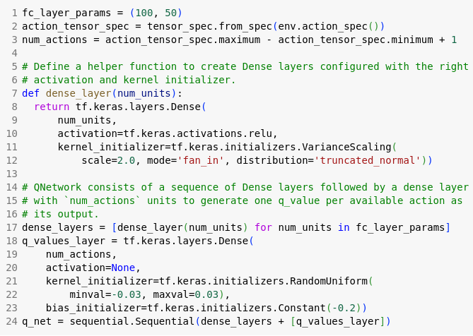
4.8 Agent
https://www.tensorflow.org/agents/tutorials/1_dqn_tutorial
Agent
We will use tf_agents.networks. to create a QNetwork.
The network will consist of a sequence of tf.keras.layers.Dense layers, where the final layer will have 1 output for each possible action.

Slide 28
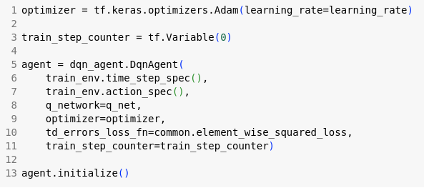
4.8 Agent
https://www.tensorflow.org/agents/tutorials/1_dqn_tutorial
Agent
Now use tf_agents.agents.dqn.dqn_agent to instantiate a DqnAgent.
In addition to the time_step_spec, action_spec and the QNetwork, the agent constructor also requires an optimizer (in this case, AdamOptimizer), a loss function, and an integer step counter.

Slide 29
4.9 Policy

Slide 30

4.9 Policy
https://www.tensorflow.org/agents/tutorials/1_dqn_tutorial
Policy
A policy defines the way an agent acts in an environment.
Typically, the goal of reinforcement learning is to train the underlying model until the policy produces the desired outcome.
In this discussion:
  1. The desired outcome is keeping the pole balanced upright over the cart.
  2. The policy returns an action (left or right) for each time_step observation.
Agents contain two policies:
  1. agent.policy — The main policy that is used for evaluation and deployment.
  2. agent.collect_policy — A second policy that is used for data collection.

Slide 31
4.9 Policy
https://www.tensorflow.org/agents/tutorials/1_dqn_tutorial
Policy
Policies can be created independently of agents.
For example, use tf_agents.policies.random_tf_policy to create a policy which will randomly select an action for each time_step.

Slide 32
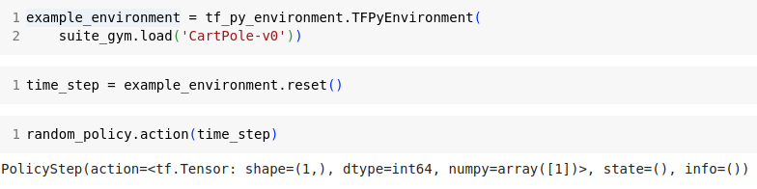
4.9 Policy
https://www.tensorflow.org/agents/tutorials/1_dqn_tutorial
Policy
To get an action from a policy, call the policy.action (time_step) method.
The time_step contains the observation from the environment.
This method returns a PolicyStep, which is a named tuple with three components:
  action — the action to be taken (in this case, 0 or 1)
  state — used for stateful (that is, RNN-based) policies
  info — auxiliary data, such as log probabilities of actions

Slide 33
4.10 Metics and Evaluation

Slide 34
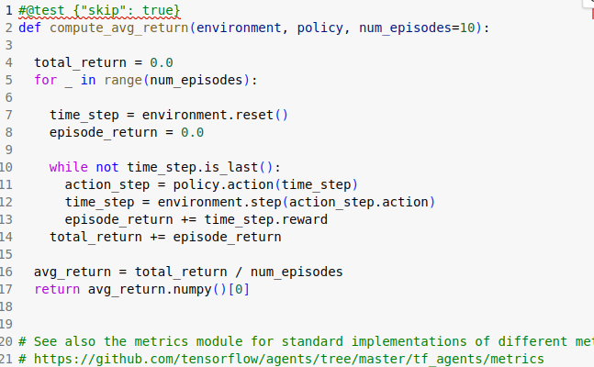
4.10 Metics and Evaluation
https://www.tensorflow.org/agents/tutorials/1_dqn_tutorial
Metrics and Evaluation
The most common metric used to evaluate a policy is the average return.
The return is the sum of rewards obtained while running a policy in an environment for an episode.
Several episodes are run, creating an average return.
The following function computes the average return of a policy, given the policy, environment, and a number of episodes.

Slide 35

4.10 Metics and Evaluation
https://www.tensorflow.org/agents/tutorials/1_dqn_tutorial
Metrics and Evaluation
Running this computation on the random_policy shows a baseline performance in the environment.

Slide 36
4.11 Replay Buffer

Slide 37
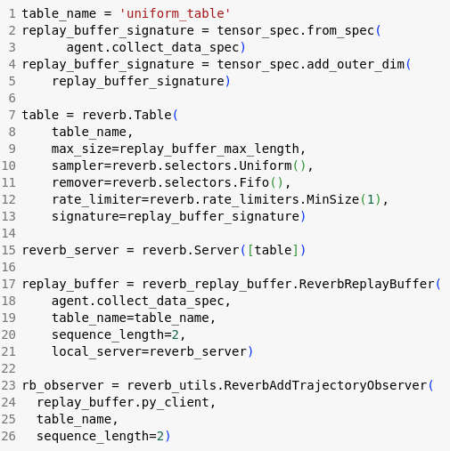
4.11 Replay Buffer
https://www.tensorflow.org/agents/tutorials/1_dqn_tutorial
Replay Buffer
In order to keep track of the data collected from the environment, we will use Reverb (Reverberation), an efficient, extensible, and easy-to-use replay system by Deepmind.
It stores experience data when we collect trajectories and is consumed during training.
This replay buffer is constructed using specs describing the tensors that are to be stored, which can be obtained from the agent using agent.collect_data_spec.

Slide 38
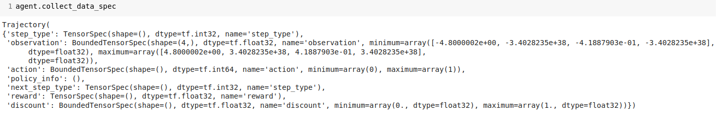
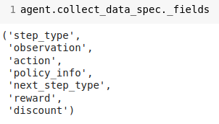
4.11 Replay Buffer
https://www.tensorflow.org/agents/tutorials/1_dqn_tutorial
Replay Buffer
For most agents, collect_data_spec is a named tuple called Trajectory, containing the specs for observations, actions, rewards, and other items.

Slide 39
4.12 Data Collection

Slide 40
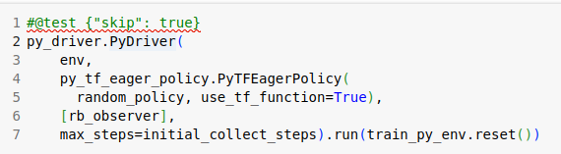
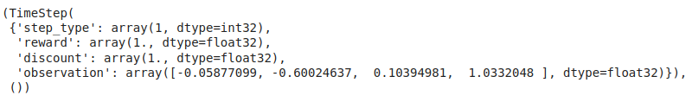
4.12 Data Collection
https://www.tensorflow.org/agents/tutorials/1_dqn_tutorial
Data Collection
Now execute the random policy in the environment for a few steps, recording the data in the replay buffer.
Here we are using 'PyDriver' to run the experience collecting loop.
We can learn more about TF Agents driver in our drivers tutorial.

Slide 41

4.12 Data Collection
https://www.tensorflow.org/agents/tutorials/1_dqn_tutorial
Data Collection
The replay buffer is now a collection of Trajectories.

Slide 42
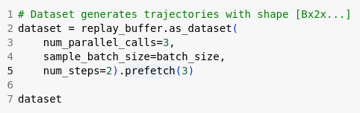
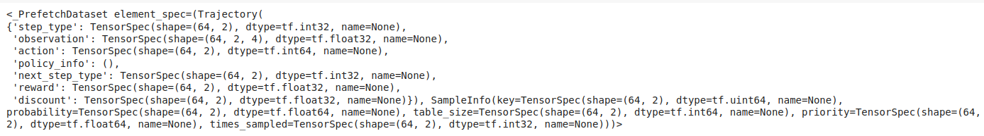
4.12 Data Collection
https://www.tensorflow.org/agents/tutorials/1_dqn_tutorial
Data Collection
The agent needs access to the replay buffer.
This is provided by creating an iterable tf.data.Dataset pipeline which will feed data to the agent.
Each row of the replay buffer only stores a single observation step.
But since the DQN Agent needs both the current and next observation to compute the loss, the dataset pipeline will sample two adjacent rows for each item in the batch (num_steps=2).
This dataset is also optimized by running parallel calls and prefetching data.

Slide 43
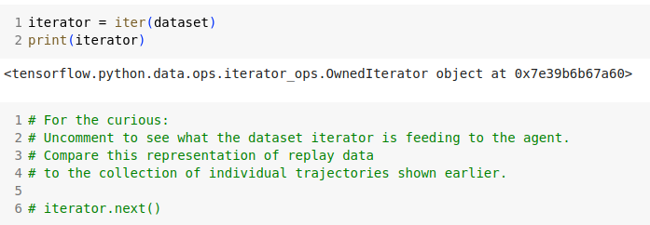
4.12 Data Collection
https://www.tensorflow.org/agents/tutorials/1_dqn_tutorial
Data Collection
We can iterate all the data by iterator.

Slide 44
4.13 Train Agent

Slide 45
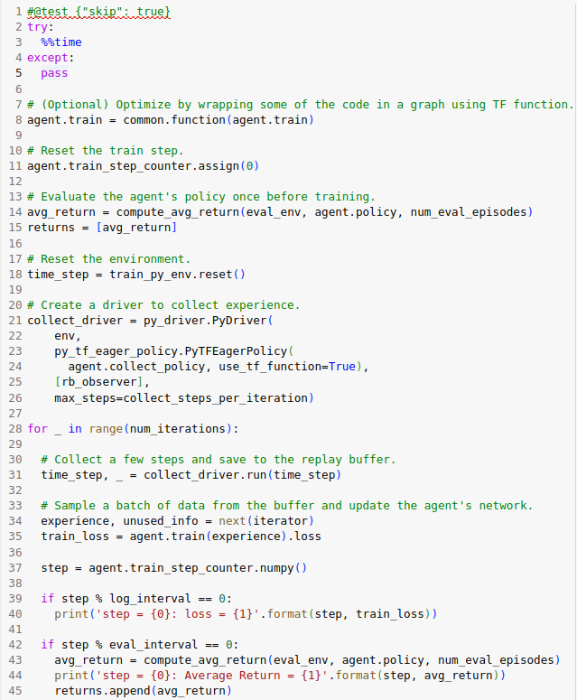
4.13 Train Agent
https://www.tensorflow.org/agents/tutorials/1_dqn_tutorial
Train Agent
Two things must happen during the training loop:
  1. collect data from the environment
  use that data to train the agent's neural network(s)
This example also periodically evaluates the policy and prints the current score.

Slide 46
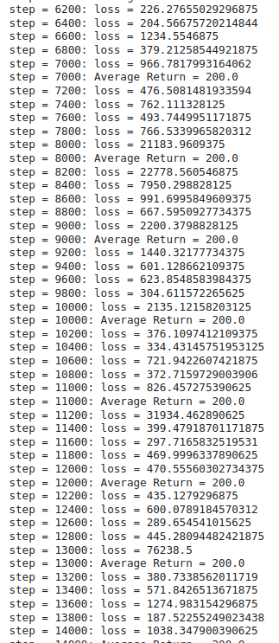
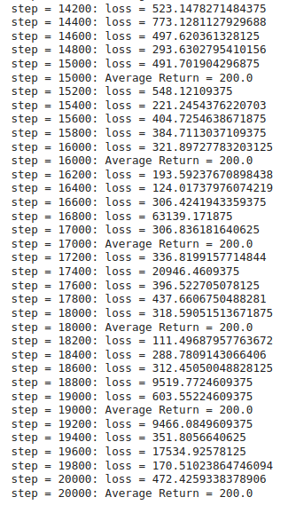
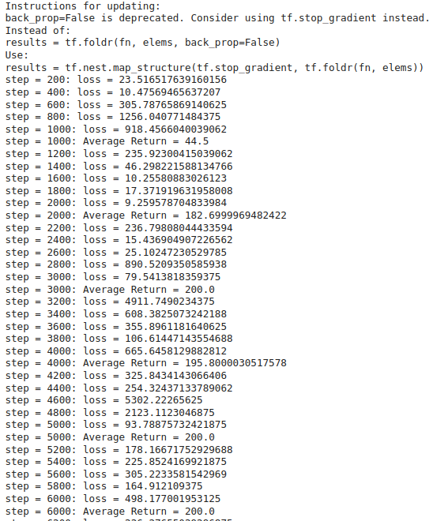
4.13 Train Agent
https://www.tensorflow.org/agents/tutorials/1_dqn_tutorial
Train Agent
The following results will take around 5 minutes to run.

Slide 47
4.14 Visualization

Slide 48
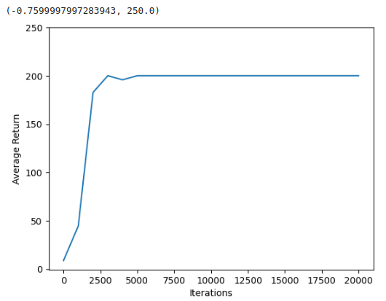
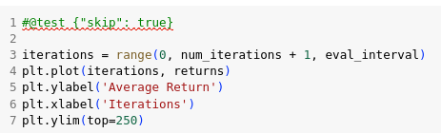
4.14 Plot
https://www.tensorflow.org/agents/tutorials/1_dqn_tutorial
Plot
Use matplotlib.pyplot to plot how the policy improved during training.
One iteration of Cartpole-v0 consists of 200 time steps.
The environment gives a reward of +1 for each step the pole stays up, so the maximum return for one episode is 200.
The charts shows the return increasing towards that maximum each time it is evaluated during training. (It may be a little unstable and not increase monotonically each time.)

Slide 49
4.15 Video

Slide 50
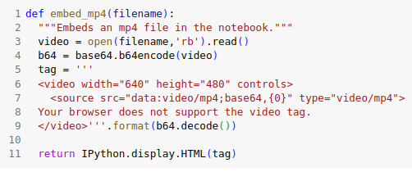
4.15 Video
https://www.tensorflow.org/agents/tutorials/1_dqn_tutorial
Video
We see an agent actually performing a task in an environment.
First, create a function to embed videos in the notebook.

Slide 51
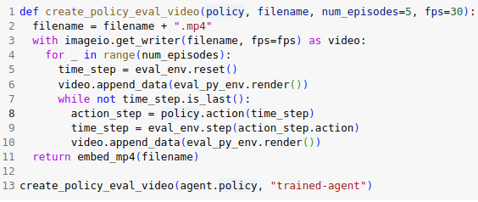
4.15 Video
https://www.tensorflow.org/agents/tutorials/1_dqn_tutorial
Video
Now iterate through a few episodes of the Cartpole game with the agent.
The underlying Python environment (the one "inside" the TensorFlow environment wrapper) provides a render() method, which outputs an image of the environment state.
These can be collected into a video.

Slide 52
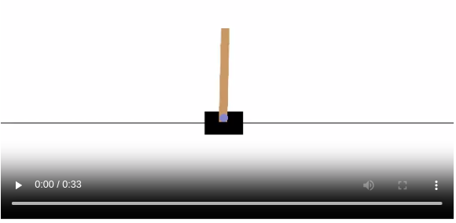
4.15 Video
https://www.tensorflow.org/agents/tutorials/1_dqn_tutorial
Video
For fun, compare the well trained agent (below) to an agent moving randomly. (It does not do as well.)

Slide 53
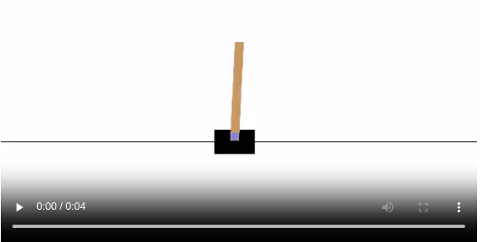
4.15 Video
https://www.tensorflow.org/agents/tutorials/1_dqn_tutorial
Video
Below agent is not train well and move randomly.

Slide 54
End

