Slide 1

15 Ranking Agent
Peter H. Chen

Slide 2
15 Ranking Agent
https://www.tensorflow.org/agents/tutorials/bandits_tutorial
Rank Agent
We discuss Ranking Agent.
The ranking algorithms in TF-Agents belong to bandit agents that operate on "per-arm" of bandit problem.
Here, we should familiarize themselves with the bandit and the per-arm bandit.

Slide 3
15.1 Install Library

Slide 4
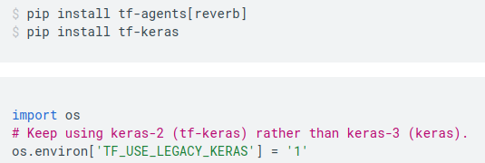
15.1 Install Library
https://www.tensorflow.org/agents/tutorials/bandits_tutorial
Install Library
Install tf-agents[reverb] and tf-keras

Slide 5
15.2 Import Library

Slide 6
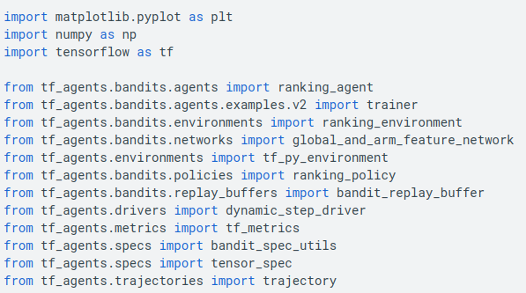
15.2 Import Library
https://www.tensorflow.org/agents/tutorials/bandits_tutorial
Import Library

Slide 7
15.3 Ranking Algorithm

Slide 8
15.3 Ranking Algorithm
https://www.tensorflow.org/agents/tutorials/bandits_tutorial
Ranking Algorithm
We discuss the ranking algorithms implemented as part of the TF-Agents Bandits library.
In a ranking problem, in every iteration an agent is presented with a set of items, and is tasked with ranking some or all of them to a list.
This ranking decision then receives some form of feedback (maybe a user does or does not click on one or more of the selected items for example).
The goal of the agent is to optimize some metric/reward with the goal of making better decisions over time.

Slide 9
15.4 Prerequisite

Slide 10
15.4 Prerequisite
https://www.tensorflow.org/agents/tutorials/bandits_tutorial
Prerequisite
The ranking algorithms in TF-Agents belong to a special type of bandit agents that operate on "per-arm" bandit problems.
Here, we should familiarize themselves with the bandit and the per-arm bandit.

Slide 11
15.5 Rank Problem and Variant

Slide 12
15.5 Rank Problem and Variant
https://www.tensorflow.org/agents/tutorials/bandits_tutorial
Rank Problem and Variant
We discuss the example of presenting items for sale to users.
1. In every iteration, we receive a set of items and possibly a number describing how many of them we should display.
2. We assume the number of items at hand is always greater than or equal to the number of slots to place them in.
3. We need to fill the slots in the display to maximize the probability that the user will interact with one or more of the displayed items.
4. The user, as well as the items, are described by features.
5. If we put items on display that are liked by the user, the probability of user/item interactions increases.
Therefore, we need to know:
1. How user-item pairs match.
2. How do we know if an item is liked by the user?
3. Feedback Types.

Slide 13
15.6 Feedback Type

Slide 14
15.6 Feedback Type
https://www.tensorflow.org/agents/tutorials/bandits_tutorial
Feedback Type
1. In the bandit problem, the feedback signal (the reward) is directly associated with a single chosen item
2. In ranking problem, we need to consider how the feedback translates to the "goodness" of the displayed items. In other words, in the ranking problem, we need to assign scores to all or some of the displayed items.
3. In tf-agent library we offer two different feedback types:
  vector feedback and
  cascading feedback

Slide 15
15.7 Vector Feedback

Slide 16
15.7 Vector Feedback
https://www.tensorflow.org/agents/tutorials/bandits_tutorial
Vector Feedback
In the vector feedback type, we assume that the agent receives a scalar score for every item in the output ranking.
These scalars are put together in a vector in the same ordering as the output ranking.
Thus the feedback is a vector of the same size as the number of elements in the ranking.
This feedback type is straightforward in the sense that we don't need to worry about converting feedback signals to scores.
On the other hand, the responsibility of scoring items falls on the designer, i.e., user, it is up to the system designer to decide what scores to give based on
  the item,
  its position, and
  whether it was interacted with by the user.

Slide 17
15.8 Cascade Feedback

Slide 18
15.8 Cascade Feedback
https://www.tensorflow.org/agents/tutorials/bandits_tutorial
Cascade Feedback
In the Cascading Feedback (“An experimental comparison of click position-bias models” by Craswell et al., 2008),
  we assume the user looks at the displayed items in a sequential manner, starting at the top slot.
  As soon as the user finds an item worthy of clicking, they click and never return to the current ranked list.
  They don't even look at items below the item clicked.
  Not clicking on any item is also a possibility, this happens when none of the displayed items are worthy of clicking.
  In this case, the user does look at all the items.
The feedback signal is composed of two elements:
  The index of the chosen element and the value of the click.
  Then it is the agent's task to translate this information to scores.
The bandit library implements:
  the convention that seen but unclicked items receive some low score (typically 0 or -1),
  the clicked item receives the click value, and the items beyond the clicked one are ignored by the agent.

Slide 19
15.9 Exploration

Slide 20
15.9 Exploration
https://www.tensorflow.org/agents/tutorials/bandits_tutorial
Exploration
To maximize the chances of the user clicking on an item, it's not enough to just choose the highest scoring items and put them high in the ranking.
  For a user with a lot of different interests, they might be most interested in sports, but they also like arts and traveling.
  Giving all the items the highest estimated scores and displaying all sporty items in the highest slots may not be optimal. The user might be in the mood for arts or traveling.
  Hence, it is a good idea to display a mix of the high-scoring interests. It is important to not only maximize the score of the displayed items but also make sure they form a diverse set.
  As with other limited-information learning problems (like bandits), it is also important to keep in mind that our decisions not only affect the immediate reward, but also the training data and future reward.
  If we always only display items based on their current estimated score, we might be missing out on high-scoring items that we haven't explored enough yet, and thus we are not aware of how good they are.
  That is, we need to incorporate exploration to our decision making process.
All of the above concepts and considerations are addressed in tf-agent[reverb] library.

Slide 21
15.10 Simulate Users

Slide 22
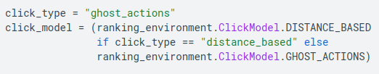
15.10 Simulate Users
https://www.tensorflow.org/agents/tutorials/bandits_tutorial
Simulate Users
First, we define the environment, the class responsible for randomly generating user and item features, and give feedback after decisions.
We also need a model for the environment to decide when to not click. We have two ways in our library, distance based and ghost actions.
In distance based, if the user features are not close enough to any of the item features, the user does not click.
In the ghost actions model, we set up extra imaginary actions in the form of unit vector item features. If the user chooses one of the ghost actions, it results in a no-click.

Slide 23
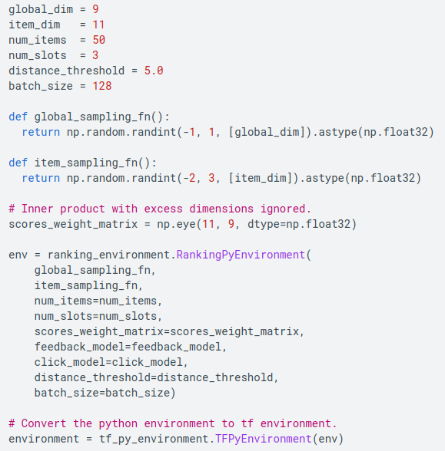
15.10 Simulate Users
https://www.tensorflow.org/agents/tutorials/bandits_tutorial
Simulate Users
We are almost ready to define the ranking environment, just a couple of preparations:
1. We define the sampling functions for the global (user) and the item features.
2. These features will be used by the environment to simulate user behavior:
  a weighted inner product of the global and item features is calculated, and
  the probability of the user clicking is proportional to the inner product values.
  The weighting of the inner product is defined by scores_weight_matrix here.

Slide 24
15.11 Define Network and Params

Slide 25
15.11 Define Network and Params
https://www.tensorflow.org/agents/tutorials/bandits_tutorial
Define Network and Params
Now, let's define a few different agents that will tackle the above environment.
All of the agents train a network that estimates scores of item/user pairs.
The difference lies in the policy, that is, how the trained network is used to make a ranking decision.
The implemented policies span from just stack ranking based on scores to taking into account diversity and exploration with the ability to tune the mixture of these aspects.
scoring_network = (
global_and_arm_feature_network.create_feed_forward_common_tower_network(
environment.observation_spec(), (20, 10), (20, 10), (20, 10)))
learning_rate = 0.005
feedback_dict = {ranking_environment.FeedbackModel.CASCADING: ranking_agent.FeedbackModel.CASCADING,
ranking_environment.FeedbackModel.SCORE_VECTOR: ranking_agent.FeedbackModel.SCORE_VECTOR}
agent_feedback_model = feedback_dict[feedback_model]

Slide 26
15.12 Stack Ranking by Score

Slide 27
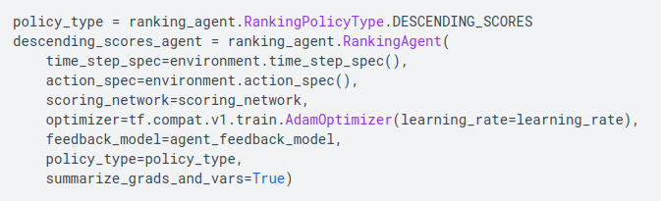
15.12 Stack Ranking by Score
https://www.tensorflow.org/agents/tutorials/bandits_tutorial
Stack Ranking by Score

Slide 28
15.13 Sampling Based on Score

Slide 29
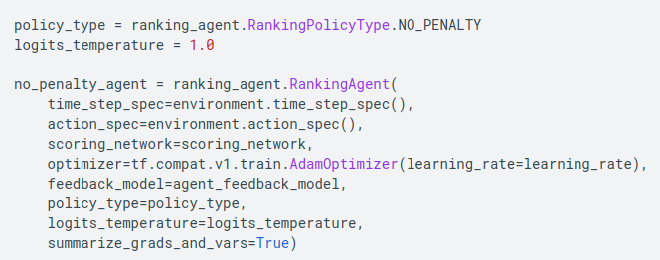
15.13 Sampling Based on Score
https://www.tensorflow.org/agents/tutorials/bandits_tutorial
Sampling Based on Score

Slide 30
15.14 Sampling Sequentially

Slide 31
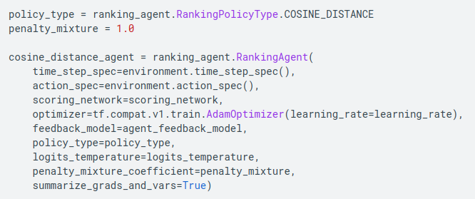
15.14 Sampling Sequentially
https://www.tensorflow.org/agents/tutorials/bandits_tutorial
Sampling Sequentially

Slide 32
15.15 Choose Agent

Slide 33
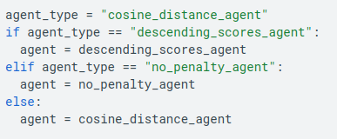
15.15 Choose Agent
https://www.tensorflow.org/agents/tutorials/bandits_tutorial
Choose Agent

Slide 34
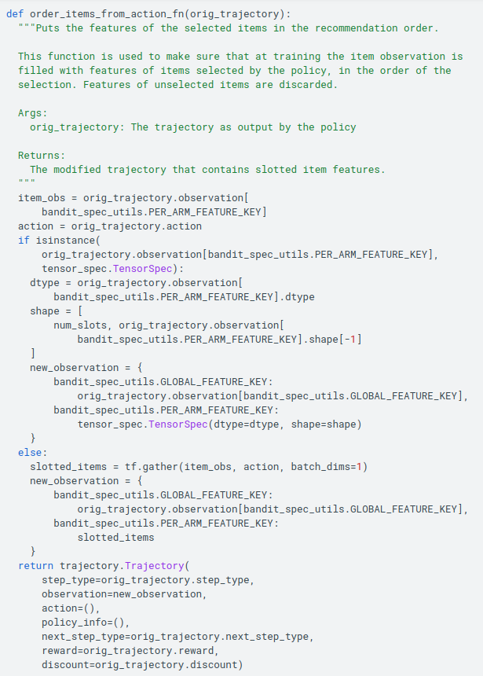
15.15 Choose Agent
https://www.tensorflow.org/agents/tutorials/bandits_tutorial
Choose Agent
Before we can start our training loop, there is one more thing we need to take care of, concerning the training data.
The arm features presented to the policy at decision time contains all items that the policy can choose from. However, at training, we need the features of items that were selected, and for convenience, in the order of the decision output.
To this end, the following function is used

Slide 35
15.16 Define Parameters

Slide 36

15.16 Define Parameters
https://www.tensorflow.org/agents/tutorials/bandits_tutorial
Define Parameters

Slide 37
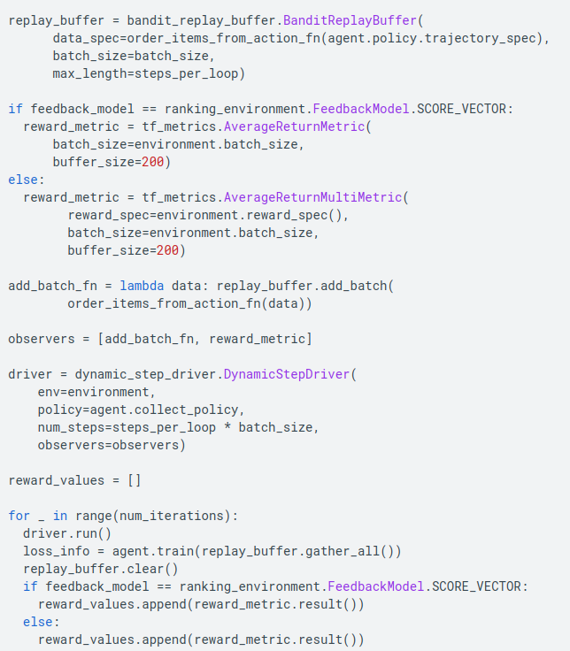
15.16 Define Parameters
https://www.tensorflow.org/agents/tutorials/bandits_tutorial
Define Parameters
As in the bandit tutorials, we define the replay buffer that will feed the agent the samples to train on.
Then, we use the driver to put everything together: The environment provides features, the policy chooses rankings, and samples are collected to be trained on.

Slide 38
15.17 Plot Reward

Slide 39
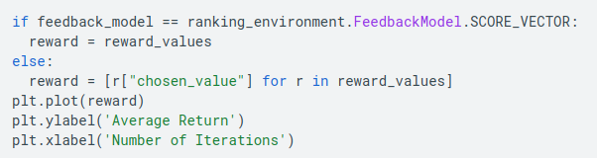
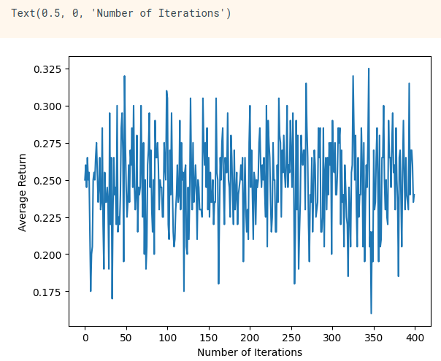
15.17 Plot Reward
https://www.tensorflow.org/agents/tutorials/bandits_tutorial
Plot Reward

Slide 40
15.18 Summary

Slide 41
15.18 Sumamry
https://www.tensorflow.org/agents/tutorials/bandits_tutorial
Summary
This tutorial has lots of tunable parameters, including the policy/agent to use, some properties of the environment, and even the feedback model. Feel free to experiment with those parameters.
There is also a ready-to-run example for ranking:
https://colab.research.google.com/github/tensorflow/agents/blob/master/docs/tutorials/ranking_tutorial.ipynb

Slide 42
End

