Slide 1

1 MuJoCo/SB3
Peter H. Chen

Slide 2
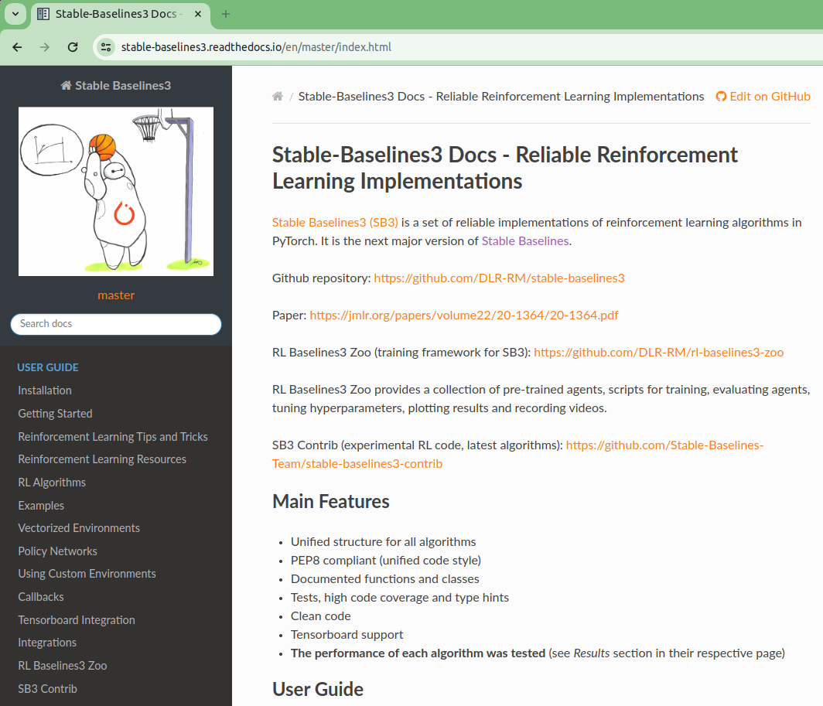
1 MuJoCo/SB3
https://www.youtube.com/watch?v=2AFl-iWGQzc&t=15s
MuJoCo/SB3 (00:00-00:10/6:09)
We discuss the SB3 (Stable Baseline 3) in MuJoCo (Multi-Joint Dynamics with Contact).
Google search “stable baselines 3”.
SB3 (Stable Baselines 3) is a set of reliable implementation of reinforcement learning algorithm in PyTorch.
Click “RL Algorithms”
https://stable-baselines3.readthedocs.io/en/master/index.html

Slide 3
1.1 RL Algorithm

Slide 4
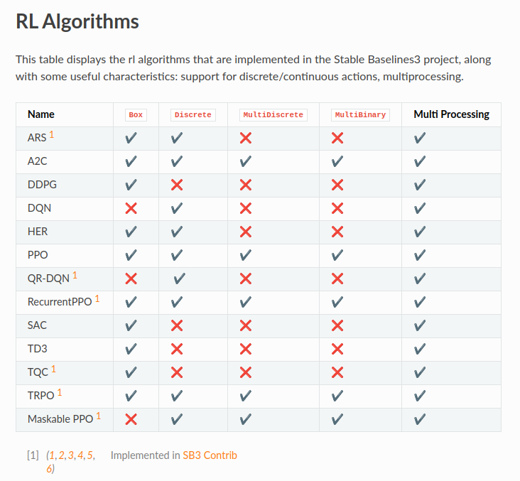
1.1 RL Algorithm
https://www.youtube.com/watch?v=2AFl-iWGQzc&t=15s
RL Algorithms (00:11-00:20/6:09)
We have a list of RL Algorithm of Stable Baselines 3.
These are all the available algorithms to choose.

Slide 5
1.2 SB3 Core/Extension Algorithm

Slide 6
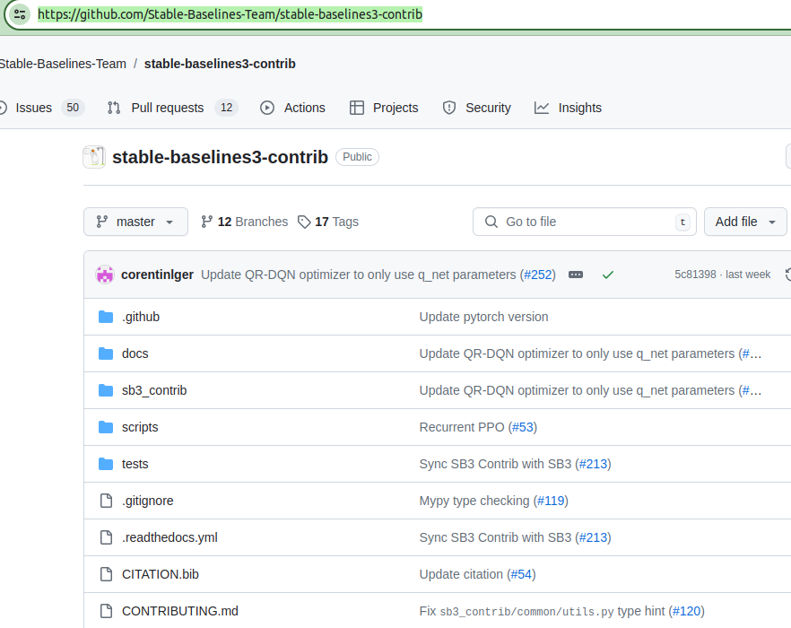
1.2 Core/Extension Algorithm
https://www.youtube.com/watch?v=2AFl-iWGQzc&t=15s
Core/Extension Algorithm (00:21-00:30/6:09)
Reference 1 implement the 6 algorithms (ARC, QR-DQN, RecurrentPPO, TQC, TRPO, Maskable PPO).
https://github.com/Stable-Baselines-Team/stable-baselines3-contrib

Slide 7
1.2 Core/Extension Algorithm
https://www.youtube.com/watch?v=2AFl-iWGQzc&t=15s
Core/Extension Algorithm (00:31-00:50/6:09)
Reference 1 is not in the stable baselines algorithms. These are extenstion libraries. The extension libraries are experimental code.
https://github.com/Stable-Baselines-Team/stable-baselines3-contrib

Slide 8
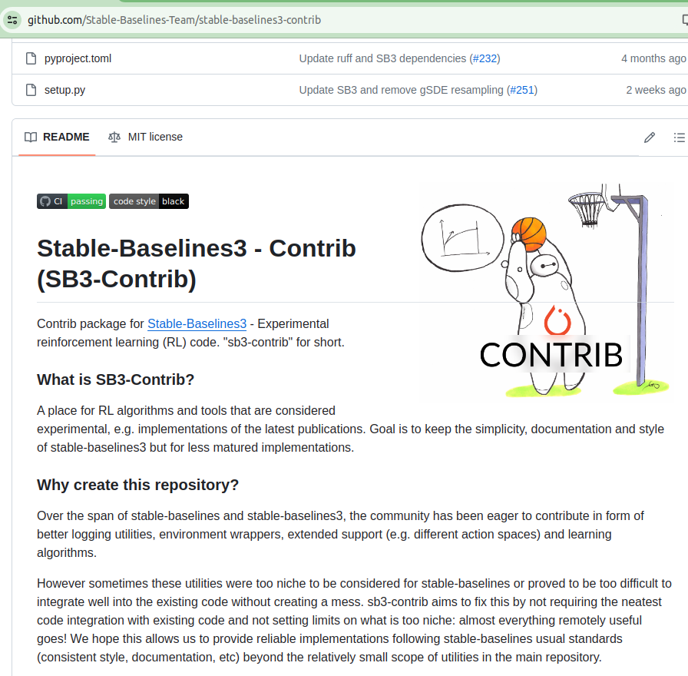
1.2 Core/Extension Algorithm
https://www.youtube.com/watch?v=2AFl-iWGQzc&t=15s
Core/Extension Algorithm (00:51-01:00/6:09)
We can see more extension implement and what is the implement motivation in this github.
https://github.com/Stable-Baselines-Team/stable-baselines3-contrib

Slide 9
1.2 Core/Extension Algorithm
https://www.youtube.com/watch?v=2AFl-iWGQzc&t=15s
SB3 Core/Extension Algorithm (01:01-01:10/6:09)
Now, we can cross out the extension.
https://stable-baselines3.readthedocs.io/en/master/guide/algos.html#id6

Slide 10
1.3 HER Algorithm

Slide 11
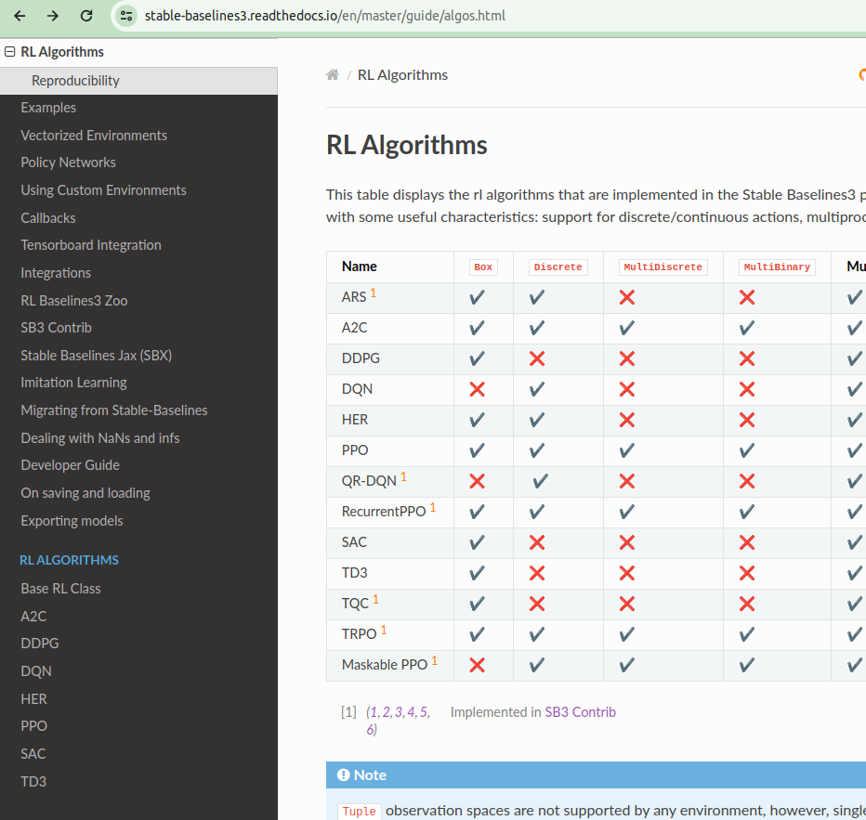
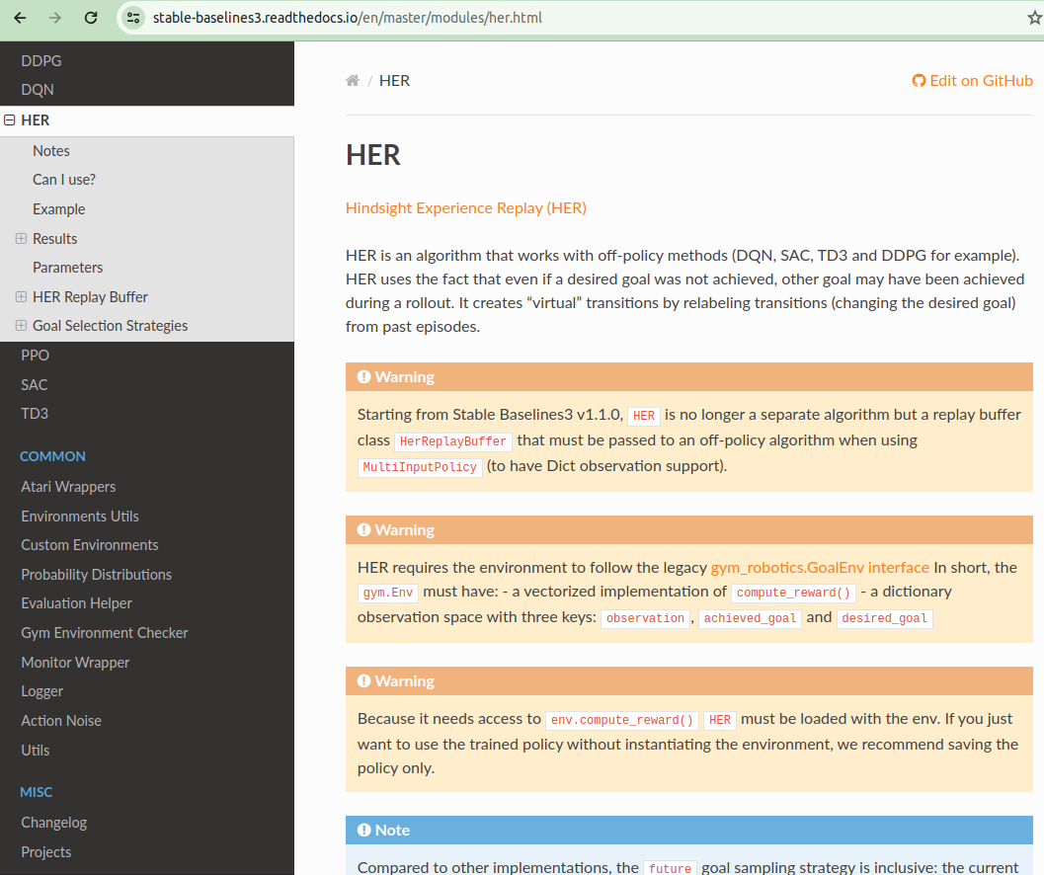
1.3 HER Algorithm
https://www.youtube.com/watch?v=2AFl-iWGQzc&t=15s
HER Algorithm (01:11-01:20/6:09)
Click “HER”
https://stable-baselines3.readthedocs.io/en/master/modules/her.html

Slide 12
1.3 HER Algorithm
https://www.youtube.com/watch?v=2AFl-iWGQzc&t=15s
HER Algorithm (01:21-01:30/6:09)
HER (Hindsight Experience Replay). HER is not actually the learning algorithm. It is used to combine with other algorithm. HER is an off-policy algorithm, i.e., HER can use other algorithms, such as, DQN, SAC, TD3, DDPG, etc.

Slide 13
1.4 On/Off-Policy Algorithm

Slide 14
1.4 On/Off-Policy Algorithm
https://www.youtube.com/watch?v=2AFl-iWGQzc&t=15s
On/Off-Policy Algorithm (01:31-01:40/6:09)
What is difference in On/Off Policy?
1. On-Policy: On-line training/learning and replay with the same strategy, such as, Q-Learning, SARSA, PPO, A2C.
1. Off-Policy: Off-Line Training/Learning and replay with different strategy, Monte Carlo, DQN, SAC, TD3, DDPG, HER.
https://stable-baselines3.readthedocs.io/en/master/guide/algos.html#id6
1
2
1
2

Slide 15
1.5 Acrobot

Slide 16
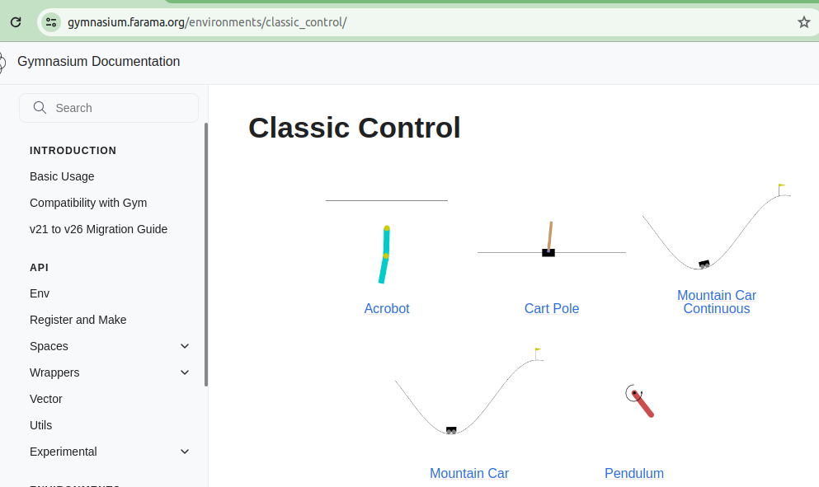
1.5 Acrotbot
https://www.youtube.com/watch?v=2AFl-iWGQzc&t=15s
Acrobot (01:41-01:50/6:09)
Loot at the Acrobot in Gymnasium.
https://gymnasium.farama.org/environments/classic_control/

Slide 17

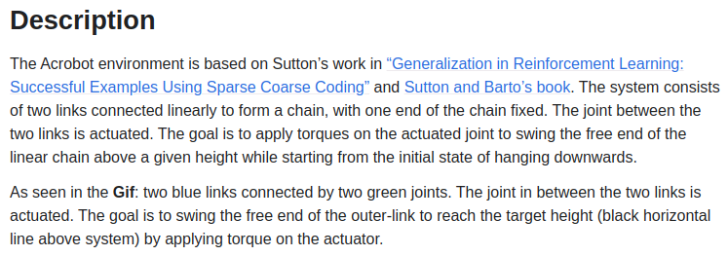
1.5 Acrotbot
https://www.youtube.com/watch?v=2AFl-iWGQzc&t=15s
Acrobot (01:41-01:50/6:09)
Goal of acrobot is to reach the target height (black line),
https://gymnasium.farama.org/environments/classic_control/

Slide 18
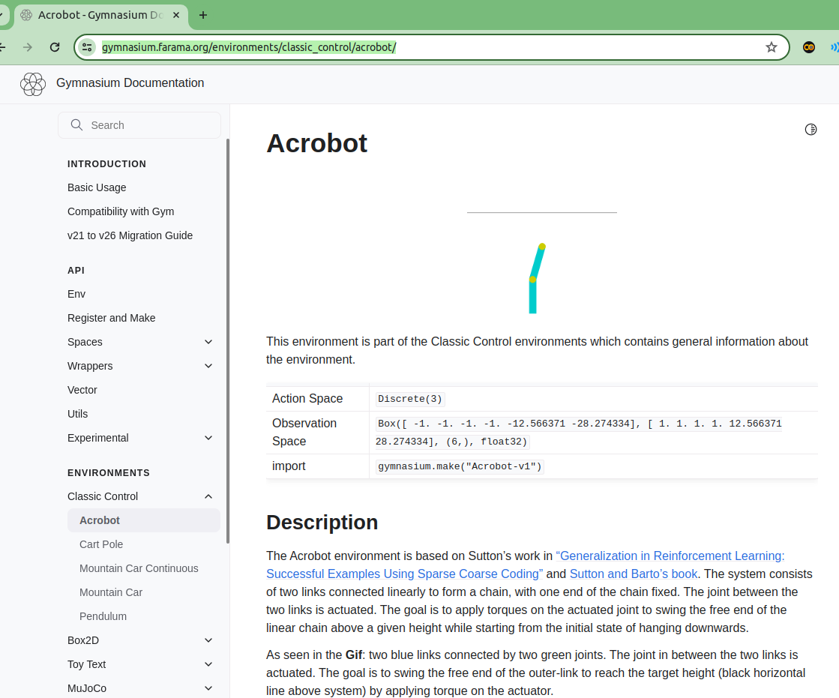
1.5 Acrotbot
https://www.youtube.com/watch?v=2AFl-iWGQzc&t=15s
Acrobot (01:51-02:00/6:09)
Look at the Acrobot in Gymnasium. The action space is what we concerned with.
https://gymnasium.farama.org/environments/classic_control/acrobot/

Slide 19
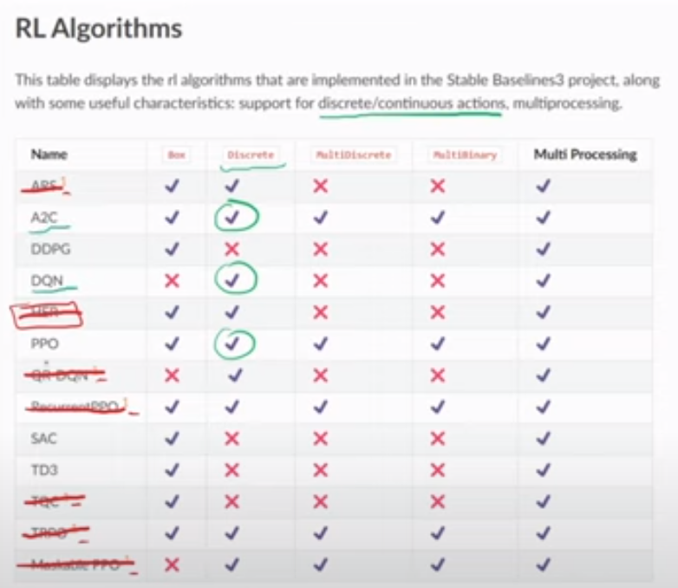
1.5 Acrotbot
https://www.youtube.com/watch?v=2AFl-iWGQzc&t=15s
Acrobot (02:01-02:30/6:09)
HER (Hindsight Experience Replay) is not actually the learning algorithm. HER is used to combine with other algorithm. We take it out here.
We have three discrete action space to choose: A2C, DQN, and PPO.
https://gymnasium.farama.org/environments/classic_control/acrobot/

Slide 20
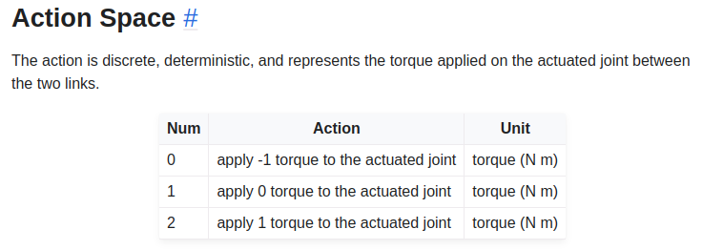
1.5 Acrotbot
https://www.youtube.com/watch?v=2AFl-iWGQzc&t=15s
Acrobot (02:31-02:50/6:09)
Action Space:
0: torque = -1 (apply left) to joint
1: torque = 0 (do nothing) to joint
2: torque = 1 (apply right) to joint
https://gymnasium.farama.org/environments/classic_control/acrobot/

Slide 21
End

