Slide 1

1.6 RL Taxonomy
Peter H. Chen

Slide 2
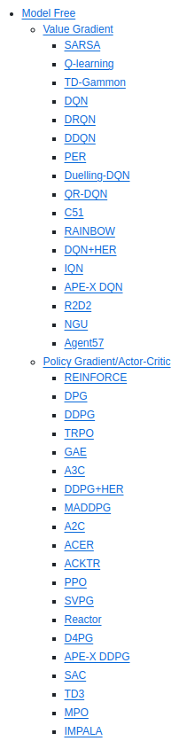
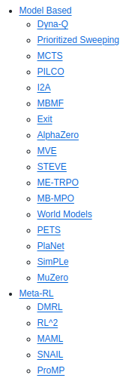
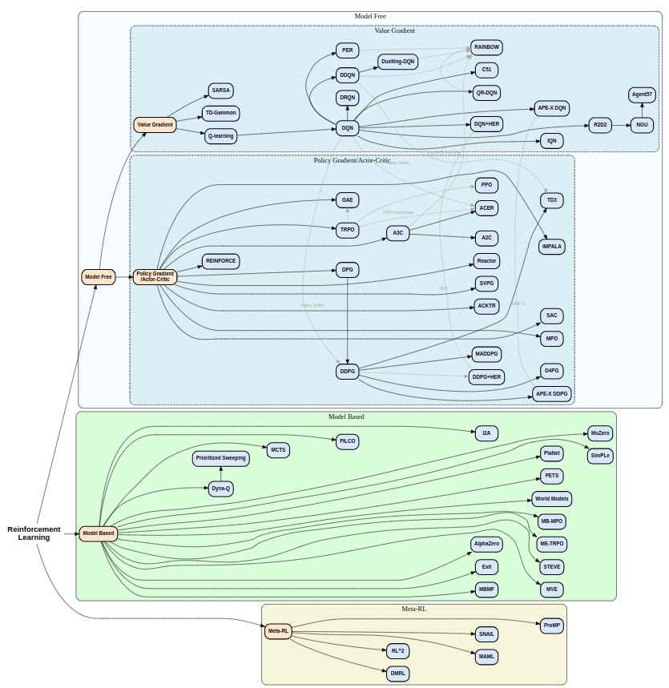
1.6 RL Taxonomy
https://www.youtube.com/watch?v=2AFl-iWGQzc&t=15s
RL Taxonomy (02:51-03:10/6:09)
We have RL taxonomy in the below link.
https://github.com/bennylp/RL-Taxonomy?tab=readme-ov-file#ReinforcementLearning

Slide 3
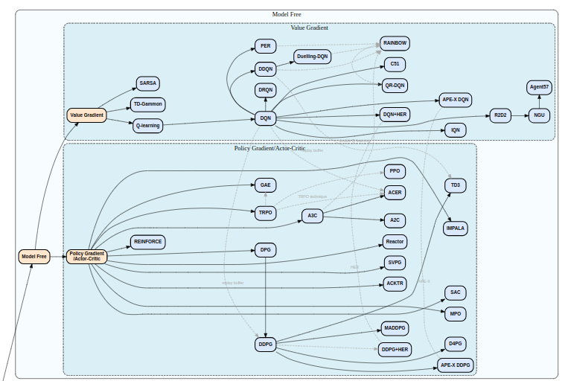
1.6 RL Taxonomy
https://www.youtube.com/watch?v=2AFl-iWGQzc&t=15s
RL Taxonomy (02:11-03:30/6:09)
Here, we only look at the Model free Reinforcement Learning.
https://github.com/bennylp/RL-Taxonomy?tab=readme-ov-file#ReinforcementLearning

Slide 4
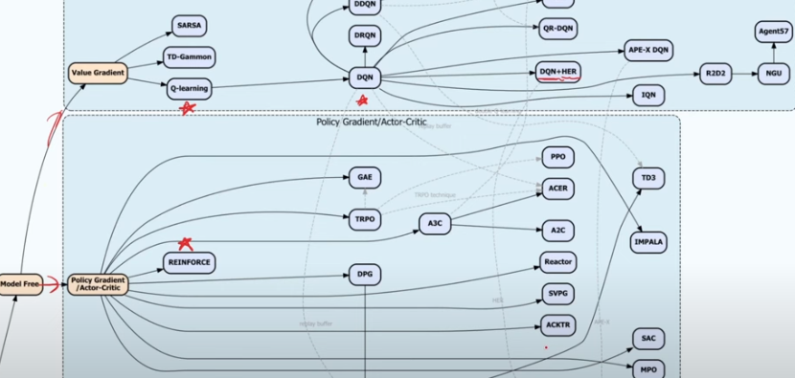
1.6 RL Taxonomy
https://www.youtube.com/watch?v=2AFl-iWGQzc&t=15s
RL Taxonomy (03:31-03:40/6:09)
We only look at Q-Learning/DQN (Value Gradient), REINFORCE (Policy Gradient/Actor-Critic).
Below, we can see DQN+HER
https://github.com/bennylp/RL-Taxonomy?tab=readme-ov-file#ReinforcementLearning

Slide 5
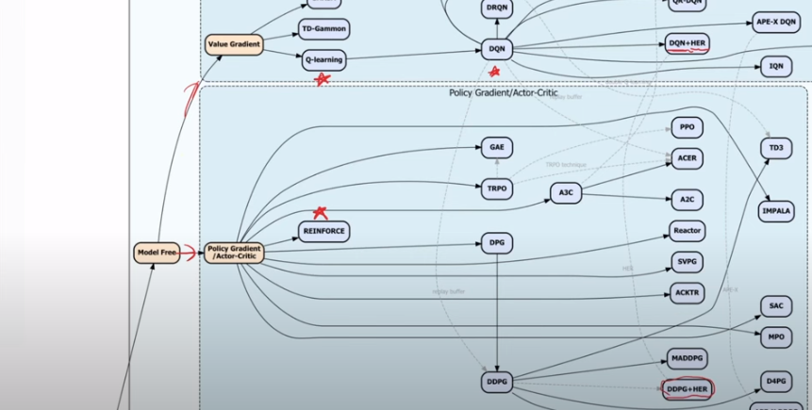
1.6 RL Taxonomy
https://www.youtube.com/watch?v=2AFl-iWGQzc&t=15s
RL Taxonomy (03:41-03:50/6:09)
Below, we also see DDPG+HER.
https://github.com/bennylp/RL-Taxonomy?tab=readme-ov-file#ReinforcementLearning

Slide 6
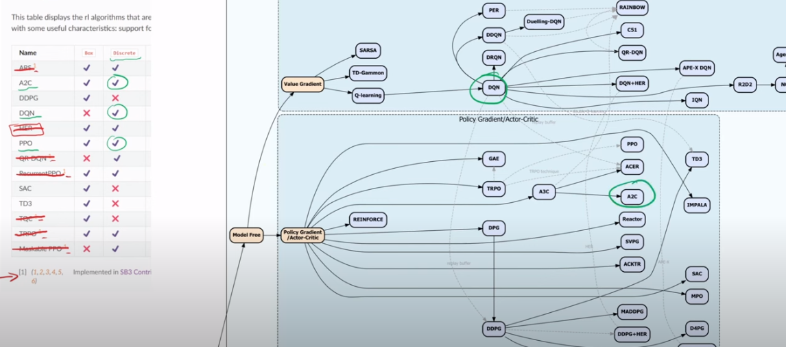
1.6 RL Taxonomy
https://www.youtube.com/watch?v=2AFl-iWGQzc&t=15s
RL Taxonomy (03:51-04:10/6:09)
We compare side by side.
https://github.com/bennylp/RL-Taxonomy?tab=readme-ov-file#ReinforcementLearning

Slide 7
1.7 RL Algorithm Timeline

Slide 8
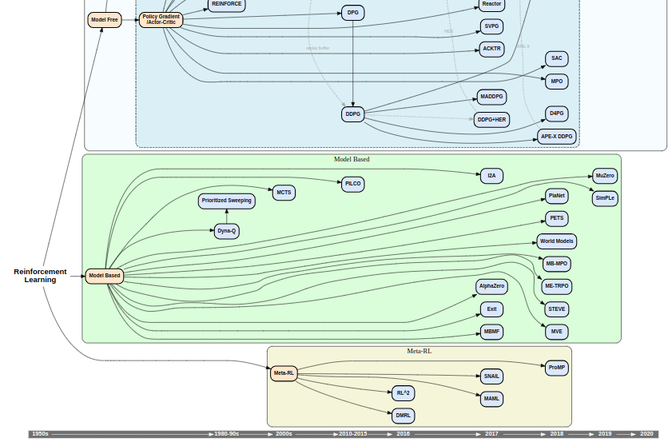
1.7 RL Algorithm Timeline
https://www.youtube.com/watch?v=2AFl-iWGQzc&t=15s
RL Algorithm Timeline (04:11-04:20/6:09)
We can see the time line of the developed algorithm.
https://github.com/bennylp/RL-Taxonomy?tab=readme-ov-file#ReinforcementLearning

Slide 9
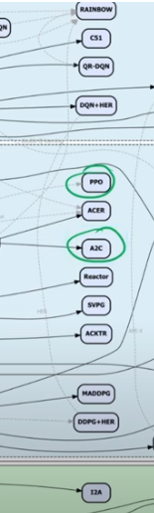
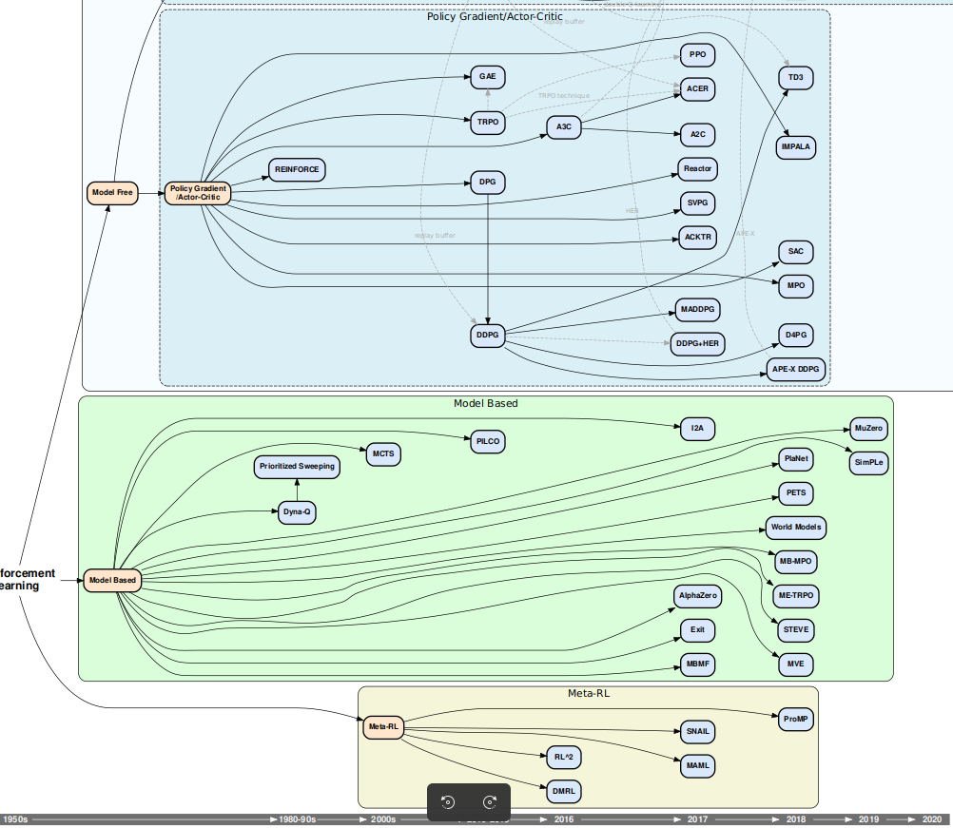
1.7 RL Algorithm Timeline
https://www.youtube.com/watch?v=2AFl-iWGQzc&t=15s
RL Algorithm Timeline (04:11-04:40/6:09)
We can see 2017, PPO and A2C are very recent and are good algorithms. This diagram will give us the idea but not the detailed of algorithm.
https://github.com/bennylp/RL-Taxonomy?tab=readme-ov-file#ReinforcementLearning

Slide 10
1.8 Pendulum

Slide 11
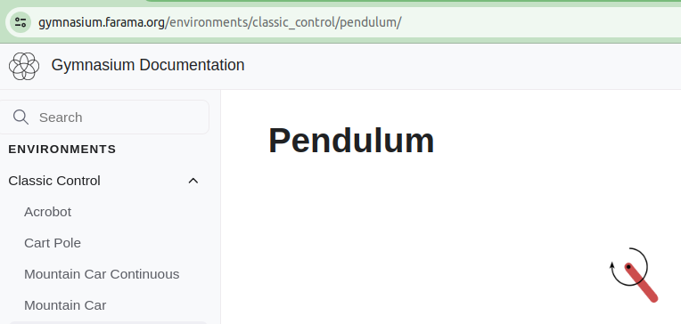
1.8 Pendulum
https://www.youtube.com/watch?v=2AFl-iWGQzc&t=15s
Pendulum (04:41-05:00/6:09)
Let’s look at the Pendulum.
The pendulum is similar to the acrobot.
https://gymnasium.farama.org/environments/classic_control/pendulum/

Slide 12
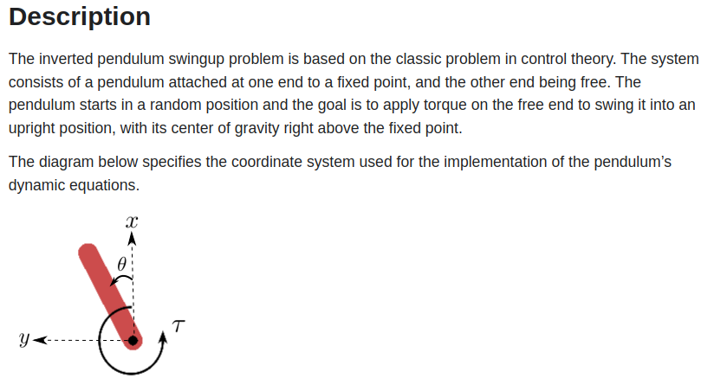
1.8 Pendulum
https://www.youtube.com/watch?v=2AFl-iWGQzc&t=15s
Pendulum (05:01-05:05/6:09)
We apply the torque at the end of pendulum and goal is have the end on the up right position.
https://gymnasium.farama.org/environments/classic_control/pendulum/

Slide 13
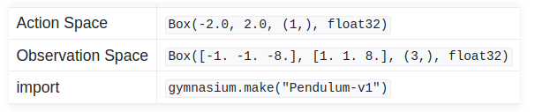
1.8 Pendulum
https://www.youtube.com/watch?v=2AFl-iWGQzc&t=15s
Pendulum (05:06-05:10/6:09)
The action space is between -1.0 to 1.0. We have the Box and choices of A2C, DDPG, PPO, SAC, and TD3.
https://gymnasium.farama.org/environments/classic_control/pendulum/

Slide 14
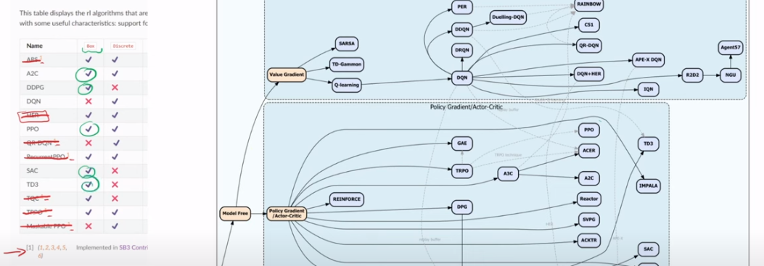
1.8 Pendulum
https://www.youtube.com/watch?v=2AFl-iWGQzc&t=15s
Pendulum (05:11-05:30/6:09)
We have the Box and choices of A2C, DDPG, PPO, SAC, and TD3.
https://gymnasium.farama.org/environments/classic_control/pendulum/

Slide 15
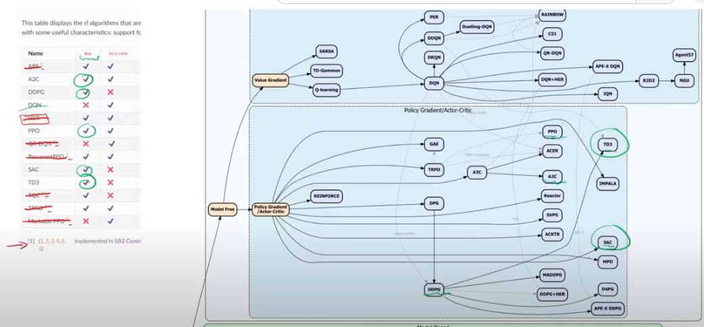
1.8 Pendulum
https://www.youtube.com/watch?v=2AFl-iWGQzc&t=15s
Pendulum (05:31-05:40/6:09)
In the right below diagram, we have 1) A2C, 2) DDPG, 3) PPO, 4) SAC, and 5) TD3.
https://gymnasium.farama.org/environments/classic_control/pendulum/
3
5
1
4
2

Slide 16
End

