Slide 1

3 Introduction to MAB
Peter H. Chen

Slide 2

3 Introduction to MAB
https://www.tensorflow.org/agents/tutorials/intro_bandit
Introduction to MAB
MAB (Multi-Armed Bandit) is a Machine Learning framework.
In MAB, an agent has to select actions (arms) in order to maximize its cumulative reward in the long term.
In each round, the agent receives some information about the current state (context), then it chooses an action based on this information and the experience gathered in previous rounds.
At the end of each round, the agent receives the reward associated with the chosen action.
Below, we have k Slot Machines (Multi-Slot One-Armed Bandits) and we need to figure out which one has the best payout, while not losing too much money.

Slide 3
3.1 MAB and RL

Slide 4
3.1 MAB and RL
https://www.tensorflow.org/agents/tutorials/intro_bandit
MAB and RL
Why is there a MAB Suite in the TF-Agents library?
What is the connection between RL and MAB?
Multi-Armed Bandits can be thought of as a special case of Reinforcement Learning.
In RL:
1. At each time step, the agent takes an action on the environment based on its policy
  π (at | st),
2. where st is the current observation from the environment, and receives a reward rt+1 and the next observation st+1 from the environment.
3. The goal is to improve the policy so as to maximize the sum of rewards (return).
4. In the general RL case, the next state (or observation) st+1 depends on the previous state st and the action at taken by the policy.
This last part (4) of above is different between MAB and RL:
in MAB, the next state, which is the observation, does not depend on the action chosen by the agent.

Slide 5
3.1 MAB and RL
https://www.tensorflow.org/agents/tutorials/intro_bandit
MAB and RL
TF-Agents Summary
  An environment outputs observations, and responds to actions with rewards.
  A policy outputs an action based on an observation, and
  An agent repeatedly updates the policy based on previous observation-action-reward tuples.

Slide 6
3.2 Mushroom Environment

Slide 7
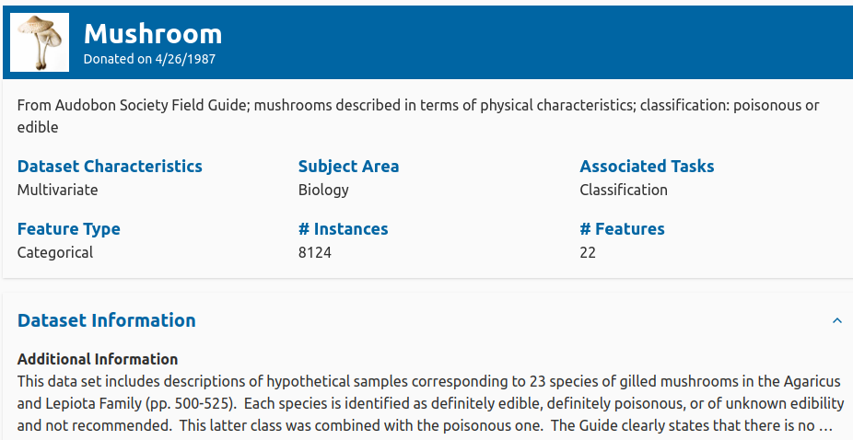
3.2 Mushroom Environment
https://www.tensorflow.org/agents/tutorials/intro_bandit
Mushroom Environment
The mushroom environment contains the mushroom dataset (Schlimmer, 1981).
The mushroom dataset consists of labeled of edible and poisonous mushrooms.
Features include shapes, colors, sizes of different parts of the mushroom, as well as odor and many more.
The mushroom dataset, just like all supervised learning datasets, can be turned into a contextual MAB problem.
Mushroom Dataset:
https://archive.ics.uci.edu/dataset/73/mushroom

Slide 8
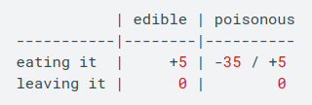

3.2 Mushroom Environment
https://www.tensorflow.org/agents/tutorials/intro_bandit
Mushroom Environment
We use the method also used by Riquelme et al. (2018).
In this conversion, the agent receives the features of a mushroom, decides to eat it or not.
Eating an edible mushroom results in a reward of +5, while eating a poisonous mushroom will give either +5 or -35 with equal probability.
Not eating the mushroom results in 0 reward, independently of the type of the mushroom.
The following table summarizes the reward assignments:
https://arxiv.org/pdf/1802.09127

Slide 9
3.3 LinUCB Agent

Slide 10
3.3 LinUCB Agent
https://www.tensorflow.org/agents/tutorials/intro_bandit
LinUCB Agent
To perform well in a contextual bandit environment, we need a good estimate on the reward function of each action, given the observation.
One possibility is to estimate the reward function with linear functions, i.e., for every action i, we are trying to find the parameter θi ∈ R^{d}, for which the estimates
  rt,i ∼ ⟨vt, θi⟩
are as close to the reality as possible.
Here vt ∈ R^{d} is the context received at time step t.
Then, if the agent is very confident in its estimates, it can choose argmax1,...,K ⟨vt, θk⟩ to get the highest expected reward.

Slide 11
3.3 LinUCB Agent
https://www.tensorflow.org/agents/tutorials/intro_bandit
LinUCB Agent
As explained above, simply choosing the arm with the best estimated reward does not lead to a good strategy.
There are many different ways to mix exploitation and exploration in linear estimator agents, and one of the most famous is the Linear Upper Confidence Bound (LinUCB) algorithm (see e.g. Li et al. 2010).
LinUCB has two main building blocks (with some details omitted):
1. It maintains estimates for the parameters of every arm with Linear Least Squares:
  θ̂̂i ∼Xi⁺ ri,
where Xi and ri are the stacked contexts and rewards of rounds where arm i was chosen, and ()⁺ is the pseudo inverse.
2. It maintains confidence ellipsoids defined by the inverse covariance Xi⊤Xi for the above estimates.
https://arxiv.org/abs/1003.0146

Slide 12
3.3 LinUCB Agent
https://www.tensorflow.org/agents/tutorials/intro_bandit
LinUCB Agent
The main idea of LinUCB is that of "Optimism in the Face of Uncertainty".
The agent incorporates exploration via boosting the estimates by an amount that corresponds to the variance of those estimates.
That is where the confidence ellipsoids come into the picture: for every arm, the optimistic estimate is
  r̂i = maxθ ∈ Ei ⟨vt,θ⟩
where Ei is the ellipsoid (椭球体) around θ̂i.
The agent chooses best looking arm argmaxi r̂i.
The above description is just an intuitive but superficial summary of what LinUCB does.
An implementation can be found in our codebase here
https://github.com/tensorflow/agents/blob/master/tf_agents/bandits/agents/lin_ucb_agent.py

Slide 13
End

