Slide 1

6 Recommender MAB
Peter H. Chen

Slide 2
6 Recommender MAB
https://www.youtube.com/watch?v=g0yDlAbi6Pc&list=PLQY2H8rRoyvxWE6bWx8XiMvyZFgg_25Q_&index=6
Recommender MAB (00:00-00:30/9:06)
We discuss the Recommender system with TF Agents/Bandits Library.
We will use Bandit Library for movie recommendation.
We have two sequences of discussions
1. Reinforcement Learning: TF Agents/Ranking system with TF Agents/Bandits Library and
2. Recommendation system: Recommendation system with Tensorflow.
We will use both Reinforcement Learning and Recommendation system
https://www.tensorflow.org/agents/tutorials/ranking_tutorial

Slide 3
6.1 RL Recommender

Slide 4
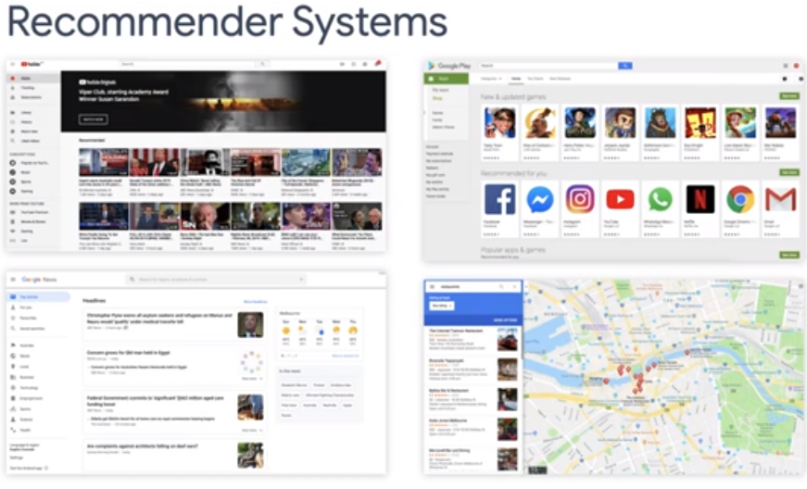
6.1 RL Recommender
https://www.youtube.com/watch?v=g0yDlAbi6Pc&list=PLQY2H8rRoyvxWE6bWx8XiMvyZFgg_25Q_&index=6
RL Recommender (00:31-00:50/9:06)
In case you are coming from the reinforcement learning path and not familiar wit recommender system.
Here, we do a quick review of recommendation system. Recommendation system are ubiquitous (existed everywhere,无处不在的), such as, Youtube, Google Play, Facebook, Amazon, Google Maps, and etc., all have a number of places for recommended items.
https://www.tensorflow.org/agents/tutorials/ranking_tutorial

Slide 5
6.2 MAB

Slide 6
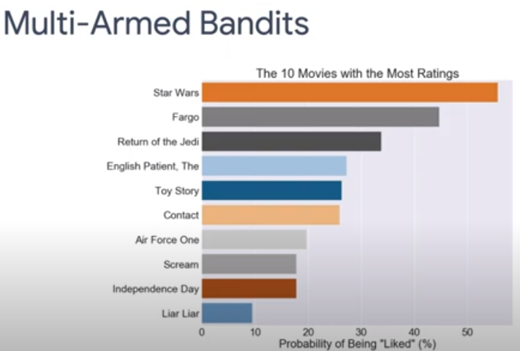
6.2 MAB
https://www.youtube.com/watch?v=g0yDlAbi6Pc&list=PLQY2H8rRoyvxWE6bWx8XiMvyZFgg_25Q_&index=6
MAB (00:51-01:00/9:06)
In this discussion, we formulate of MovieLens Recommendation system as a MAB (Multi-Armed Bandits) problem and solve it with Bandits Library.
https://github.com/tensorflow/agents/blob/master/tf_agents/bandits/agents/examples/v2/train_eval_movielens.py

Slide 7
6.3 Matrix Factorization

Slide 8
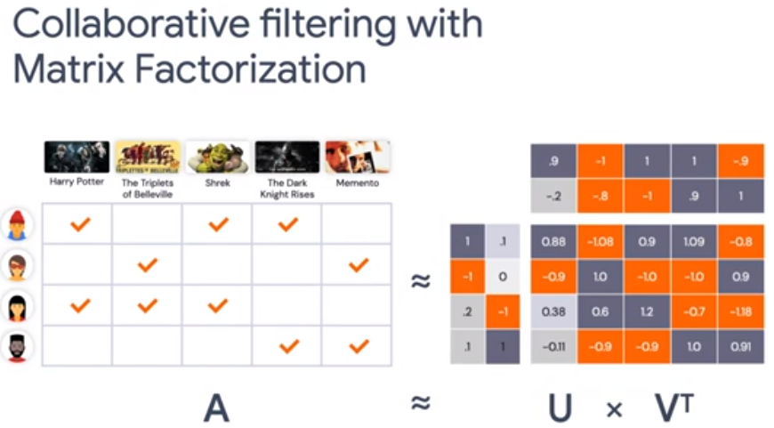
6.3 Matrix Factorization
https://www.youtube.com/watch?v=g0yDlAbi6Pc&list=PLQY2H8rRoyvxWE6bWx8XiMvyZFgg_25Q_&index=6
Matrix Factorization (01:01-01:20/9:06)
Matrix Factorization is a commonly used method for building a recommendation system.
The basic idea is we have a rating matrix that contains the rating for a set of movies from a group of users.
The rating matrix is very sparse.
https://github.com/tensorflow/agents/blob/master/tf_agents/bandits/environments/movielens_py_environment.py

Slide 9
6.3 Matrix Factorization
https://www.youtube.com/watch?v=g0yDlAbi6Pc&list=PLQY2H8rRoyvxWE6bWx8XiMvyZFgg_25Q_&index=6
Matrix Factorization (01:21-01:45/9:06)
So, we need to find a way to predict the ratings for the movies that are not rated by the users and
keeping the predicted scores as close to the ground truth rating as possible.
To do so, we want to learn the user embedding matrix U and a movie embedding matrix V transpose. This is why we called a Matrix Factorization.
https://github.com/tensorflow/agents/blob/master/tf_agents/bandits/environments/movielens_py_environment.py

Slide 10
6.4 Collaborative Filter w/ Bandits

Slide 11
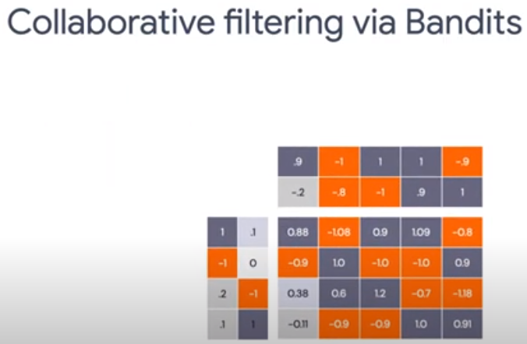
6.4 Collaborative Filter w/ Bandits
https://www.youtube.com/watch?v=g0yDlAbi6Pc&list=PLQY2H8rRoyvxWE6bWx8XiMvyZFgg_25Q_&index=6
Collaborative Filter w/ Bandit (01:46-01:55/9:06)
Now, we take the perspective of MAB (Multi-Armed Bandit).
https://github.com/tensorflow/agents/blob/master/tf_agents/bandits/environments/movielens_py_environment.py

Slide 12
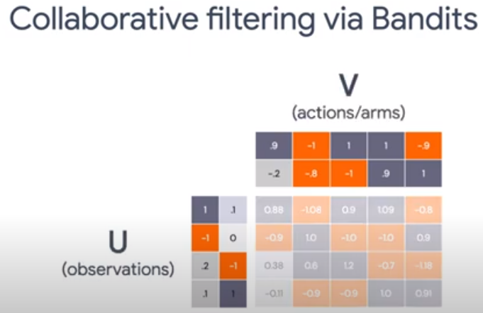
6.4 Collaborative Filter w/ Bandits
https://www.youtube.com/watch?v=g0yDlAbi6Pc&list=PLQY2H8rRoyvxWE6bWx8XiMvyZFgg_25Q_&index=6
Collaborative Filter w/ Bandit (01:56-02:00/9:06)
The rows of U are context features from the users. These are observations.
The columns are the movies recommended to the users. These are actions/arms. The users are the set of actions, represented as rows of V transpose.
https://github.com/tensorflow/agents/blob/master/tf_agents/bandits/environments/movielens_py_environment.py

Slide 13
6.4 Collaborative Filter w/ Bandits
https://www.youtube.com/watch?v=g0yDlAbi6Pc&list=PLQY2H8rRoyvxWE6bWx8XiMvyZFgg_25Q_&index=6
Collaborative Filter w/ Bandit (02:01-02:30/9:06)
The reward for recommending movie j to user i can be calculated as the inner product of the corresponding row of U(i) and V(j).
Therefore, we can use SVD decomposition to lower the matrix rank and compute the rewards.
The SVD gives us the reward approximation even for movies that are not recommended to the users.
https://github.com/tensorflow/agents/blob/master/tf_agents/bandits/environments/movielens_py_environment.py

Slide 14
6.5 Run Code

Slide 15
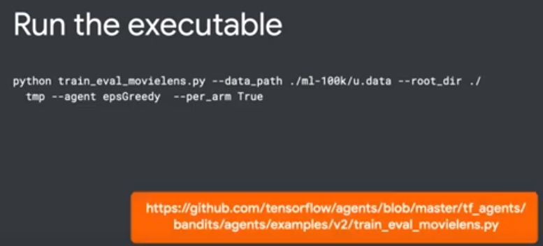
6.5 Run Code
https://www.youtube.com/watch?v=g0yDlAbi6Pc&list=PLQY2H8rRoyvxWE6bWx8XiMvyZFgg_25Q_&index=6
Run Code (02:31-02:50/9:06)
Below, we run the code
> python train_eval_movielens.py
https://github.com/tensorflow/agents/blob/master/tf_agents/bandits/agents/examples/v2/train_eval_movielens.py

Slide 16
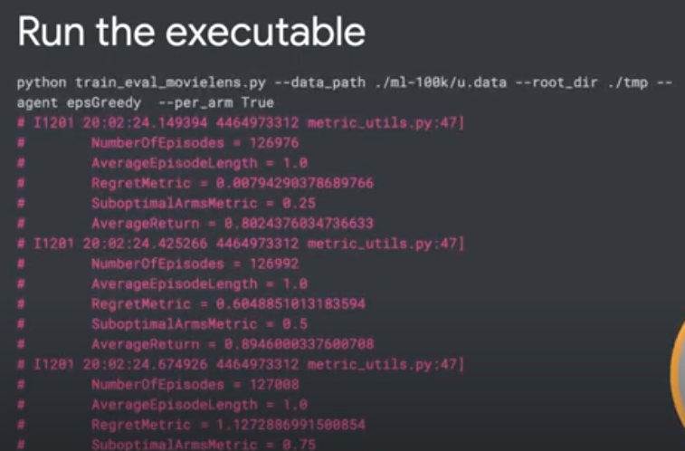
6.5 Run Code
https://www.youtube.com/watch?v=g0yDlAbi6Pc&list=PLQY2H8rRoyvxWE6bWx8XiMvyZFgg_25Q_&index=6
Run Code (02:51-03:10/9:06)
Below, the log will output the Regret Metric and Suboptimal Arms metric during the training.
In the last discussion, we already discussed the Regret Metric.
The Suboptimal Arms metric is how often the agent choose the non-optimal action during the training.
https://github.com/tensorflow/agents/blob/master/tf_agents/bandits/agents/examples/v2/train_eval_movielens.py

Slide 17
6.6 Result: No Per Arm Feature

Slide 18
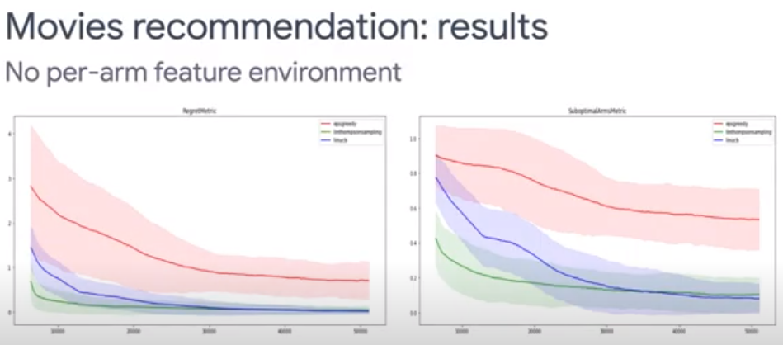
6.6 Result: No Per Arm Feature
https://www.youtube.com/watch?v=g0yDlAbi6Pc&list=PLQY2H8rRoyvxWE6bWx8XiMvyZFgg_25Q_&index=6
Result: No Per Arm Feature (03:11-03:15/9:06)
After training, we can visualize the results.
https://github.com/tensorflow/agents/blob/master/tf_agents/bandits/agents/examples/v2/train_eval_movielens.py

Slide 19
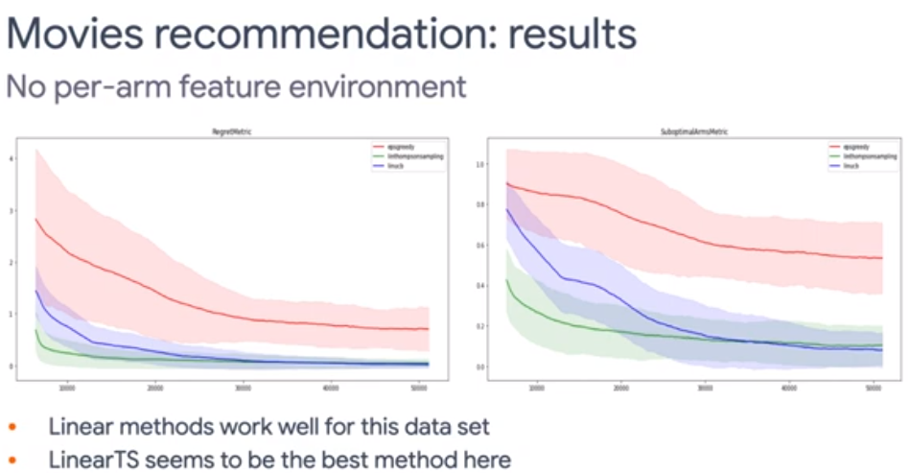
6.6 Result: No Per Arm Feature
https://www.youtube.com/watch?v=g0yDlAbi6Pc&list=PLQY2H8rRoyvxWE6bWx8XiMvyZFgg_25Q_&index=6
Result: No Per Arm Feature (03:16-03:20/9:06)
The results here is “no per-arm feature” setting.
We can see that both the Regret and Suboptimal Arm metrics are dropping quickly in the training progresses.
https://github.com/tensorflow/agents/blob/master/tf_agents/bandits/agents/examples/v2/train_eval_movielens.py

Slide 20
6.6 Result: No Per Arm Feature
https://www.youtube.com/watch?v=g0yDlAbi6Pc&list=PLQY2H8rRoyvxWE6bWx8XiMvyZFgg_25Q_&index=6
Result: No Per Arm Feature (03:21-03:30/9:06)
We can Epsilon Greedy (Red) is not doing well in this problem.
We also see the Linear UCB (Purple) and Linear Thompson (Green) sampling are very similar algorithm and have very similar performance.
https://github.com/tensorflow/agents/blob/master/tf_agents/bandits/agents/examples/v2/train_eval_movielens.py

Slide 21
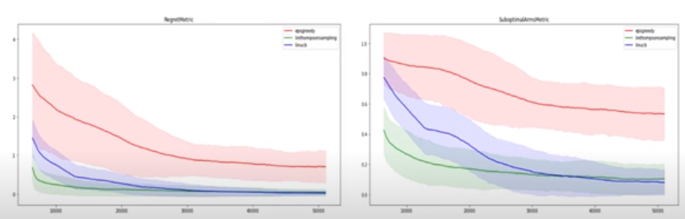
6.6 Result: No Per Arm Feature
https://www.youtube.com/watch?v=g0yDlAbi6Pc&list=PLQY2H8rRoyvxWE6bWx8XiMvyZFgg_25Q_&index=6
Result: No Per Arm Feature (03:31-04:40/9:06)
After 50,000 iterations, the Epsilon-Greedy is not doing well on this problem.
It is far away of Linear UCB and Linear Thompson Sampling methods.
The linear algorithms do better than non-linear Epsilon-Greedy algorithm in movie recommendation system.
https://github.com/tensorflow/agents/blob/master/tf_agents/bandits/agents/examples/v2/train_eval_movielens.py

Slide 22
6.7 Result: Per Arm Feature

Slide 23
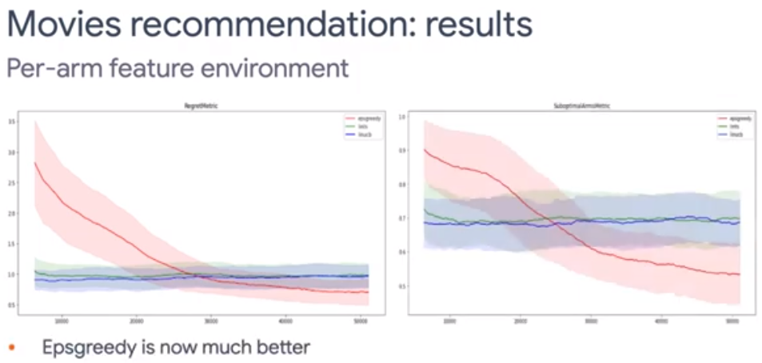
6.7 Result: Per Arm Feature
https://www.youtube.com/watch?v=g0yDlAbi6Pc&list=PLQY2H8rRoyvxWE6bWx8XiMvyZFgg_25Q_&index=6
Result: Per Arm Feature (04:41-05:45/9:06)
Epsilon-Greedy of Neural Network is much better in much better.
https://github.com/tensorflow/agents/blob/master/tf_agents/bandits/agents/examples/v2/train_eval_movielens.py

Slide 24
6.8 Case Study

Slide 25
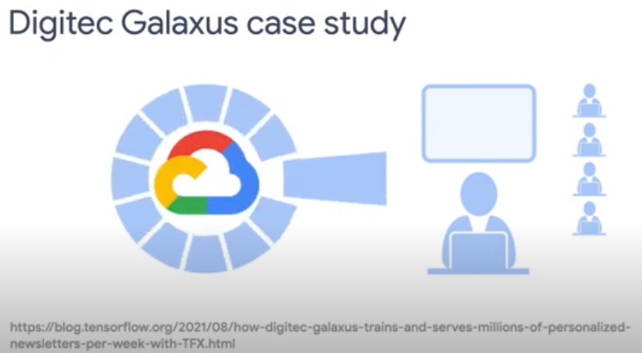
6.8 Case Study
https://www.youtube.com/watch?v=g0yDlAbi6Pc&list=PLQY2H8rRoyvxWE6bWx8XiMvyZFgg_25Q_&index=6
Case Study (05:48-06:00/9:06)
https://github.com/tensorflow/agents/blob/master/tf_agents/bandits/agents/examples/v2/train_eval_movielens.py

Slide 26
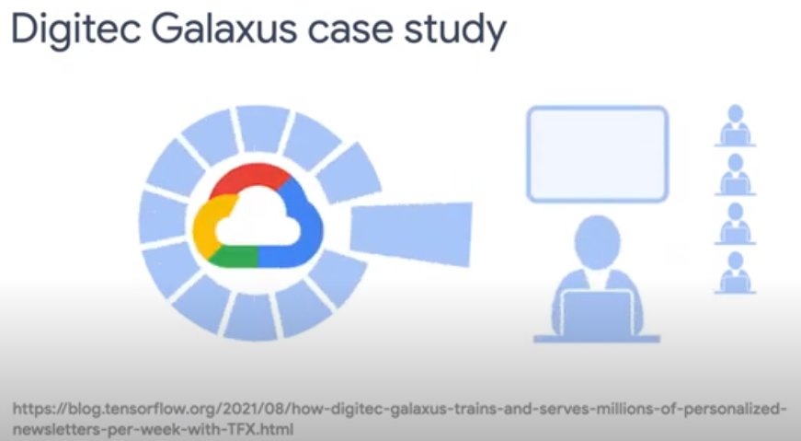
6.8 Case Study
https://www.youtube.com/watch?v=g0yDlAbi6Pc&list=PLQY2H8rRoyvxWE6bWx8XiMvyZFgg_25Q_&index=6
Case Study (06:01-06:10/9:06)
https://github.com/tensorflow/agents/blob/master/tf_agents/bandits/agents/examples/v2/train_eval_movielens.py

Slide 27
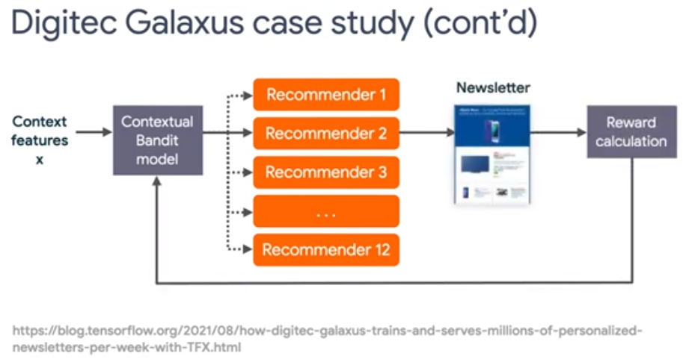
6.8 Case Study
https://www.youtube.com/watch?v=g0yDlAbi6Pc&list=PLQY2H8rRoyvxWE6bWx8XiMvyZFgg_25Q_&index=6
Case Study (06:11-07:40/9:06)
News letter.
https://github.com/tensorflow/agents/blob/master/tf_agents/bandits/agents/examples/v2/train_eval_movielens.py

Slide 28
6.9 References

Slide 29
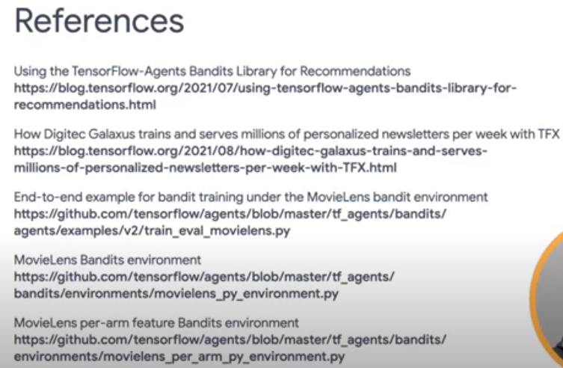

6.9 References
https://www.youtube.com/watch?v=g0yDlAbi6Pc&list=PLQY2H8rRoyvxWE6bWx8XiMvyZFgg_25Q_&index=6
References (07:41-09:06/9:06)
https://blog.tensorflow.org/2021/07/using-tensorflow-agents-bandits-library-for-recommendations.html

Slide 30
End

