Slide 1

3.3 CNN
Peter H. Chen

Slide 2
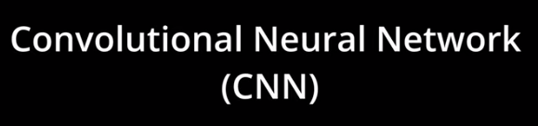
3.3 CNN
https://www.youtube.com/watch?v=qKePPepISiA&list=PL58zEckBH8fCt_lYkmayZoR9XfDCW9hte&index=3
CNN (04:01-04:05/12:05)
Let’s see how CNN (Convolutional Neural Network) fits into this.

Slide 3
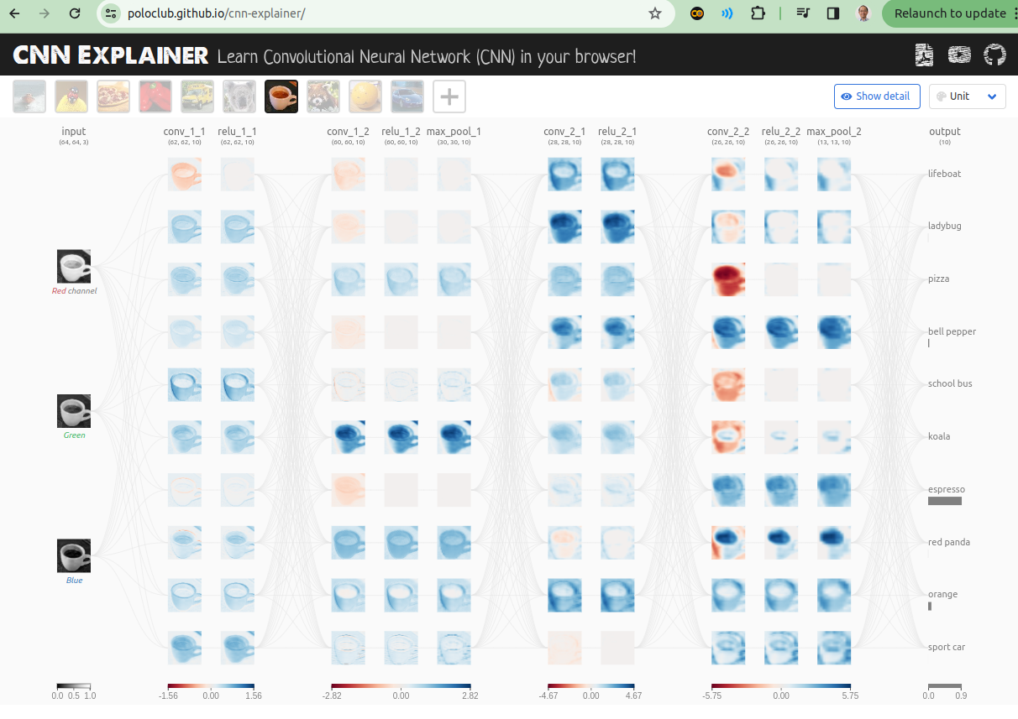
3.3 CNN
https://www.youtube.com/watch?v=qKePPepISiA&list=PL58zEckBH8fCt_lYkmayZoR9XfDCW9hte&index=3
CNN (04:11-04:20/12:05)
CNN is used for image classification for deep learning.
Google Search “CNN Explainer: Learn Convolutional Neural Network (CNN) in your browser!”.
Below is a good web site for CNN explanation.
https://poloclub.github.io/cnn-explainer/

Slide 4
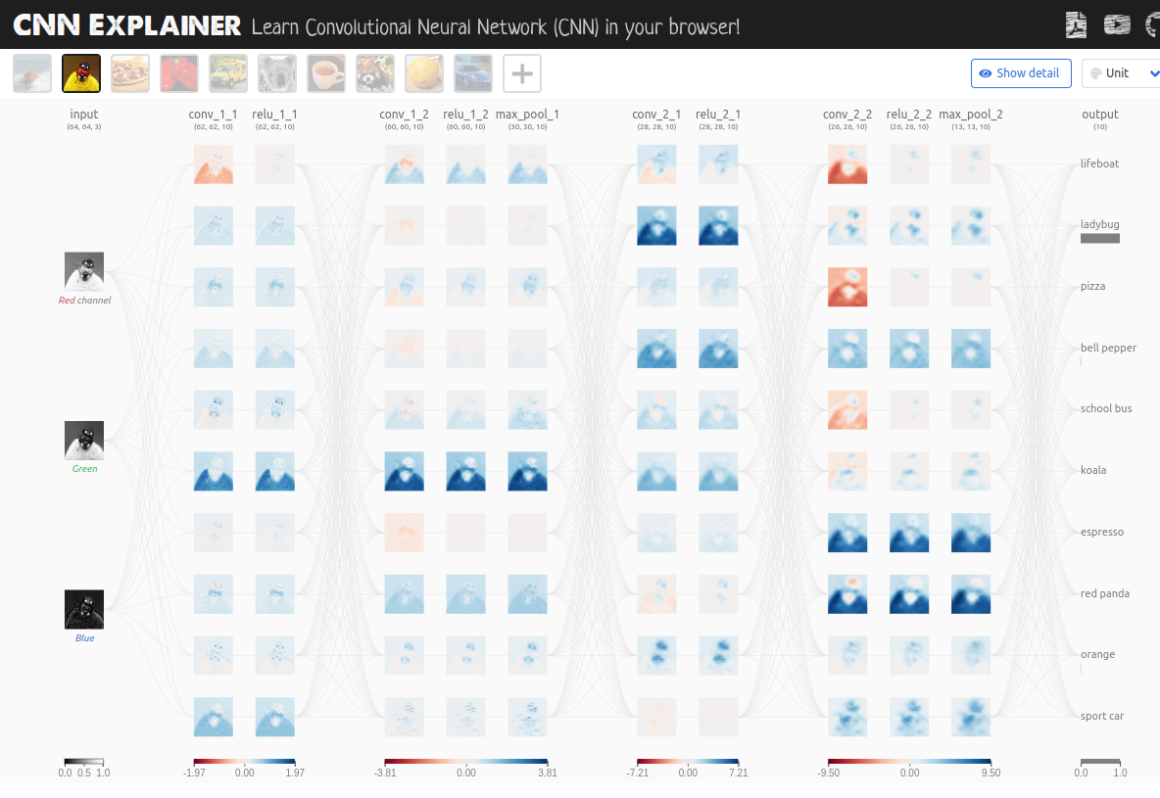
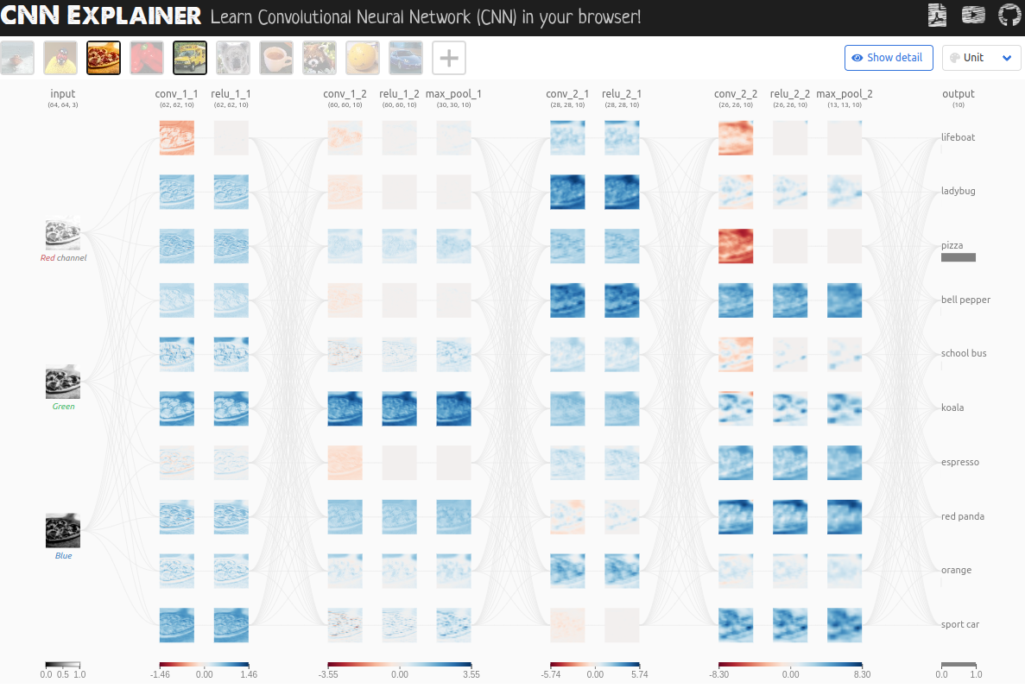
3.3 CNN
https://www.youtube.com/watch?v=qKePPepISiA&list=PL58zEckBH8fCt_lYkmayZoR9XfDCW9hte&index=3
CNN (04:21-04:30/12:05)
Here, We can click different images and get different predictions.
1. We click “lady bug” image, then NN (neural network) predict “ladybug”.
2. We click “pizza” image, then NN predict “pizza”.
Go through the web site and get the high level view of CNN for frozen lake environment.
https://poloclub.github.io/cnn-explainer/
1
2

Slide 5
3.3 CNN
https://www.youtube.com/watch?v=qKePPepISiA&list=PL58zEckBH8fCt_lYkmayZoR9XfDCW9hte&index=3
CNN (04:31-04:40/12:05)
When we click a cup of coffee image, the “coffee” image break into three RGB (Red, Green, Blue) channels.
1. We can see the original image is 64 x 64 pixels. As the image goes through the neural network, the image size become smaller. Here, we can see the image become
2. conv_1_1 and relu_1_1 are 62 x 62,
3. conv_1_2 and relu_1_2 are 60 x 60,
4. max_pool_1 is 30 x 30,
5. conv_2_1 and relu_2_1 are 28 x 28
6. conv_2_2 and relu_2_2 are 26 x 26
7. finally, the max_pool_2 is 13 x 13 before image goes to the output (predict 10 classes)
https://poloclub.github.io/cnn-explainer/
1
2
3
4
5
6
7
8

Slide 6
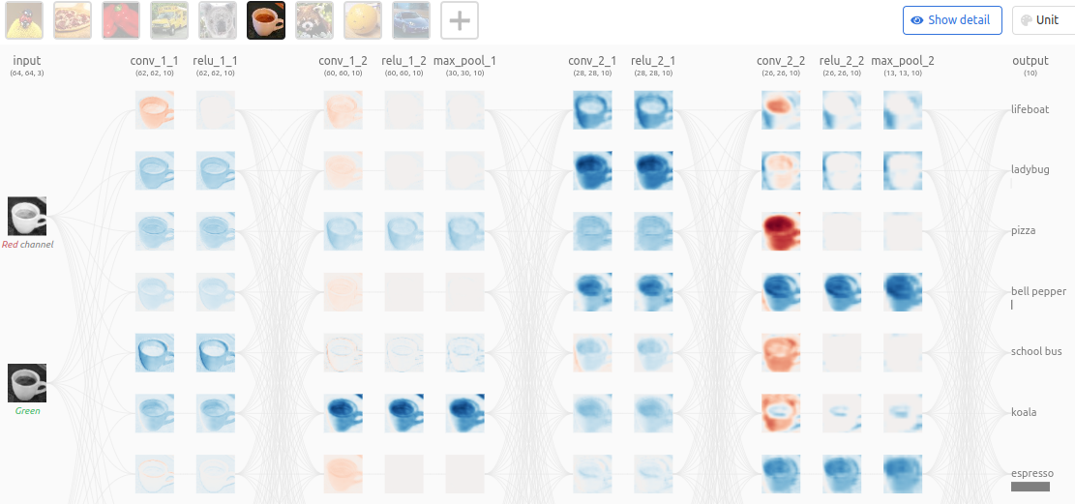
3.3 CNN
https://www.youtube.com/watch?v=qKePPepISiA&list=PL58zEckBH8fCt_lYkmayZoR9XfDCW9hte&index=3
CNN (04:41-05:00/12:05)
CNN has significantly reduce the image size from 64 x 64 into 13 x 13.
Although the image sizes are reduced, the features of the image is not lost.
Finally, the the extracted feature goes into the output layer and predict the output.
https://poloclub.github.io/cnn-explainer/

Slide 7
3.3 CNN
https://www.youtube.com/watch?v=qKePPepISiA&list=PL58zEckBH8fCt_lYkmayZoR9XfDCW9hte&index=3
CNN (05:01-05:20/12:05)
This is the classification problem.
The input is “a cup of coffee” image, the prediction /classification is “espresso” which is correct.
In our case, the output would be the possible actions and the Q-values estimated for those actions.
https://poloclub.github.io/cnn-explainer/

Slide 8
3.4 Add CNN to DQN

Slide 9

3.4 Add CNN to DQN
https://www.youtube.com/watch?v=qKePPepISiA&list=PL58zEckBH8fCt_lYkmayZoR9XfDCW9hte&index=3
Add CNN to DQN (05:21-05:22/12:05)
Now, we add CNN (Convolutional Neural Network) to DQN (Deep Q-Neural Network)

Slide 10
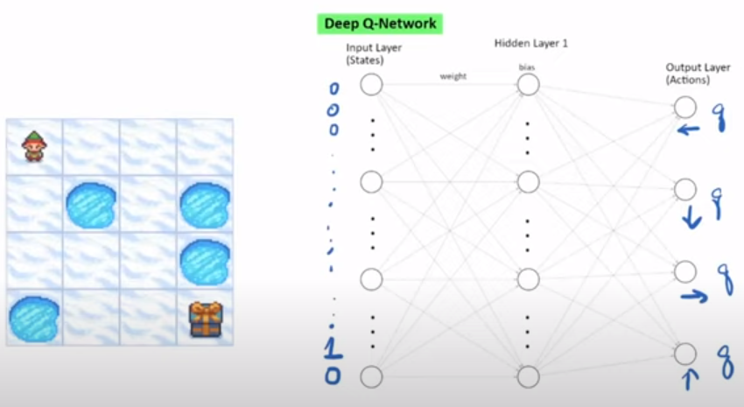
3.4 Add CNN to DQN
https://www.youtube.com/watch?v=qKePPepISiA&list=PL58zEckBH8fCt_lYkmayZoR9XfDCW9hte&index=3
Add CNN to DQN (05:23-05:30/12:05)
Let’s see what do we need to change in our current network.

Slide 11
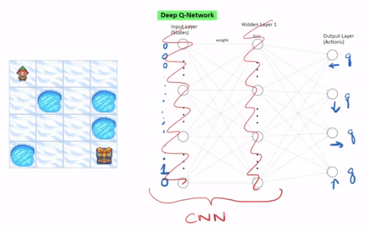
3.4 Add CNN to DQN
https://www.youtube.com/watch?v=qKePPepISiA&list=PL58zEckBH8fCt_lYkmayZoR9XfDCW9hte&index=3
Add CNN to DQN (05:23-05:30/12:05)
Obviously, the input layer is no longer need and hidden layer is disappear.
We will replace this portion with the CNN (Convolutional Neural Network).

Slide 12
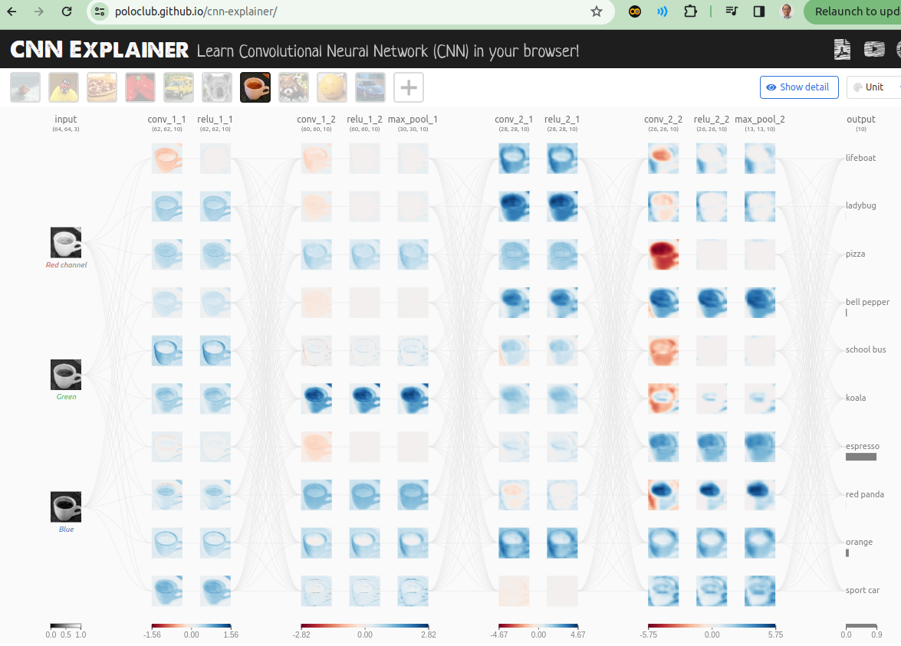
3.4 Add CNN to DQN
https://www.youtube.com/watch?v=qKePPepISiA&list=PL58zEckBH8fCt_lYkmayZoR9XfDCW9hte&index=3
Add CNN to DQN (05:23-05:45/12:05)
Obviously, the input layer is no longer need and hidden layer is disappear.
We will replace this portion with the CNN (Convolutional Neural Network).
What we will do is to take this CNN and insert into our DQN (Deep Q-Network).

Slide 13
3.4 Add CNN to DQN
https://www.youtube.com/watch?v=qKePPepISiA&list=PL58zEckBH8fCt_lYkmayZoR9XfDCW9hte&index=3
Add CNN to DQN (05:46-05:50/12:05)
How about the inputs? Normally, we would pass this image into the network as the pixel level.

Slide 14
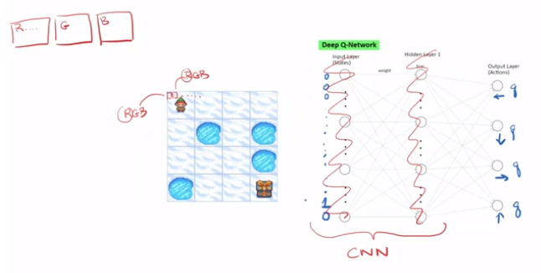
3.4 Add CNN to DQN
https://www.youtube.com/watch?v=qKePPepISiA&list=PL58zEckBH8fCt_lYkmayZoR9XfDCW9hte&index=3
Add CNN to DQN (05:51-06:25/12:05)
So, we have first pixel, second pixel, and so on. We send the pixels into DQN (Deep Q-Network). Before we send, we need to break out all the channels.
Red goes into its own matrix and same thing for the green and then blue.
So, we will pass the separate matrices into the network.

Slide 15
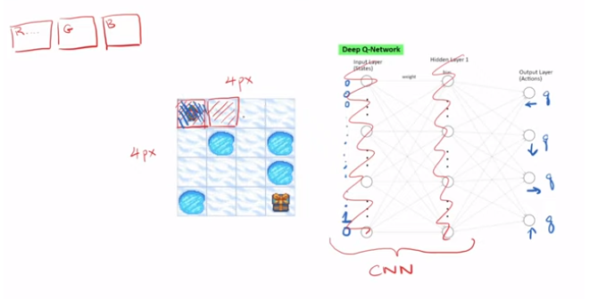
3.4 Add CNN to DQN
https://www.youtube.com/watch?v=qKePPepISiA&list=PL58zEckBH8fCt_lYkmayZoR9XfDCW9hte&index=3
Add CNN to DQN (06:26-06:50/12:05)
Unfortunately, this environment does not return us the pixel level information.
We send the pixels into the network, a 4 pixels x 4 pixels image.
We only pass the color pixel to spot for the agent.
Other cells will default to white or something like that.

Slide 16
End

