Slide 1

1 TF Agent Overview
Peter H. Chen

Slide 2
1 TF Agent Overview
https://www.tensorflow.org/agents/overview
TF Agent Overview
Agents makes designing, implementing and testing new RL algorithms easier, by providing well tested modular components that can be modified and extended.
It enables fast code iteration, with good test integration and benchmarking.

Slide 3
1.1 Installation

Slide 4
1.1 Installation
https://www.tensorflow.org/agents/overview
Installation
TF-Agents publishes nightly and stable builds.
For a list of releases read the Releases section.
The commands below cover installing TF-Agents stable and nightly from pypi.org as well as from a GitHub clone.
Note:
For Reverb (replay buffer), TF-Agents will only work with Linux.

Slide 5
1.2 Stable Release

Slide 6
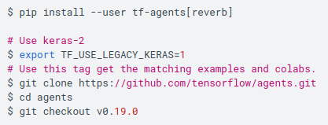
1.2 Stable Release
https://www.tensorflow.org/agents/overview
Stable Release
Run the commands below to install the most recent stable release.

Slide 7
End

