Slide 1

9 QL: Value Change
Peter H. Chen

Slide 2
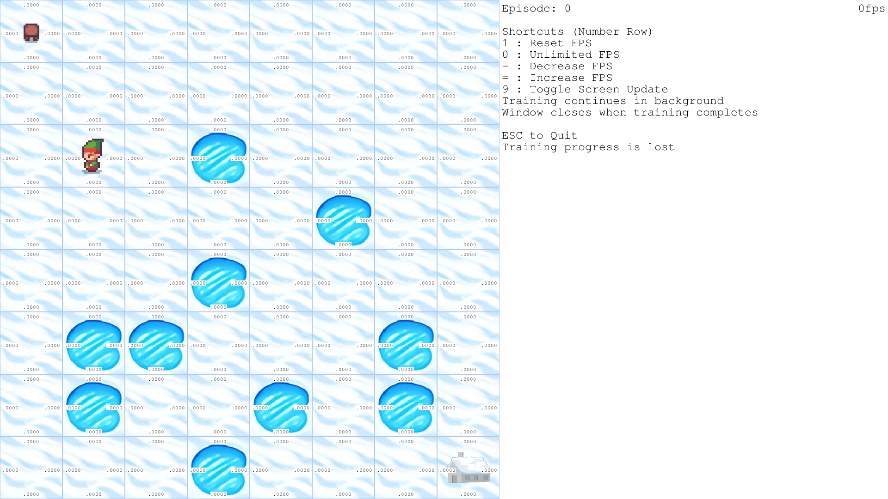
9 QL: Value Change
https://www.youtube.com/watch?v=1W_LOB-0IEY&list=PL58zEckBH8fCt_lYkmayZoR9XfDCW9hte&index=9
QL: Value Change (00:00-00:02/4:52)
We discuss the Q-Learning Value Change using Frozen Lake example. We make display bigger. We display the Q-Value on top of each cell
Now, we can see Q-Learning in real-time

Slide 3
9 QL: Value Change
https://www.youtube.com/watch?v=1W_LOB-0IEY&list=PL58zEckBH8fCt_lYkmayZoR9XfDCW9hte&index=9
QL: Value Change (00:03-00:04/4:52)
1. Create/Activate gym environment
> conda create --name gym
> conda activate gym

Slide 4
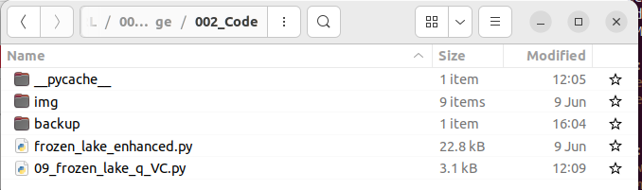
9 QL: Value Change
https://www.youtube.com/watch?v=1W_LOB-0IEY&list=PL58zEckBH8fCt_lYkmayZoR9XfDCW9hte&index=9
QL: Value Change (00:05-00:06/4:52)
To run it, we need the
1. img folder: GUI display
2. frozen_lake_enhanced.py: Utility function
3. 09_frozen_lake_q_VC.py: Main Program
1
2
3

Slide 5
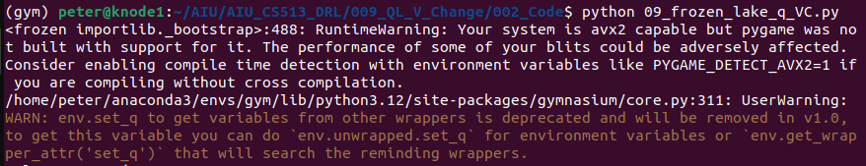
9 QL: Value Change
https://www.youtube.com/watch?v=1W_LOB-0IEY&list=PL58zEckBH8fCt_lYkmayZoR9XfDCW9hte&index=9
QL: Value Change (00:07-00:10/4:52)
Run value change of frozen lake Q-Learning.
> python 09_frozen_lake_q_VC.py

Slide 6
9.1 Compare Codes

Slide 7
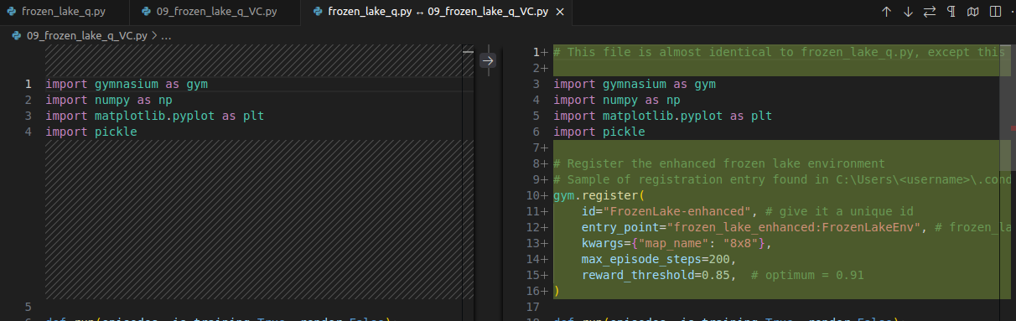
9.1 Compare Code
https://www.youtube.com/watch?v=1W_LOB-0IEY&list=PL58zEckBH8fCt_lYkmayZoR9XfDCW9hte&index=9
Compare Code (00:11-00:30/4:52)
We use VS code to compare the codes of Value Change vs original frozen lake.
> code .
frozen_lake_q.py
> Select to compare
09_frozen_lake_q_VC.py
> Compare with selected

Slide 8
9.2 Register

Slide 9
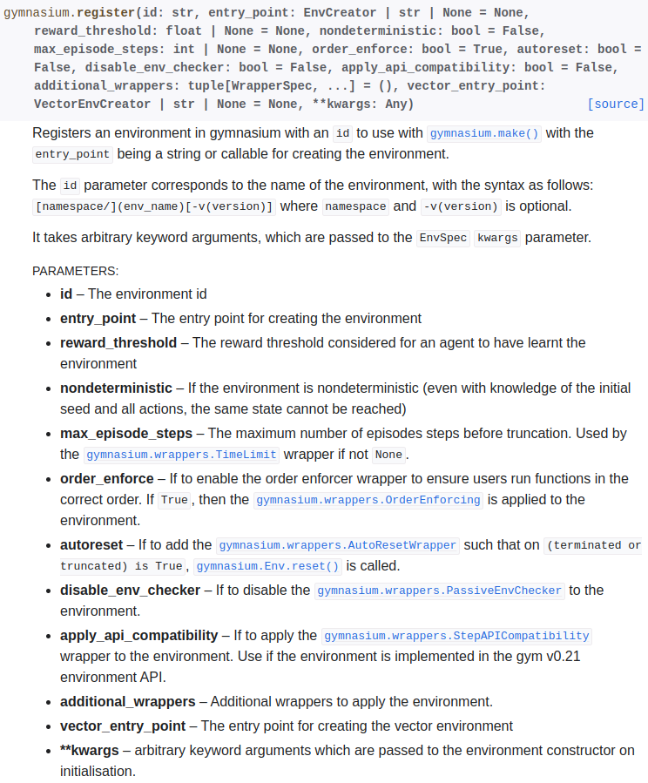
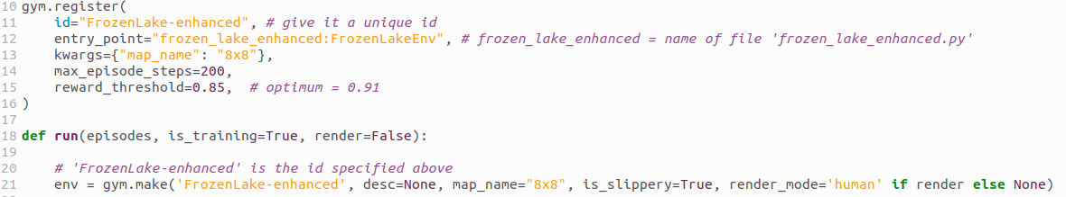
9.2 Register
https://www.youtube.com/watch?v=1W_LOB-0IEY&list=PL58zEckBH8fCt_lYkmayZoR9XfDCW9hte&index=9
Register (00:31-00:35/4:52)
Register the customized environment
1. id: any unique string name
2. entry_point: utility file name.
3.kwargs: string passed to environment
4. max_episode_steps = 200
5. reward_threshold= 0.85
https://gymnasium.farama.org/api/registry/

Slide 10
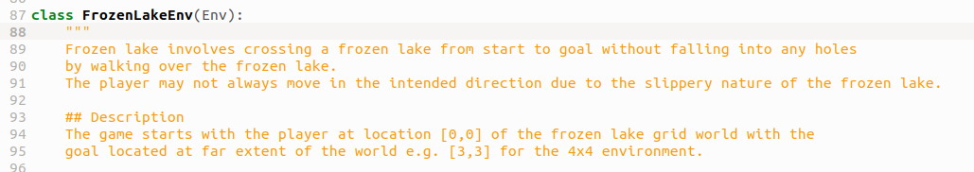
9.2 Register
https://www.youtube.com/watch?v=1W_LOB-0IEY&list=PL58zEckBH8fCt_lYkmayZoR9XfDCW9hte&index=9
Register (00:36-00:40/4:52)
entry_point: “utility file name”:”class name”

Slide 11
9.3 Make Environment

Slide 12
9.3 Make Environment
https://www.youtube.com/watch?v=1W_LOB-0IEY&list=PL58zEckBH8fCt_lYkmayZoR9XfDCW9hte&index=9
Make Environment (00:41-00:50/4:52)
Make environment with ID string defined in register.
https://gymnasium.farama.org/api/registry/

Slide 13
9.4 Run

Slide 14
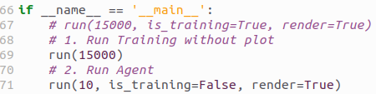
9.4 Run
https://www.youtube.com/watch?v=1W_LOB-0IEY&list=PL58zEckBH8fCt_lYkmayZoR9XfDCW9hte&index=9
Run (00:51-01:00/4:52)
1. Train for 15000 episodes
> run (15000, is_training=True, render=true)
2. run agent 10 episodes
> run (10, is_training=False, render=true)

Slide 15
9.4 Run
https://www.youtube.com/watch?v=1W_LOB-0IEY&list=PL58zEckBH8fCt_lYkmayZoR9XfDCW9hte&index=9
Run (00:07-00:10/4:52)
Run value change of frozen lake Q-Learning.
> python 09_frozen_lake_q_VC.py

Slide 16
9.5 Increase Speed

Slide 17
9.5 Increase Speed
https://www.youtube.com/watch?v=1W_LOB-0IEY&list=PL58zEckBH8fCt_lYkmayZoR9XfDCW9hte&index=9
Increase Speed (01:11-03:00/4:52)
=: Increase the FPS (Frame Per Second)
-: Decrease the FPS (Frame Per Second)
9: toggle screen update On/Off. Turn off will be trained faster without refresh than train slower with refresh.

Slide 18
9.6 Check Q-Value

Slide 19
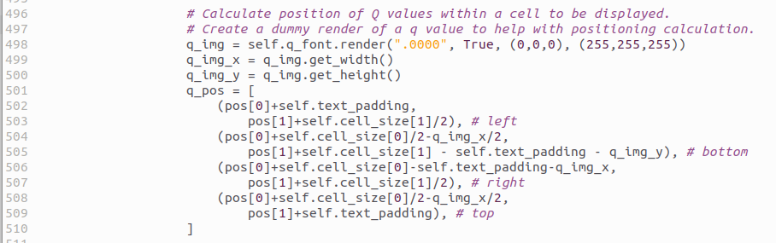
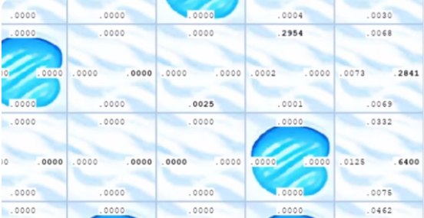
9.6 Check Q-Value
https://www.youtube.com/watch?v=1W_LOB-0IEY&list=PL58zEckBH8fCt_lYkmayZoR9XfDCW9hte&index=9
Check Q-Value (03:01-03:50/4:52)
In frozen_lake_enhanced.py, there are four Q-values displayed on left/bottom/right/top for agent to go left/down/ right/up, respectively.
The agent pick up the largest Q-value to take action.

Slide 20
9.7 Check Reward

Slide 21
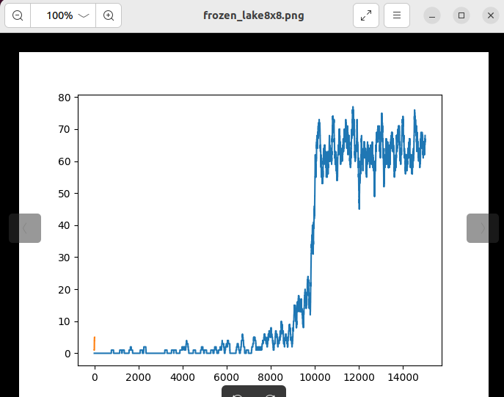
9.7 Check Reward
https://www.youtube.com/watch?v=1W_LOB-0IEY&list=PL58zEckBH8fCt_lYkmayZoR9XfDCW9hte&index=9
Check Reward (03:51-04:30/4:52)
Check frozen_lake8x8.png for reward plot.

Slide 22
9.8 Run Agent Run Only

Slide 23
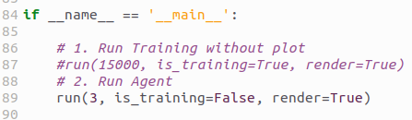
9.7 Check Reward
https://www.youtube.com/watch?v=1W_LOB-0IEY&list=PL58zEckBH8fCt_lYkmayZoR9XfDCW9hte&index=9
Check Reward (03:51-04:30/4:52)
We can run agent play only
1. Remove the training run 15000.
2. run 3 times with “is_training=False”.
1
2

Slide 24
End

