Slide 1

4 Continuous Actor
Peter H. Chen

Slide 2
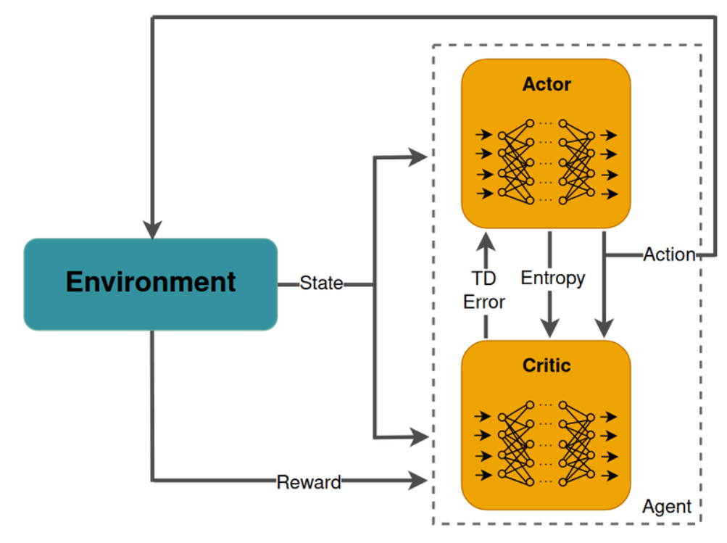
4 Continuous Actor
https://www.youtube.com/watch?v=VmZI_YkfPBM&list=PLQY2H8rRoyvxWE6bWx8XiMvyZFgg_25Q_&index=4
Continuous Actor (00:00-00:25/9:09)
We discuss the Continuous Control and Actor-Leaner API.
In the last discussion, we discussed the end-to-end project of board game app with TF-Agents and TFLite.
In this discussion, we discussed a new type of environment and a new set of API to train the agent.
https://www.tensorflow.org/agents/tutorials/7_SAC_minitaur_tutorial

Slide 3
4.1 SAC Agent

Slide 4
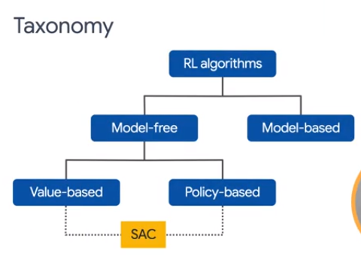

4.1 SAC Agent
https://www.youtube.com/watch?v=VmZI_YkfPBM&list=PLQY2H8rRoyvxWE6bWx8XiMvyZFgg_25Q_&index=4
SAC Agent (00:26-00:40/9:09)
Let’s talk about the new agent, SAC (Soft Actor-Critic) Agent.
SAC is a bridge between Value-Based Methods and Policy-Based Methods.
https://www.tensorflow.org/agents/tutorials/7_SAC_minitaur_tutorial

Slide 5
4.2 Actor-Critic Method

Slide 6
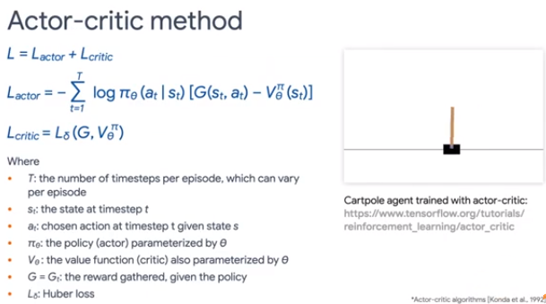
4.2 Actor-Critic Method
https://www.youtube.com/watch?v=VmZI_YkfPBM&list=PLQY2H8rRoyvxWE6bWx8XiMvyZFgg_25Q_&index=4
Actor-Critic Method (00:41-01:20/9:09)
Below, we break the Loss function SAC (Soft Actor-Critic) into two parts: Actor and Critic.
1. Actor: The policy is referred to as the Actor that Proposes/Executes a set of possible actions for a given state.
2. Critic: The estimated value function is referred to as a Critic which Evaluates the actions taken by the actor based on the given policy.
https://www.tensorflow.org/agents/tutorials/7_SAC_minitaur_tutorial
1
2

Slide 7
4.3 SAC

Slide 8
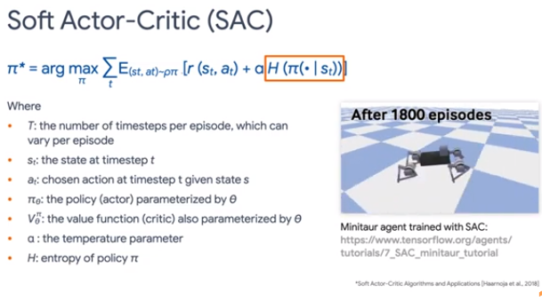
4.3 SAC
https://www.youtube.com/watch?v=VmZI_YkfPBM&list=PLQY2H8rRoyvxWE6bWx8XiMvyZFgg_25Q_&index=4
SAC (01:21-02:00/9:09)
The key idea behind SAC (Soft Actor-Critic) is entropy regularization.
In Information theory, entropy is related to the randomness of random variables.
The entropy is higher, the random variable is more unpredictable.
Why do we need the entropy item in the objective function?
In addition to the reward, we have the entropy item in the objective function for more exploration.
https://www.tensorflow.org/agents/tutorials/7_SAC_minitaur_tutorial

Slide 9
4.4 Minitaur Environment

Slide 10
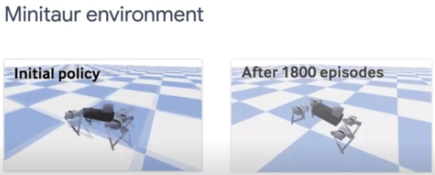
4.4 Minitaur Environment
https://www.youtube.com/watch?v=VmZI_YkfPBM&list=PLQY2H8rRoyvxWE6bWx8XiMvyZFgg_25Q_&index=4
Minitaur Environment (01:21-02:00/9:09)
Previously, we have used classical CartPole Environment and custom environment.
They share one thing in common: The actions in both environments are discrete.
In CartPole, the actions are 0 or 1. In the simple board game (custom) environment, the actions are cell positions, encoded as integer between 0 to 64 (8 x 8 cell grid). In these cases, we call them discrete control problems.
In this discussion, we will use a new environment called Minitaur. Minitaur is a Greek Word with the hull head and human body.
https://www.tensorflow.org/agents/tutorials/7_SAC_minitaur_tutorial

Slide 11
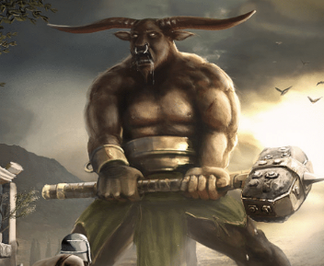
4.4 Minitaur Environment
https://www.youtube.com/watch?v=VmZI_YkfPBM&list=PLQY2H8rRoyvxWE6bWx8XiMvyZFgg_25Q_&index=4
Minitaur Environment (01:21-02:00/9:09)
What is meaning of Minitaur?
Minitaur (Minos+Bull, Bull of Minos) is a Greek Word with the bull head and human body.
https://www.tensorflow.org/agents/tutorials/7_SAC_minitaur_tutorial

Slide 12
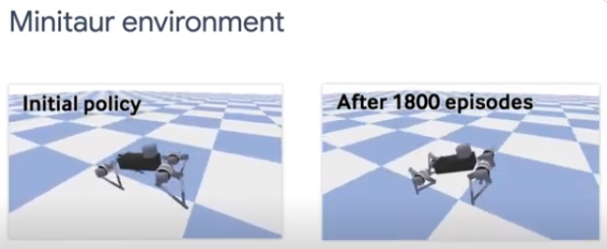
4.4 Minitaur Environment
https://www.youtube.com/watch?v=VmZI_YkfPBM&list=PLQY2H8rRoyvxWE6bWx8XiMvyZFgg_25Q_&index=4
Minitaur Environment (01:21-02:55/9:09)
The goal of Minitaur is train the four-leg of minitaur robot to walk.
This task is also called as locomotion or one of the example of MuJoCo (Multi-Joint Contact).
In minitaur, The actions are eight float values for the motor angles which we can control. Since these angles are continuous numbers, minitaur is a continuous control problem.
https://www.tensorflow.org/agents/tutorials/7_SAC_minitaur_tutorial

Slide 13
4.5 Agents Compatibility

Slide 14
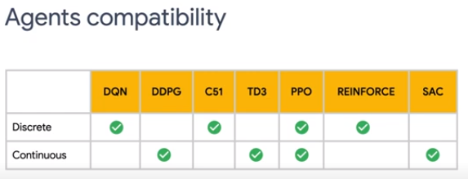
4.5 Agents Compatibility
https://www.youtube.com/watch?v=VmZI_YkfPBM&list=PLQY2H8rRoyvxWE6bWx8XiMvyZFgg_25Q_&index=4
Agents Compatibility (02:56-03:15/9:09)
TF-Agents have a number of built-in agents available.
Different agents support different problem types.
For example, DQN and REINFORCE do not support continuous control and SAC does not support discrete control.
Make sure you choose the right agent for our own task.
https://www.tensorflow.org/agents/tutorials/7_SAC_minitaur_tutorial

Slide 15
4.6 Load Minitaur Gym Environment

Slide 16
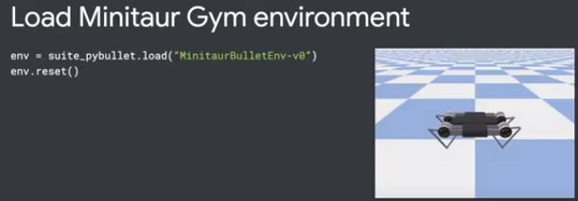
4.6 Load Minitaur Gym Environment
https://www.youtube.com/watch?v=VmZI_YkfPBM&list=PLQY2H8rRoyvxWE6bWx8XiMvyZFgg_25Q_&index=4
Load Minitaur Gym Environment (03:16-03:45/9:09)
In our previous episodes, we were using the driver to collect the experience and then train the agents.
This time, we will use a new Actor-Learner API.
The reason we want to use this new API is to support distributed training. We will get into the distributed training at the end.
Now, we import the Minitaur Environment.
Minitaur is a PyBullet environment. We have to import the PyBullet environment first.
https://pybullet.org/wordpress/

Slide 17
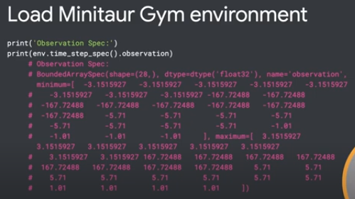
4.6 Load Minitaur Gym Environment
https://www.youtube.com/watch?v=VmZI_YkfPBM&list=PLQY2H8rRoyvxWE6bWx8XiMvyZFgg_25Q_&index=4
Load Minitaur Gym Environment (03:46-04:30/9:09)
Below, we print out the environment observation for each action.
We can see the observation and action specs.
As we can see, the observation is very complex.
Below we define minimum and maximum 28 (= 8 + 8 + 12) values for angles, velocities, and torques.
In each action, we receive 28 observation values representing the angles, velocities, and torques, respectively for all the motors.
https://github.com/bulletphysics/bullet3/blob/master/examples/pybullet/gym/pybullet_envs/__init__.py

Slide 18
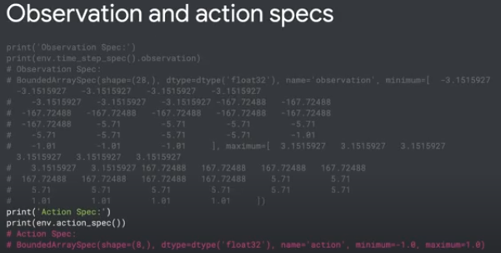
4.6 Load Minitaur Gym Environment
https://www.youtube.com/watch?v=VmZI_YkfPBM&list=PLQY2H8rRoyvxWE6bWx8XiMvyZFgg_25Q_&index=4
Load Minitaur Gym Environment (03:46-04:10/9:09)
In return, the environment expects 8 values for the actions between -1 and 1. These are the motor angles.
https://github.com/bulletphysics/bullet3/blob/master/examples/pybullet/gym/pybullet_envs/__init__.py

Slide 19
4.7 Enable GPU

Slide 20
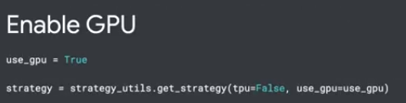
4.7 Enable GPU
https://www.youtube.com/watch?v=VmZI_YkfPBM&list=PLQY2H8rRoyvxWE6bWx8XiMvyZFgg_25Q_&index=4
Enable GPU (04:11-04:30/9:09)
Below, we use GPU.
https://www.tensorflow.org/agents/tutorials/7_SAC_minitaur_tutorial

Slide 21
4.8 Create Critic Network

Slide 22
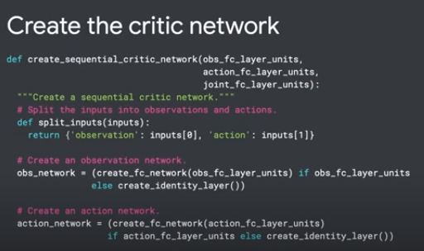
4.8 Create Critic Network
https://www.youtube.com/watch?v=VmZI_YkfPBM&list=PLQY2H8rRoyvxWE6bWx8XiMvyZFgg_25Q_&index=4
Create Critic Network (04:11-04:40/9:09)
The SAC (Soft Actor-Critic) Agent needs
1. a Critic Network to predict values (for evaluation) and
2. an Actor Network to predict actions (for action) based on the predictive value.
Below, we create a critic network using the helper function.
The critic network will have an observation network branch and an action network branch.
https://www.tensorflow.org/agents/tutorials/7_SAC_minitaur_tutorial

Slide 23
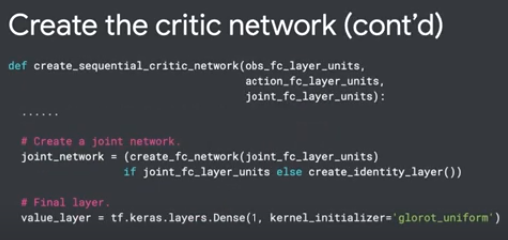
4.8 Create Critic Network
https://www.youtube.com/watch?v=VmZI_YkfPBM&list=PLQY2H8rRoyvxWE6bWx8XiMvyZFgg_25Q_&index=4
Create Critic Network (04:41-04:45/9:09)
We
1. merge the observation branch and action branch and
2. stack them into a joint network at the top before we output the prediction.
https://www.tensorflow.org/agents/tutorials/7_SAC_minitaur_tutorial
1
2

Slide 24
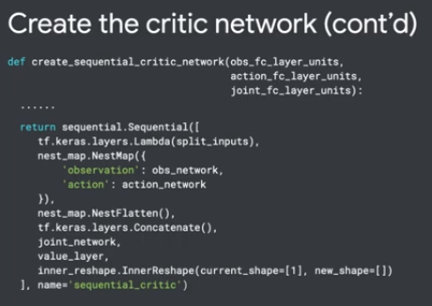
4.10 Instantiate SAC Agent
https://www.youtube.com/watch?v=VmZI_YkfPBM&list=PLQY2H8rRoyvxWE6bWx8XiMvyZFgg_25Q_&index=4
Instantiate SAC Agent (04:46-04:50/9:09)
Finally, we return the sequential model instance.
https://www.tensorflow.org/agents/tutorials/7_SAC_minitaur_tutorial

Slide 25
4.9 Create Actor Network

Slide 26
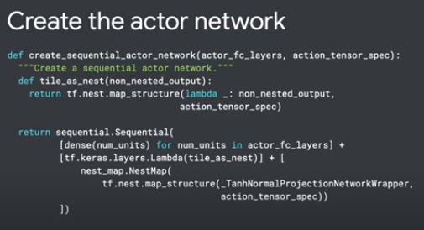
4.9 Create Actor Network
https://www.youtube.com/watch?v=VmZI_YkfPBM&list=PLQY2H8rRoyvxWE6bWx8XiMvyZFgg_25Q_&index=4
Create Actor Network (04:51-05:05/9:09)
Similarly, we create an Actor Network.
The actor Network predicts actions which is sampled from multivariate normal probability distribution.
https://www.tensorflow.org/agents/tutorials/7_SAC_minitaur_tutorial

Slide 27
4.10 Instantiate SAC Agent

Slide 28
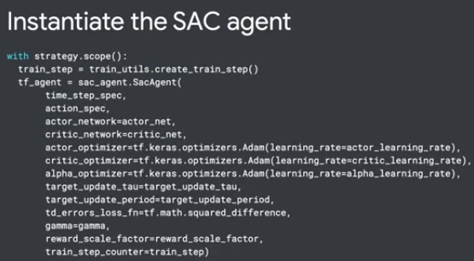
4.10 Instantiate SAC Agent
https://www.youtube.com/watch?v=VmZI_YkfPBM&list=PLQY2H8rRoyvxWE6bWx8XiMvyZFgg_25Q_&index=4
Instantiate SAC Agent (05:06-05:15/9:09)
We then instantiate the SAC Agent with parameters of actor network and critic network, and etc.
https://www.tensorflow.org/agents/tutorials/7_SAC_minitaur_tutorial

Slide 29
4.11 Setup Replay Buffer

Slide 30
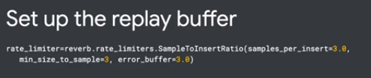
4.11 Setup Replay Buffer
https://www.youtube.com/watch?v=VmZI_YkfPBM&list=PLQY2H8rRoyvxWE6bWx8XiMvyZFgg_25Q_&index=4
Setup Replay Buffer (05:16-05:20/9:09)
We will use replay buffer here.
We will use a rate limiter for the enforce conditions on when items can be
1. Inserted into table or
2. Sampled from the table.
We use sample_per_insert ratio = 0.3. This sets the average ratio of insert to samples by blocking the insert and sample request.
The sample_per_insert is useful for controlling the number of times each item is sampled before being removed by the new sample.
The sample_per_insert is a hyperparameter for user to tune up for better performance.
https://www.tensorflow.org/agents/tutorials/7_SAC_minitaur_tutorial

Slide 31
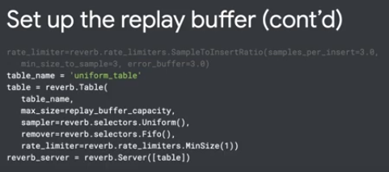
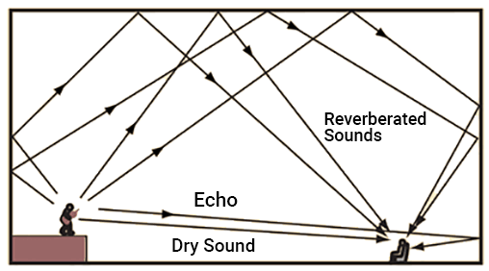
4.11 Setup Replay Buffer
https://www.youtube.com/watch?v=VmZI_YkfPBM&list=PLQY2H8rRoyvxWE6bWx8XiMvyZFgg_25Q_&index=4
Setup Replay Buffer (05:16-05:55/9:09)
1. We create the reverb (Reverberation, sound waves reflect off surfaces) table and
2. The reverb server.
https://www.tensorflow.org/agents/tutorials/7_SAC_minitaur_tutorial

Slide 32
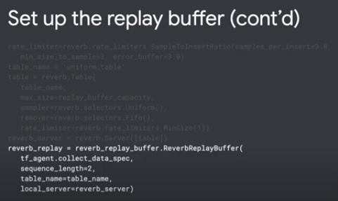
4.11 Setup Replay Buffer
https://www.youtube.com/watch?v=VmZI_YkfPBM&list=PLQY2H8rRoyvxWE6bWx8XiMvyZFgg_25Q_&index=4
Setup Replay Buffer (05:56-06:00/9:09)
Then, we define the replay buffer.
https://www.tensorflow.org/agents/tutorials/7_SAC_minitaur_tutorial

Slide 33
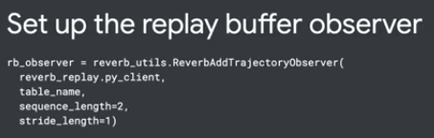
4.11 Setup Replay Buffer
https://www.youtube.com/watch?v=VmZI_YkfPBM&list=PLQY2H8rRoyvxWE6bWx8XiMvyZFgg_25Q_&index=4
Setup Replay Buffer (06:01-06:15/9:09)
Next, we define a function that extracts the training dataset from the replay buffer.
We will pass this extract dataset to the TF Learner.
So that the TF Learner can sample the training data from the replay buffer.
https://www.tensorflow.org/agents/tutorials/7_SAC_minitaur_tutorial

Slide 34
4.12 Setup Replay Buffer for Observer

Slide 35
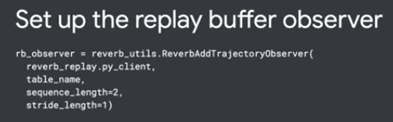
4.12 Setup Replay Buffer for Observer
https://www.youtube.com/watch?v=VmZI_YkfPBM&list=PLQY2H8rRoyvxWE6bWx8XiMvyZFgg_25Q_&index=4
Setup Replay Buffer for Observer (06:16-06:20/9:09)
We then create replay buffer for observer.
https://www.tensorflow.org/agents/tutorials/7_SAC_minitaur_tutorial

Slide 36
4.13 Actor to Collect Experience

Slide 37
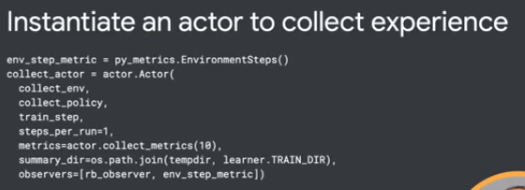
4.13 Actor to Collect Experience
https://www.youtube.com/watch?v=VmZI_YkfPBM&list=PLQY2H8rRoyvxWE6bWx8XiMvyZFgg_25Q_&index=4
Actor to Collect Experience (06:21-06:35/9:09)
Now, we instantiate an Actor to collect environment and collect policy to gather experience.
We also need to create an evaluation actor (critic) to evaluate the policy during training.
We skip the evaluation actor (Critic) part here.
https://www.tensorflow.org/agents/tutorials/7_SAC_minitaur_tutorial

Slide 38
4.14 Learner for Training

Slide 39
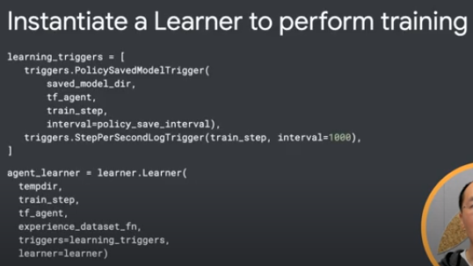

4.14 Learner for Training
https://www.youtube.com/watch?v=VmZI_YkfPBM&list=PLQY2H8rRoyvxWE6bWx8XiMvyZFgg_25Q_&index=4
Learner for Training (06:36-06:50/9:09)
The TF Learner perform updates of the gradient step size (to the policy variables using experience data from the replay buffer).
During the training, the TF Learner can push a new set of variable values to the variable container.
https://www.tensorflow.org/agents/tutorials/7_SAC_minitaur_tutorial

Slide 40
4.15 Run Training Loop

Slide 41
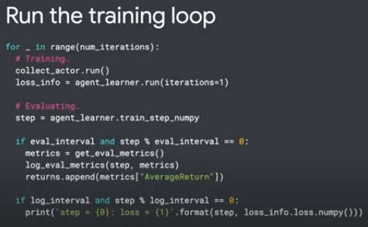
4.15 Run Training Loop
https://www.youtube.com/watch?v=VmZI_YkfPBM&list=PLQY2H8rRoyvxWE6bWx8XiMvyZFgg_25Q_&index=4
Run Training Loop (06:51-07:00/9:09)
Now, we can run the training loop
1. First, use the actors to collect the experience
2. Next, use the Learner to Train the model.
https://www.tensorflow.org/agents/tutorials/7_SAC_minitaur_tutorial

Slide 42
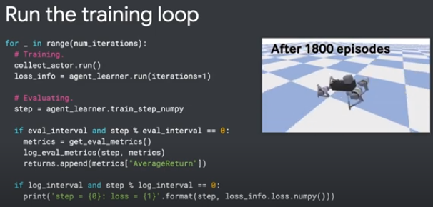
4.15 Run Training Loop
https://www.youtube.com/watch?v=VmZI_YkfPBM&list=PLQY2H8rRoyvxWE6bWx8XiMvyZFgg_25Q_&index=4
Run Training Loop (06:51-07:05/9:09)
After training, we will get a trained Minitaur agent that walks smoothly.
https://www.tensorflow.org/agents/tutorials/7_SAC_minitaur_tutorial

Slide 43
4.16 TF-Agents Distributed Collection

Slide 44
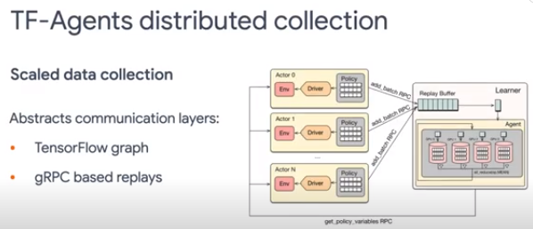
4.16 TF-Agents Distributed Collection
https://www.youtube.com/watch?v=VmZI_YkfPBM&list=PLQY2H8rRoyvxWE6bWx8XiMvyZFgg_25Q_&index=4
TF-Agents Distributed Collection (07:06-07:40/9:09)
We just walk through the non-distributed training.
When we use Tensorflow to train the models, we can accelerate the training with accelerators, such as, GPU or TPU.
On the top, we can use distributed training for multiple CPUs/Cores and multiple accelerators (GPUs/TPUs) to run even faster.
With TF Actor-Learner API, we can feed in large amount of training data. We can have many instances of actors interacting with environment and collecting the training data in Parallel fashion.
https://www.tensorflow.org/agents/tutorials/7_SAC_minitaur_tutorial

Slide 45
4.17 Distributed Architecture

Slide 46
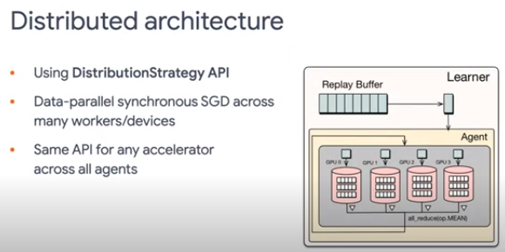
4.17 Distributed Architecture
https://www.youtube.com/watch?v=VmZI_YkfPBM&list=PLQY2H8rRoyvxWE6bWx8XiMvyZFgg_25Q_&index=4
Distributed Architecture (07:41-08:40/9:09)
The training trajectories will still be stored in a replay buffer and
Our learner will be sampling these trajectories and feed back them to the accelerators for faster training.
Under the hood,
1. The learner leverage the DistributionStrategy API in Tensorflow.
2. Use Data Parallelism to speed thing up.
The API interface is the same for any accelerator across all agents and is made easy to use.
https://www.tensorflow.org/agents/tutorials/7_SAC_minitaur_tutorial

Slide 47
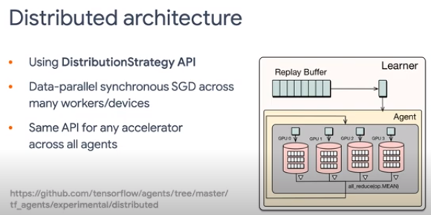
4.17 Distributed Architecture
https://www.youtube.com/watch?v=VmZI_YkfPBM&list=PLQY2H8rRoyvxWE6bWx8XiMvyZFgg_25Q_&index=4
Distributed Architecture (08:21-03:25/9:09)
Below is the github tensorflow for distributed Soft Actor-Critic.
Now, we understand how the distributed reinforcement training work.
https://github.com/tensorflow/agents/blob/master/tf_agents/experimental/distributed/examples/sac/sac_reverb_server.py

Slide 48
4.18 References

Slide 49
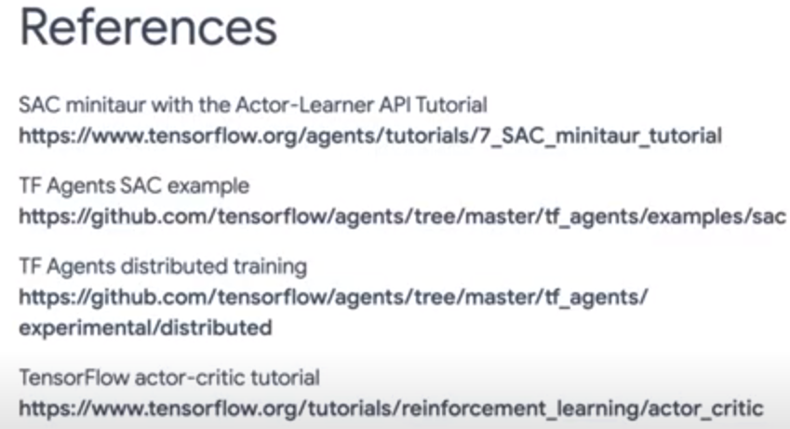
4.18 References
https://www.youtube.com/watch?v=VmZI_YkfPBM&list=PLQY2H8rRoyvxWE6bWx8XiMvyZFgg_25Q_&index=4
References (08:26-09:09/9:09)
Below are the references for Soft Actor-Critic and Distributed Training.
We discuss:
1. The continuous and discrete control.
2. Walk through the SAC Codes with Minitaur example using Actor-Learner API.
3. Discuss the Distributed Training.

Slide 50
End

