Slide 1

4 Reinforce
Peter H. Chen

Slide 2
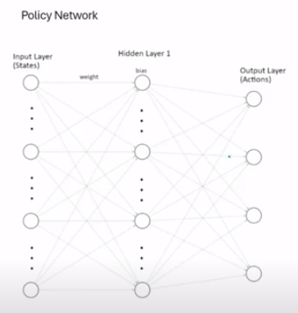
4 Reinforce
https://www.youtube.com/watch?v=boEO7tN7uoY&list=PL58zEckBH8fCt_lYkmayZoR9XfDCW9hte&index=4
Reinforce (00:00-00:20/08:14)
We discuss the Reinforce or VPG (Vanilla Policy Gradient) Algorithm.
The goal of Reinforce Algorithm is to train the Deep Network.
1. The input is the observation space (or the state) and
2. The output are the actions that the agent can takes.
3. The hidden layers are customizable. You can have more (or less) layers or more (or less) nodes by trial and error.
3
1
2

Slide 3
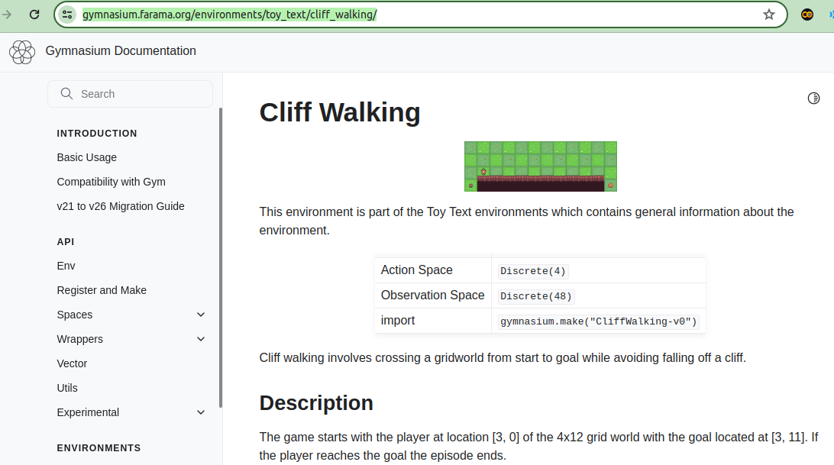
4 Reinforce
https://www.youtube.com/watch?v=boEO7tN7uoY&list=PL58zEckBH8fCt_lYkmayZoR9XfDCW9hte&index=4
Reinforce (00:21-00:25/08:14)
We take the “Cliff Walking” example from Gym Environment (Farama Gymnasium).
https://gymnasium.farama.org/environments/toy_text/cliff_walking/.

Slide 4
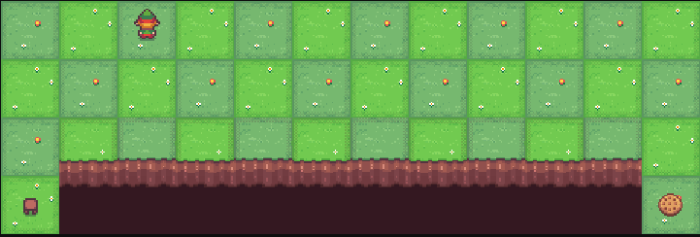
4 Reinforce
https://www.youtube.com/watch?v=boEO7tN7uoY&list=PL58zEckBH8fCt_lYkmayZoR9XfDCW9hte&index=4
Reinforce (00:26-00:30/08:14)
Let’s zoom in.
In “Cliff walking” game, agent tries to cross a grid world from starting point to goal and avoid falling off a cliff.
https://gymnasium.farama.org/environments/toy_text/cliff_walking/.

Slide 5
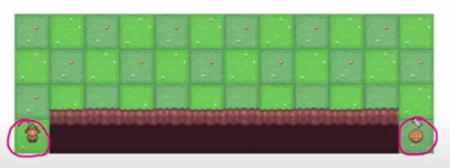
4 Reinforce
https://www.youtube.com/watch?v=boEO7tN7uoY&list=PL58zEckBH8fCt_lYkmayZoR9XfDCW9hte&index=4
Reinforce (00:26-00:30/08:14)
1. The agent starts at bottom of left corner.
2. The objective is to reach the cookie at the bottom of right corner.
https://gymnasium.farama.org/environments/toy_text/cliff_walking/.
1
2

Slide 6
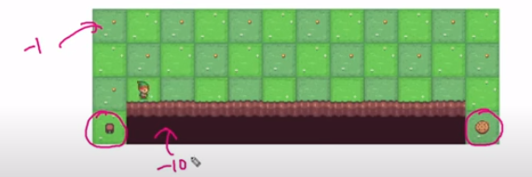
4 Reinforce
https://www.youtube.com/watch?v=boEO7tN7uoY&list=PL58zEckBH8fCt_lYkmayZoR9XfDCW9hte&index=4
Reinforce (00:31-00:45/08:14)
1. At each of these states, the agent enters and receives a -1 reward or -1 penalty.
2. If the agent tries to walk off the cliff, it receives -100 penalty.
3. The episode ends when the agent gets to the cookie.
https://gymnasium.farama.org/environments/toy_text/cliff_walking/.
1
3
2

Slide 7
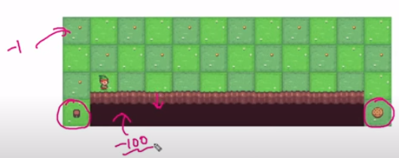
4 Reinforce
https://www.youtube.com/watch?v=boEO7tN7uoY&list=PL58zEckBH8fCt_lYkmayZoR9XfDCW9hte&index=4
Reinforce (00:46-01:10/08:14)
The environment does not let the agent fall of the cliff.
The environment only gives a penalty if the agent tries to walk off the cliff. The episode will continue until the reaches the goal or reaches the limit we set.
We don’t want the agent to be walking around indefinitely.
https://gymnasium.farama.org/environments/toy_text/cliff_walking/.

Slide 8
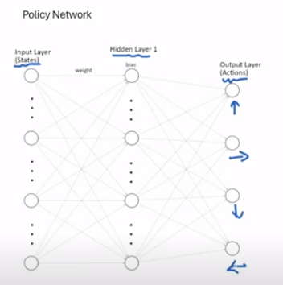
4 Reinforce
https://www.youtube.com/watch?v=boEO7tN7uoY&list=PL58zEckBH8fCt_lYkmayZoR9XfDCW9hte&index=4
Reinforce (01:11-01:20/08:14)
We map the observation and space state to the network diagram here.
The agent can go up, right, down, or left.
These nodes represents these actions.
https://gymnasium.farama.org/environments/toy_text/cliff_walking/.

Slide 9
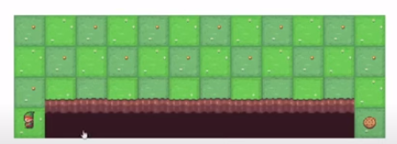
4 Reinforce
https://www.youtube.com/watch?v=boEO7tN7uoY&list=PL58zEckBH8fCt_lYkmayZoR9XfDCW9hte&index=4
Reinforce (01:21-01:30/08:14)
For the input, there are actually 48 (= 4 x 12) cells.
There are start, cookie, and cliff cells that the agent cannot step into.
https://gymnasium.farama.org/environments/toy_text/cliff_walking/.

Slide 10
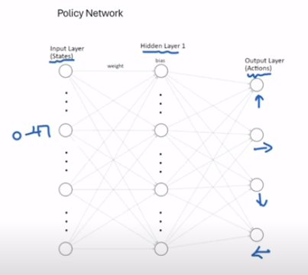
4 Reinforce
https://www.youtube.com/watch?v=boEO7tN7uoY&list=PL58zEckBH8fCt_lYkmayZoR9XfDCW9hte&index=4
Reinforce (01:31-01:40/08:14)
I tried using 0 to 47 nodes for the inputs that work very well.
https://gymnasium.farama.org/environments/toy_text/cliff_walking/.

Slide 11
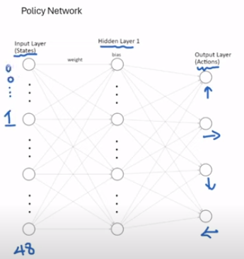
4 Reinforce
https://www.youtube.com/watch?v=boEO7tN7uoY&list=PL58zEckBH8fCt_lYkmayZoR9XfDCW9hte&index=4
Reinforce (01:41-01:55/08:14)
I tried 48 (0 to 47) nodes, initialized them all to zeros.
Depending on where the agent is, when the agent walk in, I mark it to 1.
Below is the typical input would look like this.
https://gymnasium.farama.org/environments/toy_text/cliff_walking/.

Slide 12
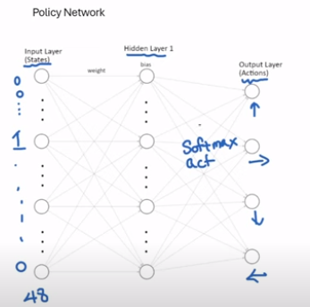
4 Reinforce
https://www.youtube.com/watch?v=boEO7tN7uoY&list=PL58zEckBH8fCt_lYkmayZoR9XfDCW9hte&index=4
Reinforce (01:56-02:10/08:14)
Right before the output layer, we apply a softmax activation function on the previous (hidden layer1) layer.
What softmax activation function does is it gives a probability distribution.
https://gymnasium.farama.org/environments/toy_text/cliff_walking/.

Slide 13
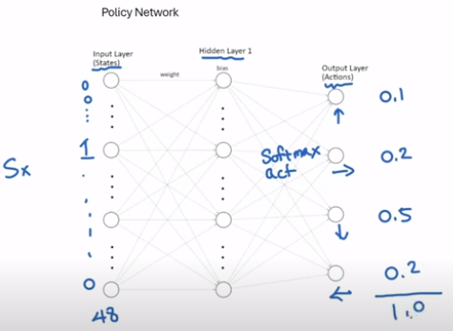
4 Reinforce
https://www.youtube.com/watch?v=boEO7tN7uoY&list=PL58zEckBH8fCt_lYkmayZoR9XfDCW9hte&index=4
Reinforce (02:11-02:45/08:14)
Give you a example: given a particular state, we could have a chance on the output layer. Let’s say, 10% chance of taking the up action, 20% chance of going right, 50% of going down, and 20% chance of going left. If you sum them together, it has to add up to 100%. When we create this network in PyTorch. PyTorch will assign random weights and random biases which also produces a random set of probabilities to begin with.
When we train the network by adjusting its weights and biases, the probabilities will become meaningful.
https://gymnasium.farama.org/environments/toy_text/cliff_walking/.

Slide 14
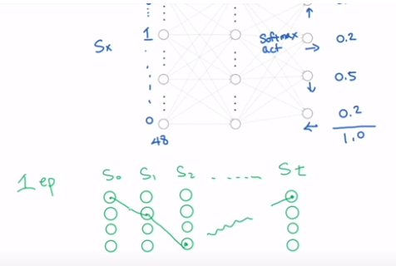
4 Reinforce
https://www.youtube.com/watch?v=boEO7tN7uoY&list=PL58zEckBH8fCt_lYkmayZoR9XfDCW9hte&index=4
Reinforce (02:46-03:30/08:14)
Let’s walk through one example of one episode.
In one episode, the agent can go into many states until the episode ends.
Each one of those states, the agent selects an action based on the probability of selecting one of those actions.
Let’s say, it takes a path of this, and then this, and then somehow, it ends here.
https://gymnasium.farama.org/environments/toy_text/cliff_walking/.

Slide 15
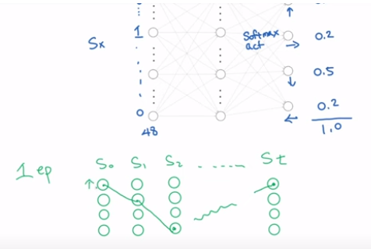
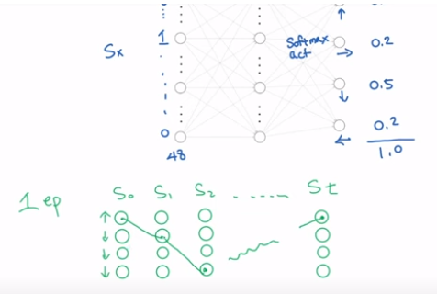
4 Reinforce
https://www.youtube.com/watch?v=boEO7tN7uoY&list=PL58zEckBH8fCt_lYkmayZoR9XfDCW9hte&index=4
Reinforce (02:31-03:40/08:14)
1. In the first action, if we can determine that action was good, we can increase the probability of taking this action.
2. The next time around in the next episode which essentially decreases the probability of the other actions.
https://gymnasium.farama.org/environments/toy_text/cliff_walking/.
1
2

Slide 16
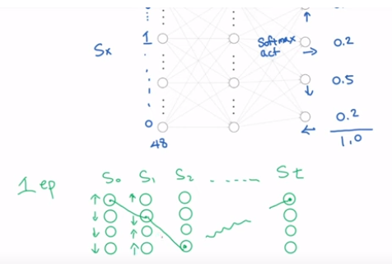
4 Reinforce
https://www.youtube.com/watch?v=boEO7tN7uoY&list=PL58zEckBH8fCt_lYkmayZoR9XfDCW9hte&index=4
Reinforce (02:31-04:10/08:14)
1. In the second action, if that was not a good choice, we will decrease the probability of taking the action (blue color) again.
2. and we will increase probability of other ones (red colors).
We will repeat this for all the experiences.
After the adjustment, in the episode 2, we repeat the same thing over again and eventually, by the end of training, we should have the policy that can take the agent on the best path to the goal.
https://gymnasium.farama.org/environments/toy_text/cliff_walking/.

Slide 17
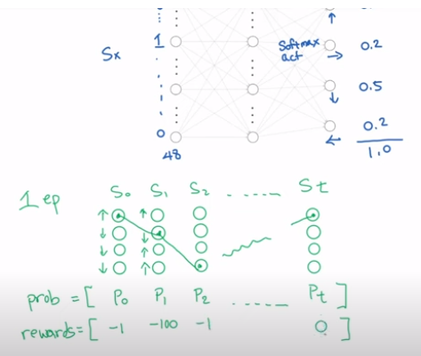
4 Reinforce
https://www.youtube.com/watch?v=boEO7tN7uoY&list=PL58zEckBH8fCt_lYkmayZoR9XfDCW9hte&index=4
Reinforce (04:11-04:45/08:14)
Now, how do we determine the action was good one or a bad one?
1. We need to collect the probability that was used during that episode. Whatever the probability was, we will save it. Whatever this one was. We will save that and so on.
2. We also need to record down the rewards that was collected by taking those actions. I just put some real number here. When agent reach cookie, the agent does not get any reward.
https://gymnasium.farama.org/environments/toy_text/cliff_walking/.
1
2

Slide 18
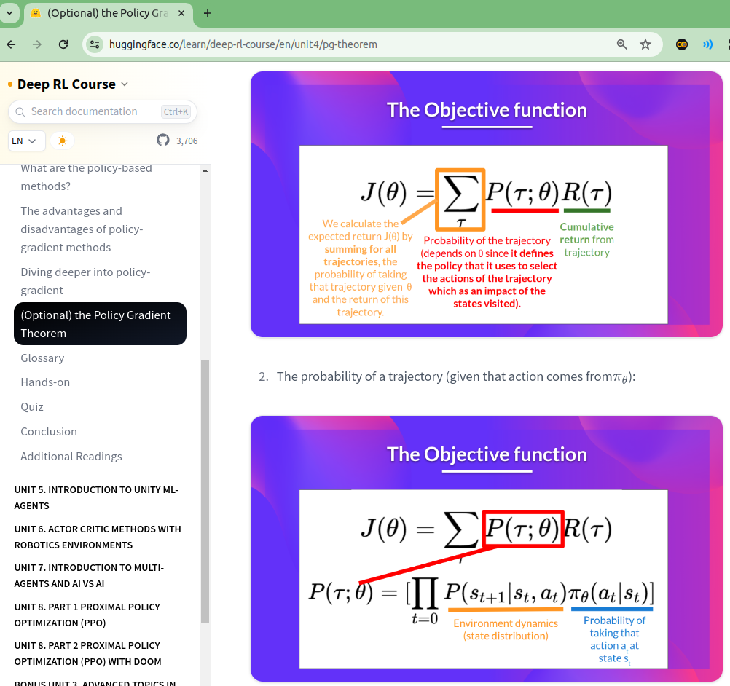
4 Reinforce
https://www.youtube.com/watch?v=boEO7tN7uoY&list=PL58zEckBH8fCt_lYkmayZoR9XfDCW9hte&index=4
Reinforce (04:46-05:20/08:14)
Usually, we want to optimize a network. We calculate the loss using a function like mean square error.
https://huggingface.co/learn/deep-rl-course/en/unit4/pg-theorem
For reinforcement learning, we want to optimize the objective function that function.
We can refer this objective function on HuggingFace Tutorial.
We will not to know the detail of the math of this formula.
We will see how it works.

Slide 19
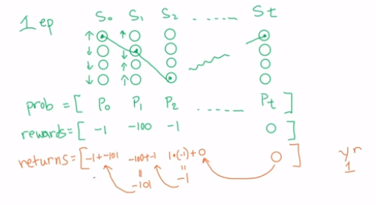
4 Reinforce
https://www.youtube.com/watch?v=boEO7tN7uoY&list=PL58zEckBH8fCt_lYkmayZoR9XfDCW9hte&index=4
Reinforce (05:21-06:35/08:14)
Using the reward, we want to calculate the cumulative returns.
The formula is generally like this.
1. It is the discount factor [r (gamma) = 1] multiplied by the reward.
2. We do not discount the first one = 0
3. r x reward + previous experience = (1) x (-1) + 0 = -1
4. r x reward + previous experience = (1) x (-100) + (-1) = -101
5. r x reward + previous experience = (1) x (-1) + (-101) = -102
https://huggingface.co/learn/deep-rl-course/en/unit4/pg-theorem
Cumulative returns
2
1
5
4
3

Slide 20
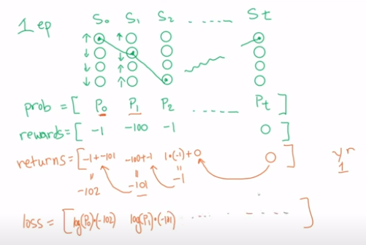
4 Reinforce
https://www.youtube.com/watch?v=boEO7tN7uoY&list=PL58zEckBH8fCt_lYkmayZoR9XfDCW9hte&index=4
Reinforce (06:36-06:55/08:14)
Now, we want to calculate the loss of the objective function.
1. We take the log of probability multiplied by the cumulative return.
2. Same thing for the next one, take log (p1) x (-101),
3. and so on.
https://huggingface.co/learn/deep-rl-course/en/unit4/pg-theorem
1
2
3

Slide 21
4 Reinforce
https://www.youtube.com/watch?v=boEO7tN7uoY&list=PL58zEckBH8fCt_lYkmayZoR9XfDCW9hte&index=4
Reinforce (06:56-07:10/08:14)
At this point, with the loss, we can tell PyTorch to do back propagation or gradient descent to minimize the loss.
But for reinforcement learning, we actually to do the opposite.
We want to do gradient ascent to find the maximum returns.
https://huggingface.co/learn/deep-rl-course/en/unit4/pg-theorem

Slide 22
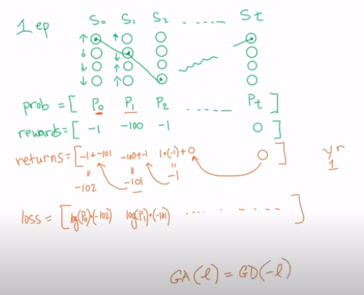
4 Reinforce
https://www.youtube.com/watch?v=boEO7tN7uoY&list=PL58zEckBH8fCt_lYkmayZoR9XfDCW9hte&index=4
Reinforce (07:11-07:35/08:14)
How can we do the gradient ascent in PyTorch?
There is a rule that if we want to do gradient ascent on a loss. We can actually do gradient descent negative of that loss.
Which means, we can just flip the signs of all of our loss and apply for regular gradient descent to it.
https://huggingface.co/learn/deep-rl-course/en/unit4/pg-theorem

Slide 23
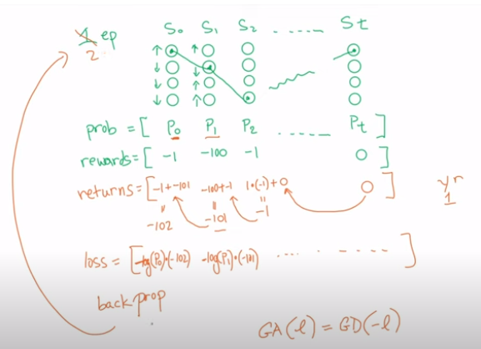
4 Reinforce
https://www.youtube.com/watch?v=boEO7tN7uoY&list=PL58zEckBH8fCt_lYkmayZoR9XfDCW9hte&index=4
Reinforce (07:36-08:14/08:14)
1. The last step, is to apply back propagation and then that makes adjustment to our network.
2. We go back up and repeat that for the next episode.
We will keep going all the way until the network is trained.
https://huggingface.co/learn/deep-rl-course/en/unit4/pg-theorem
2
1

Slide 24
End

