Slide 1

13 C51 Agent
Peter H. Chen

Slide 2
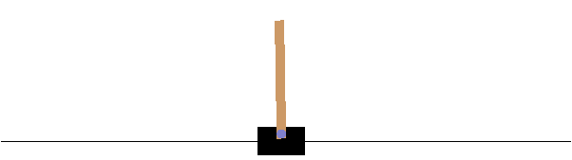
13 C51 Agent
https://www.tensorflow.org/agents/tutorials/9_c51_tutorial
C51 Agent
We discuss how to train a C51 (Categorical DQN) Agent with Cartpole example using TF-Agents Library.
We focus below:
1. Basic knowledge: DQN.
2. The differences between DQN and C51.

Slide 3
13.1 Install Library

Slide 4
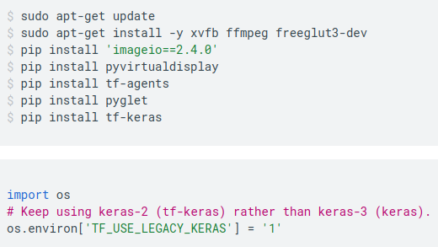
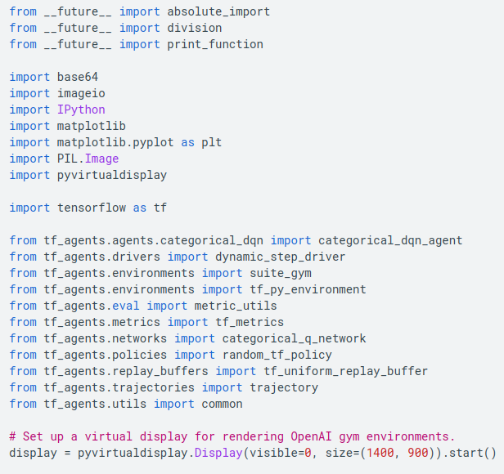
13.1 Install Library
https://www.tensorflow.org/agents/tutorials/9_c51_tutorial
Install Library
Install tf-agents and tf-keras.
Note:
“from __future__ import feature”: Python compiler for new Python release (future release).

Slide 5
13.2 Hyperparameter

Slide 6
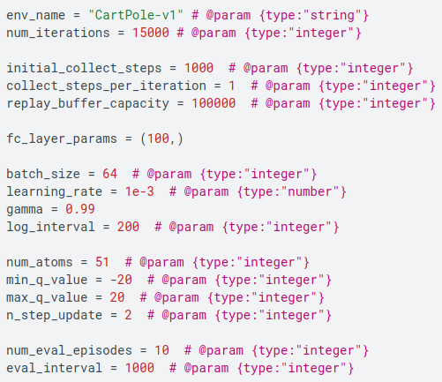
13.2 Hyperparameter
https://www.tensorflow.org/agents/tutorials/9_c51_tutorial
Hyperparameter

Slide 7
13.3 Environment

Slide 8
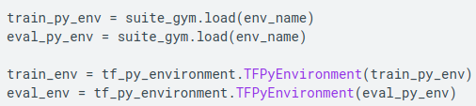
13.3 Environment
https://www.tensorflow.org/agents/tutorials/9_c51_tutorial
Environment
Load the environment as before, with one for training and one for evaluation.
Here we use CartPole-v1 (vs. CartPole-v0 in the DQN), which has a larger max reward of 500 rather than 200.

Slide 9
13.4 Agent

Slide 10
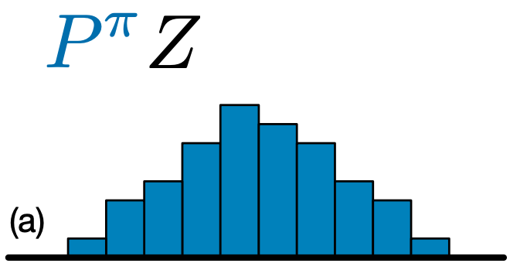
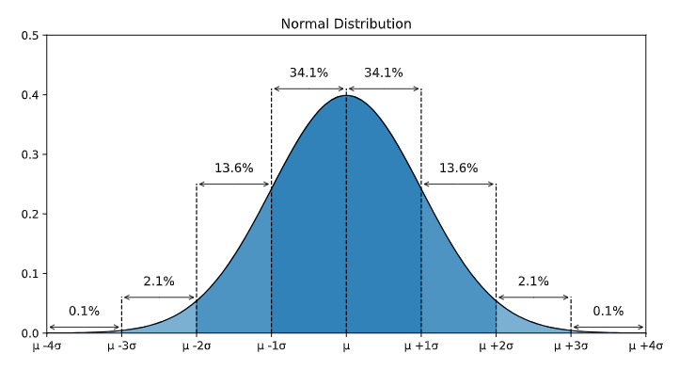
13.4 Agent
https://www.tensorflow.org/agents/tutorials/9_c51_tutorial
Agent
C51 is a Q-learning algorithm based on DQN.
Like DQN, it can be used on any environment with a discrete action space.
The main difference between C51 and DQN is:
1. Rather than simply predicting the Q-value for each state-action pair,
2. C51 predicts a histogram model for the probability distribution of the Q-value or distribution of the action.
Below are some example of probability distribution.

Slide 11
13.4 Agent
https://www.tensorflow.org/agents/tutorials/9_c51_tutorial
Agent
Why do we use the distribution instead of expected value?
We use distribution rather than simply the expected value because
1. Distribution is more stable during training,
2. Distribution leads to improved final performance.
3. For the problem with bimodal or multimodal value distributions, the single average does not provide an accurate picture.
C51 Algorithm
1. In order to train on probability distributions rather than on values, C51 must perform some complex distributional computations in order to calculate its loss function.
2. TF-Agents take care for us.

Slide 12
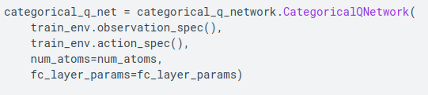
13.4 Agent
https://www.tensorflow.org/agents/tutorials/9_c51_tutorial
Agent
Create C51 Agent
To create a C51 Agent, we first need to create a CategoricalQNetwork.
The API of the CategoricalQNetwork is the same as that of the QNetwork, except that there is an additional argument num_atoms.
This represents the number of support points in our probability distribution estimates.
Below image has 10 support points (categories), each represented by a vertical blue bar.
In C51 Algorithm, the default number of atoms (Categories) is 51.

Slide 13
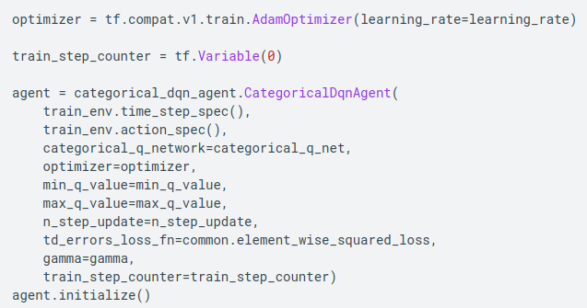
13.4 Agent
https://www.tensorflow.org/agents/tutorials/9_c51_tutorial
Agent
We also need an optimizer to train the network we just created, and a train_step_counter variable to keep track of how many times the network was updated.
Note that one other significant difference from vanilla DqnAgent is that we now need to specify min_q_value and max_q_value as arguments.
These specify the most extreme values of the support (in other words, the most extreme of the 51 atoms on either side).
Make sure to choose these appropriately for your particular environment. Here we use -20 and 20.

Slide 14
13.4 Agent
https://www.tensorflow.org/agents/tutorials/9_c51_tutorial
Agent
One last thing to note is that we also added an argument to use n-step updates with n = 2.
In single-step Q-learning (n = 1), we only compute the error between the Q-values at the current time step and the next time step using the single-step return (based on the Bellman optimality equation).
The single-step return is defined as:
  Gt=Rt+1 + γ V (st+1)
  where we define V (s)=maxa Q (s, a)
N-step updates involve expanding the standard single-step return function n times:
  Gt^{n}=Rt+1+ γ Rt+2 + γ² Rt+3 + ⋯ + γ^{n} V (st+n)
N-step updates enable the agent to bootstrap from further in the future, and with the right value of n, this often leads to faster learning.
Note:
C51 Agent and Rainbow Agent:
1. Although C51 and n-step updates are often combined with prioritized replay to form the core of the Rainbow agent, we saw no measurable improvement from implementing prioritized replay.
Moreover, we find that when combining our C51 agent with n-step updates alone, our agent performs as well as other Rainbow agents on the sample of Atari environments we've tested.

Slide 15
13.5 Metrics and Evaluation

Slide 16
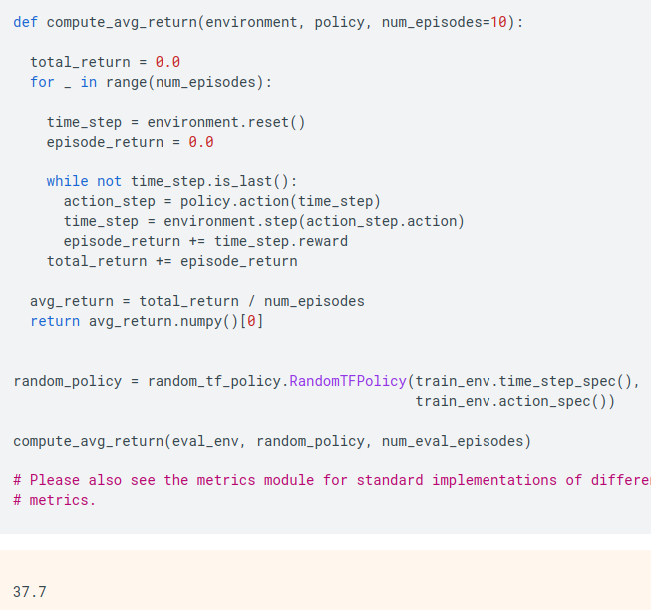
13.5 Metrics and Evaluation
https://www.tensorflow.org/agents/tutorials/9_c51_tutorial
Metrics and Evaluation
The most common metric used to evaluate a policy is the average return.
The return is the sum of rewards obtained while running a policy in an environment for an episode, and we usually average this over a few episodes.
We can compute the average return metric as follows.

Slide 17
13.6 Data Collection

Slide 18
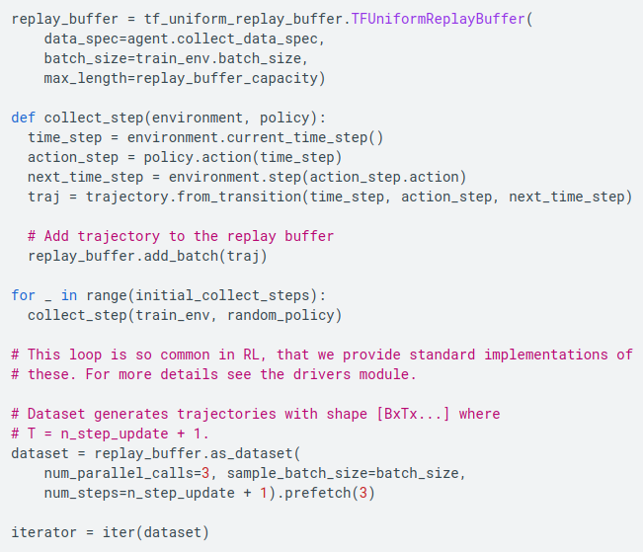
13.6 Data Collection
https://www.tensorflow.org/agents/tutorials/9_c51_tutorial
Data Collection
Same as the DQN, we set up the replay buffer and the initial data collection with the random policy.

Slide 19
13.7 Train Agent

Slide 20
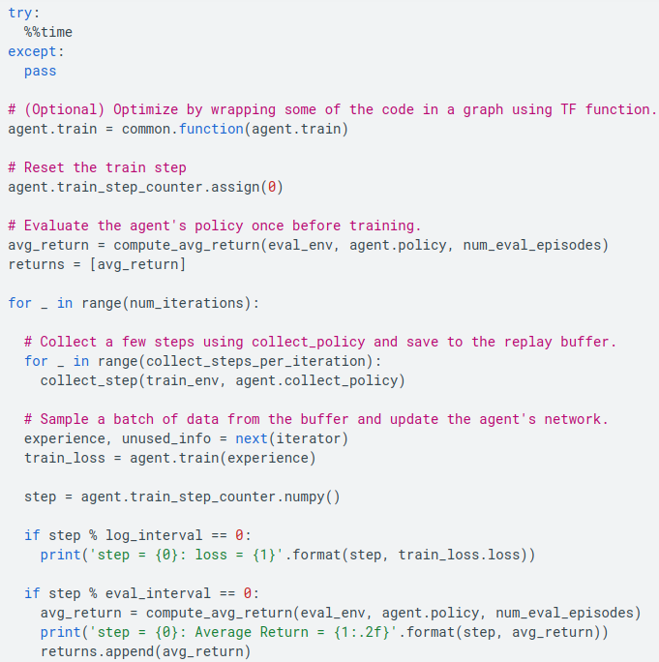
13.7 Train Agent
https://www.tensorflow.org/agents/tutorials/9_c51_tutorial
Train Agent
The training loop involves both collecting data from the environment and optimizing the agent's networks.
Along the way, we will occasionally evaluate the agent's policy to see how we are doing.
Here, the training will take ~7 minutes to run.

Slide 21
13.8 Visualization

Slide 22
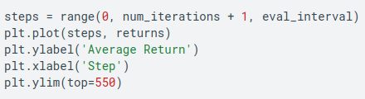

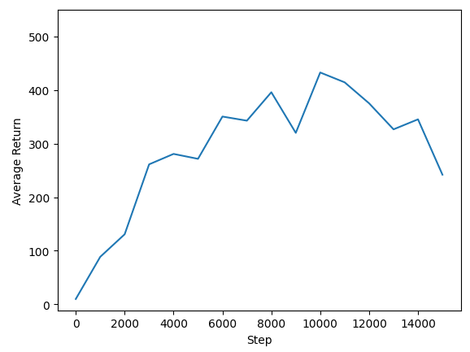
13.8 Visualization
https://www.tensorflow.org/agents/tutorials/9_c51_tutorial
Visualization
Plots:
We can plot return vs global steps to see the performance of our agent.
In Cartpole-v1, the environment gives a reward of +1 for every time step the pole stays up, and since the maximum number of steps is 500, the maximum possible return is also 500.

Slide 23
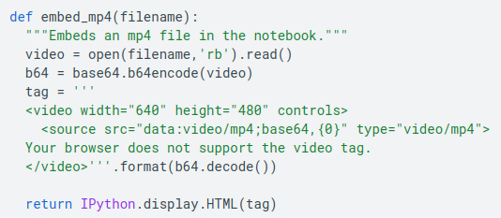
13.8 Visualization
https://www.tensorflow.org/agents/tutorials/9_c51_tutorial
Visualization
Videos:
It is helpful to visualize the performance of an agent by rendering the environment at each step.
Before we do that, let us first create a function to embed videos in this colab.

Slide 24
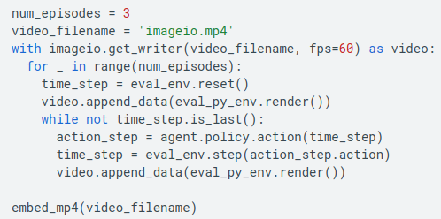
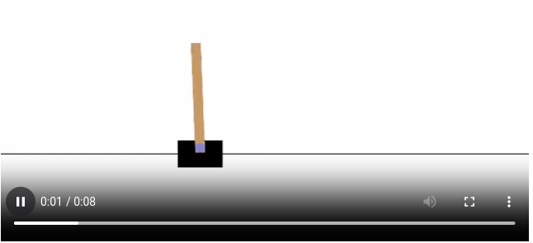
13.8 Visualization
https://www.tensorflow.org/agents/tutorials/9_c51_tutorial
Visualization
The following code visualizes the agent's policy for a few episodes:

Slide 25
13.8 Visualization
https://www.tensorflow.org/agents/tutorials/9_c51_tutorial
Visualization
C51 tends to do slightly better than DQN on CartPole-v1.
The difference between the two agents becomes more and more significant in increasingly complex environments.
For example, on the full Atari 2600 benchmark, C51 demonstrates a mean score improvement of 126% over DQN after normalizing with respect to a random agent. Additional improvements can be gained by including n-step updates.
For a deeper dive into the C51 algorithm, see A Distributional Perspective on Reinforcement Learning (2017).

Slide 26
End

