Slide 1

11 QL: Train Cart Pole
Peter H. Chen

Slide 2
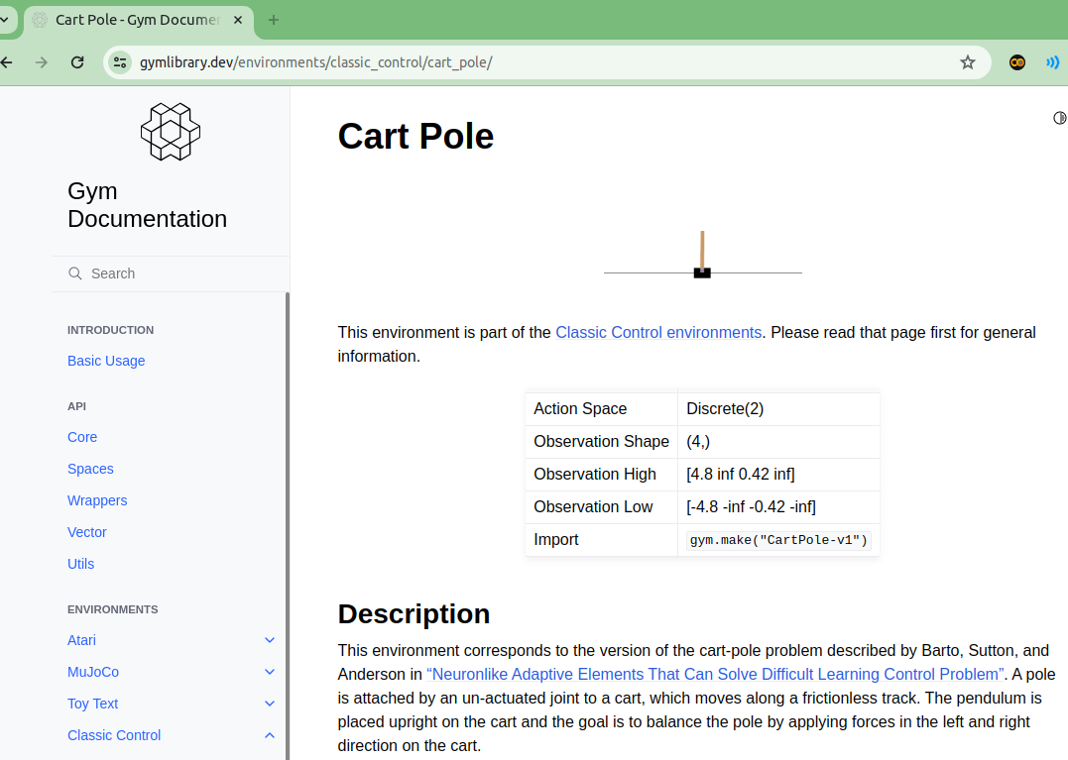
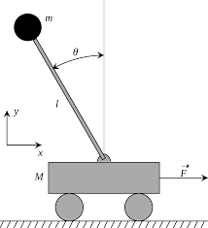
11 QL: Train Cart Pole
https://www.youtube.com/watch?v=2u1REHeHMrg&list=PL58zEckBH8fCt_lYkmayZoR9XfDCW9hte&index=11
QL: Train Cart Pole (00:00-00:10/9:16)
We discuss the robot how to balance the cart pole.
https://www.gymlibrary.dev/environments/classic_control/cart_pole/

Slide 3
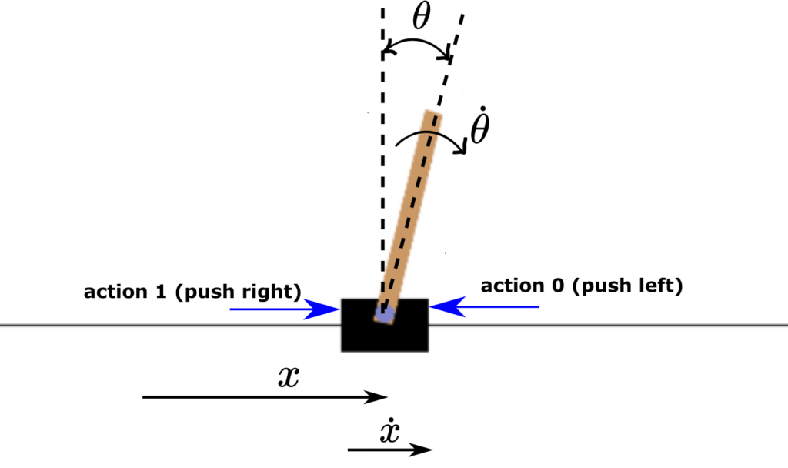
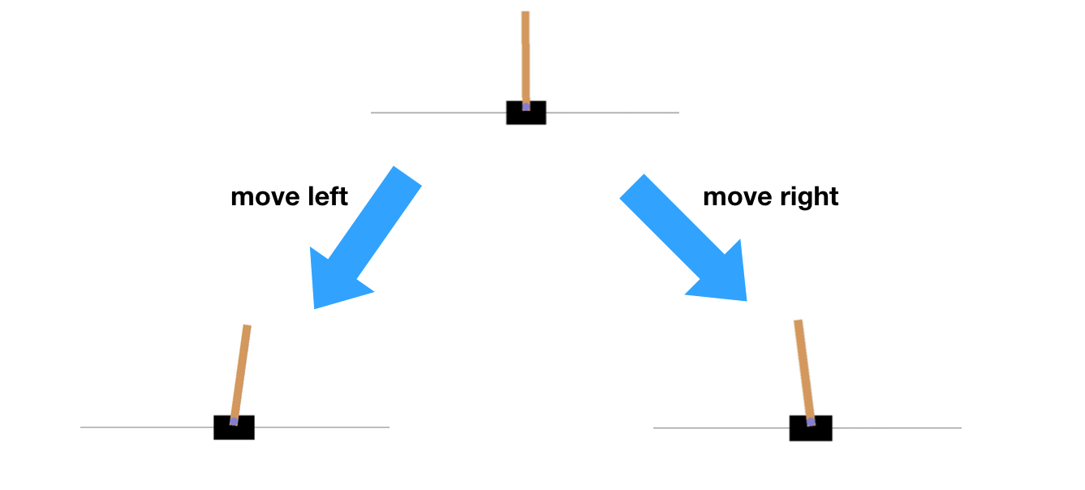
11 QL: Train Cart Pole
https://www.youtube.com/watch?v=2u1REHeHMrg&list=PL58zEckBH8fCt_lYkmayZoR9XfDCW9hte&index=11
QL: Train Cart Pole (00:11-00:20/9:16)
We discuss the robot how to balance the cart pole.
At the bottom, there is a black box called cart and we have balance pole on the top.
We push the box at the bottom to left or right.
https://www.gymlibrary.dev/environments/classic_control/cart_pole/

Slide 4
11.1 Action and State

Slide 5
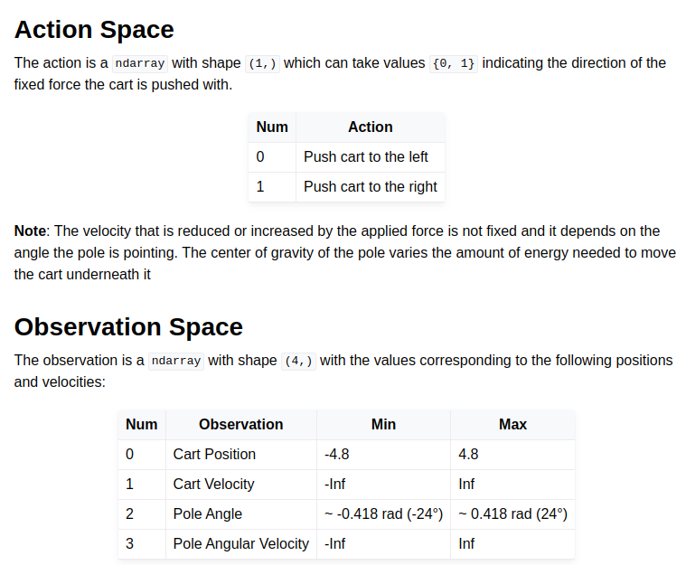
11.1 Action and State
https://www.youtube.com/watch?v=2u1REHeHMrg&list=PL58zEckBH8fCt_lYkmayZoR9XfDCW9hte&index=11
Action and State (00:21-00:22/9:16)
We have the action space and observation space (states).
https://www.gymlibrary.dev/environments/classic_control/cart_pole/

Slide 6
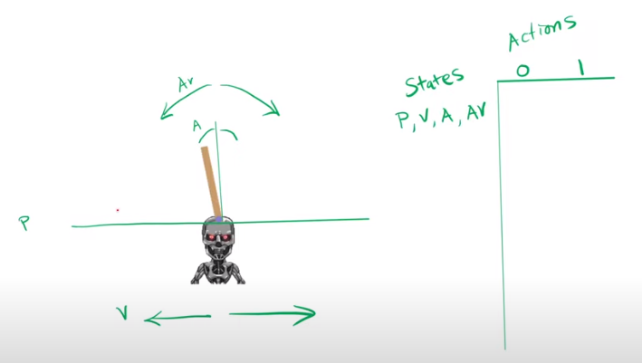
11.1 Action and State
https://www.youtube.com/watch?v=2u1REHeHMrg&list=PL58zEckBH8fCt_lYkmayZoR9XfDCW9hte&index=11
Action and State (00:21-01:05/9:16)
We put the the action of pushing left or right and generate states of P (Position), V (Velocity), A (Angle), and AV (Angular Velocity).
We right actions and states on the Q-Table.
https://www.gymlibrary.dev/environments/classic_control/cart_pole/

Slide 7
11.2 Position and Angle Boundary

Slide 8
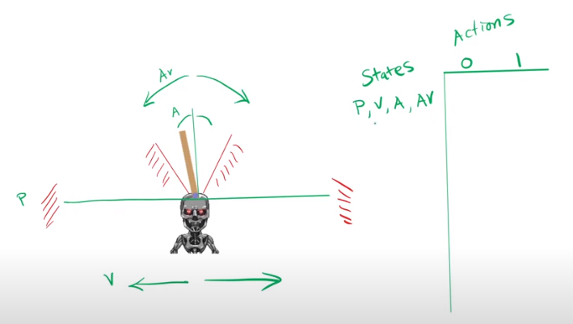
11.2 Position and Angle Boundary
https://www.youtube.com/watch?v=2u1REHeHMrg&list=PL58zEckBH8fCt_lYkmayZoR9XfDCW9hte&index=11
Position and Angle Boundary (01:06-01:20/9:16)
1. If agent moves the Cart outside the left and right boundary, the game is over.
2. If agent moves the cart and the pole outside the certain angle, the pole fall and the game is over as well.
https://www.gymlibrary.dev/environments/classic_control/cart_pole/
2
1

Slide 9
11.2 Position and Angle Boundary
https://www.youtube.com/watch?v=2u1REHeHMrg&list=PL58zEckBH8fCt_lYkmayZoR9XfDCW9hte&index=11
QL: Train Cart Pole (01:06-01:30/9:16)
These four attributes (P, V, A, AV) are floating points which means we have infinity number of combinations.
Of course, we cannot have infinity number of combinations in the Q-table.
https://www.gymlibrary.dev/environments/classic_control/cart_pole/

Slide 10
11.3 Discretize Position and Angle

Slide 11
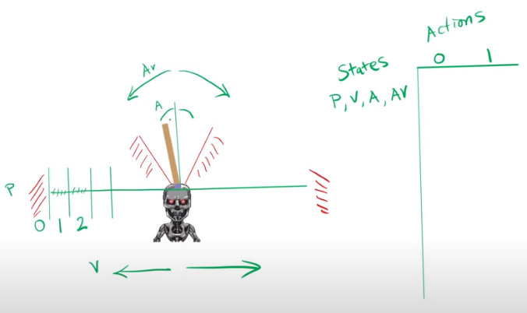
11.3 Discretize Position and Angle
https://www.youtube.com/watch?v=2u1REHeHMrg&list=PL58zEckBH8fCt_lYkmayZoR9XfDCW9hte&index=11
Discretize Position and Angle (01:31-01:45/9:16)
We divide the position in the x-axis into segments so that we can check the position is in the range or goes out of bound (Game over).
https://www.gymlibrary.dev/environments/classic_control/cart_pole/

Slide 12
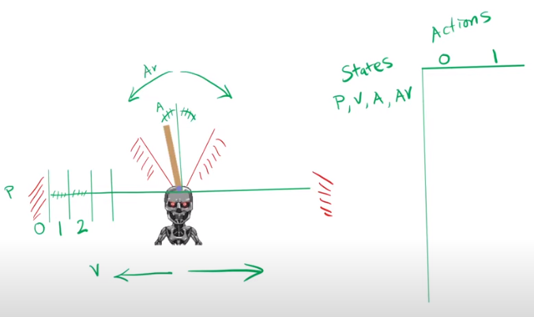
11.3 Discretize Position and Angle
https://www.youtube.com/watch?v=2u1REHeHMrg&list=PL58zEckBH8fCt_lYkmayZoR9XfDCW9hte&index=11
Discretize Position and Angle (01:46-02:05/9:16)
Similarly, we divide the angle and angular velocity into segments.
We check the angles and angular velocity are inside the range.
https://www.gymlibrary.dev/environments/classic_control/cart_pole/

Slide 13
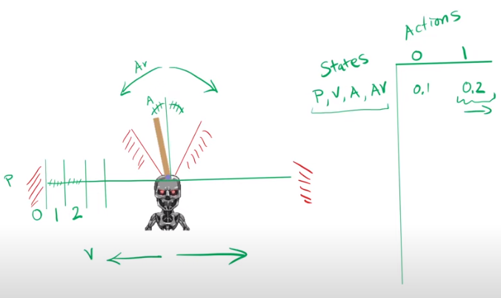
11.3 Discretize Position and Angle
https://www.youtube.com/watch?v=2u1REHeHMrg&list=PL58zEckBH8fCt_lYkmayZoR9XfDCW9hte&index=11
Discretize Position and Angle (02:06-02:10/9:16)
We have Action and States in Q-table.
The Q-value tell us which action to choose.
https://www.gymlibrary.dev/environments/classic_control/cart_pole/

Slide 14
11.4 Conda Environment

Slide 15
11.4 Conda Environment
https://www.youtube.com/watch?v=2u1REHeHMrg&list=PL58zEckBH8fCt_lYkmayZoR9XfDCW9hte&index=11
Conda Environment (02:11-02:12/9:16)
Create/Activate Conda Environment:
> conda create --name gym
(base) > conda activate gym
(gym) >

Slide 16
11.5 Compare Codes

Slide 17
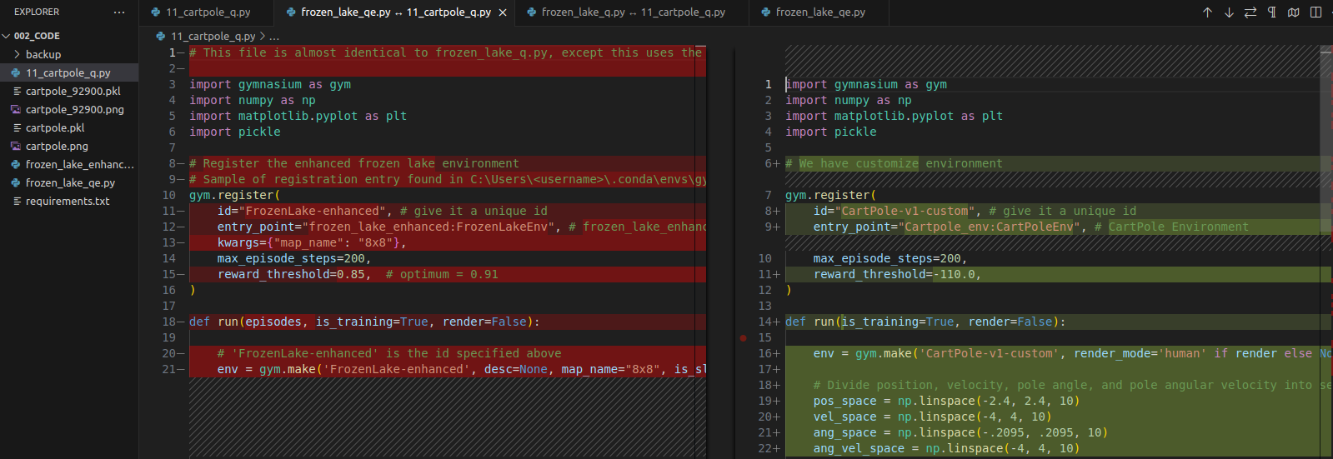
11.5 Compare Codes
https://www.youtube.com/watch?v=2u1REHeHMrg&list=PL58zEckBH8fCt_lYkmayZoR9XfDCW9hte&index=11
Compare Codes (02:13-02:14/9:16)
Compare the code changes in frozen_lake_qe.py (Frozen Lake for Q-Table/Enhanced) and cart pole.
1. frozen_lake_qe.py: Select for compare
2. 11_cartpole_qe.py: Compare with selected
We can see the code changes from frozen lake to cart pole.
1
2

Slide 18
11.6 Register Custom Environment

Slide 19
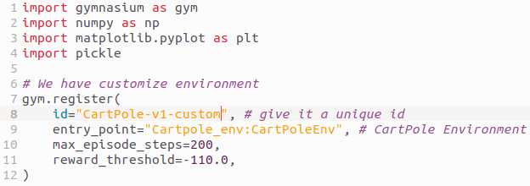
11.6 Register Custom Environment
https://www.youtube.com/watch?v=2u1REHeHMrg&list=PL58zEckBH8fCt_lYkmayZoR9XfDCW9hte&index=11
Register Custom Environment (02:15-02:30/9:16)
Register CartPole Custom Environment. The custom environment is very complicated.
In the code, we use Gymnastic environment instead of custom environment. Skip this step.

Slide 20
11.7 Create Environment

Slide 21
11.7 Create Environment
https://www.youtube.com/watch?v=2u1REHeHMrg&list=PL58zEckBH8fCt_lYkmayZoR9XfDCW9hte&index=11
Create Environment (02:31-02:35/9:16)
1. Create CartPole Custom Environment. It is too complicated to create the custom environment. We do not use this in our code
2. Use gymnasium cartpole environment is easier.
1
2

Slide 22
11.8 Discretize Position/Velocity

Slide 23
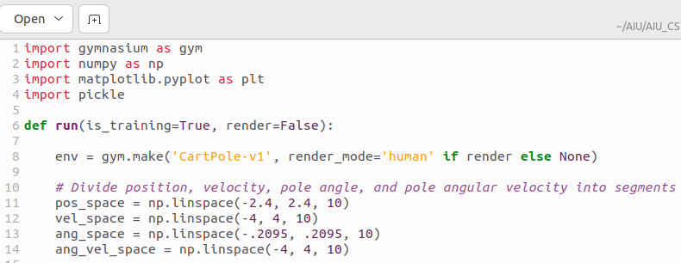
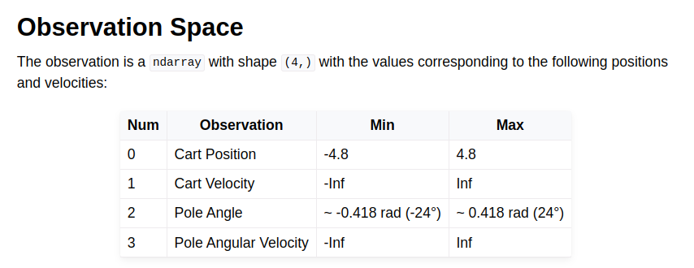
11.8 Discretize Position/Velocity
https://www.youtube.com/watch?v=2u1REHeHMrg&list=PL58zEckBH8fCt_lYkmayZoR9XfDCW9hte&index=11
Discretize Position/Velocity (02:36-03:50/9:16)
1. Cart:
  1.1 Position space: Discretize position space of cart into segments.
  1.2 Velocity space: Discretize velocity space of cart into segments.
2. Pole:
  2.1 Angle space: Discretize angle space of pole into segments.
  2.2. Angle velocity space: Discretize Angle velocity of pole into segments.
We replace four attributes for position and velocity for Cart and Pole.
Because we cannot do the infinity segments, we take from -4 to 4 for vecolrotu and angular velocity.

Slide 24
11.9 Q-Table

Slide 25
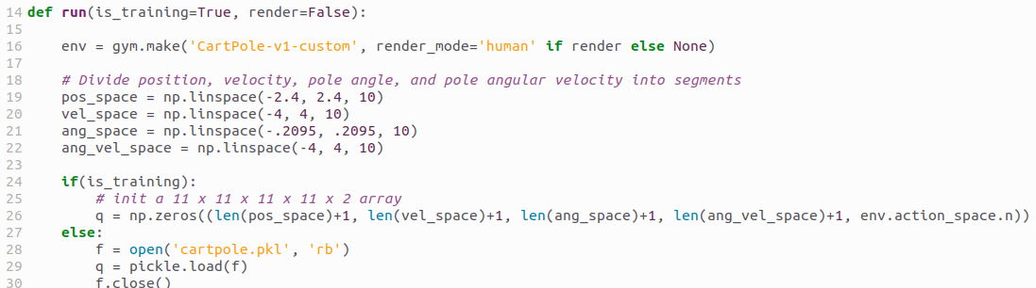
11.9 Q-Table
https://www.youtube.com/watch?v=2u1REHeHMrg&list=PL58zEckBH8fCt_lYkmayZoR9XfDCW9hte&index=11
Q-Table (02:36-03:50/9:16)
We initialize Q-table to:
11 x 11 x 11 x 11 x 2 (2 actions: left or right)

Slide 26
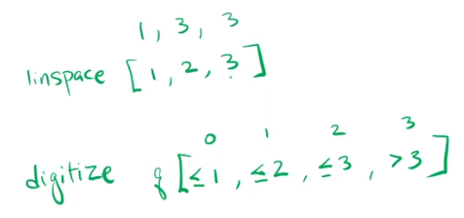
11.9 Q-Table
https://www.youtube.com/watch?v=2u1REHeHMrg&list=PL58zEckBH8fCt_lYkmayZoR9XfDCW9hte&index=11
Q-Table (02:36-04:50/9:16)
Why 11 x 11 x 11 x 11 x 2?
Let’s say we have [1, 3, 3], for example, number 0, number range 0 to 2, and actions rnage 0 to 2.
When we digitize the dimension, we have serval dimension (index 0, 1, 2, 3) by linspace (linear space).
For example, the index 0 is ≤ 1, index 1 is ≤ 2, index 2 is ≤ 3, index 3 is > 3.
How to calculate all the combinations?
The total combinations of q-table is 1 x 3 x 3 for linspace [1, 3, 3] of each dimension.
Mathematically, this multiplication is called Cartesian products.
The linspace = num of elements + 1.

Slide 27
11.10 Initialize Hyperparameter

Slide 28
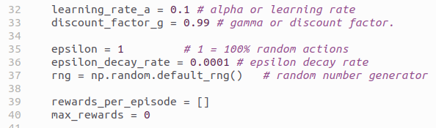
11.10 Initialize Hyperparameter
https://www.youtube.com/watch?v=2u1REHeHMrg&list=PL58zEckBH8fCt_lYkmayZoR9XfDCW9hte&index=11
Initialize Hyperparameter (04:51-05:40/9:16)

Slide 29
11.11 Initialize Cart and Pole

Slide 30
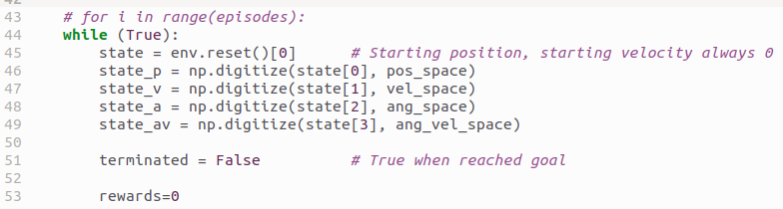
11.11 Initialize Cart and Pole
https://www.youtube.com/watch?v=2u1REHeHMrg&list=PL58zEckBH8fCt_lYkmayZoR9XfDCW9hte&index=11
Initialize Cart and Pole (05:41-05:50/9:16)
Initialize Cart (Position and Velocity) and Pole (angle Position and angle Velocity)

Slide 31
11.12 Loop with Reward Limit

Slide 32
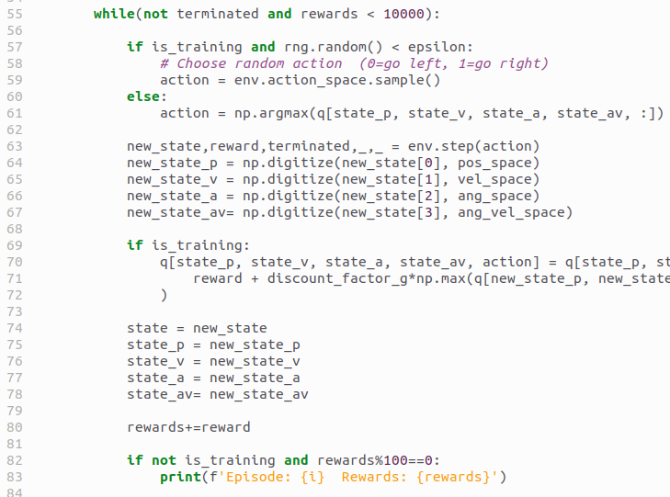
11.12 Loop with Reward Limit
https://www.youtube.com/watch?v=2u1REHeHMrg&list=PL58zEckBH8fCt_lYkmayZoR9XfDCW9hte&index=11
Loop with Reward Limit (05:51-06:00/9:16)
mean_rewards > 1000, then break loop.

Slide 33
11.13 Choose Action

Slide 34
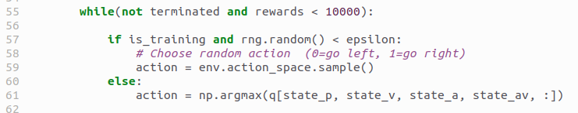
11.13 Choose Action
https://www.youtube.com/watch?v=2u1REHeHMrg&list=PL58zEckBH8fCt_lYkmayZoR9XfDCW9hte&index=11
Choose Action (06:01-06:10/9:16)
1. Choose random action
2. Select the best action from cart (position and velocity) and pole (angle position and angle velocity).

Slide 35
11.14 Choose Action

Slide 36
11.14 Choose Action
https://www.youtube.com/watch?v=2u1REHeHMrg&list=PL58zEckBH8fCt_lYkmayZoR9XfDCW9hte&index=11
Choose Action (06:01-06:10/9:16)
1. Choose random action
2. Get the best action.
1
2

Slide 37
11.15 Step Action to New State

Slide 38

11.15 Step Action to New State
https://www.youtube.com/watch?v=2u1REHeHMrg&list=PL58zEckBH8fCt_lYkmayZoR9XfDCW9hte&index=11
Step Action to New State (06:11-06:30/9:16)
1. Step the next action
2. Update the new state for cart (position and velocity) and pole (angle position and angle velocity).
1
2

Slide 39
11.16 Q-Value

Slide 40
11.16 Q-Value
https://www.youtube.com/watch?v=2u1REHeHMrg&list=PL58zEckBH8fCt_lYkmayZoR9XfDCW9hte&index=11
Q-Value (06:31-06:35/9:16)
In training mode, we calculate and Update the Q-Value.
The Q-Value includes the Cart (position and Velocity) and Pole (angle position and angle velocity)

Slide 41
11.17 Update State and Rewards

Slide 42
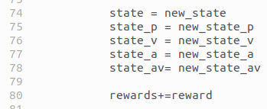
11.17 Update State and Rewards
https://www.youtube.com/watch?v=2u1REHeHMrg&list=PL58zEckBH8fCt_lYkmayZoR9XfDCW9hte&index=11
Update State and Rewards (06:36-06:40/9:16)
1. Update the state.
2. Update the rewards (total rewards).

Slide 43
11.18 Mean/Episode Reward

Slide 44
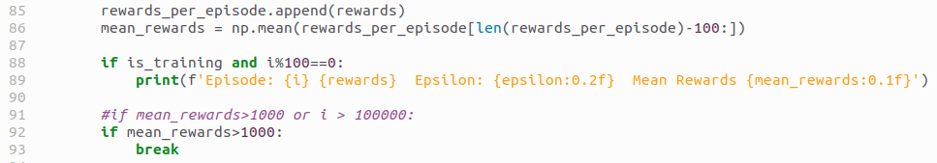
11.18 Mean/Episode Reward
https://www.youtube.com/watch?v=2u1REHeHMrg&list=PL58zEckBH8fCt_lYkmayZoR9XfDCW9hte&index=11
Mean/Episode Reward (06:41-06:50/9:16)
We
1. keep the episode reward
2. we print reward data every 100 episode.
3. mean episode reward for exit the forever while loop. Previously, we control the limit number of episode. In this case, we loop forever until we found the mean of reward is more than 1000.
1
2
3

Slide 45
11.19 Update Epsilon/Counter

Slide 46
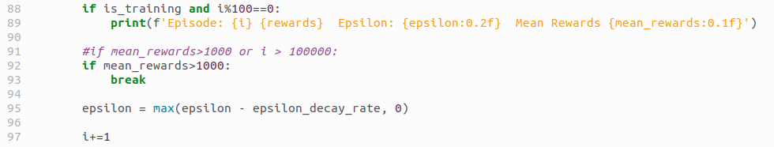
11.19 Update Epsilon/Counter
https://www.youtube.com/watch?v=2u1REHeHMrg&list=PL58zEckBH8fCt_lYkmayZoR9XfDCW9hte&index=11
Update Epsilon/Counter (06:51-07:15/9:16)
We
1. Update the Epsilon. After each episode, the randomness is decrease, i.e., the best action is increased.
2. Update the print counter i (we print every 100 episode).

Slide 47
11.20 Save Q-Table/Rewards

Slide 48
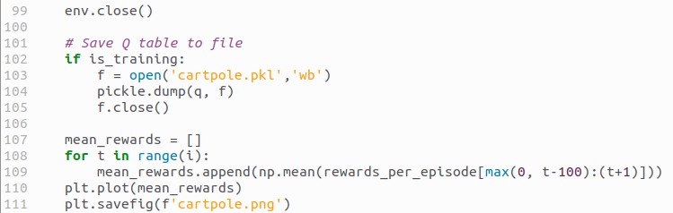
11.20 Save Q-Table/Rewards
https://www.youtube.com/watch?v=2u1REHeHMrg&list=PL58zEckBH8fCt_lYkmayZoR9XfDCW9hte&index=11
Save-Q-Table/Rewards (07:16-07:30/9:16)
We
1. Close environment
2. Save Q-Table
3. Save Rewards

Slide 49
11.21 Main Program

Slide 50

11.21 Main Program
https://www.youtube.com/watch?v=2u1REHeHMrg&list=PL58zEckBH8fCt_lYkmayZoR9XfDCW9hte&index=11
Main Program (07:31-07:40/9:16)
We have
1. training mode: Save Q-Table without display
2. agent play mode: Read Q-Table and display.

Slide 51
11.22 Training

Slide 52

11.22 Training
https://www.youtube.com/watch?v=2u1REHeHMrg&list=PL58zEckBH8fCt_lYkmayZoR9XfDCW9hte&index=11
Training (07:41-08:30/9:16)
Agent in training mode: Save Q-Table without display
1. Conda activate in gym
> conda activate gym
2. We

Slide 53


11.22 Training
https://www.youtube.com/watch?v=2u1REHeHMrg&list=PL58zEckBH8fCt_lYkmayZoR9XfDCW9hte&index=11
Training (07:41-08:30/9:16)
In the training mode,
1. We do not display the cart pole with render = False.
2. We comment out the play mode
3. The Q-table is saved as cartpole.pkl and the rewards is saved as cartploe.png
1
2
3

Slide 54
11.23 Playing

Slide 55

11.23 Playing
https://www.youtube.com/watch?v=2u1REHeHMrg&list=PL58zEckBH8fCt_lYkmayZoR9XfDCW9hte&index=11
Playing (08:31-09:16/9:16)
1. Comment out the training mode
2. Run with Play mode
1
2

Slide 56
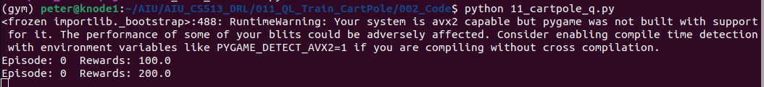
11.23 Playing
https://www.youtube.com/watch?v=2u1REHeHMrg&list=PL58zEckBH8fCt_lYkmayZoR9XfDCW9hte&index=11
Playing (08:31-09:16/9:16)
1. After training is finished. Agent play mode:
> python 11_cartpole_q.py
2. The agent reads Q-Table from cartpole.pkl and and find the best action of cartpole.
1
2

Slide 57
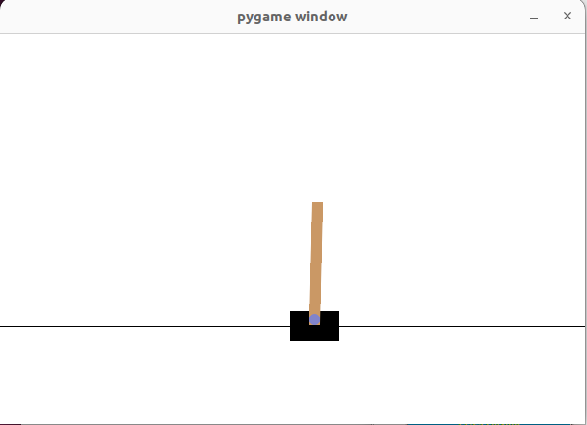
11.23 Playing
https://www.youtube.com/watch?v=2u1REHeHMrg&list=PL58zEckBH8fCt_lYkmayZoR9XfDCW9hte&index=11
Playing (08:31-09:16/9:16)
Agent play mode: Read Q-Table and display.

Slide 58
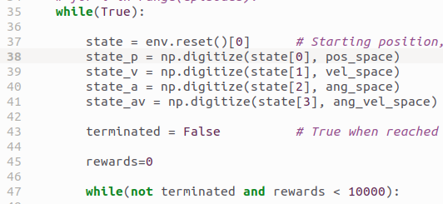
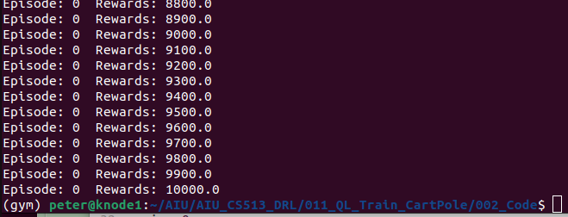
11.23 Playing
https://www.youtube.com/watch?v=2u1REHeHMrg&list=PL58zEckBH8fCt_lYkmayZoR9XfDCW9hte&index=11
Playing (08:31-09:16/9:16)
In the play mode, the agent stop after total rewards reach 10000.

Slide 59
End

